Slide 1

Teacher Attrition in the United States
What twenty-eight years of labour force data show
José Elías Durán Roa
José Manuel Torres
Directorate for Education and Skills

Slide 2
Why this project?
Motivation
▪ Understand why teachers leave the profession.
▪ Is there a real policy margin to soften teacher shortages by retaining teachers, or bringing them back?
Problem
▪ Official statistics on teacher attrition are published only every four or five years.
▪ We start with the United States, the country with the most information available.
2

Slide 3
The data, in one slide
▪ One source. The Census Bureau's household survey (the CPS), which records every worker's occupation each year.
▪ One definition. A teacher is anyone whose main job last year was school teaching; a leaver is a teacher no longer teaching a year later.
▪ One series. Twenty-eight consecutive years (1998–2025), matching the official benchmark where it exists and filling the years in between.
The methodological detail is in the appendix of the long deck and in the paper.
3

Slide 4
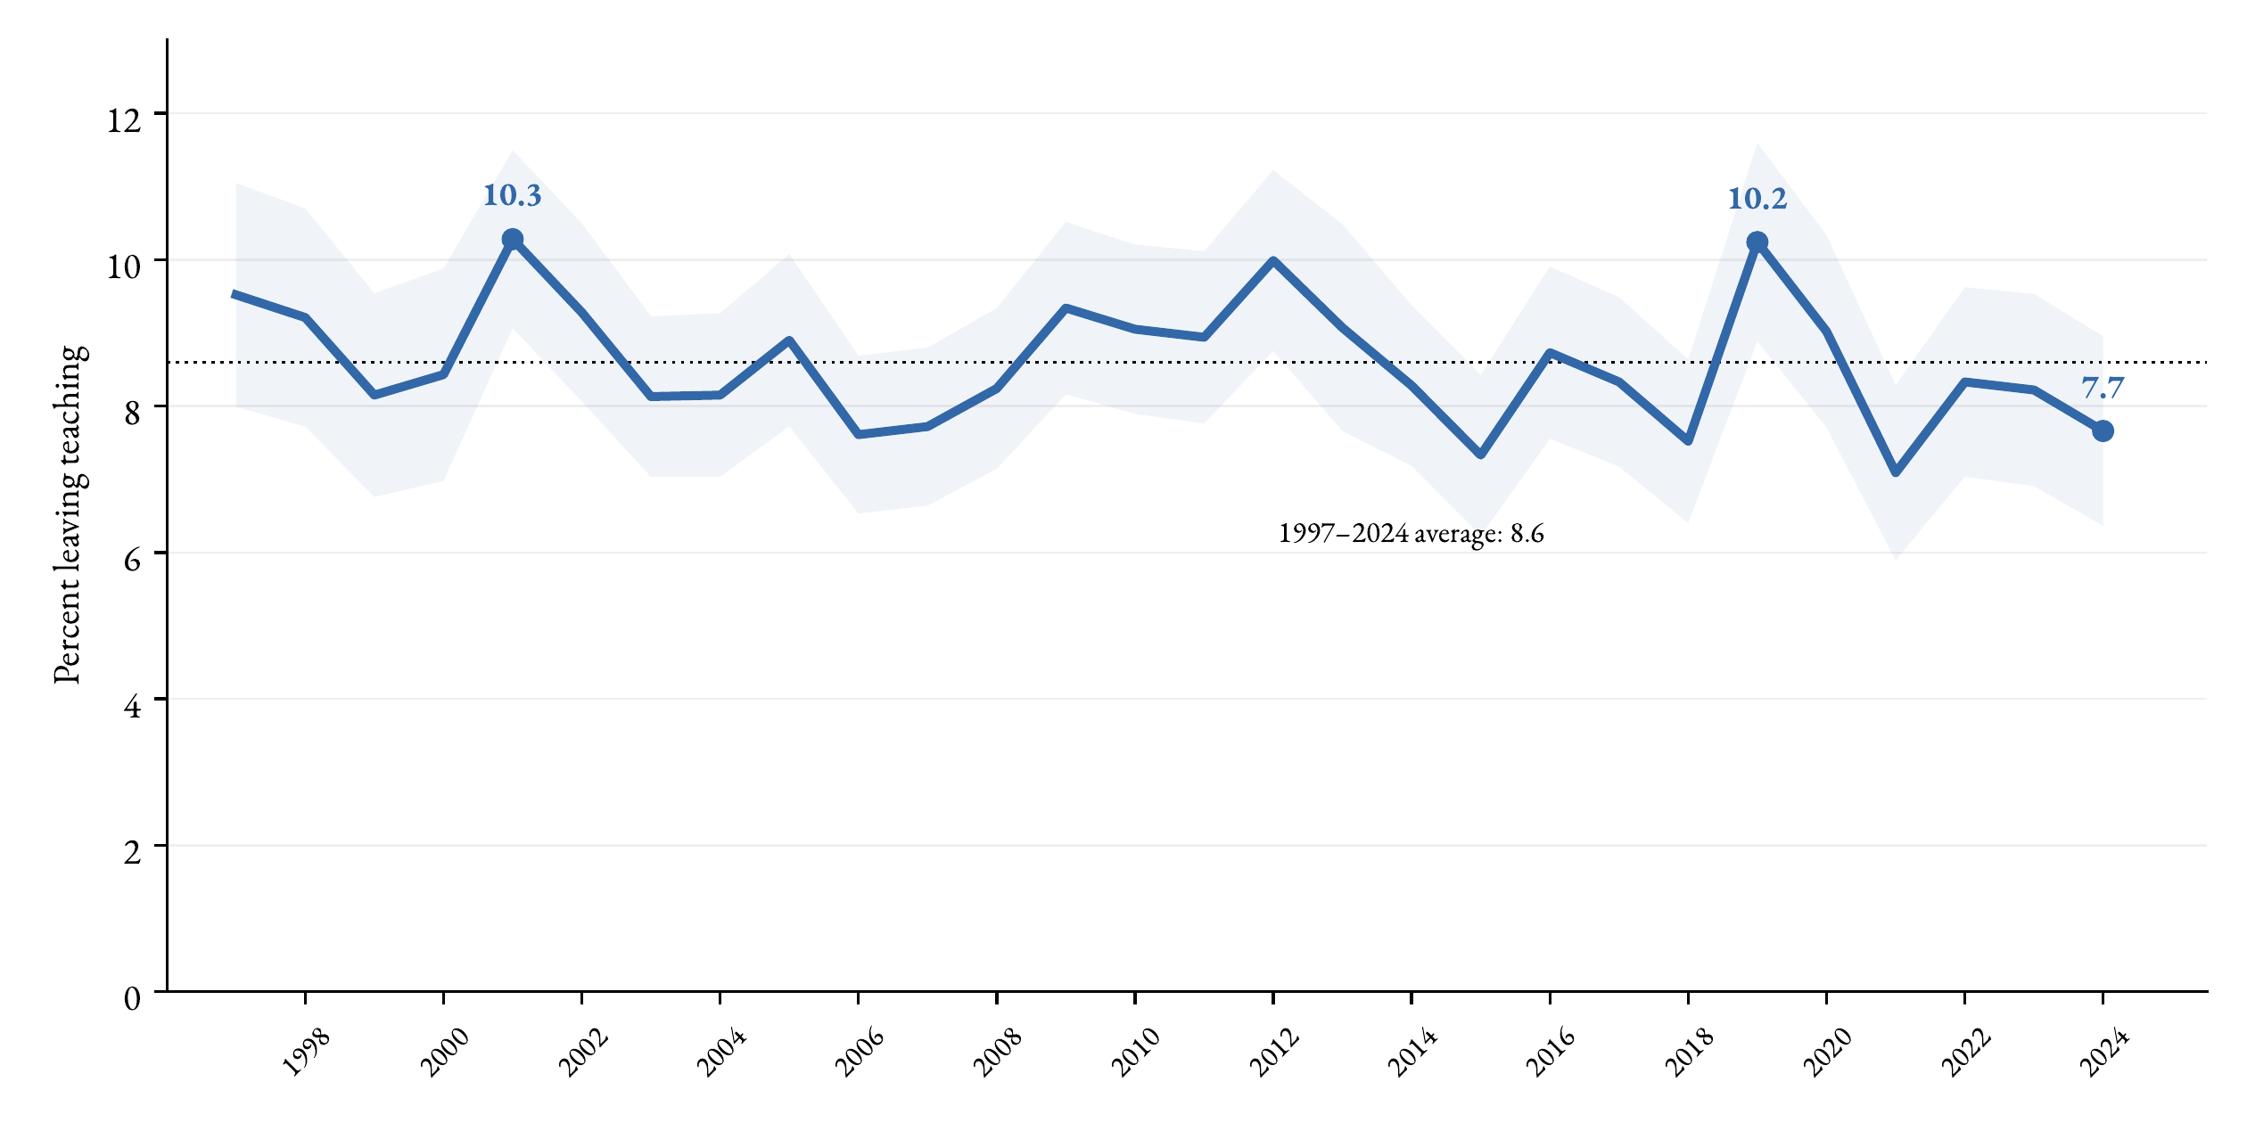
Leaving teaching, 1997–2024
Key message. Around 8 of every 100 teachers leave each year, and the rate has been stable for 25 years. Attrition is a permanent flow, not a recent crisis.
4

Slide 5
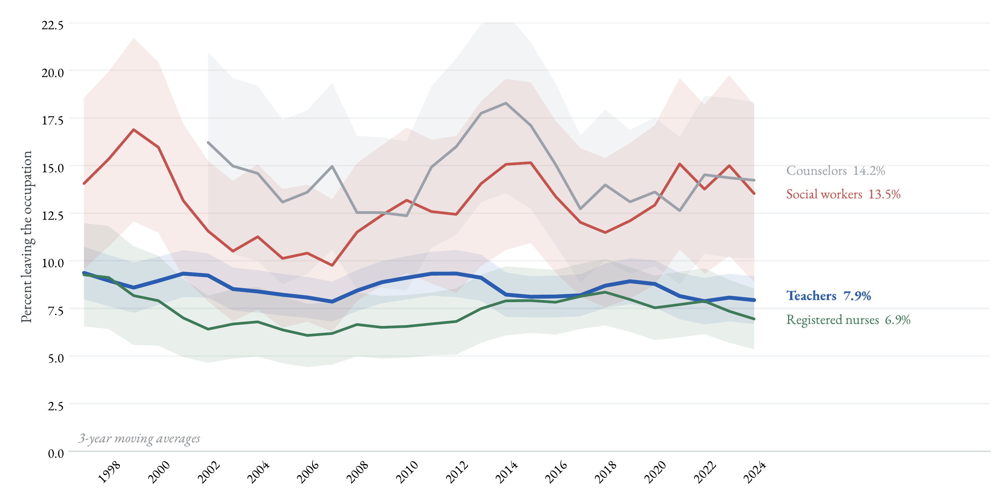
Leaving the occupation, by profession
Key message. Teachers leave at rates similar to or below the comparable professions. The distinctive part of teaching is who leaves and where they go, not how many.
5

Slide 6
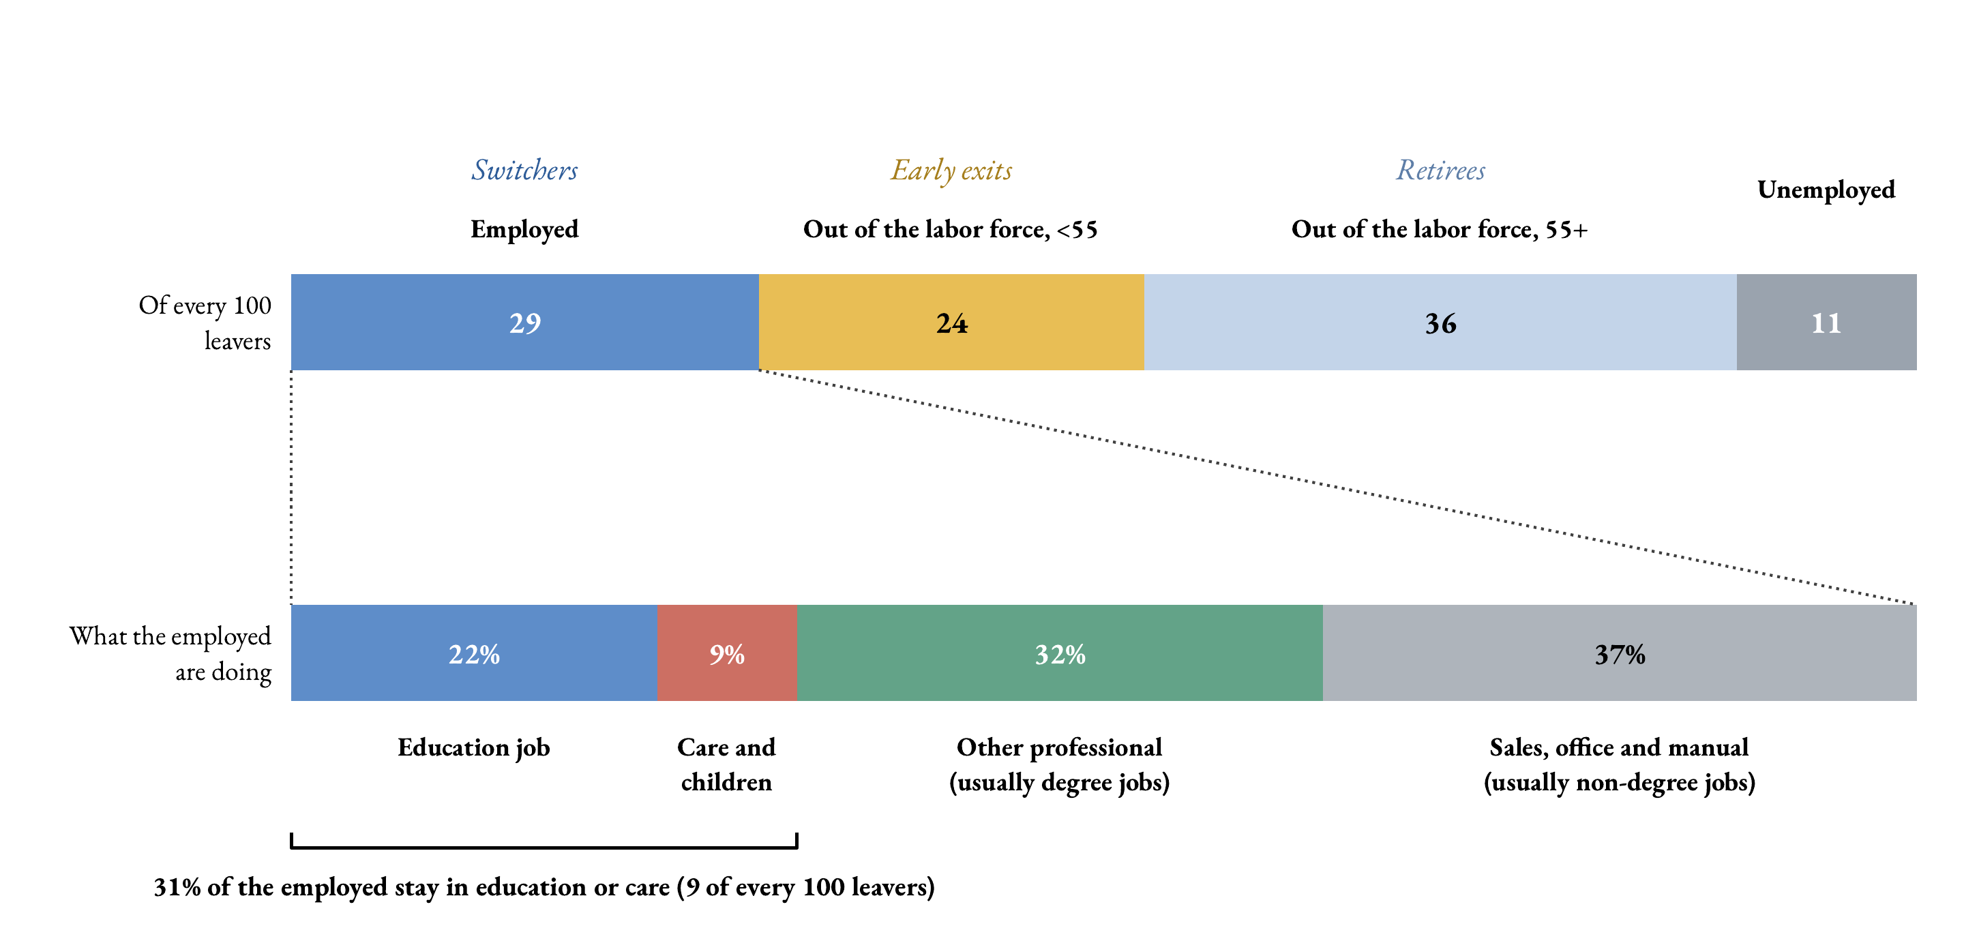
Of every 100 leavers (average, 2020–2024)
Key message. Teachers are not being poached: 7 of every 10 leavers exit employment altogether — to retirement, home or unemployment. Only 3 in 10 trade teaching for another job.
6

Slide 7
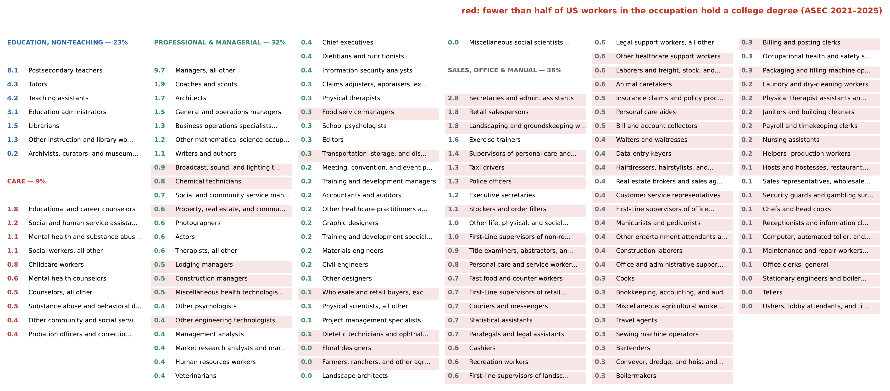
Where the employed leavers go
Key message. More than a third of the employed leavers move to occupations where most workers hold no college degree (in red). Leaving teaching usually means leaving the profession, not moving up.
7

Slide 8
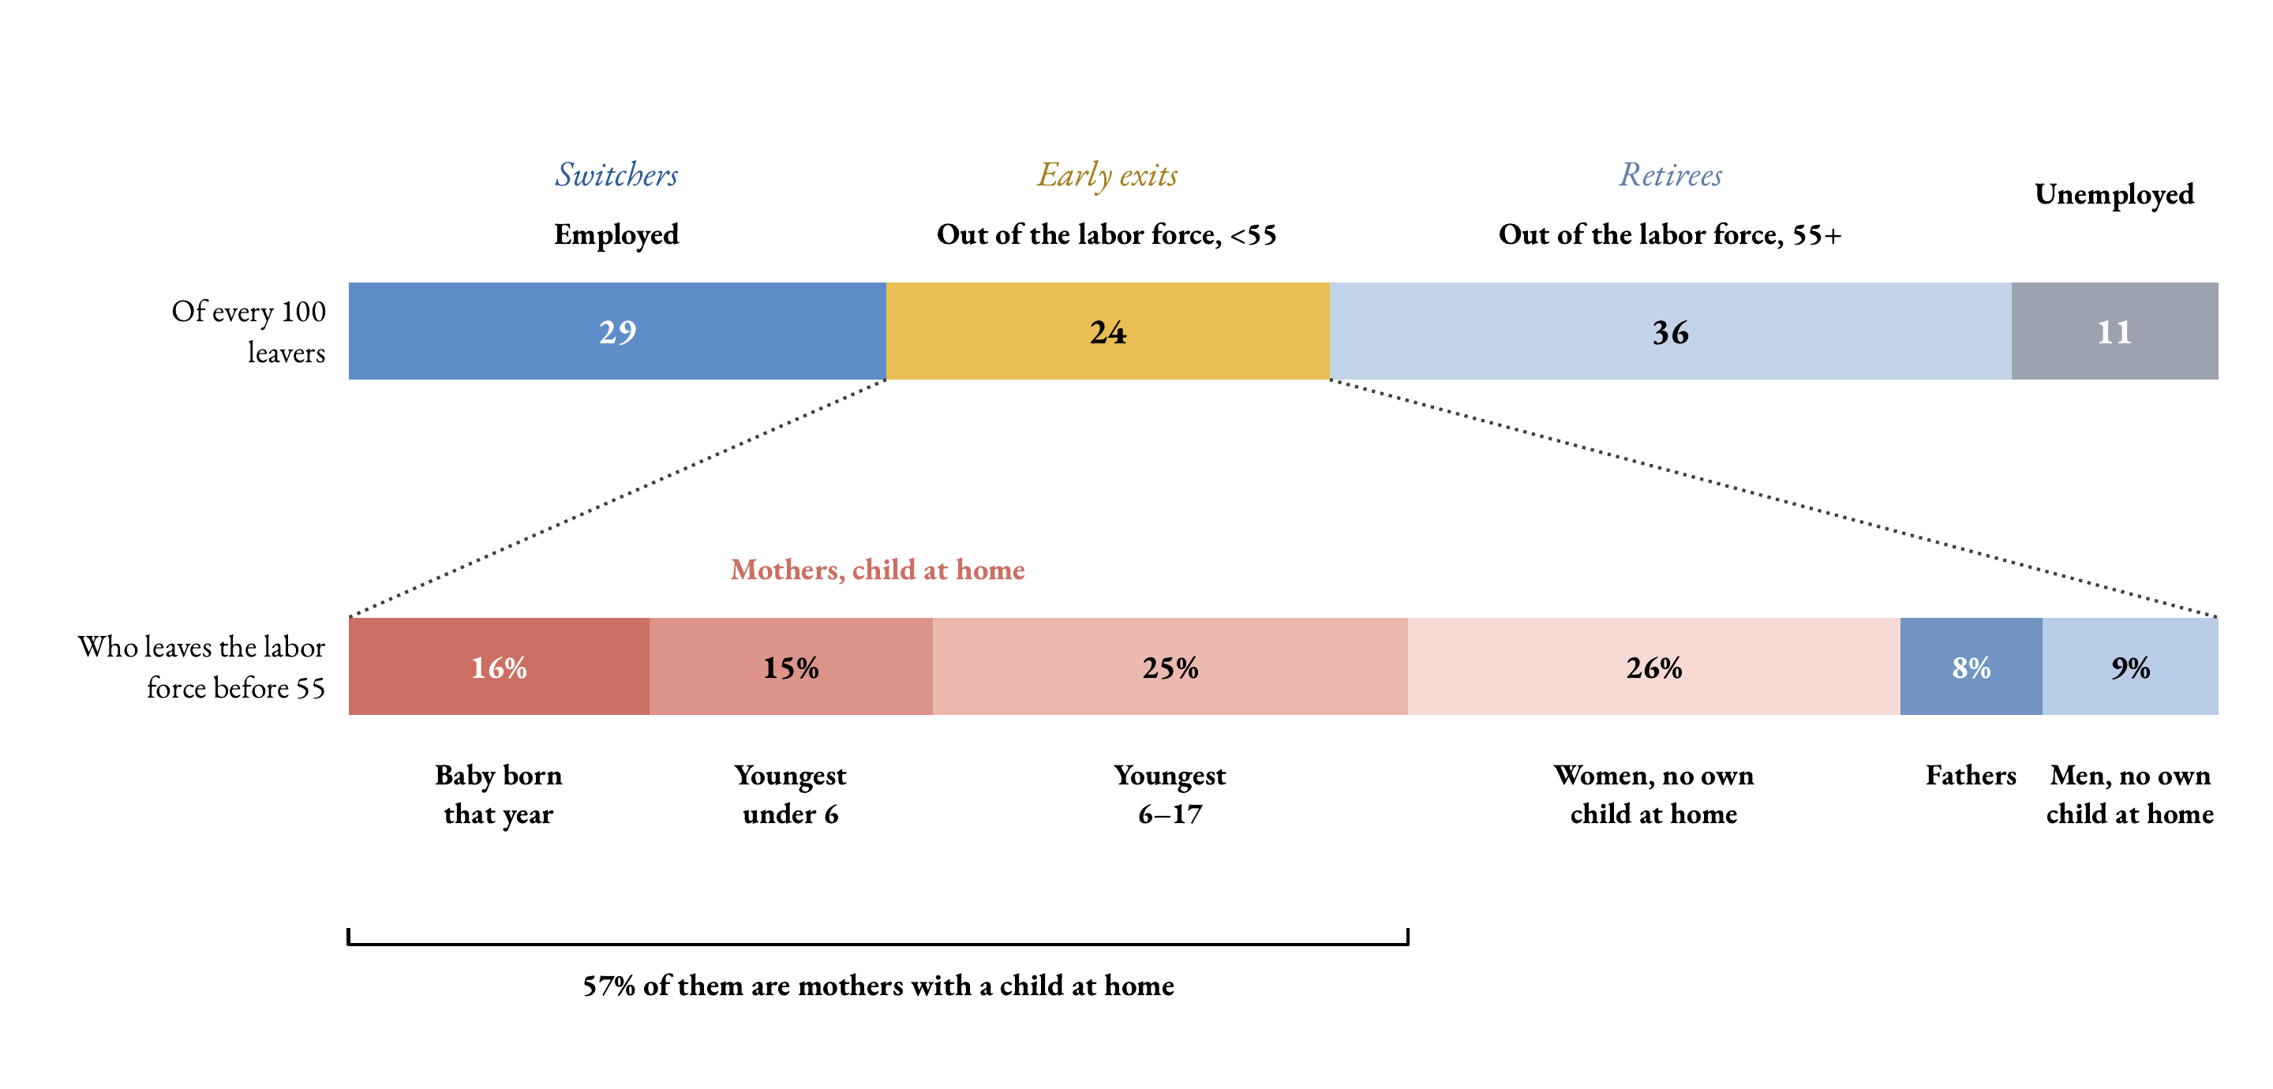
Who leaves the labor force before 55 (average, 2020–2024)
Key message. Early labor-force exit is mostly a family story. More than half of this group are mothers with a child at home.
8

Slide 9
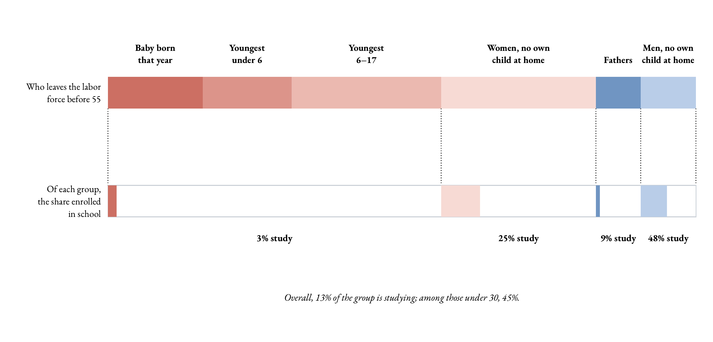
And the youngest of them leave to study
Key message. Studying is the exit of the young and the childless, not of the mothers. Among leavers under 30, almost half are enrolled in school.
9

Slide 10
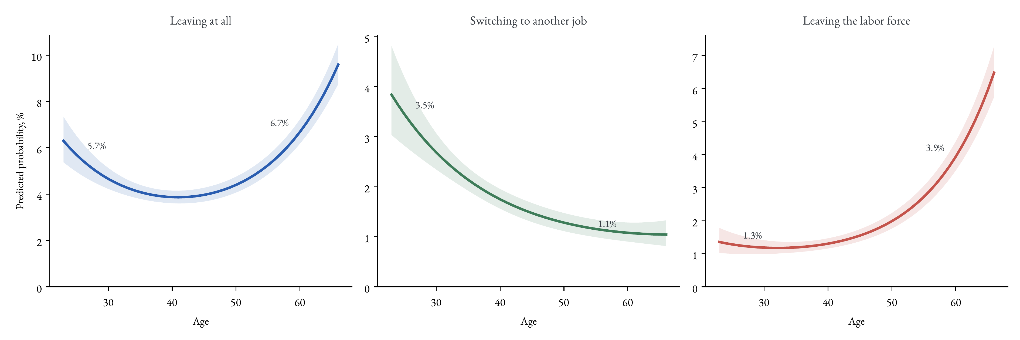
Leaving, over the life cycle
Key message. Put retention efforts where they can work: the first years of the career (mentoring, stable placements). Retirements can only be planned for, not prevented.
10

Slide 11
What this says for policy: three margins, quantified
Retirees (out of the labor force, over 55)
About 3% of teachers retire each year, a third of all exits. Delaying retirement extends careers but does not reintegrate anyone.
Switchers (employed in another job)
About 2% move to another job each year, often to jobs that do not require a degree. A real margin, but shortages cannot be closed through retention alone.
Early exits (out of the labor force, under 55)
About 2% leave the labor force before 55 each year. Most are mothers at home, for whom flexibility may be the missing piece. The young and childless leave to study and need re-entry paths.
11

Slide 12
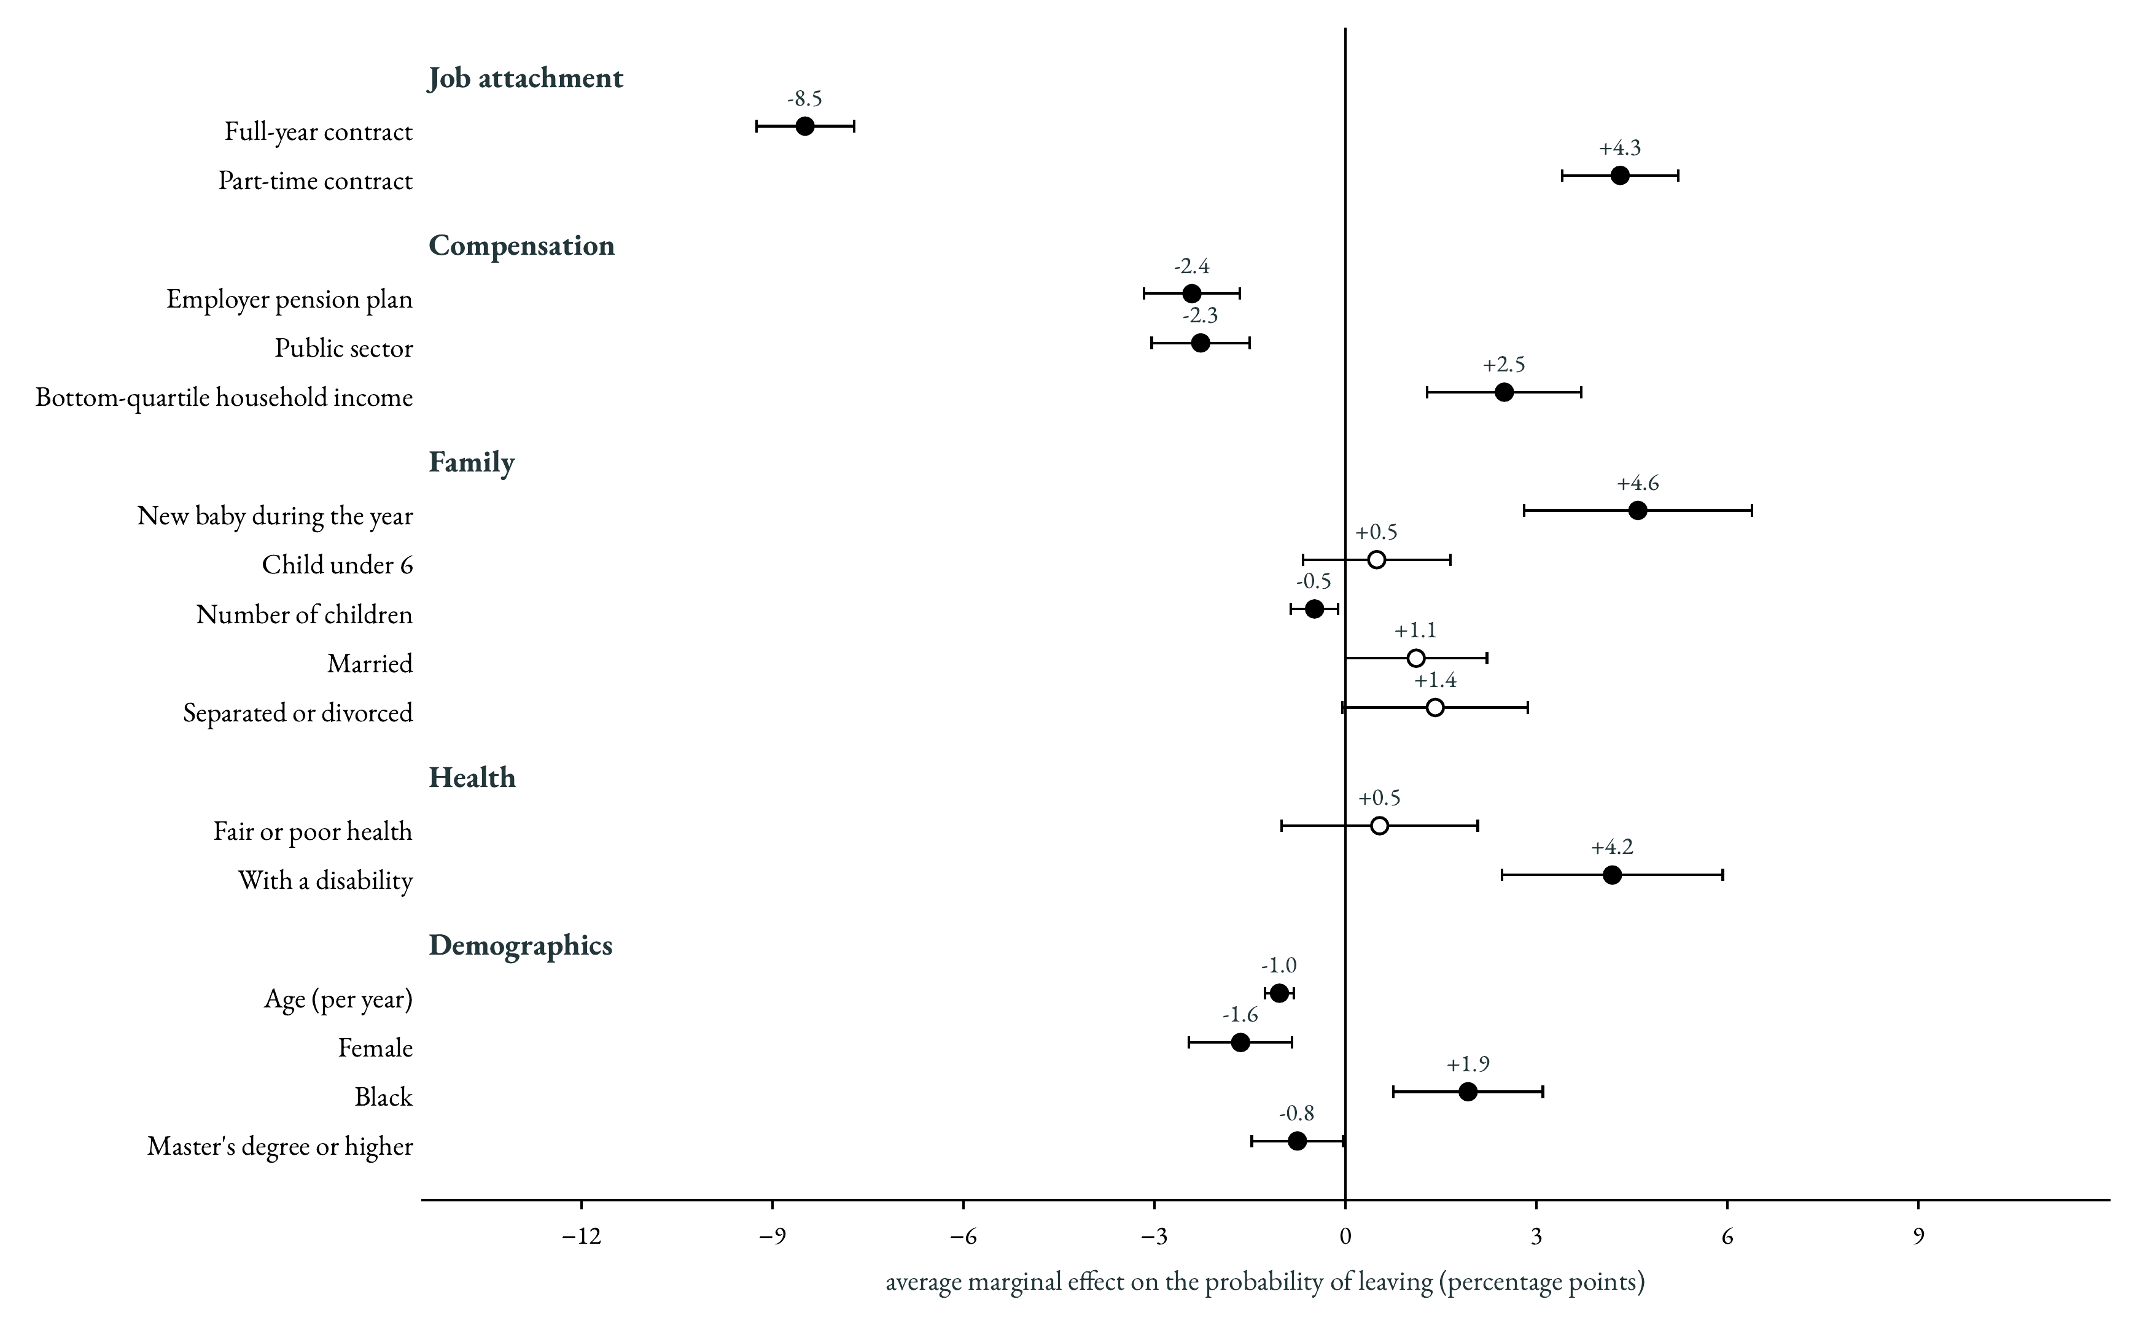
What correlates with leaving
12

Slide 13
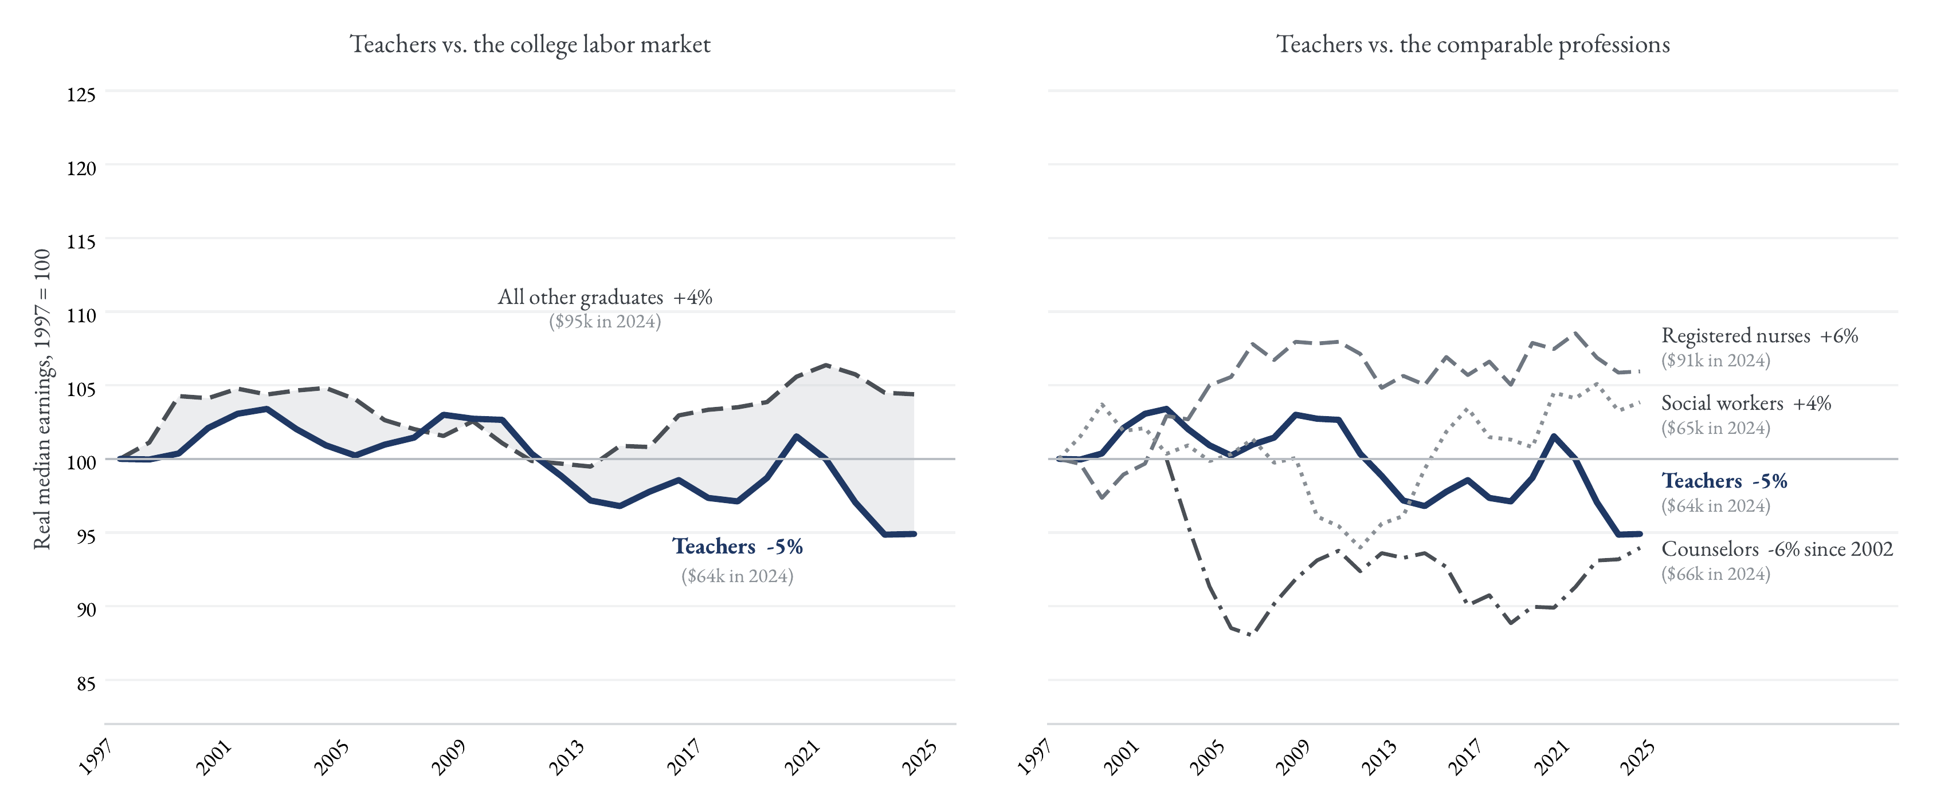
Relative pay since 1997
Key message. Teacher pay has not grown in 25 years, and neither has it in the closest helping professions. The typical graduate now out-earns a teacher by $30,000 a year.
13

Slide 14
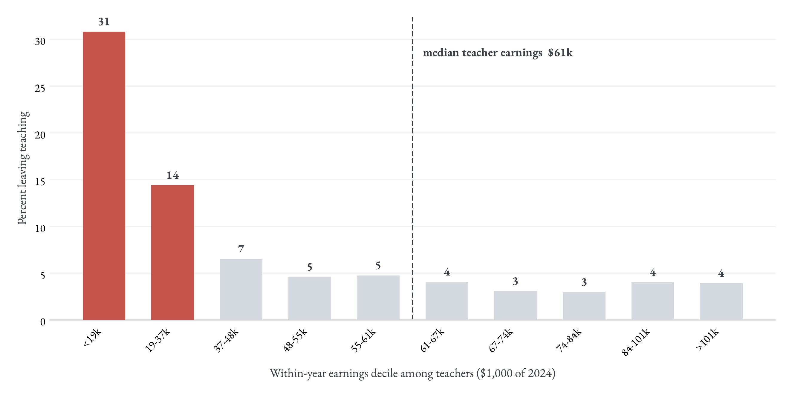
Leaving, by position in the teacher pay distribution
Key message. Leaving is concentrated in the bottom two pay deciles, where part-year and part-time contracts live. Above the median, pay barely matters.
14

Slide 15
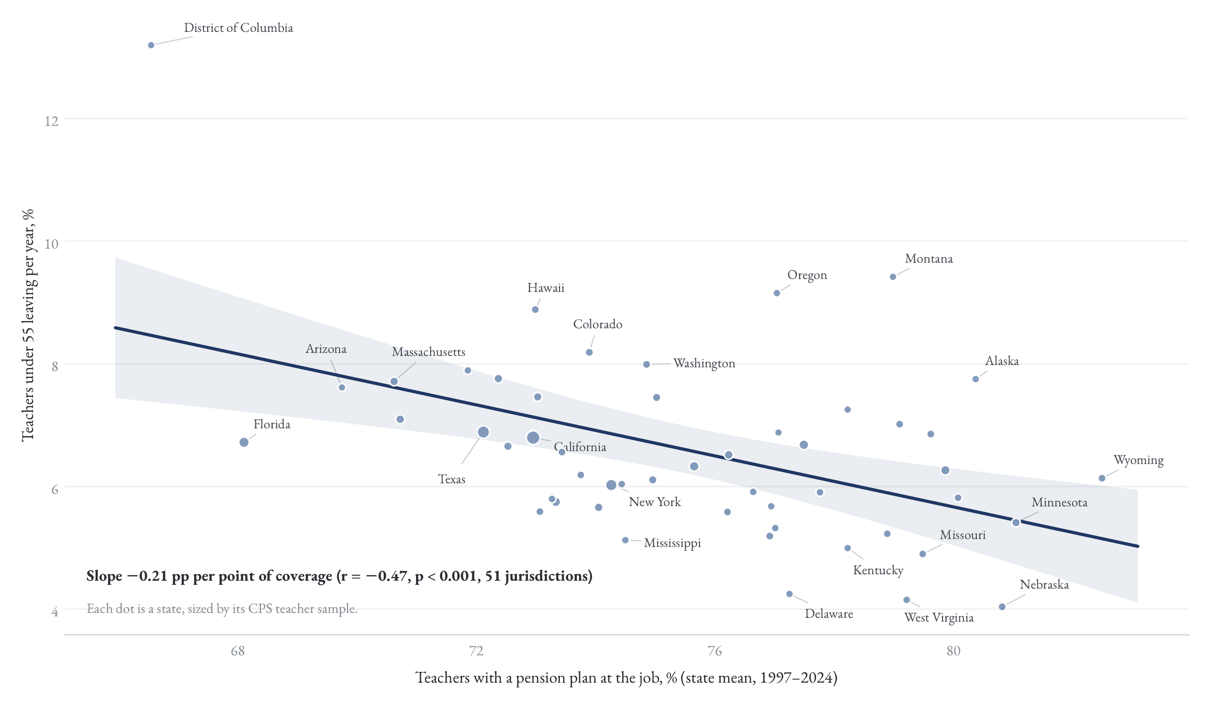
Pension coverage and leaving, across states
Key message. States where more teachers have a pension plan lose fewer teachers before 55. Economic security retains.
15

Slide 16
Open questions
▪ Pay floors. Leaving concentrates in the bottom two pay deciles. Would raising the floor retain more teachers than raising the average?
▪ Early careers. Exits peak in the first years of the career. Which policies move this margin — mentoring, stable placements, or pay?
▪ Family exits. Half of the early labor-force exits are mothers with a child at home. Is this an education policy problem or a child-care one?
▪ Re-entry. The young leave to study and mothers leave to care. How many could come back, and what would bring them back?
▪ What we cannot see. Working conditions and school climate are invisible in household data. What would it take to measure them every year?
16

