Slide 1
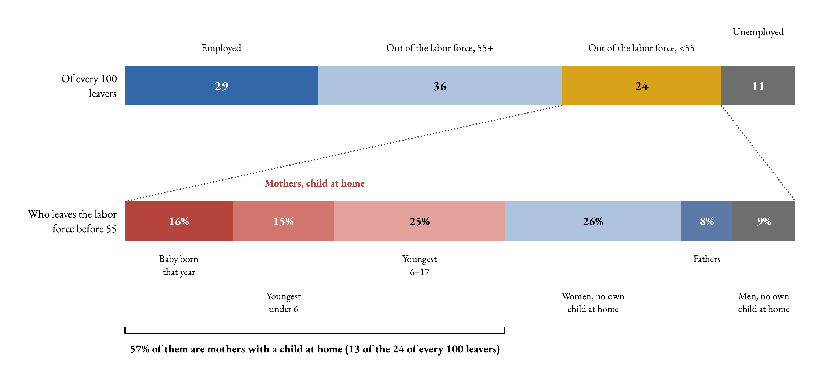
Who leaves the labor force before 55 (average, 2020–2024)
Key message. Early labor-force exit is mostly a family story. More than half of this group are mothers with a child at home.
☞ Pooled 1997–24

Slide 2
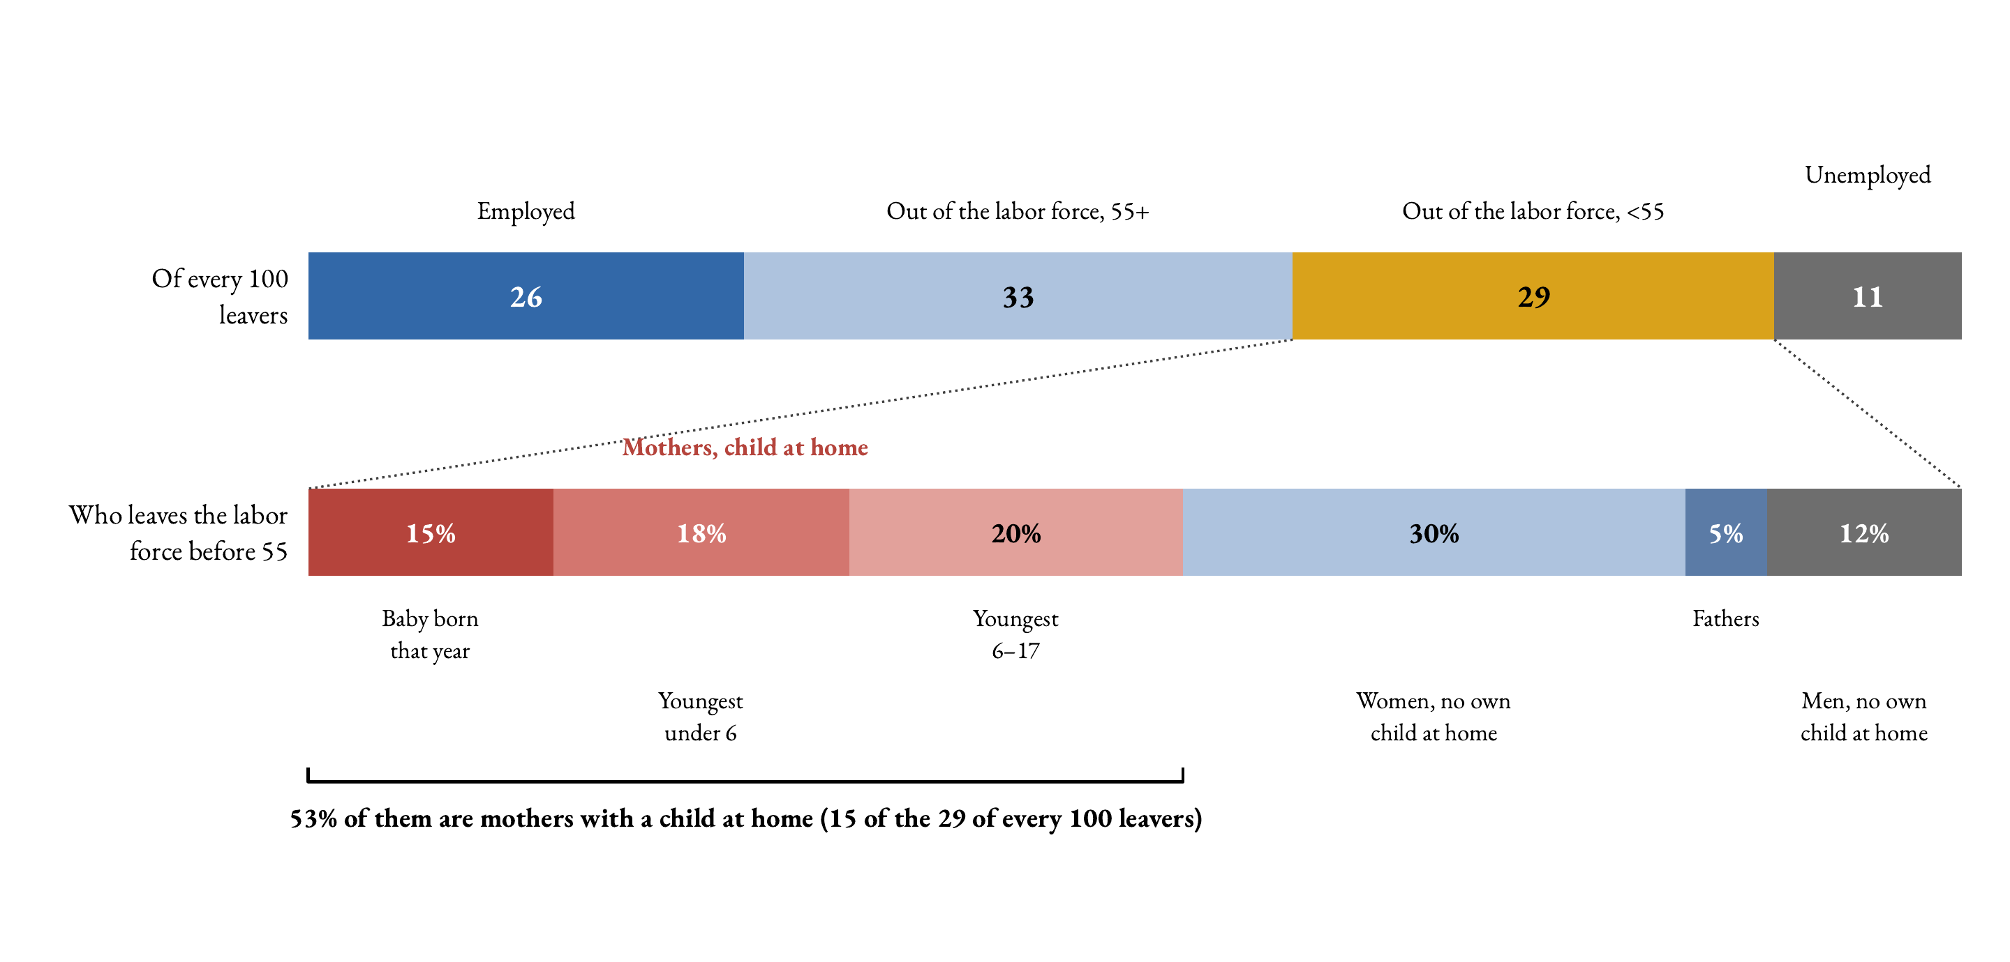
The same cascade, pooled 1997–2024
Over the whole period (6,931 leavers) the picture is the same: 29 of every 100 leavers exit the labor force before 55, and 53% of them are mothers with a child at home (15 of the 29). The five-year window is not driving the composition.
☞ Back

