Slide 1
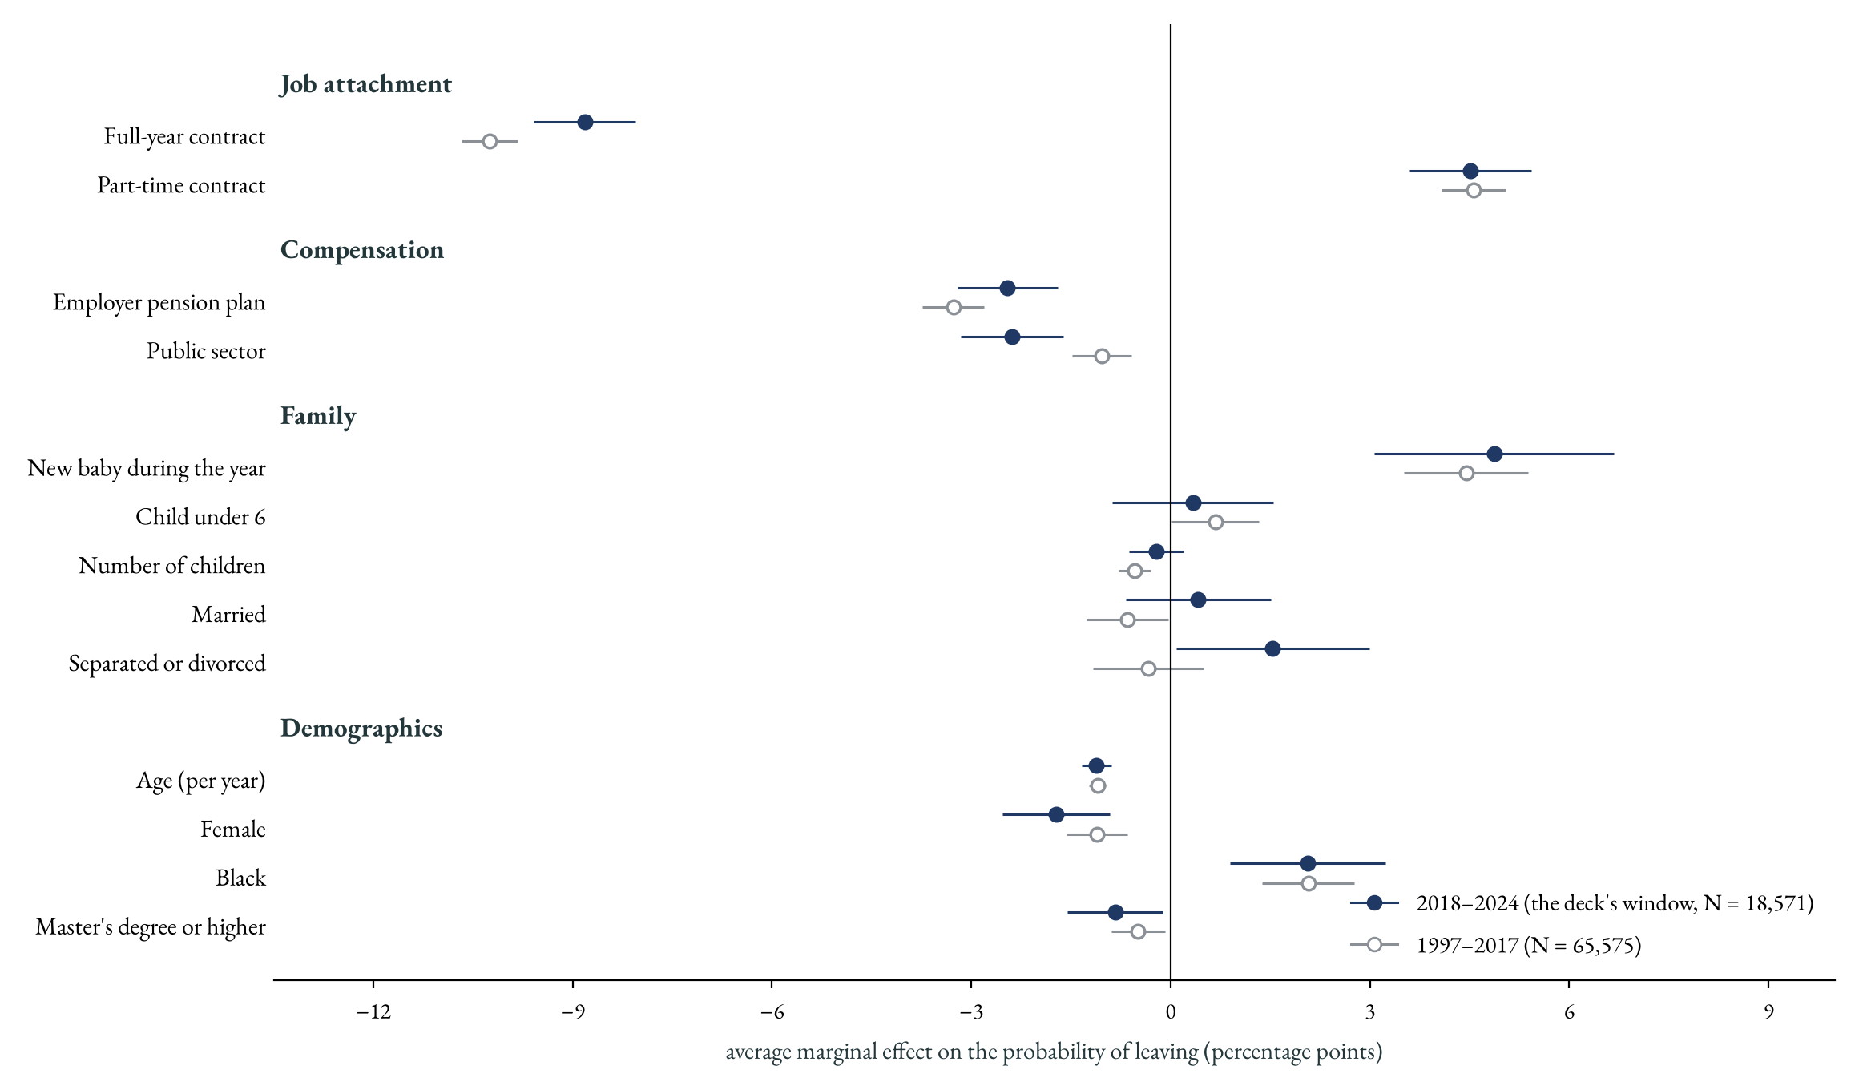
Are the margins stable over time?
☞ robustness
(copy this button to the main deck)
Probit average marginal effects in percentage points, estimated separately on 1997–2017 and on the deck's window 2018–2024, with the controls available in every year. Benchmarks: average annual leaving probability 7.9% (1997–2017) and 7.3% (2018–2024). With the full controls (health, disability, income; available from 2019) the 2018–24 margins are unchanged.
☞ back

Slide 2
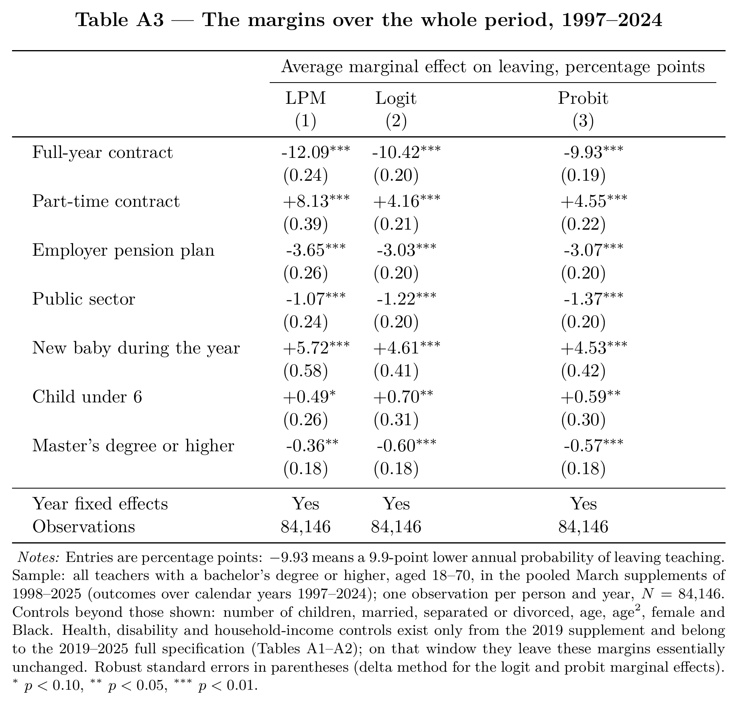
The margins over the whole period
☞ back

Slide 3
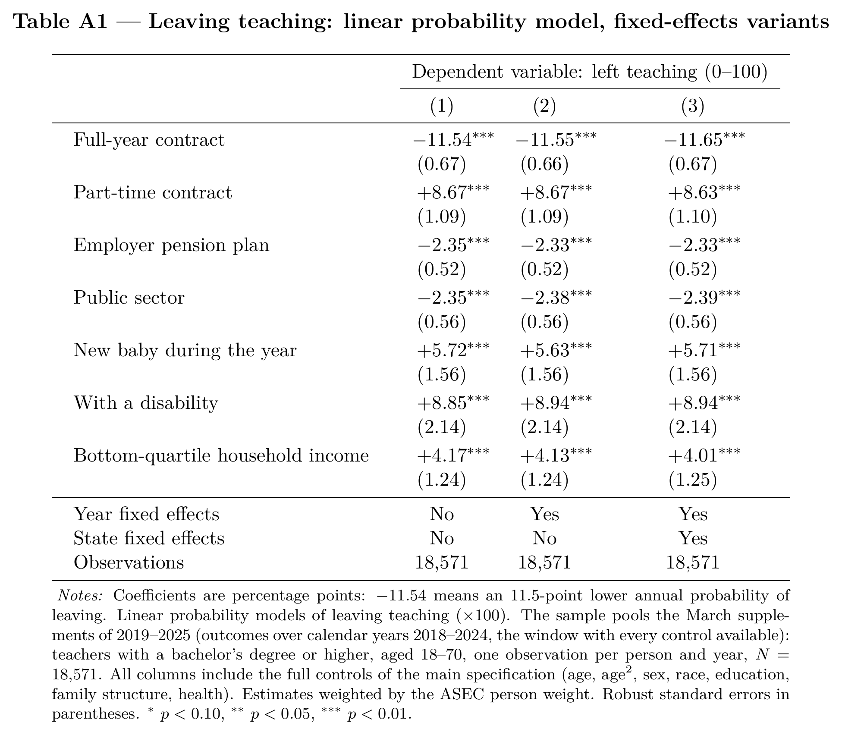
Fixed-effects variants, full specification
☞ back

Slide 4
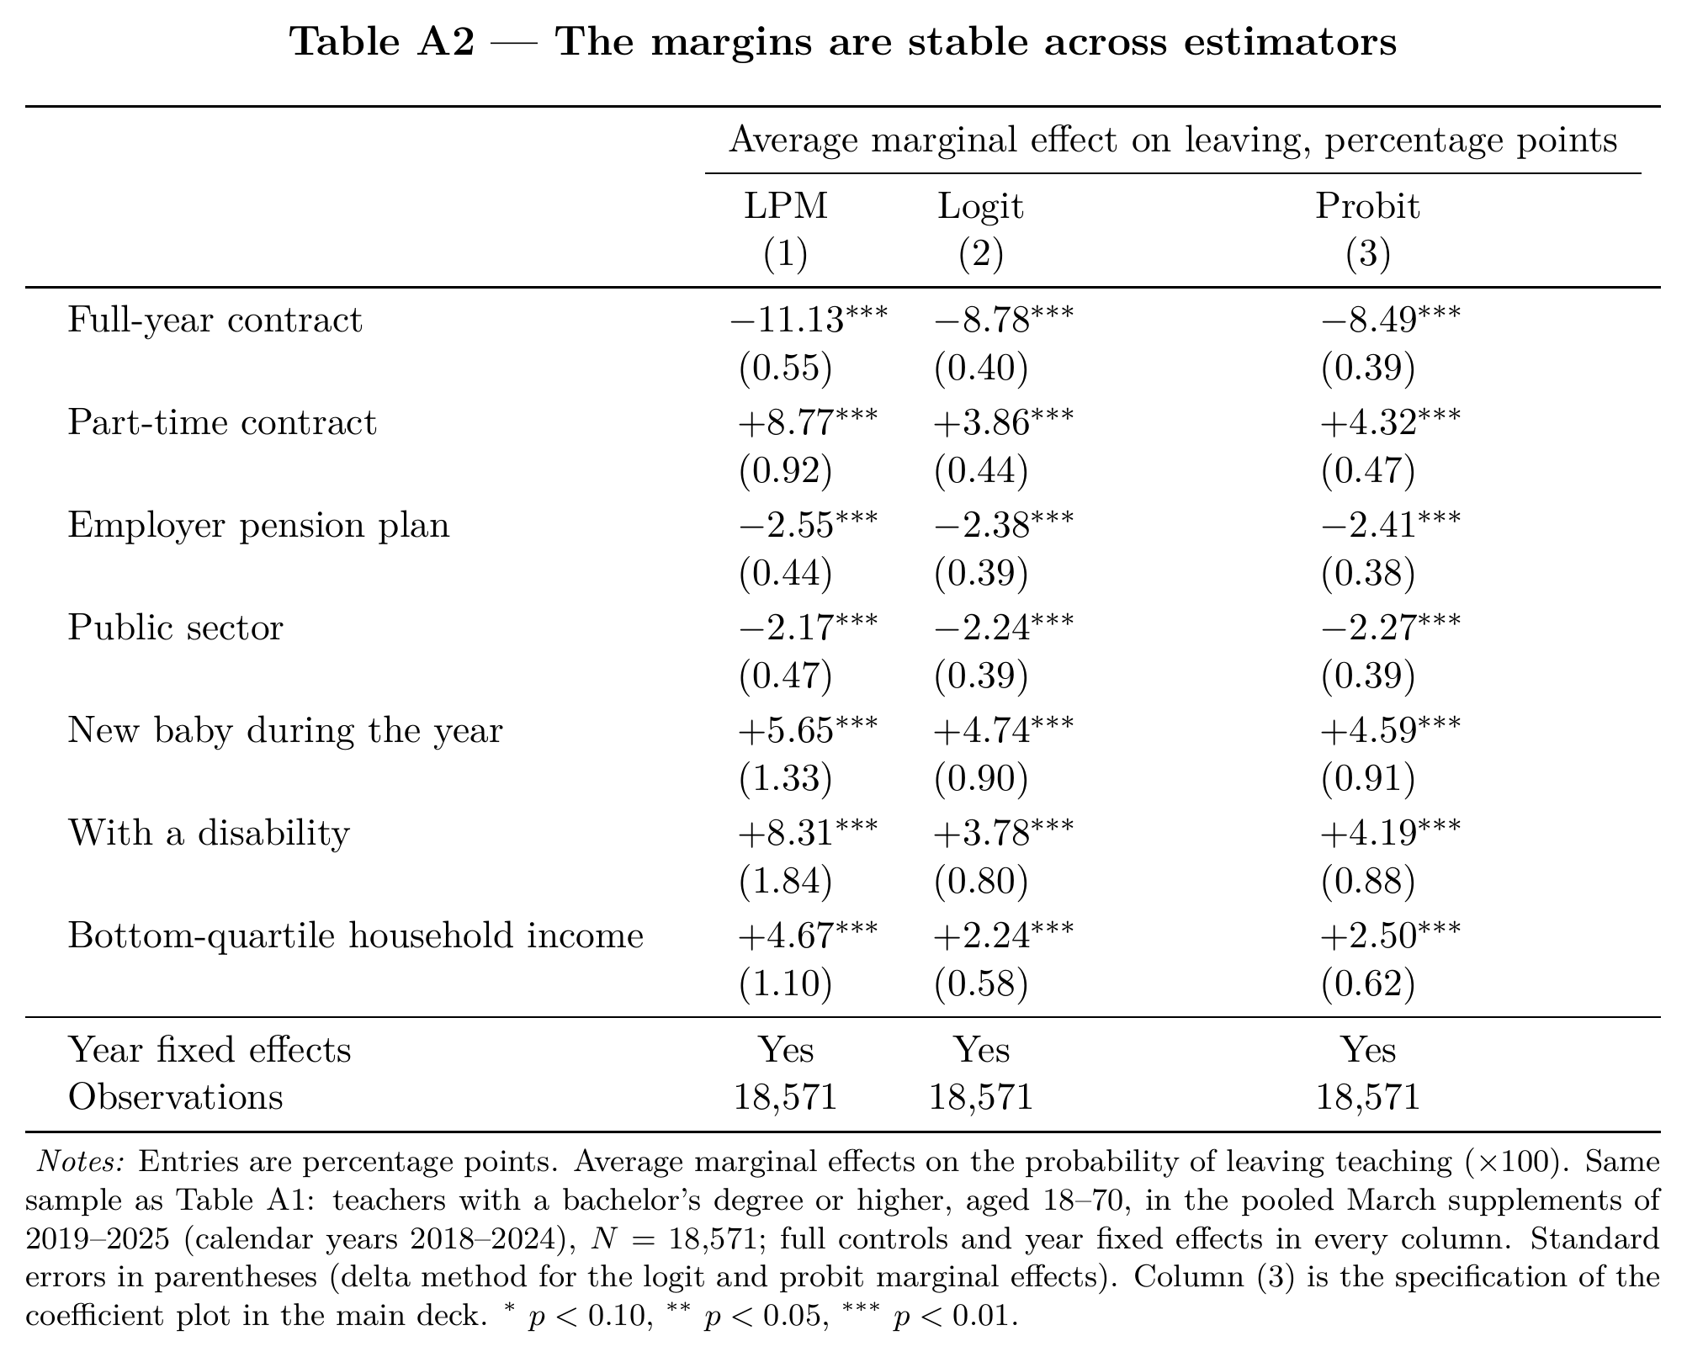
LPM vs logit vs probit, full specification
☞ back

