Slide 1
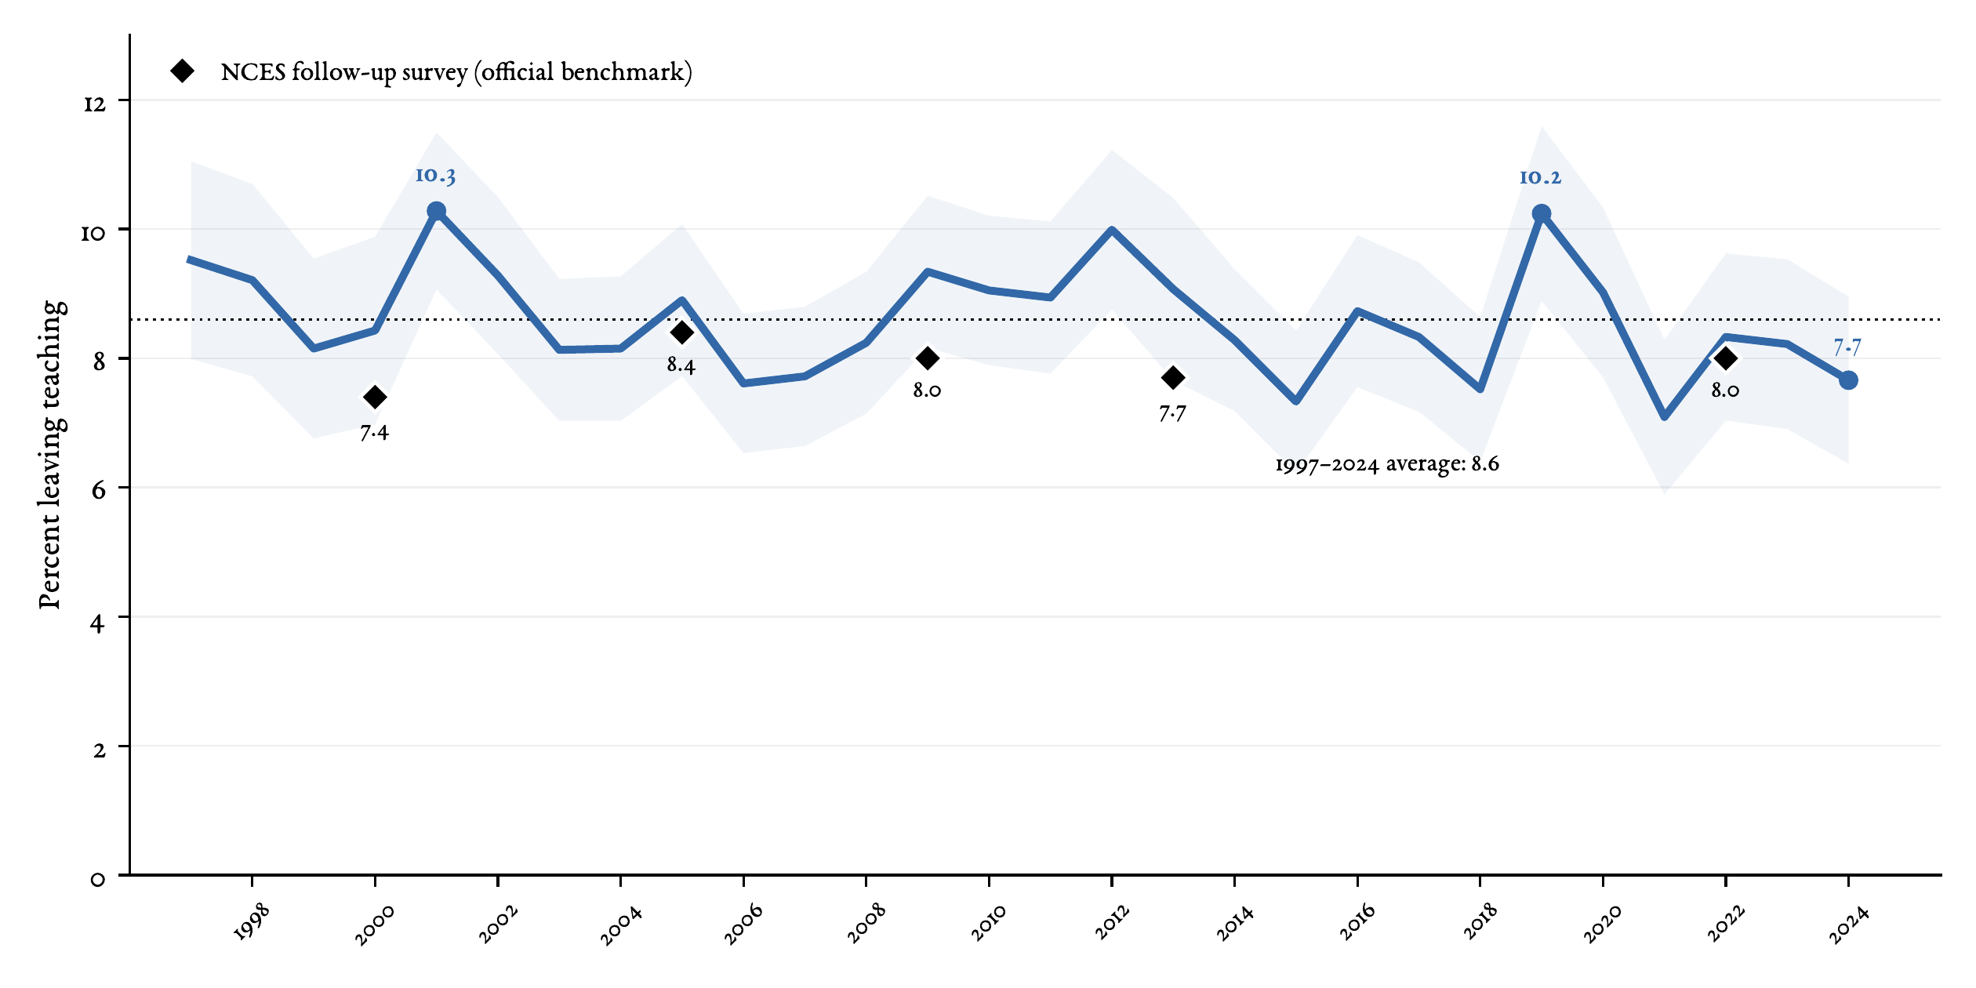
Leaving teaching, 1997–2024
Key message. The leaving rate has remained stable, oscillating between 7 and 10%. The US rate stands slightly above the average (6.5%) of the OECD countries with reported data in the latest edition of Education at a Glance.
1

