Slide 1
Who counts as a teacher
By the Census occupation code — the code the Census Bureau assigns to the occupation of the longest job held last year (CPS ASEC)
SURVEYS 1998–2002
SURVEYS 2003–2019
SURVEYS 2020–2025
Census occupation classification of 1990
Census occupation classification of 2002/2010 (SOC)
Census occupation classification of 2018
Pre-K &
kindergarten
155
Teachers, prekindergarten and kindergarten
2300
Preschool and kindergarten teachers
2300
Preschool and kindergarten teachers
Elementary
& middle †
156
Teachers, elementary school †
2310
Elementary and middle school teachers
2310
Elementary and middle school teachers
Secondary
157
Teachers, secondary school †
2320
Secondary school teachers
2320
Secondary school teachers
Special
education
158
Teachers, special education
2330
Special education teachers
2330
Special education teachers
Other
teachers
159
Teachers, n.e.c. (not elsewhere classified)
2340
Other teachers and instructors
2360
Other teachers and instructors
2003 reclassification
2020 reclassification
Traceable as a block: the K–12 teaching group maps one-to-one across the three classifications — every figure uses the union, never a sub-code across regimes.
† middle-school teachers sit under elementary or secondary before 2003, with elementary (2310) after. Never included: postsecondary (2200s) · tutors (2350) · teaching assistants (2540/2545) · childcare workers (4600) · administrators (0230).

Slide 2
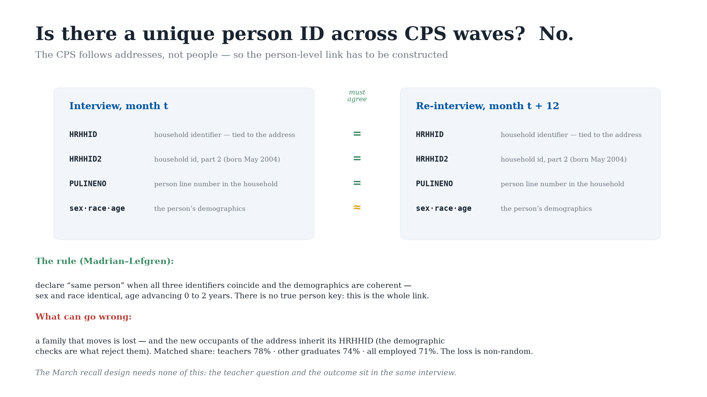

Slide 3
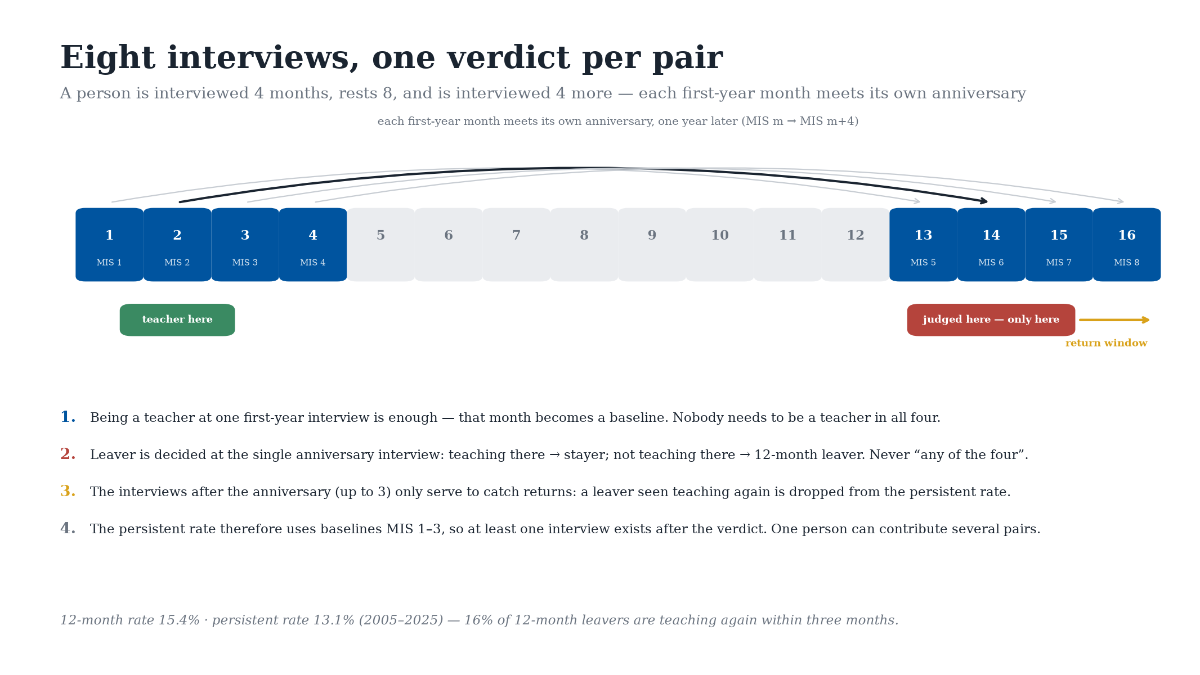

Slide 4
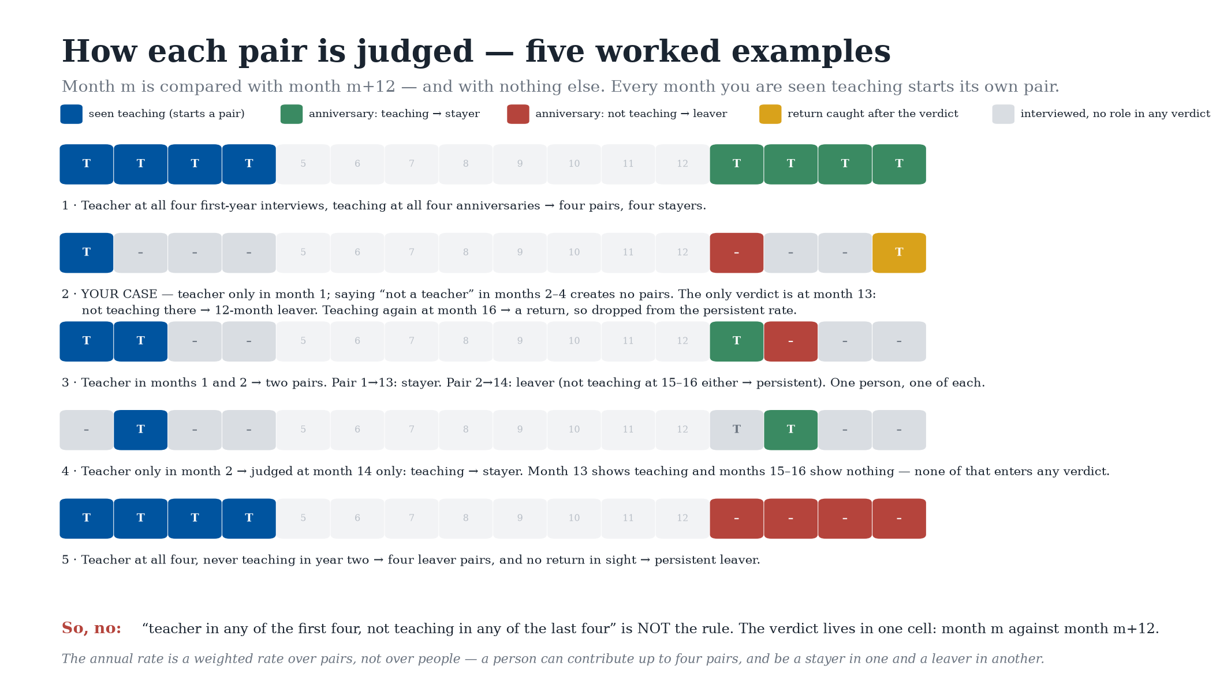

Slide 5
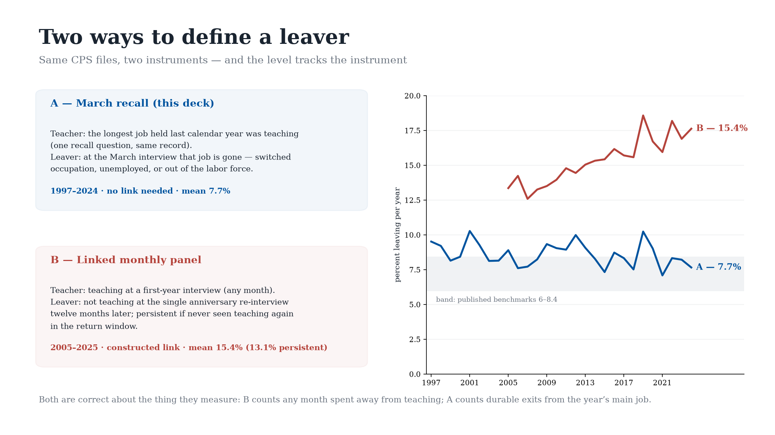

Slide 6
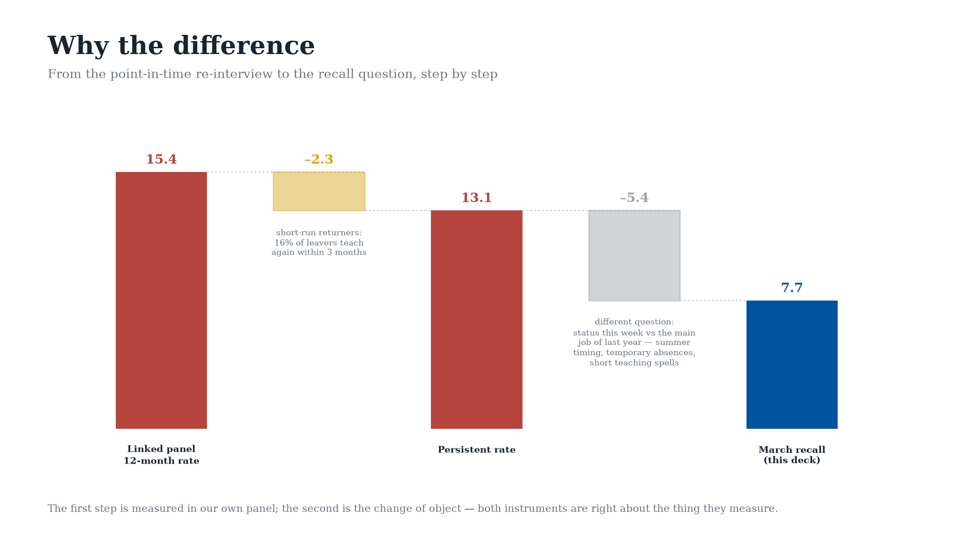

Slide 7
