Slide 1
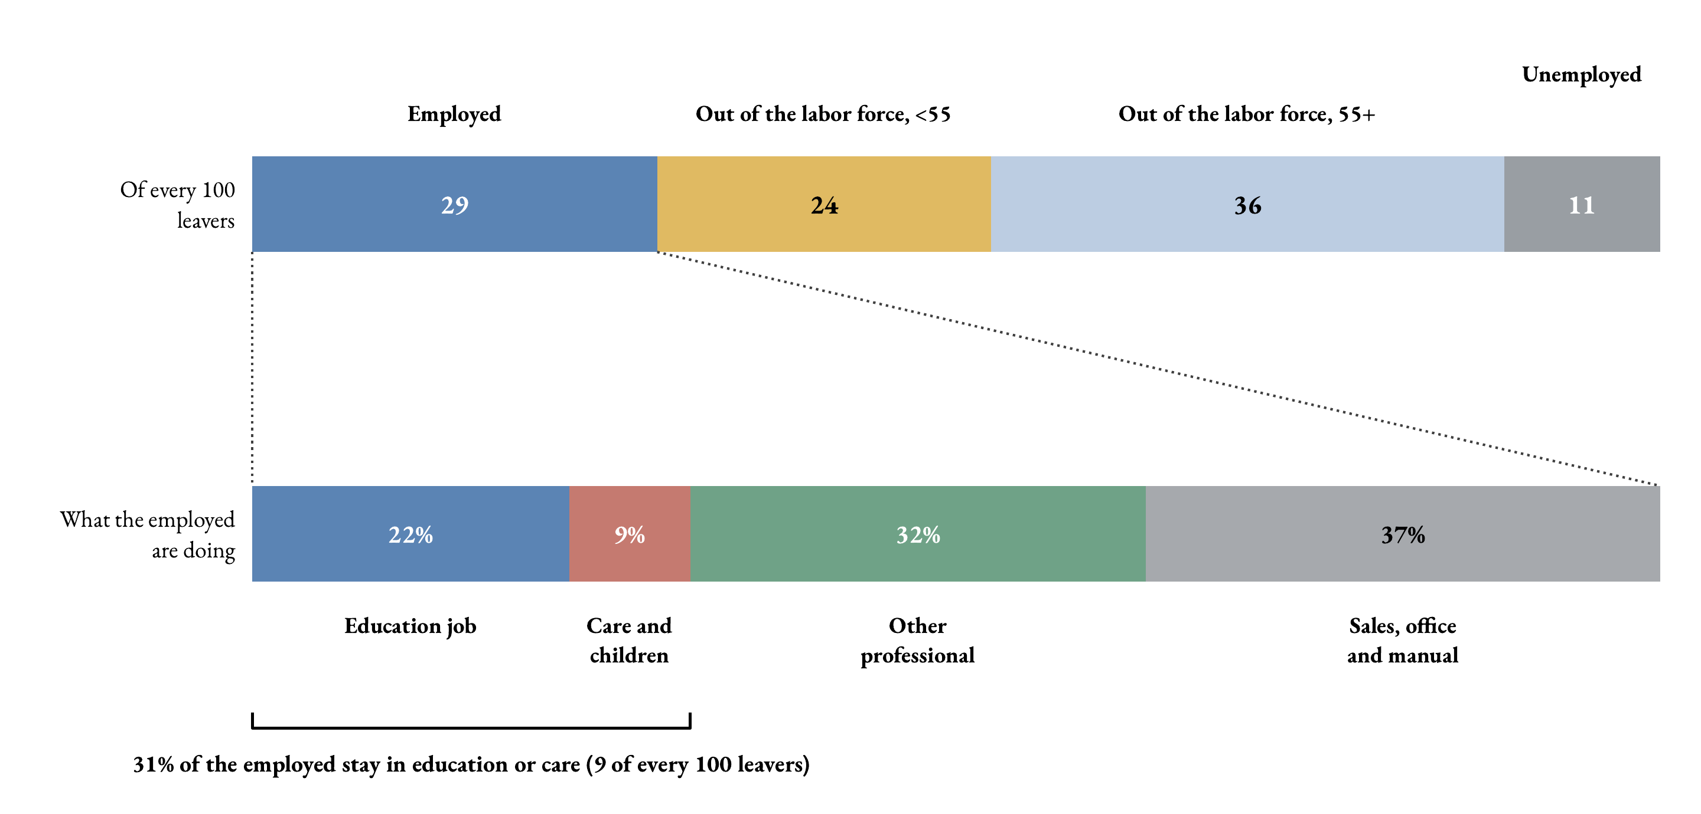
Of every 100 leavers (average, 2020–2024)
Key message. A third find another job, a third retire, and the rest split between early labor-force exit and unemployment.
☞ Pooled 1997–24
☞ Vs NCES follow-up

Slide 2
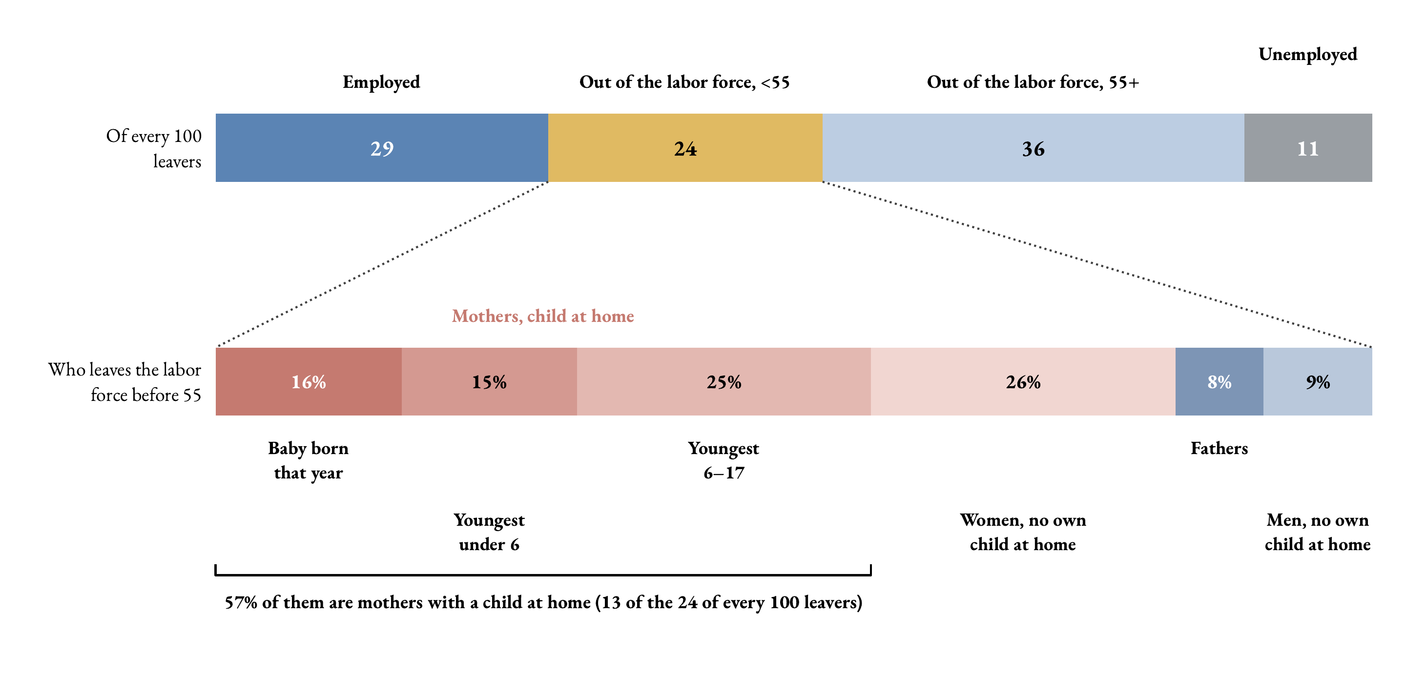
Who leaves the labor force before 55 (average, 2020–2024)
Key message. Early labor-force exit is mostly a family story. More than half of this group are mothers with a child at home.
☞ Pooled 1997–24

Slide 3
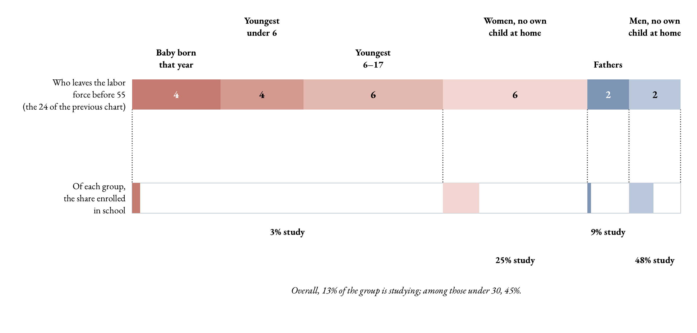
And the youngest of them leave to study
Key message. Studying is the exit of the young and the childless, not of the mothers. Among leavers under 30, almost half are enrolled in school.

Slide 4
Three margins for re-attraction policies
Retirees (out of the labor force, over 55)
About 3% of teachers retire each year, a third of all exits. Delaying retirement extends careers and can be a short-term solution to local teacher shortages, but it does not reintegrate anyone.
Switchers (employed in another job)
About 2% move to another job each year, often to jobs that do not require a degree. A real margin, but shortages cannot be closed through re-attraction alone.
Early exits (out of the labor force, under 55)
About 2% leave the labor force before 55 each year. Most are mothers at home, for whom flexibility and re-entry paths may facilitate reintegration. This also applies to the ones that leave to study.

Slide 5
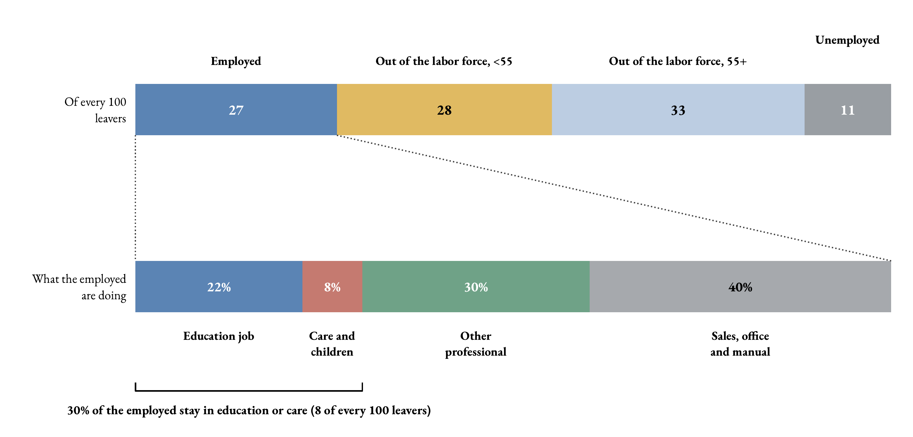
The same flow, pooled 1997–2024
Over the whole period 1997–2024 (6,866 leavers, destination groups mapped across the 1990 and 2002/2010/2018 classifications) the composition barely moves: 27 to another job, 33 retired, 28 out of the labor force before 55 and 12 unemployed; the employed split is 22 / 8 / 30 / 40 percent. The five-year window is not driving the picture.
☞ Back

Slide 6
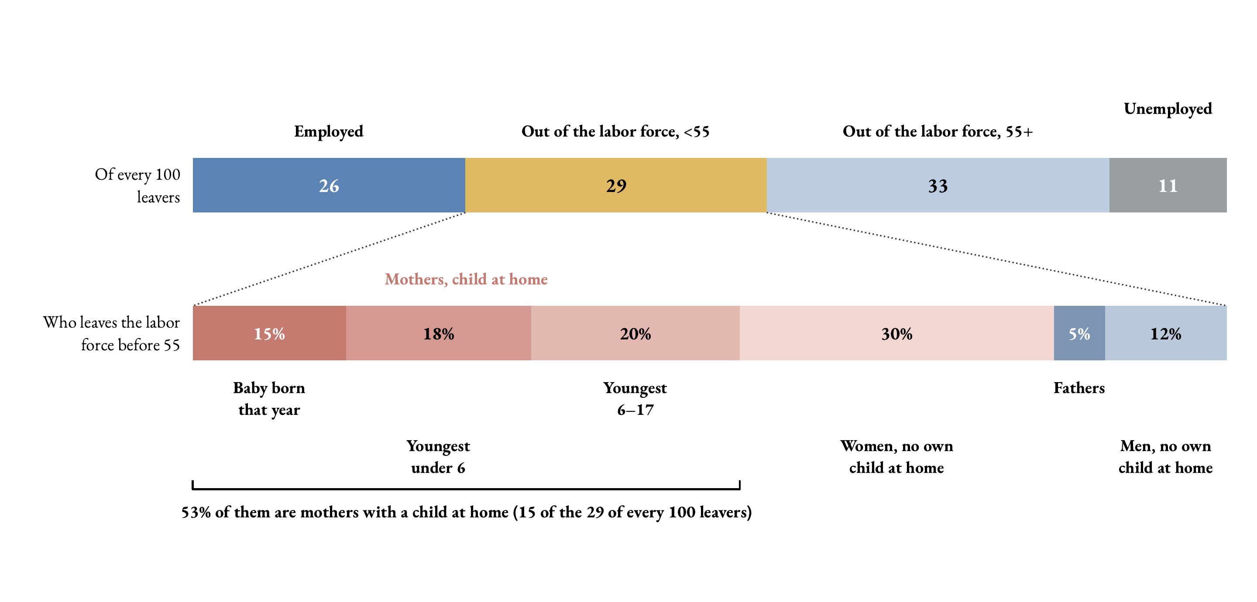
The same cascade, pooled 1997–2024
Over the whole period (6,931 leavers) the picture is the same: 29 of every 100 leavers exit the labor force before 55, and 53% of them are mothers with a child at home (15 of the 29). The five-year window is not driving the composition.
☞ Back

