Slide 1
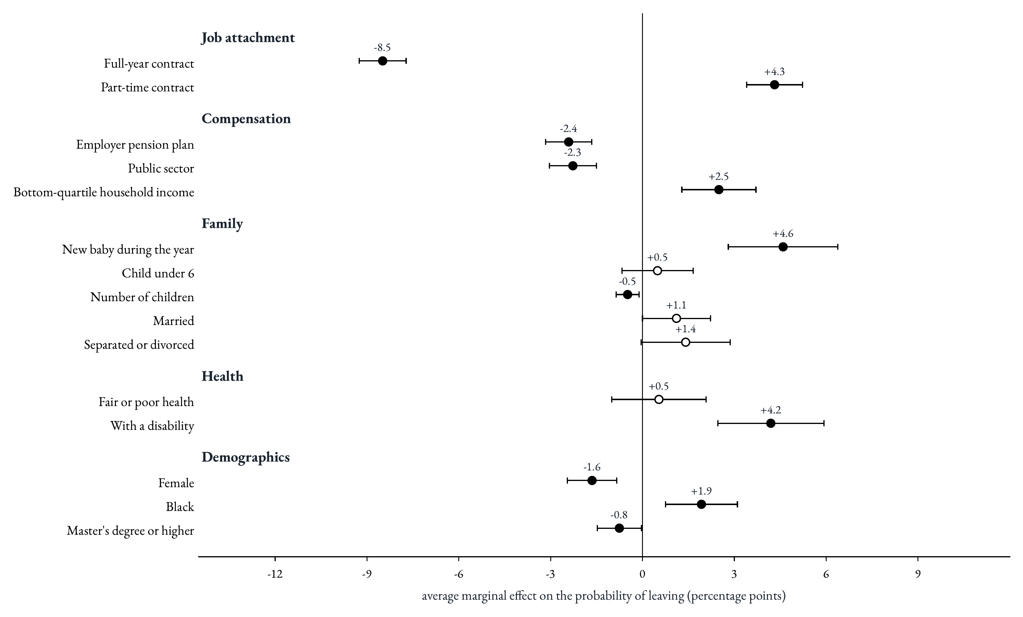
What correlates with leaving
1
Notes:
Read each dot as the change in the probability of leaving, in percentage points, against an average of about 7 in 100 teachers a year. The hierarchy is clear. First, the contract: a full-year contract goes with 8.5 points less leaving, and a part-time contract with 4.3 points more. These are the largest effects on the chart. Second, life events: a new baby adds 4.6 points and a disability 4.2. Third, economic security: a pension plan and a public-school job each cut leaving by about 2.3 points, and living in a bottom-quartile household adds 2.5. Surprisingly, demographics matter much less: being a woman, being Black or holding a master's degree moves the rate by 2 points at most once contracts, life events and security are accounted for.

