Slide 1
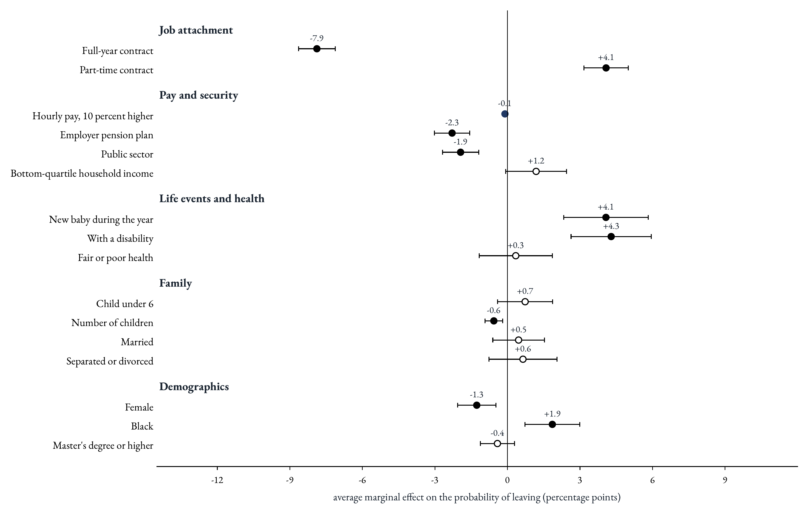
What correlates with leaving
Key message. Contracts matter most, then life events and economic security. Demographics matter far less, and pay works mostly through the contract.
1
Notes:
Read each dot as the change in the probability of leaving, in percentage points, against an average of about 7 in 100 teachers a year. The hierarchy is clear. First, the contract: a full-year contract goes with almost 8 points less leaving, and a part-time contract with 4 points more. These are the largest effects on the chart. Second, life events: a new baby or a disability each add about 4 points. Third, security: a pension plan and a public-school job each cut leaving by about 2 points. Surprisingly, demographics matter much less: being a woman, being Black or holding a master's degree moves the rate by 2 points at most once contracts and life events are accounted for. Pay is measured per hour, because weeks and hours are already in the model: a 10 percent higher hourly pay goes with 0.1 points less leaving, about 1.6 percent of the average rate. That does not make pay irrelevant. Low pay comes bundled with part-year and part-time contracts, which is where most of the action is, as the next charts show.

