Slide 1
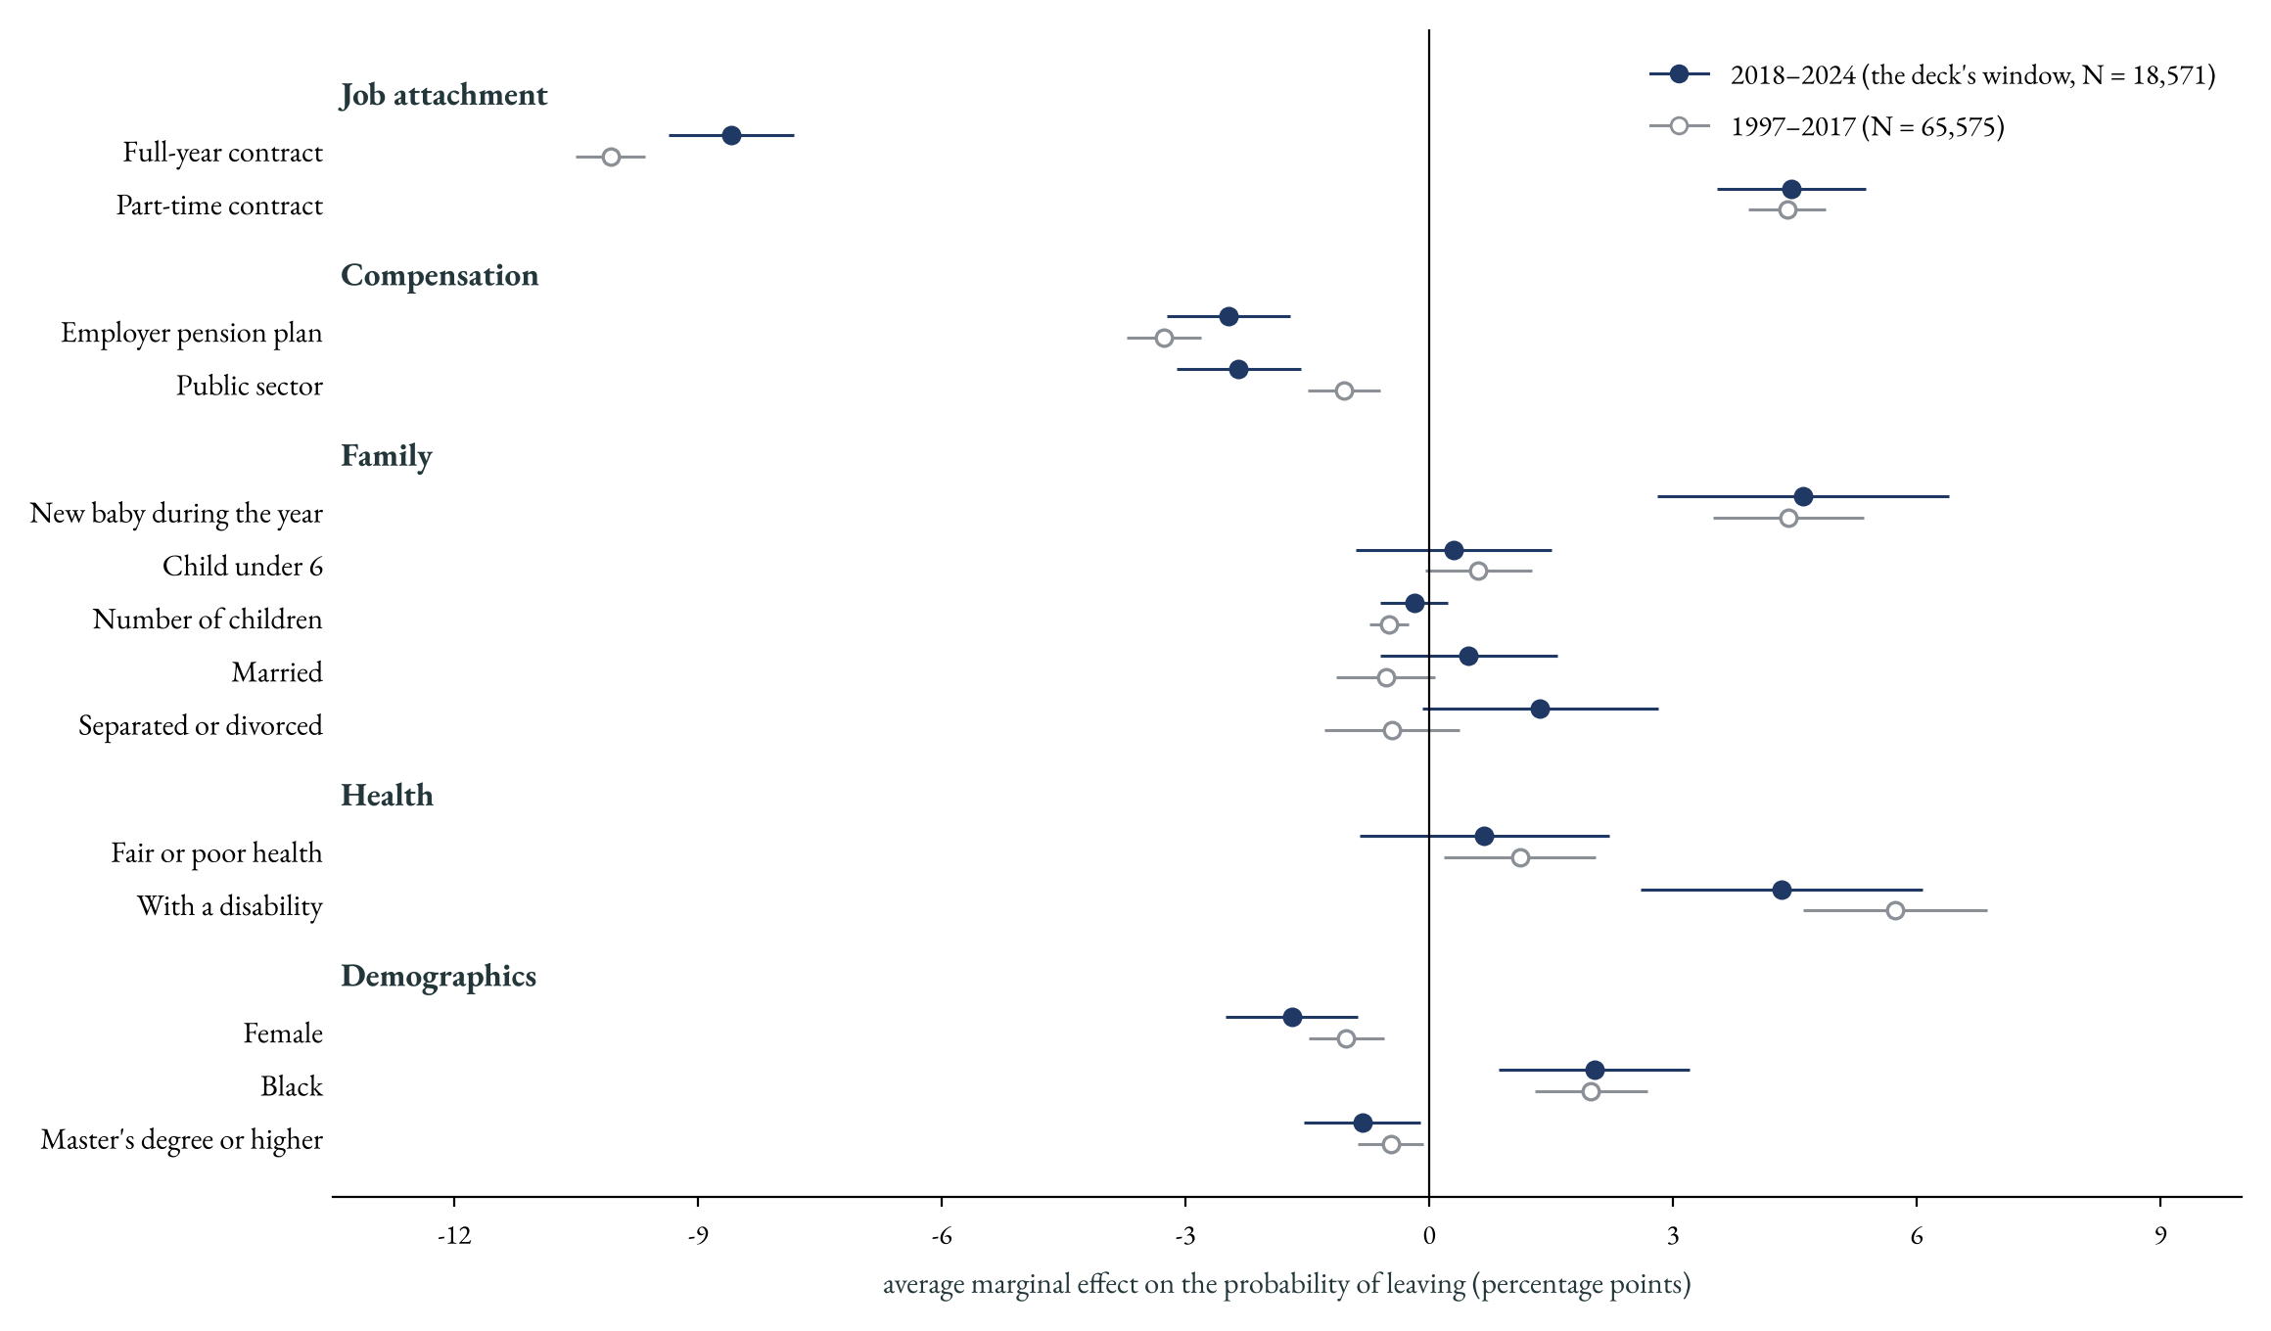
Are the margins stable over time?
Probit average marginal effects with the controls available in every year, health and disability included. Age enters as a quadratic and is not shown. Baseline rates: 7.9% (1997–2017) and 7.3% (2018–2024).
☞ selection table

Slide 2
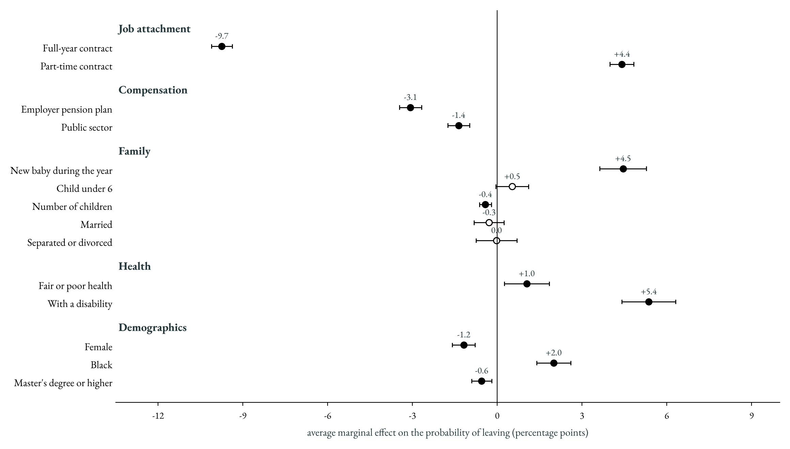
The margins over the whole period
Probit average marginal effects, surveys 1998–2025, N = 84,146, health and disability included. Age enters as a quadratic and is not shown.
☞ selection table

Slide 3
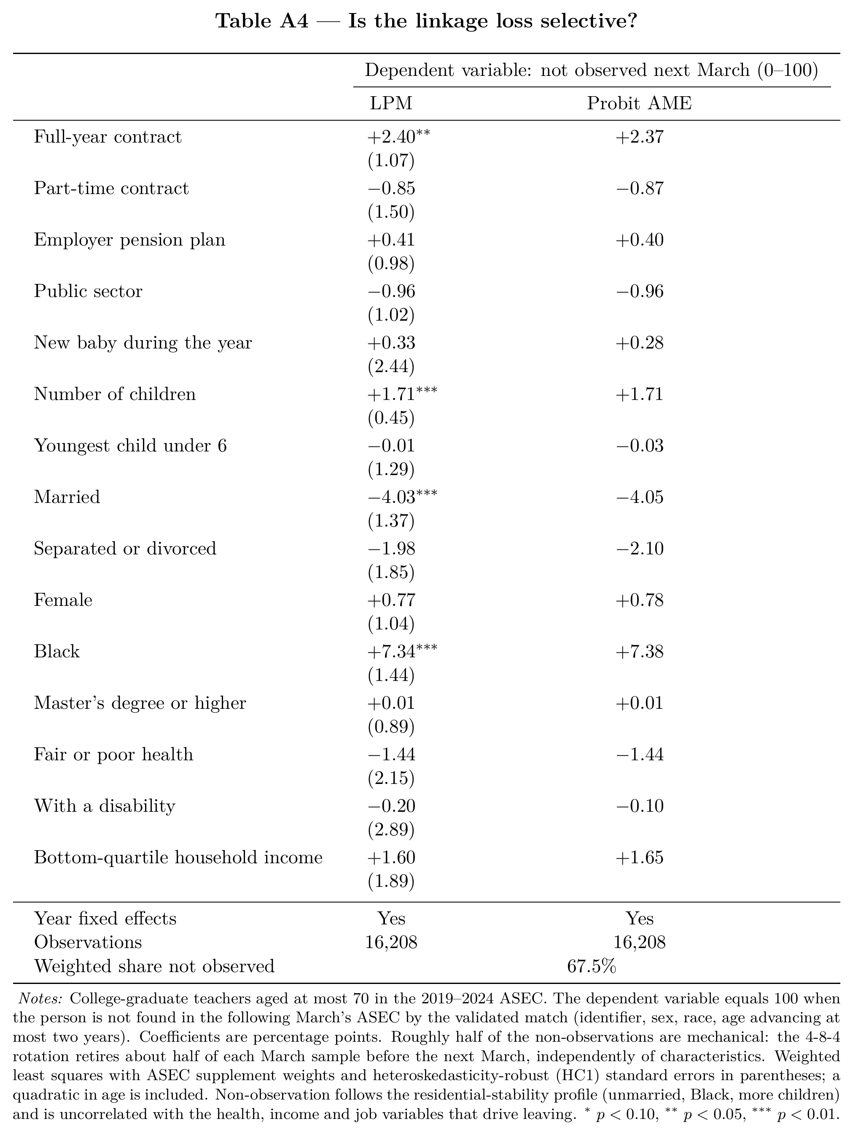
Is the linkage loss selective?
☞ Back

