Slide 1
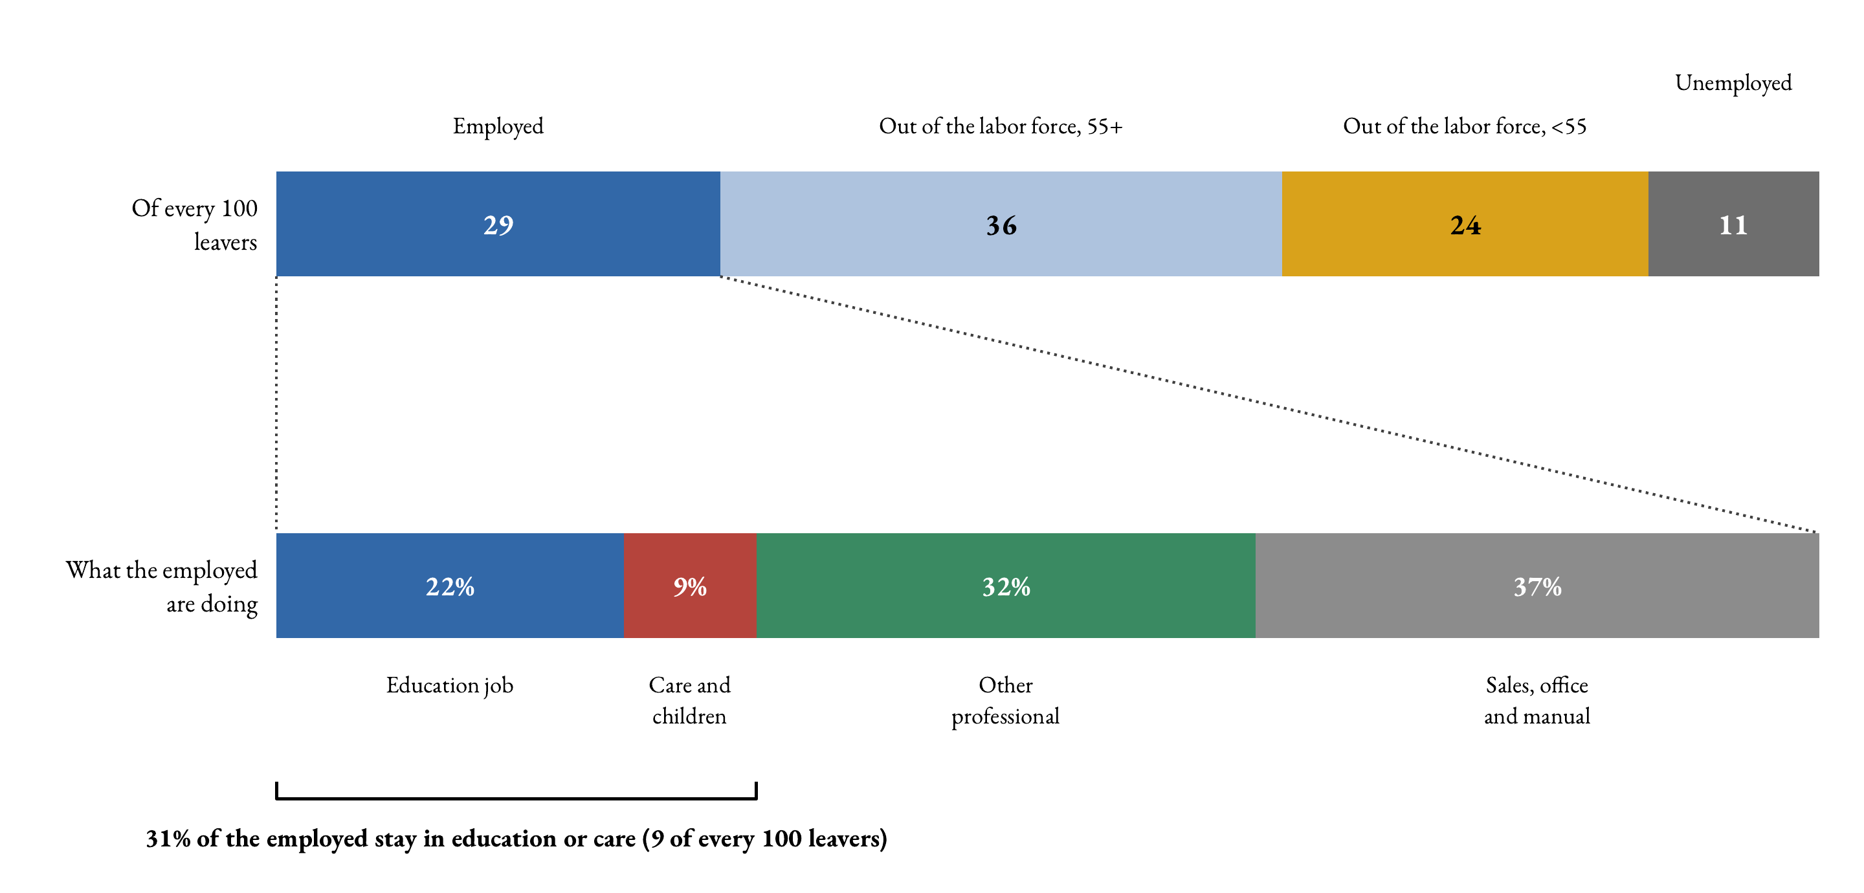
Of every 100 leavers (average, 2020–2024)
Key message. A third find another job, a third retire, and the rest split between early labor-force exit and unemployment.
☞ Pooled 1997–24

Slide 2
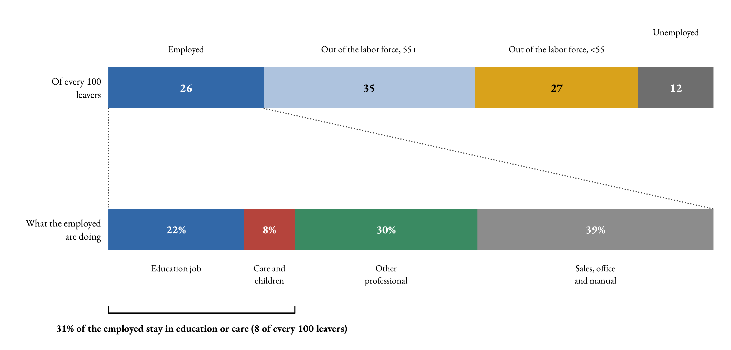
The same flow, pooled 1997–2024
Over the whole period 1997–2024 (6,866 leavers, destination groups mapped across the 1990 and 2002/2010/2018 classifications) the composition barely moves: 27 to another job, 33 retired, 28 out of the labor force before 55 and 12 unemployed; the employed split is 22 / 8 / 30 / 40 percent. The five-year window is not driving the picture.
☞ Back

