Slide 1

Directorate for Education and Skills
Who Leaves Teaching, and Why?
The Anatomy of Teacher Attrition in the United States, 1997–2024
José Elías Durán Roa
University of Alicante / OECD
July 2026

Slide 2
Motivation
Measuring teacher attrition is hard as it requires following the same teachers over time.
In the US, the official source is the NCES Teacher Follow-up Survey. It runs every four to five years, on small samples, and its microdata are not public.
Researchers found an alternative measure, the CPS, the largest longitudinal survey in the US. Harris & Adams (2007) and Aldeman & Yi (2025) used it to show that teacher attrition is similar to that of comparable professions.
Contribution
I build the longest continuous measurement of teacher attrition in the US, twenty-eight consecutive years (1998 – 2025) from a single instrument, and characterize who leaves, where they go, what leaving pays, who returns, and what moves the rate.

Slide 3
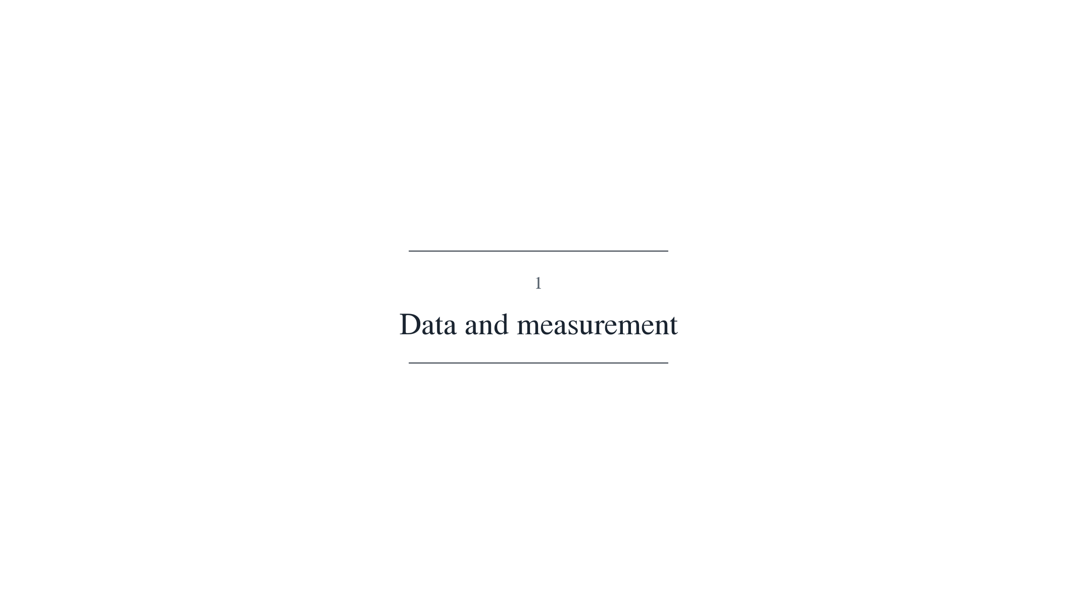

Slide 4
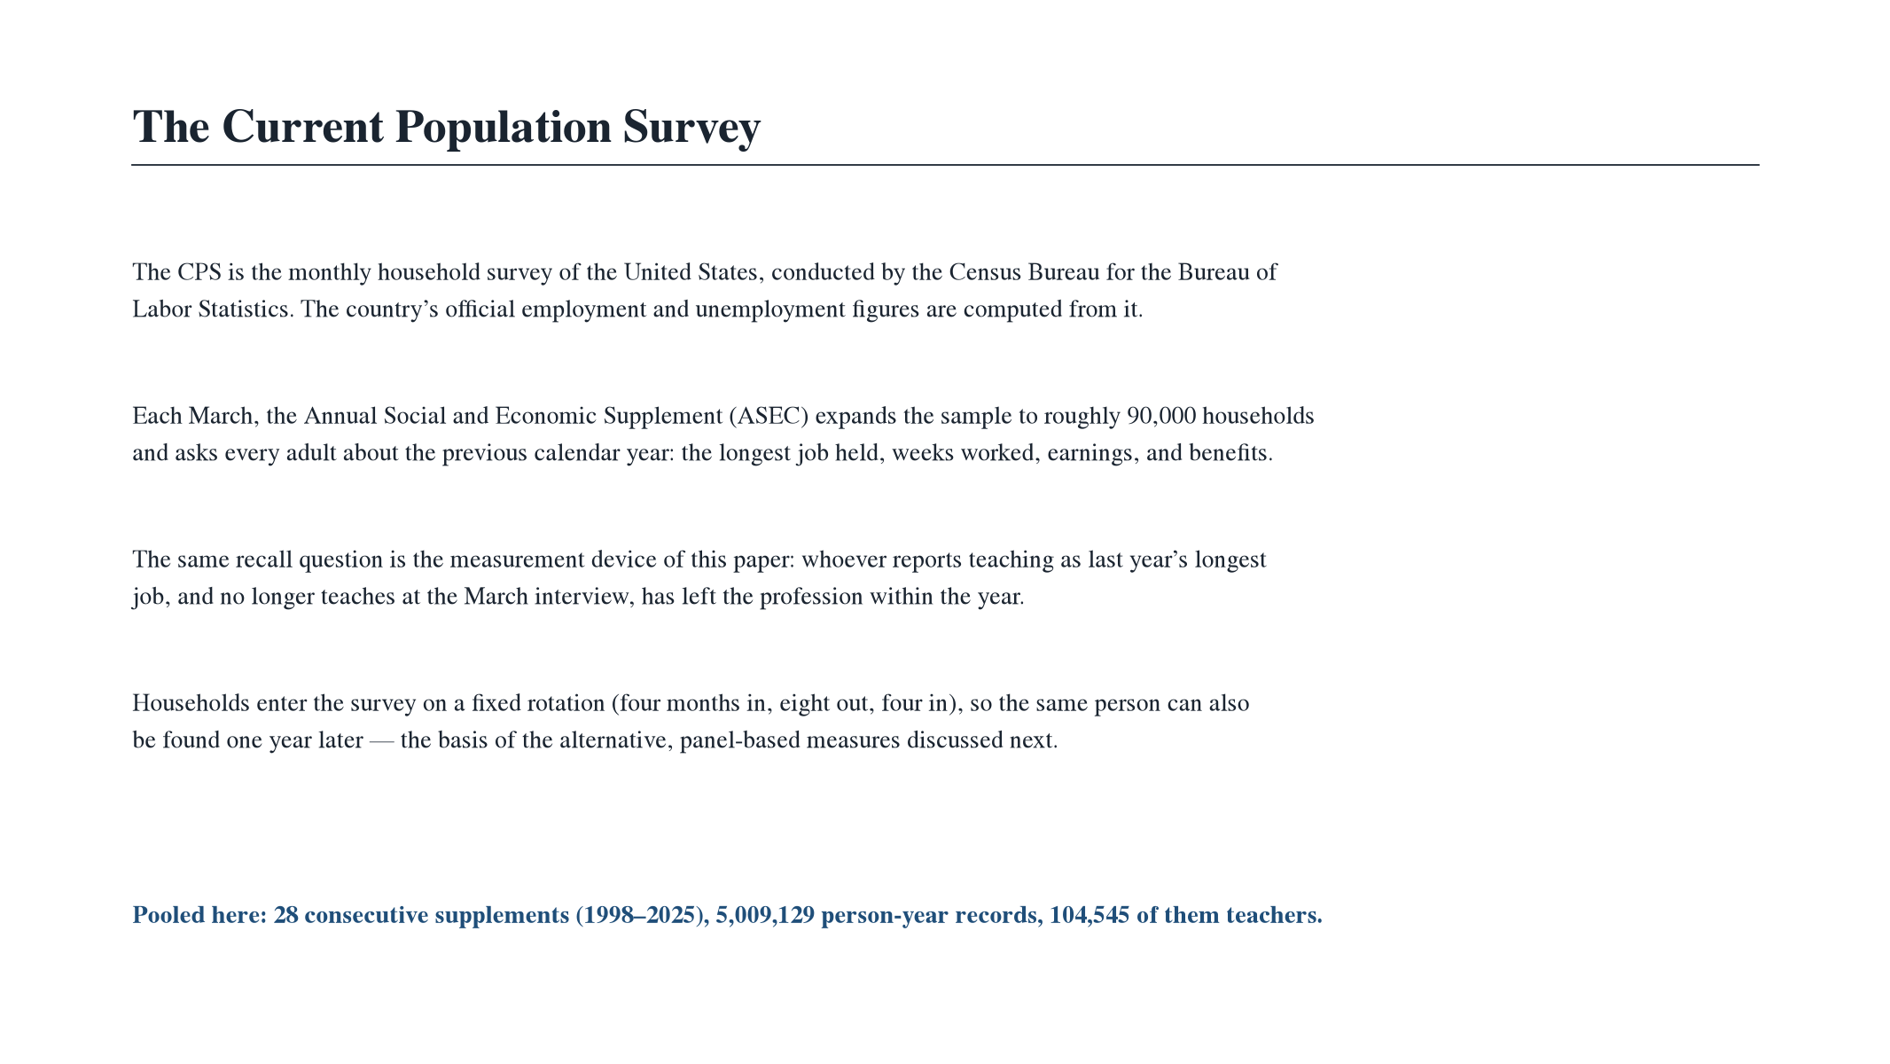

Slide 5
Data
The Current Population Survey (CPS) is the main household survey in US, used to compute the country’s official employment statistics.
I pool all its rounds from 1998 to 2025 into a single file and turn it into a tool for following teachers
Each March, respondents report the longest job held last calendar year and their occupation today. Whoever taught last year and no longer teaches has left the profession within the year.
My final dataset holds 5 million individual records, with 104,545 teachers, around 3,700 per year.

Slide 6
Who counts as a teacher
Census occupation classification of 1990
Census occupation classification of 2002/2010
Census occupation classification of 2018
Surveys 1998–2002
Surveys 2003–2019
Surveys 2020–2025
Pre-K &
kindergarten
155
Teachers, prekindergarten and kindergarten
2300
Preschool and kindergarten teachers
2300
Preschool and kindergarten teachers
Elementary
& middle †
156
Teachers, elementary school †
2310
Elementary and middle school teachers
2310
Elementary and middle school teachers
Secondary
157
Teachers, secondary school †
2320
Secondary school teachers
2320
Secondary school teachers
Special
education
158
Teachers, special education
2330
Special education teachers
2330
Special education teachers
Other
teachers
159
Teachers, n.e.c. (not elsewhere classified)
2340
Other teachers and instructors
2360
Other teachers and instructors
2003 reclassification
2020 reclassification
Traceable as a block: the K–12 teaching group maps one-to-one across the three classifications — every figure uses the union, never a sub-code across regimes.† middle-school teachers sit under elementary or secondary before 2003, with elementary (2310) after

Slide 7
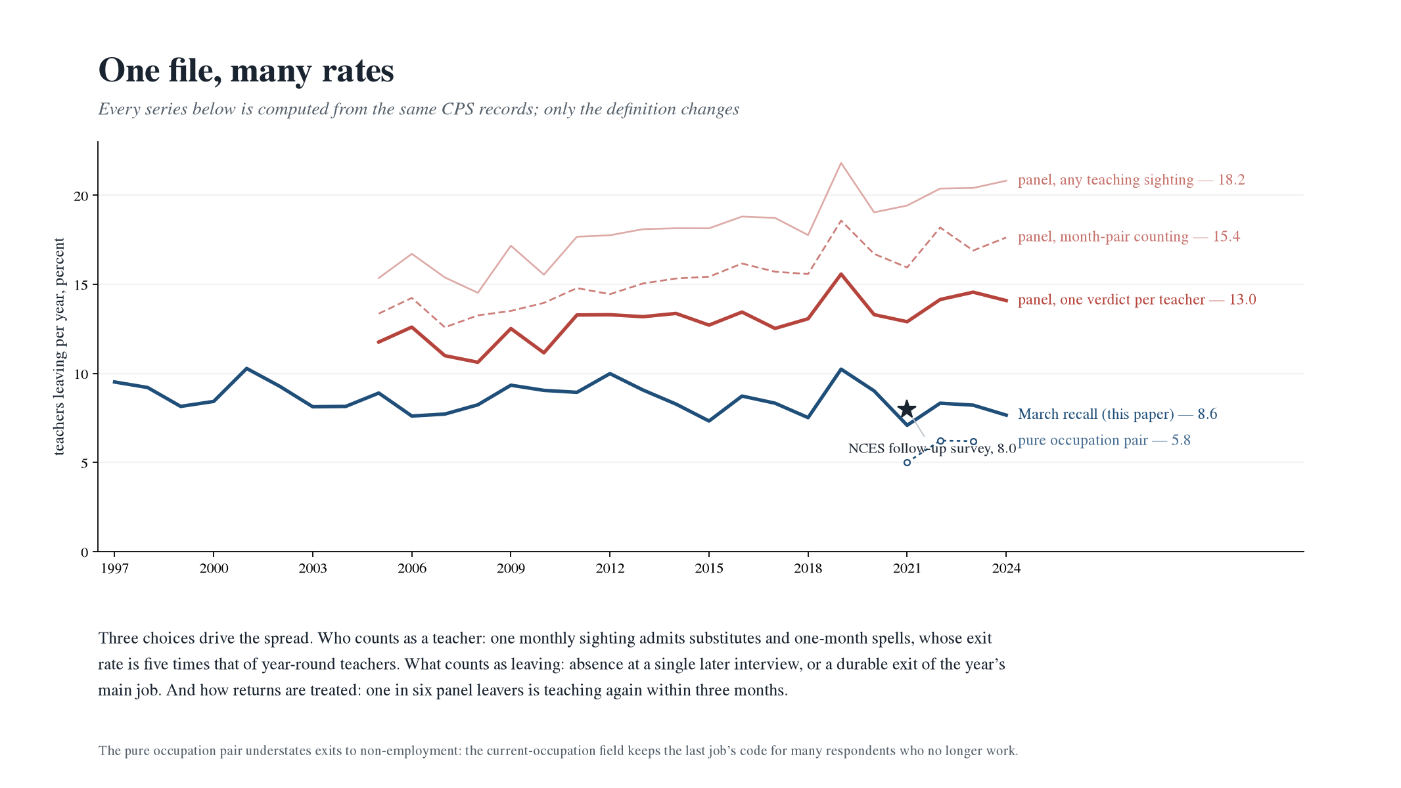

Slide 8
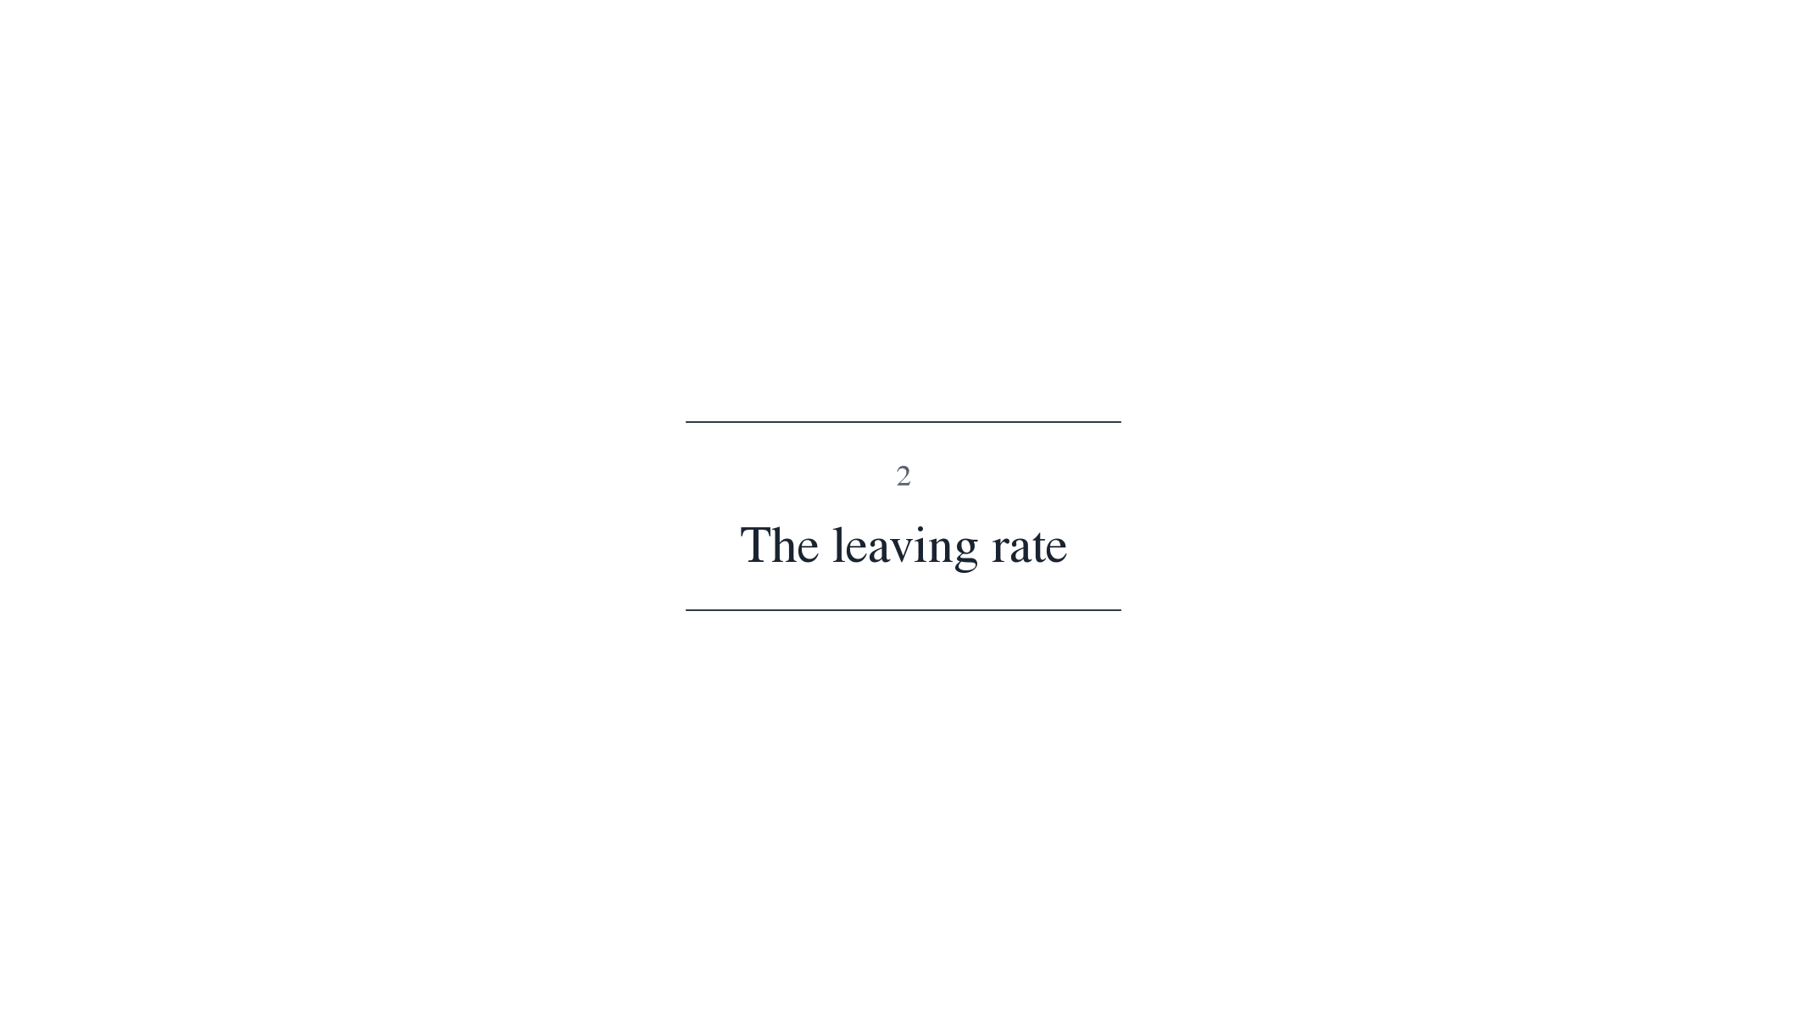

Slide 9
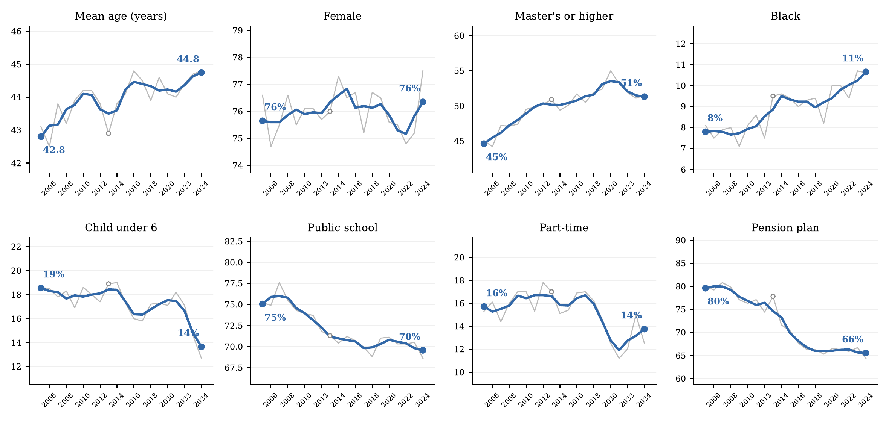
Figure 1. Composition of the Teaching Workforce, 2005–2024
Notes: College-graduate teachers aged 18+ whose longest job last year was K–12 teaching; ASEC supplement weights. Thin gray lines are annual values; blue lines are centered 3-year averages, with endpoint values printed. “Public school,” “part-time,” and “pension plan” refer to the longest job held last year; the open circle marks 2013, a year with a reduced sample due to the ASEC redesign. Source: author’s calculations from March CPS supplements, survey years 2006–2025.

Slide 10
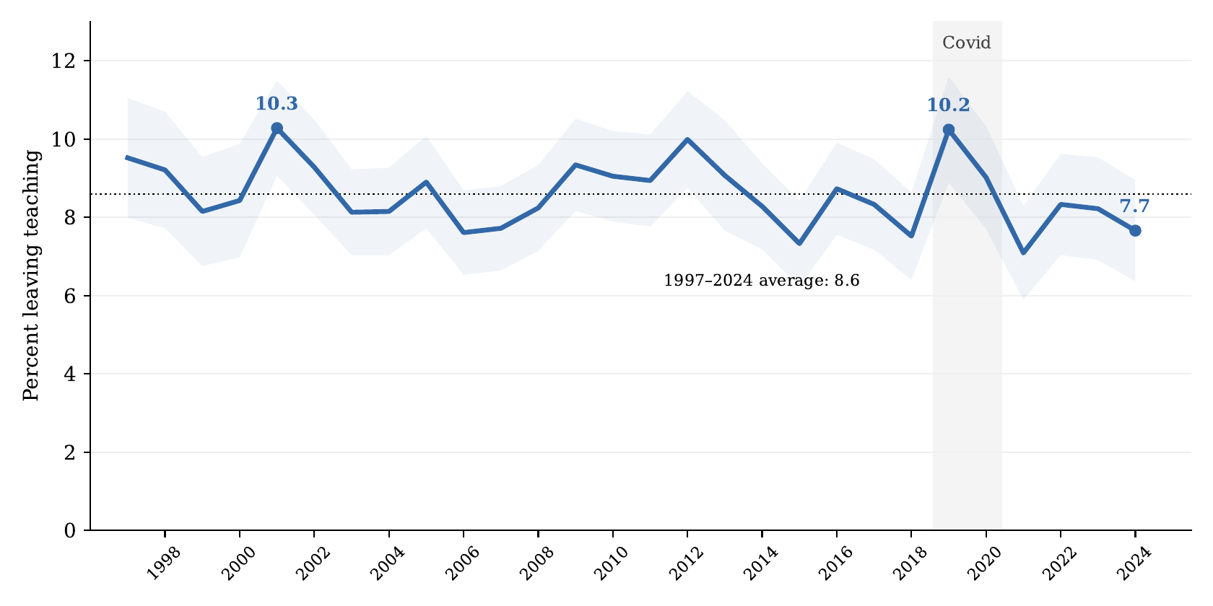
Figure 2. Leaving Teaching, 1997–2024
Notes: Share of college-graduate teachers (longest job last calendar year) not employed in a teaching occupation the following March; ASEC weights. Shaded band: 95 percent confidence interval using a design factor of 1.5. Dotted line: the 1997–2024 mean (8.6). The gray band marks the Covid supplements. Source: author’s calculations from March CPS supplements, survey years 1998–2025.
Notes:
Twenty-eight years, no trend. The two worst years are 2001 and 2019, a generation apart. Any exodus narrative starts from a fact this series does not contain.

Slide 11
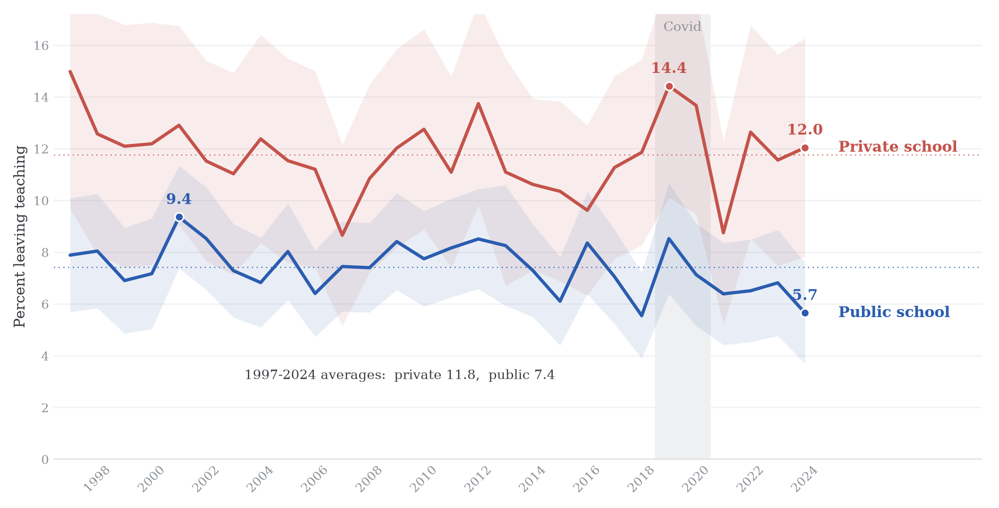
Figure 3. Leaving Teaching by School Sector, 1997-2024
Notes: Annual share of college-graduate teachers leaving the profession by the following March, by sector of the teaching-year job (class of worker: government vs. private), ASEC weights. Shaded bands: 95 percent confidence intervals with a design factor of 1.5; dotted lines: the 1997-2024 sector means. The gray band marks the Covid supplements. Source: author’s calculations from March CPS supplements, survey years 1998-2025.

Slide 12
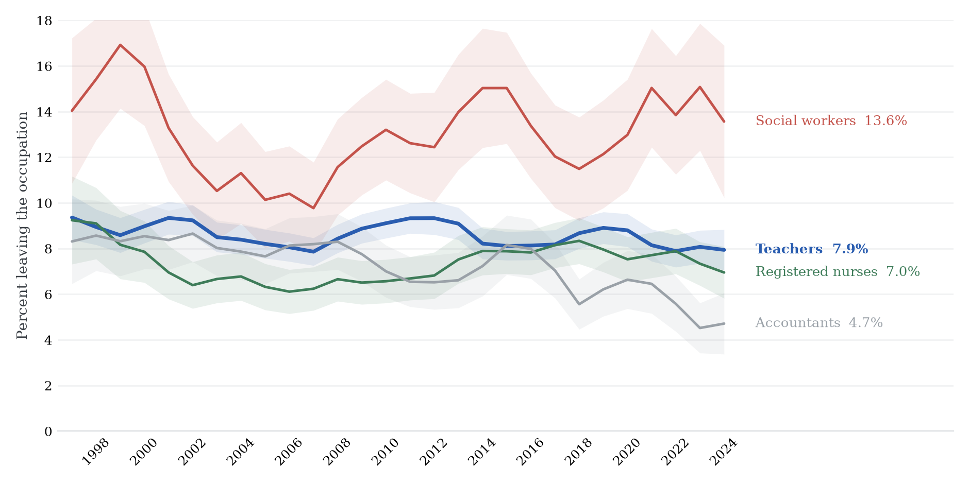
Figure 4. Rates of Leaving the Occupation, Teachers and Comparable Professions
Notes: Percent of college graduates aged 18 and over whose longest job last year was in each occupation and who are no longer in it at the following March interview, by any route; centered 3-year pooled windows with shaded 95 percent confidence bands; occupation codes harmonized across the 1990, 2002, 2010 and 2018 Census classifications. Source: Author’s calculations from March CPS supplements, 1998–2025.

Slide 13
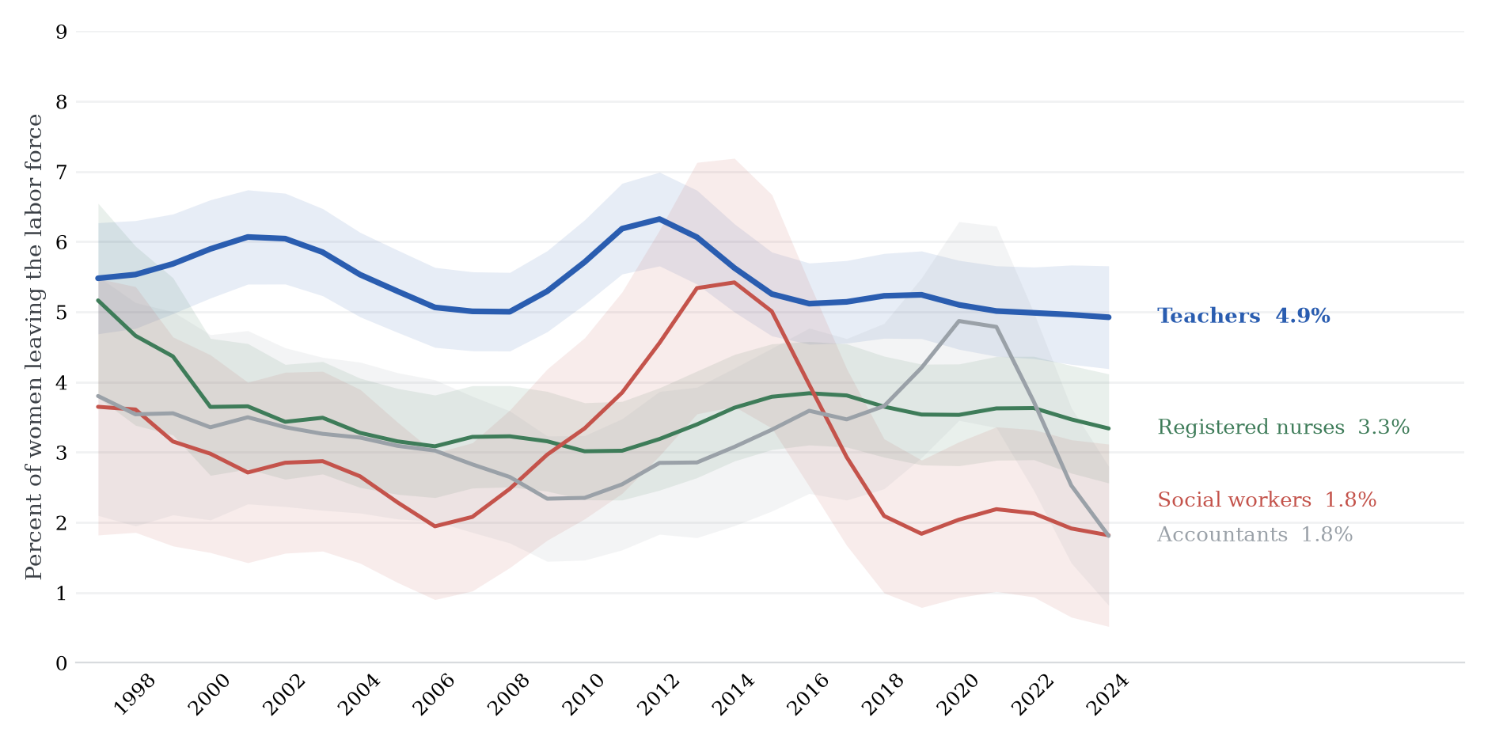
Figure 5. Labor Force Exit of Women, Teachers and Comparable Professions
Notes: Percent of college-graduate women in each occupation who are out of the labor force at the following March interview; centered 3-year pooled windows, additionally smoothed with a 3-year moving average; shaded 95 percent confidence bands. Source: Author’s calculations from March CPS supplements, 1998–2025.

Slide 14
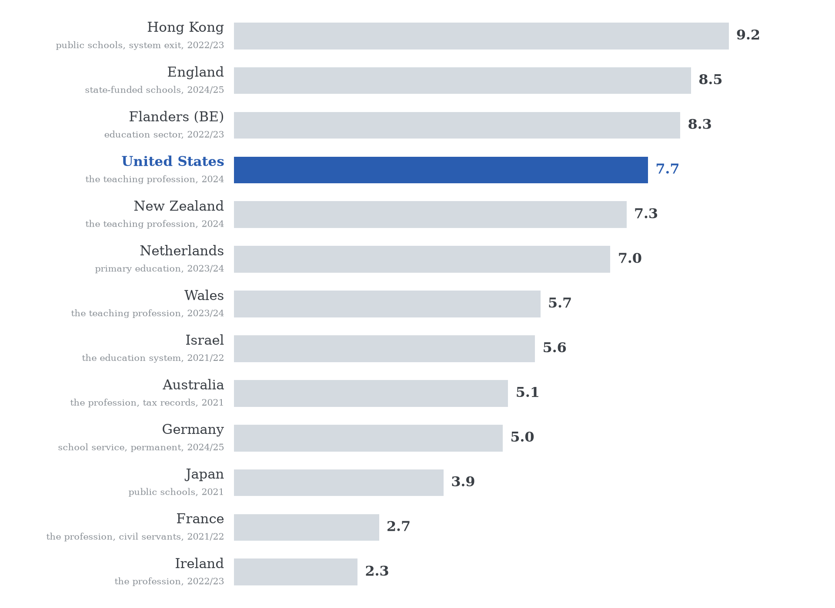
Figure 6. Teachers Leaving per Year Across Countries
Notes: Most recent year available, 2021 or later; every bar is an annual flow over the teacher stock with retirements included; the counted object is printed under each name. Sources: Hong Kong EDB via LegCo; DfE School Workforce Census 2025; OECD Education at a Glance 2025 Table D8.4 (Flanders, France, Ireland); author’s CPS estimate (United States); NZ Ministry of Education; OCW/DUO (Netherlands, primary); Welsh Government SWAC; Israel CBS; e61 Institute tax records (Australia); Destatis flow tables via FiBS (Germany, excl. BY, NI, NRW); MEXT (Japan).

Slide 15
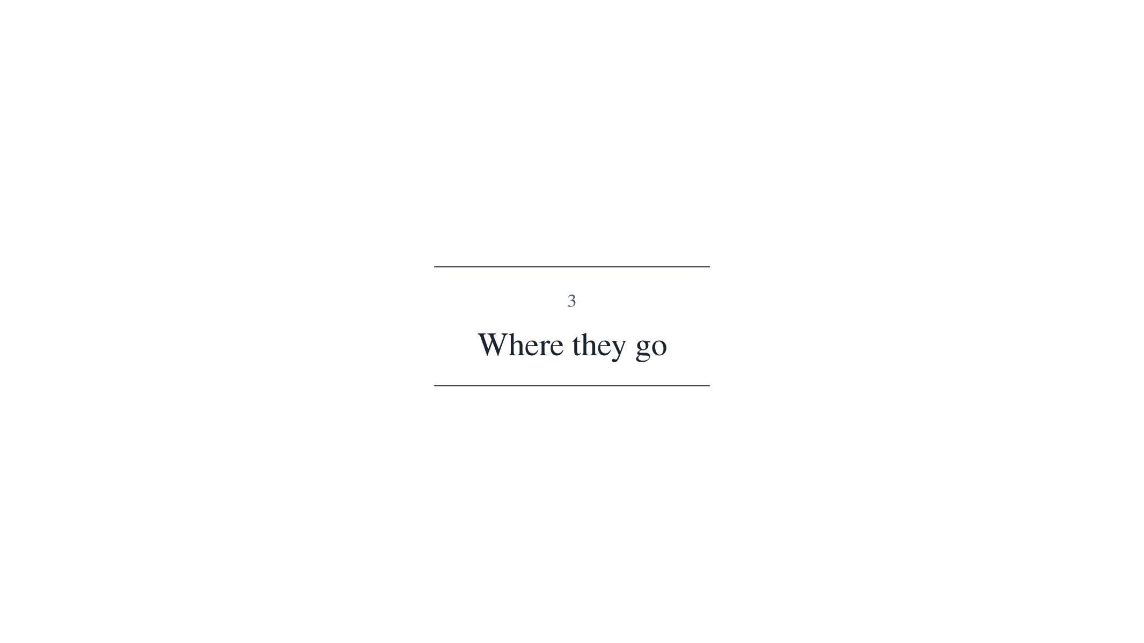

Slide 16
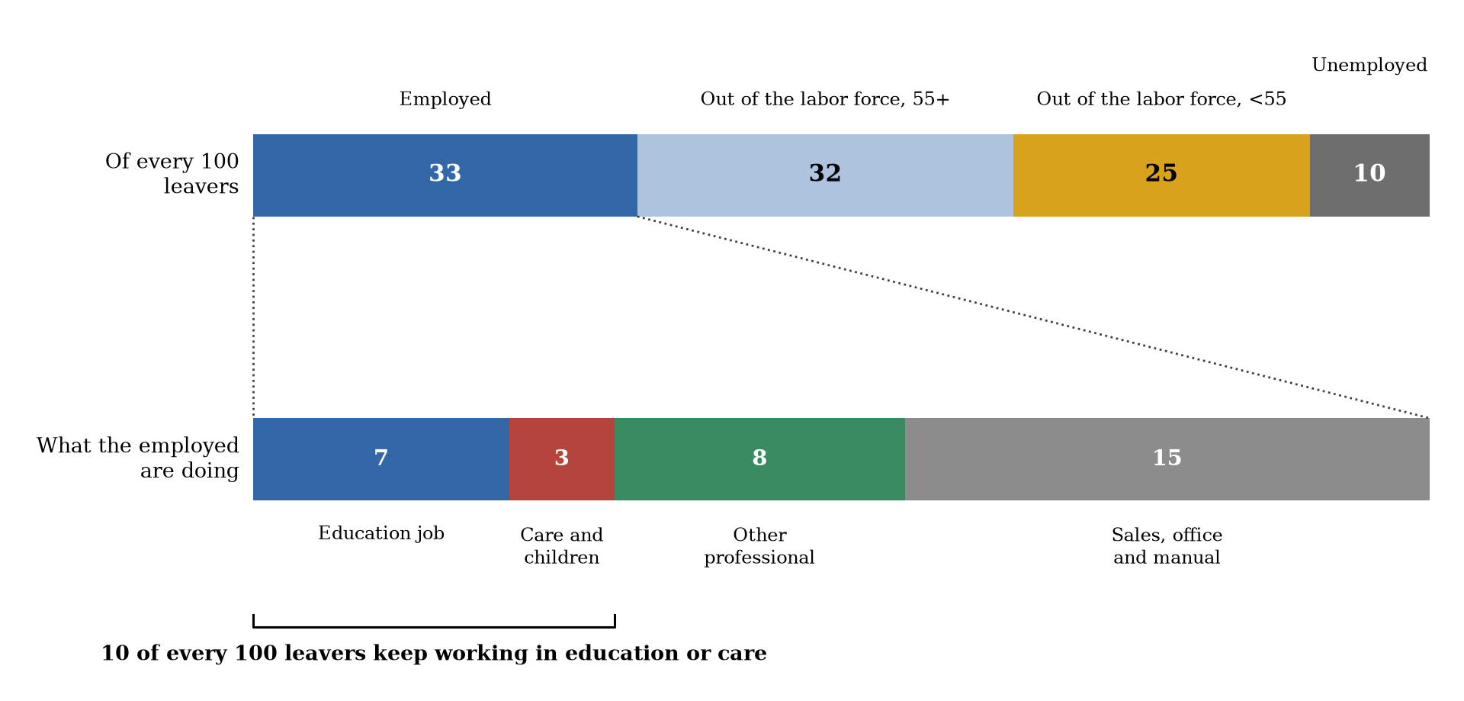
Figure 7. Destinations of Teachers Who Leave the Profession, 2024
Notes: College-graduate leavers of teaching year 2024, observed in March 2025 (178 leavers, ASEC weights). Top bar: labor force status at the March 2025 interview, per 100 leavers; “out of the labor force” is split at age 55. Bottom bar: the occupational destination of the 33 employed leavers, rescaled to sum to their total. Single-year estimates; the pooled 2015–2024 version is in the paper. Source: author’s calculations from the March 2025 CPS supplement.

Slide 17
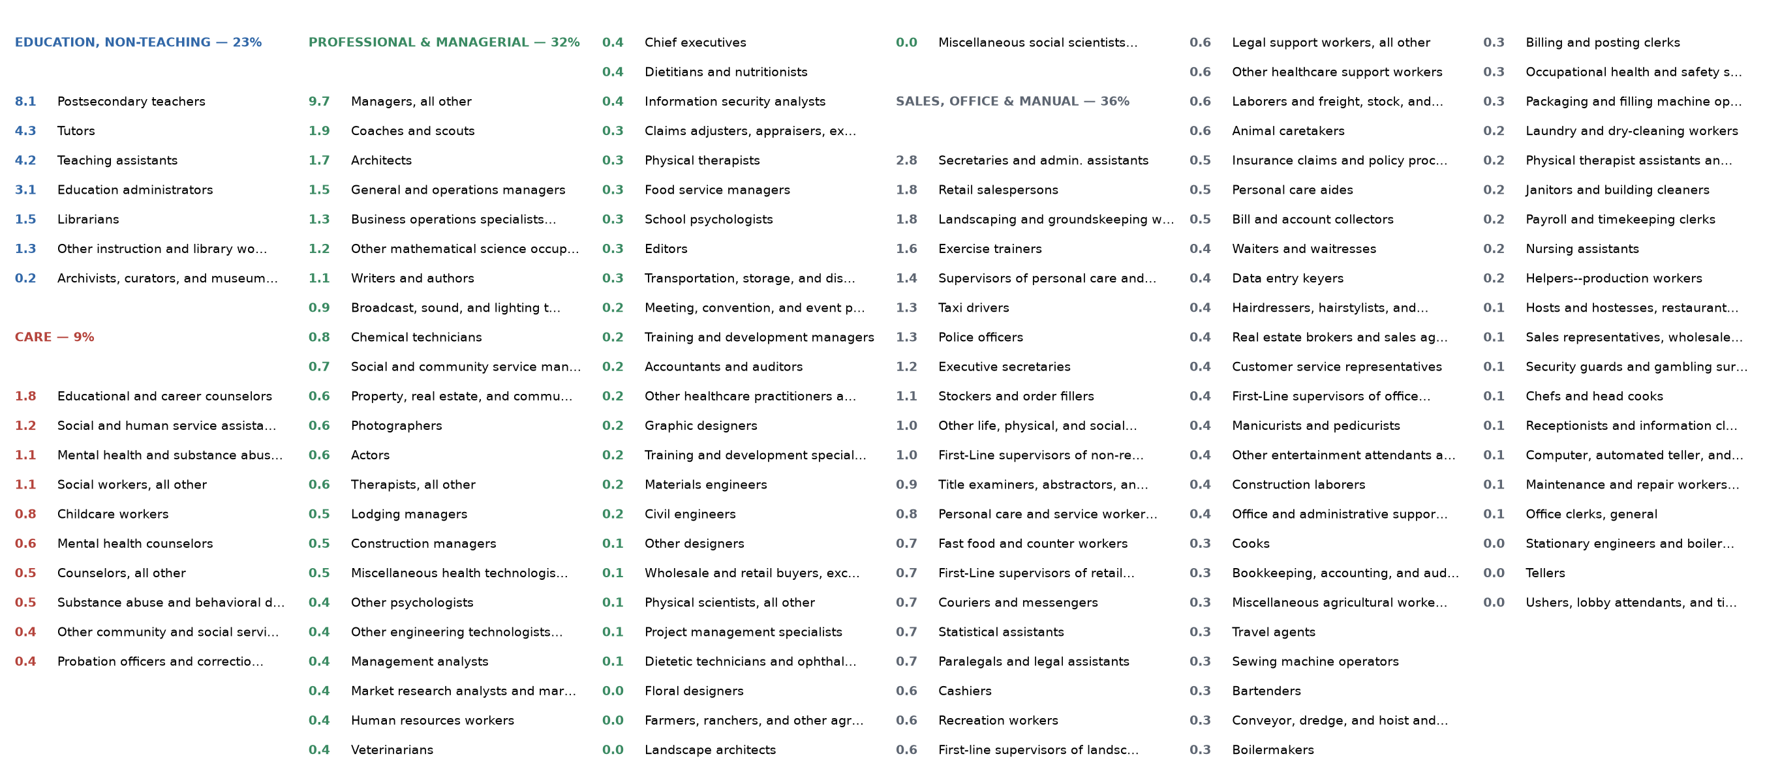
Figure 8. Where the Employed Leavers Go: Every Occupation, 2019–2024
Notes: Every destination occupation of the college-graduate leavers employed the March after the teaching year, in percent of employed leavers, pooled over teaching years 2019–2024 (2018 Census occupation codes); groups and colors as in Figure 7, with group totals in the headers. Shares below roughly 1 percent rest on one to three sample cases and are indicative only. Source: author’s calculations from March CPS supplements, survey years 2020–2025.

Slide 18
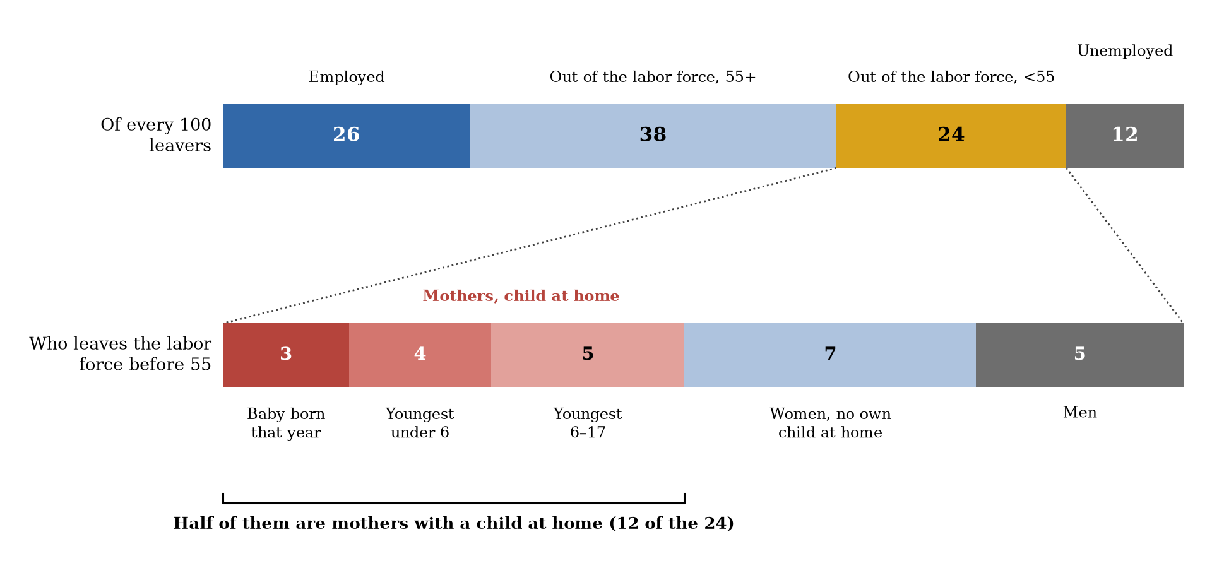
Figure 9. Who Leaves the Labor Force Before 55, 2015–2024
Notes: College-graduate leavers pooled over teaching years 2015–2024, ASEC weights. Top bar: labor force status at the March interview after the teaching year, per 100 leavers; “out of the labor force” is split at age 55. Bottom bar: the 24 who leave the labor force before 55, rescaled to sum to their total. Mothers are women with an own child in the household, split by the age of the youngest; “baby born that year” is an own child aged 0. Source: author’s calculations from March CPS supplements.

Slide 19
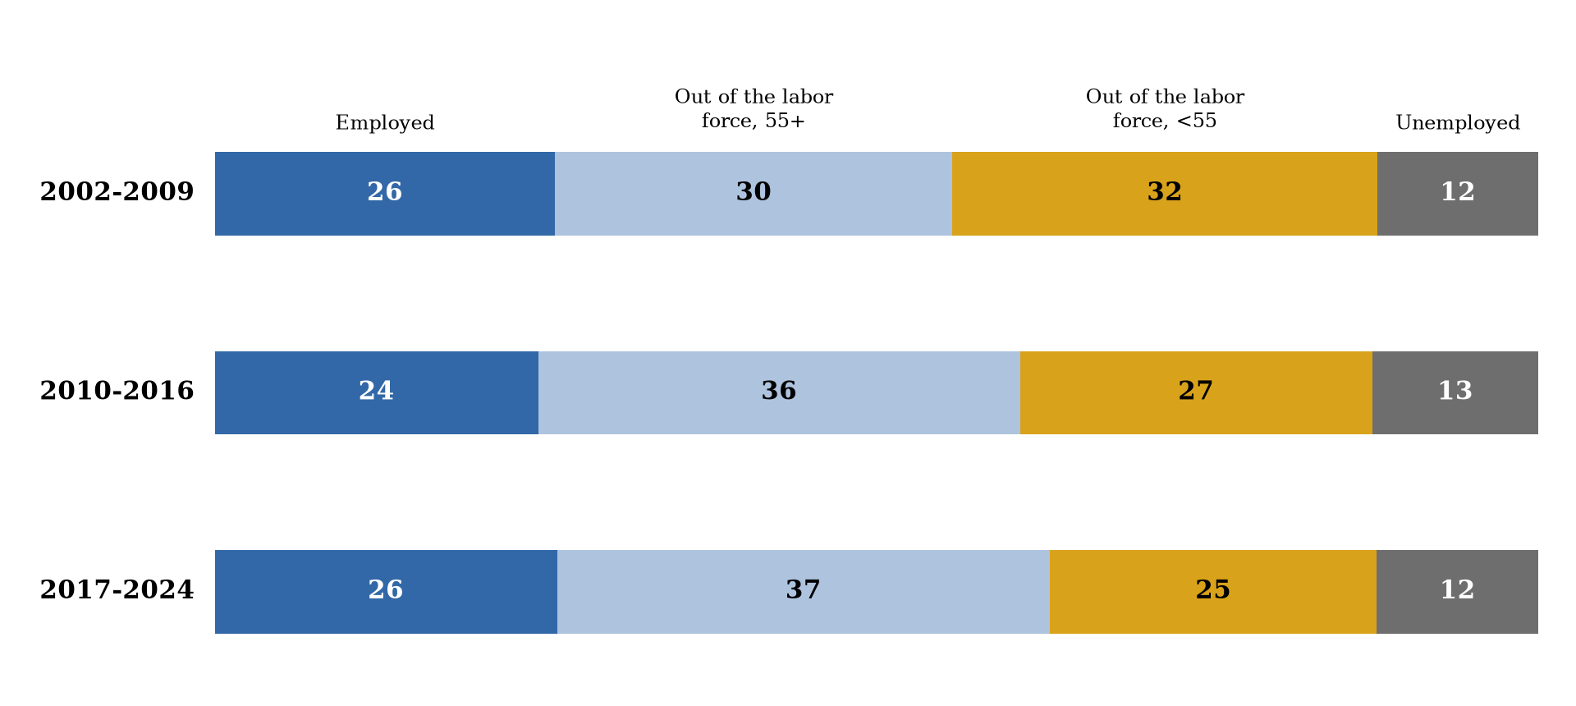
Figure 10. The Routes out of Teaching, 2002-2024
Notes: Labor force status of college-graduate leavers at the March interview after the teaching year, per 100 leavers (each bar sums to 100), pooled over the teaching years shown; “out of the labor force” is split at age 55. Source: author’s calculations from March CPS supplements.

Slide 20


Slide 21
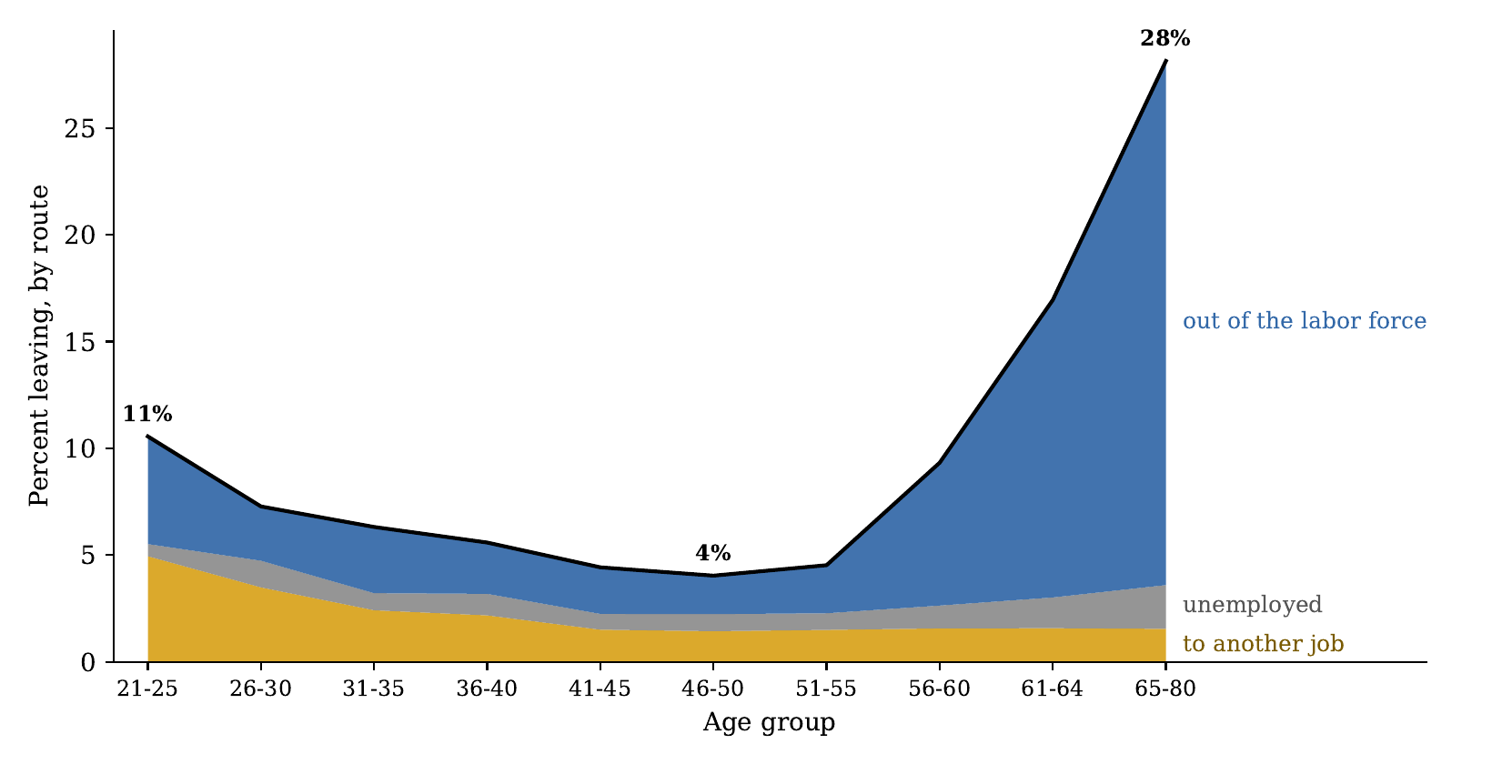
Figure 11. Leaving Teaching by Age and Route
Notes: College-graduate teachers pooled over calendar 2015–2024, ASEC weights; ten age groups. The black line is the total leaving rate; stacked areas decompose it into exits to another job, unemployment, and out of the labor force. Source: author’s calculations from March CPS supplements.

Slide 22
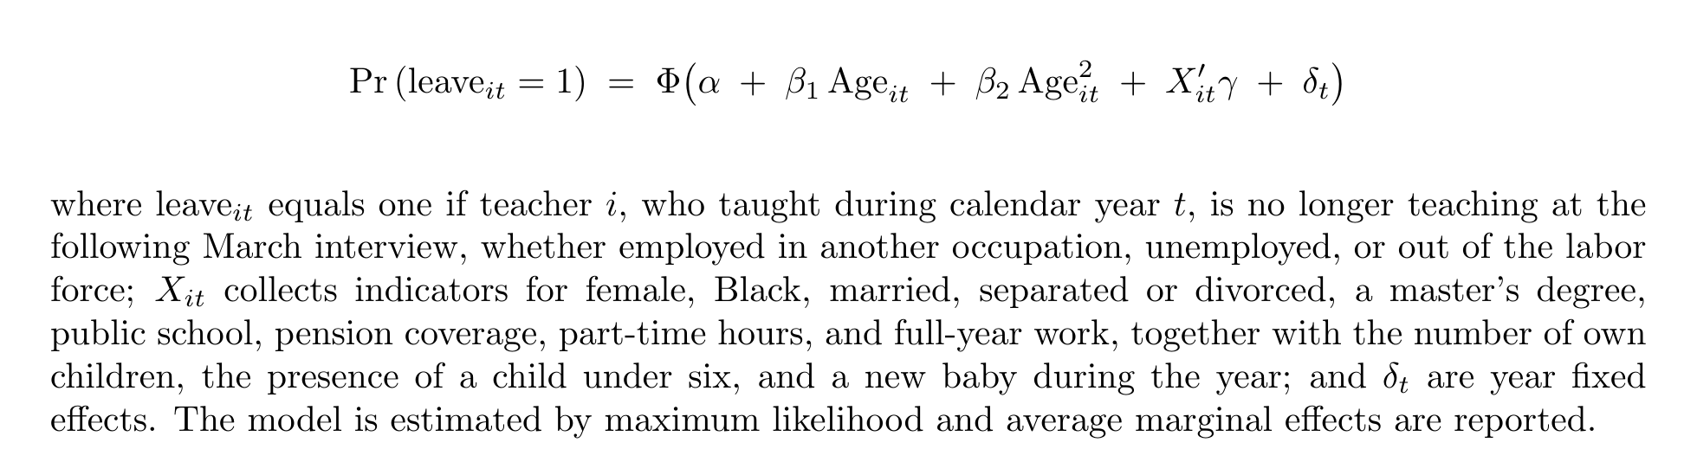
I estimate the probability of leaving given the observed characteristics using a probit :

Slide 23
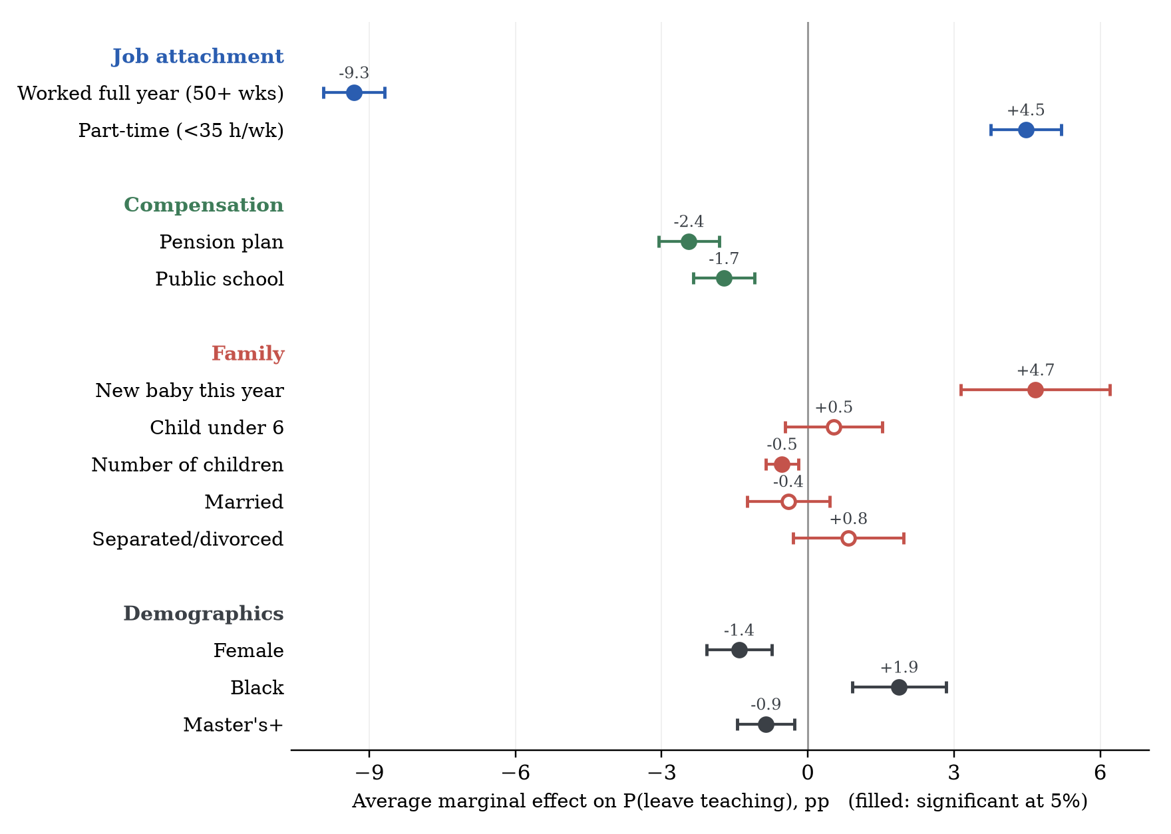
Figure 12. Average Marginal Effects on the Probability of Leaving Teaching
Notes: Average marginal effects (percentage points) on the probability of leaving teaching, from a probit on college-graduate teachers pooled over calendar 2015–2024 with year effects; whiskers are 95 percent confidence intervals; filled markers are significant at 5 percent. Age enters the model as a quadratic and its profile is shown in the next figure. “Worked full year” is 50+ weeks at the last-year job; “part-time” is under 35 weekly hours. n = 28,900. Source: author’s calculations from March CPS supplements. The regression have an n= 28,932

Slide 24
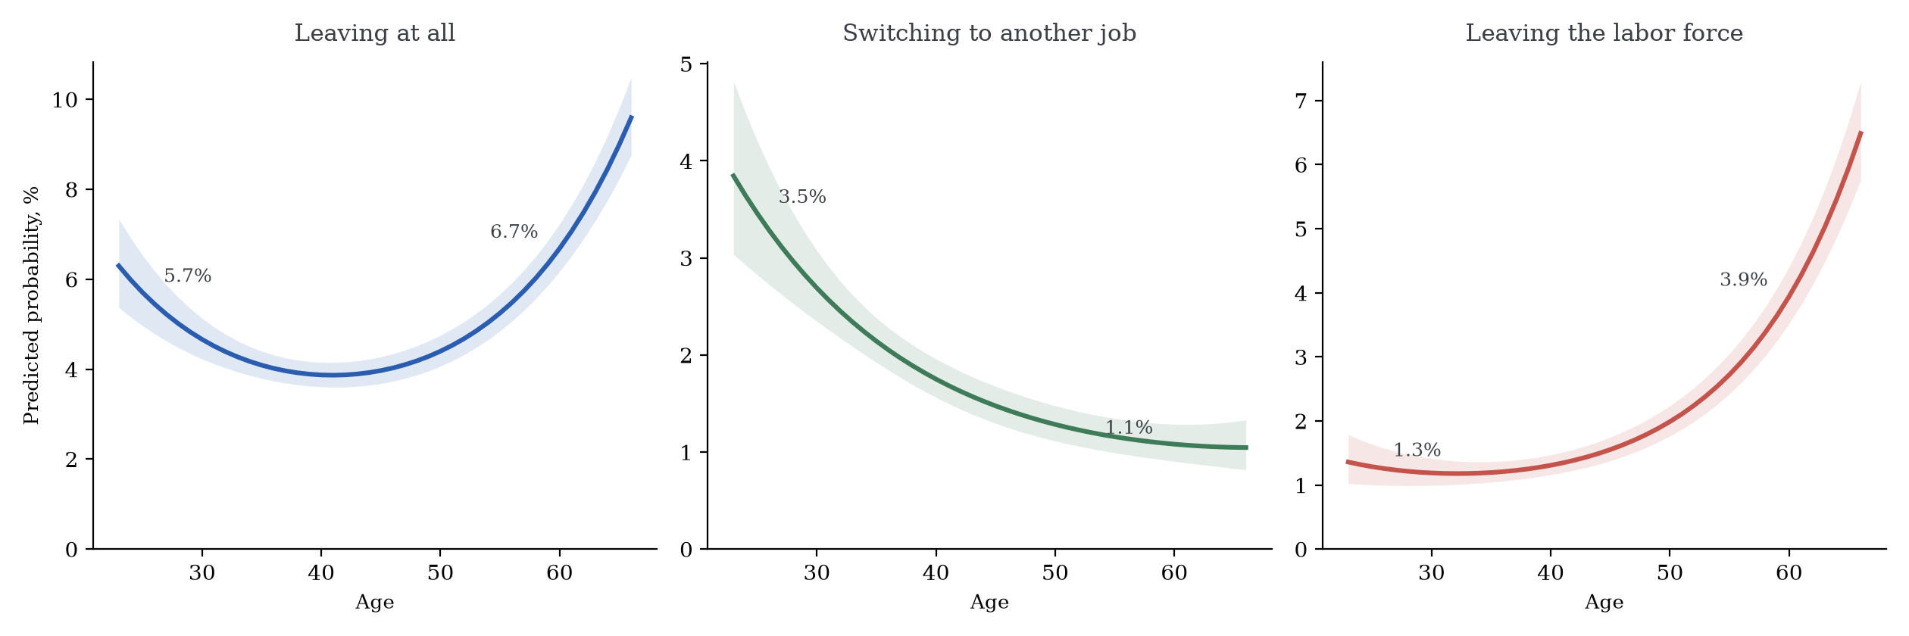
Figure 13. The Age Profile of Leaving Teaching
Notes: Each panel is the predicted probability by age from a separate probit on college-graduate teachers pooled over calendar 2015–2024 (age entered as a quadratic, other covariates at sample means, year effects). Left: leaving teaching by any route; center: moving to another occupation; right: leaving the labor force. Exits to unemployment are the residual route and are not shown, so the two right panels do not sum exactly to the left one. Shaded bands: 95 percent confidence intervals by the delta method. Source: author’s calculations from March CPS supplements.

Slide 25
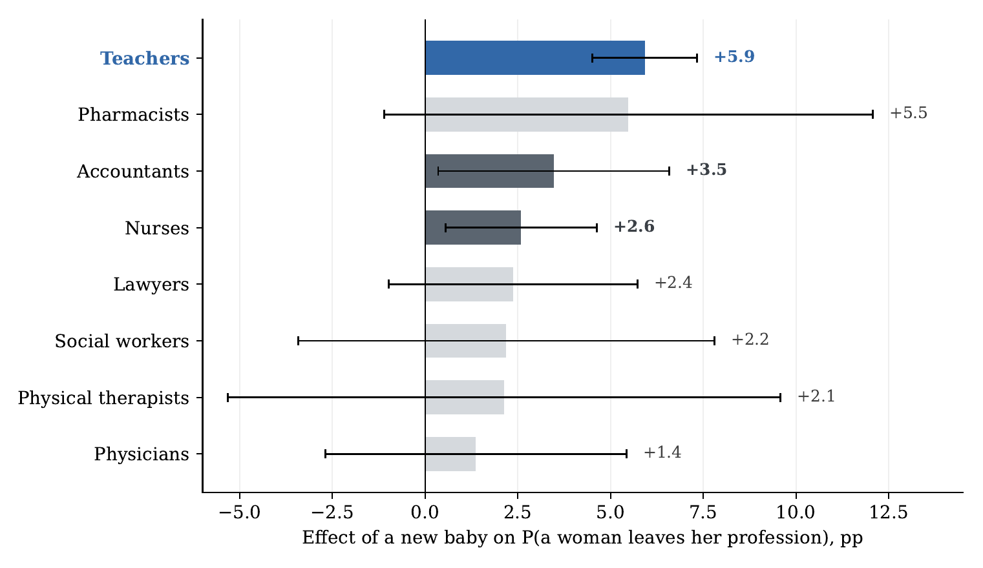
Figure 14. The Effect of a New Baby on Leaving, by Profession
Notes: Average marginal effect of a new baby (own child aged 0 in the household) on the probability that a woman leaves each profession, from profession-specific probits with age, age squared, marital status, education, and year effects; whiskers are 95 percent confidence intervals. Solid bars are significant at 5 percent; light bars are not. Samples pool 2010–2024. Source: author’s calculations from March CPS supplements.

Slide 26


Slide 27
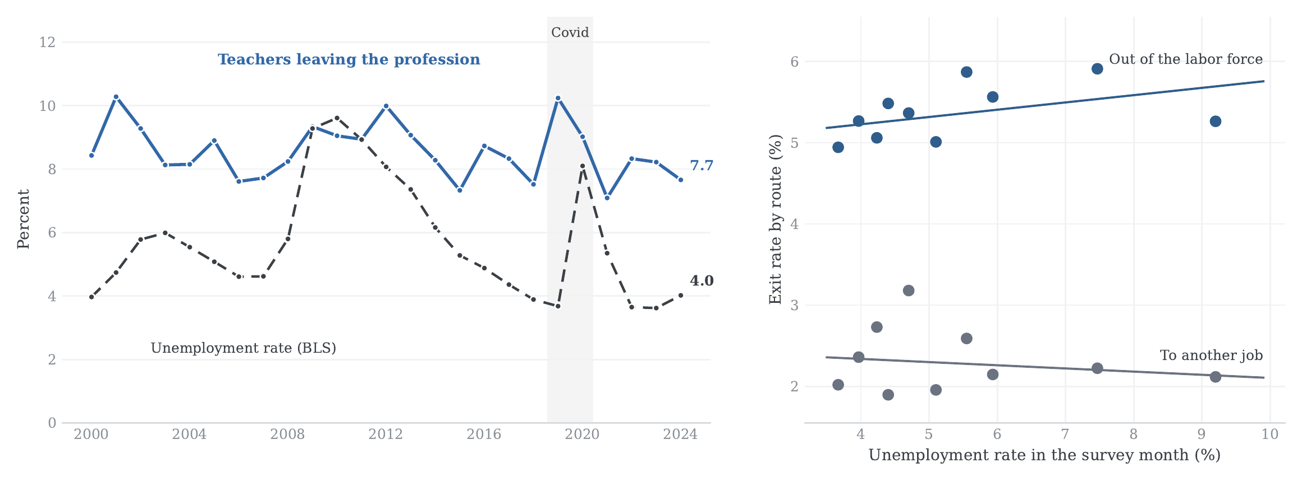
Figure 15. Leaving Teaching and the Unemployment Rate, 1997–2024
Notes: Left: the leaving series (annual, from calendar 2000) against the BLS national unemployment rate (annual average). Right: binned scatter (deciles of the unemployment rate in the survey month, March of t+1, when the exit is observed) of the two labor-market routes, with OLS fits on the underlying annual data; correlations are −0.16 (to another job) and +0.29 (out of the labor force). Unemployment: BLS via FRED (UNRATE). Source: author’s calculations from March CPS supplements.

Slide 28
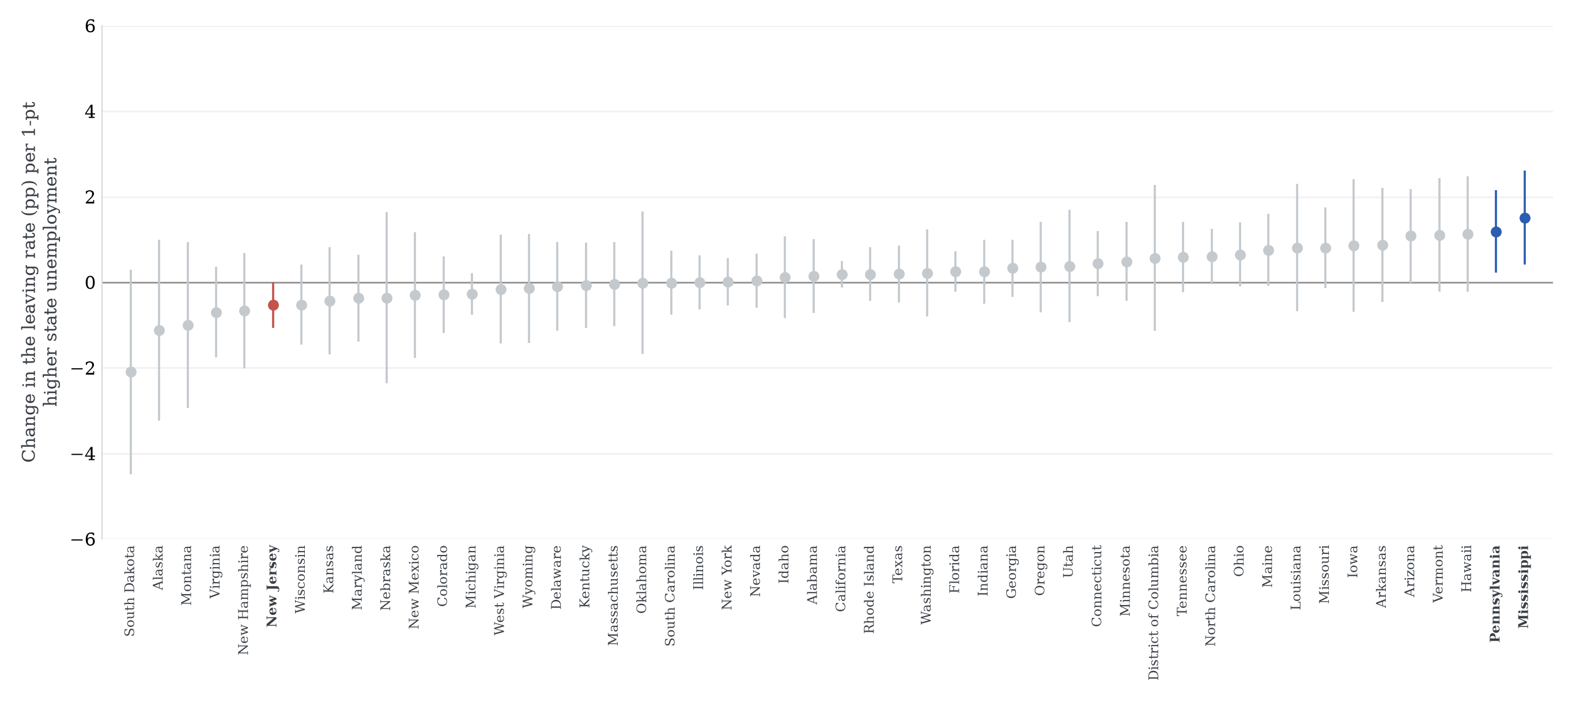
Figure 16. State-Level Cyclicality of Leaving Across the States
Notes: Slope of a weighted linear probability model of leaving on the state unemployment rate in the survey month, estimated separately by state on all years 1997–2024; whiskers are 95 percent intervals, heteroskedasticity-robust; bold and colored: significant at 5 percent. States with fewer than 400 teacher observations are excluded (North Dakota). Source: Author’s calculations from March CPS supplements and BLS LAUS.

Slide 29
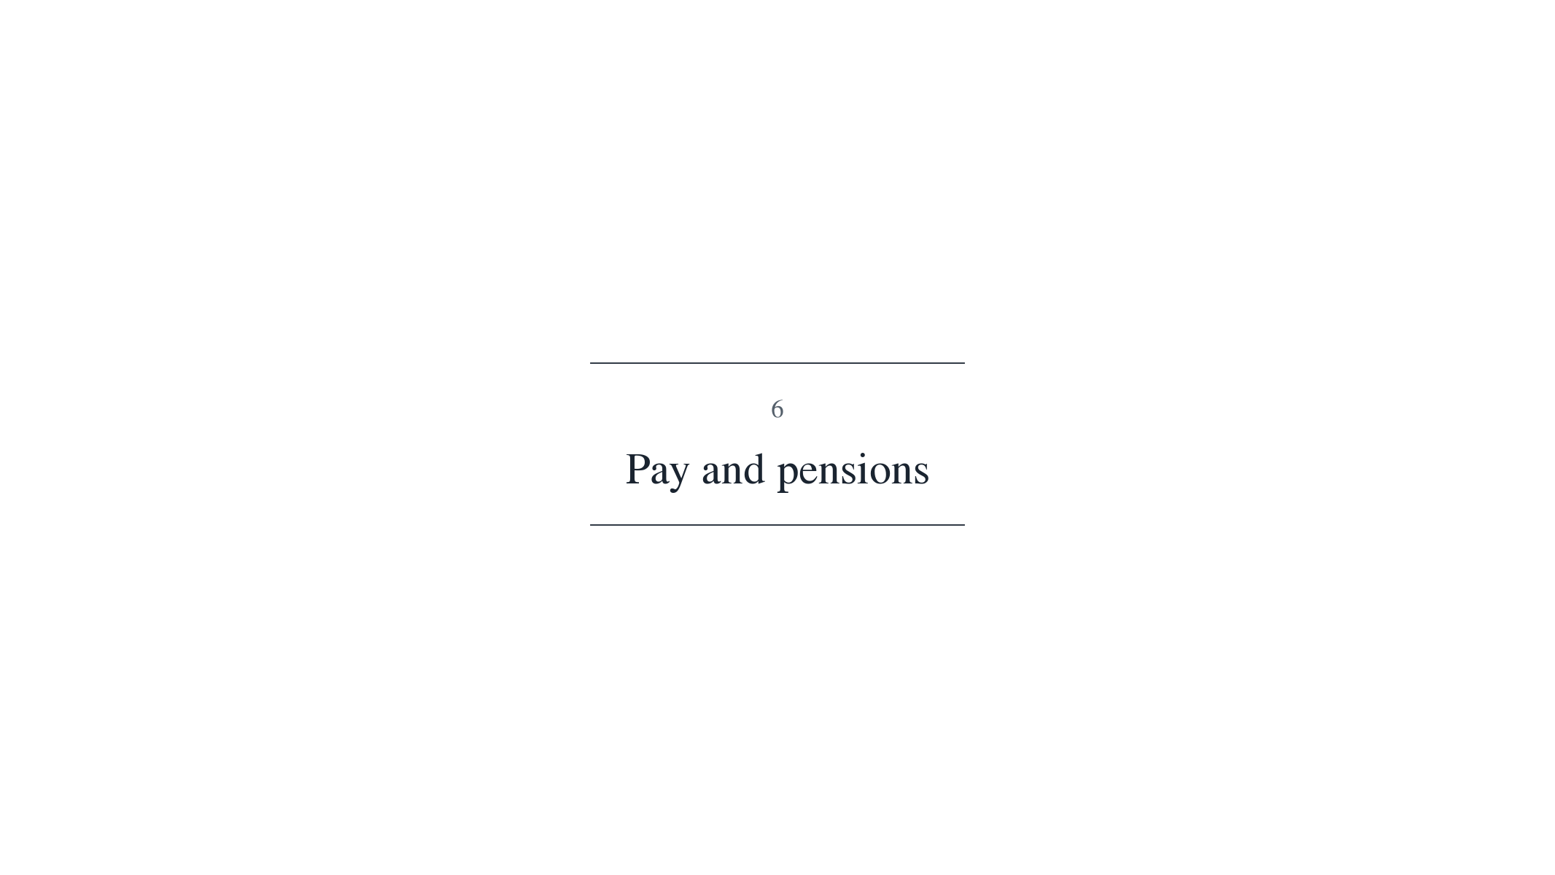

Slide 30
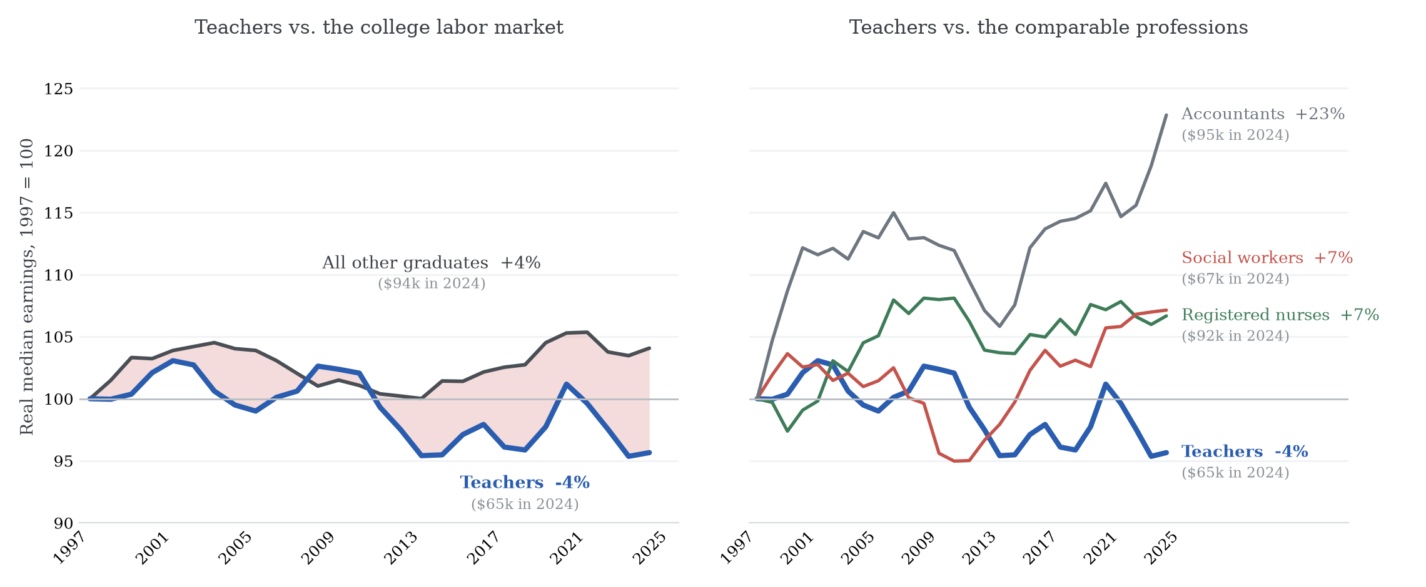
Figure 17. Real Earnings Growth by Profession since 1997
Notes: Weighted median annual wage and salary earnings of full-time, full-year college graduates aged 25–60, in each profession and overall, deflated to 2024 dollars with the CPI-U; the two windows pool survey years 2004–2014 and 2015–2025. Filled dots (with values): recent window. Source: author’s calculations from March CPS supplements; CPI: BLS via FRED.

Slide 31
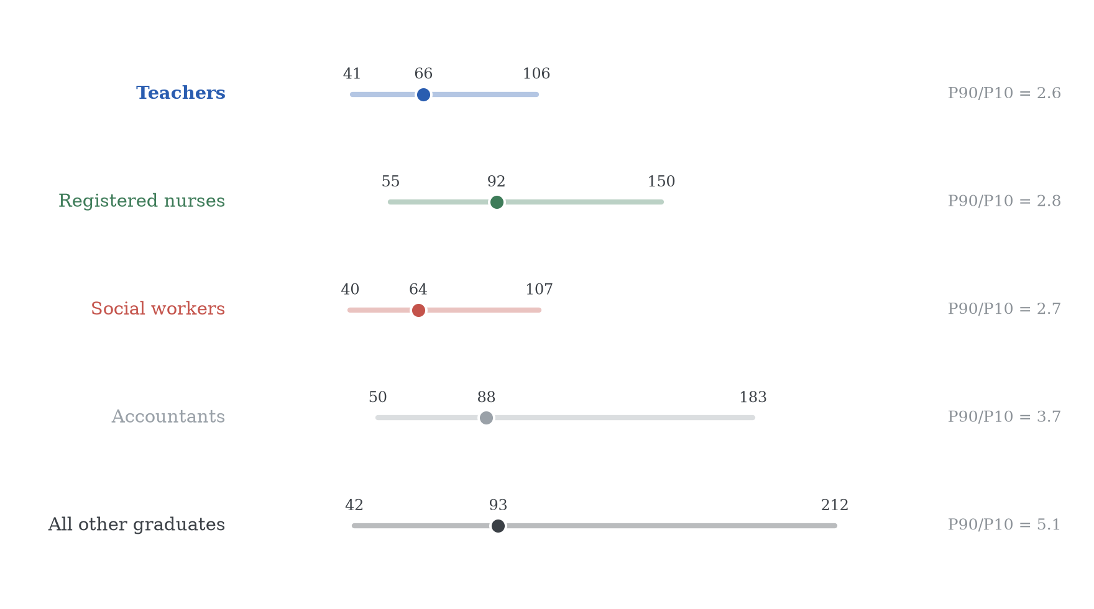
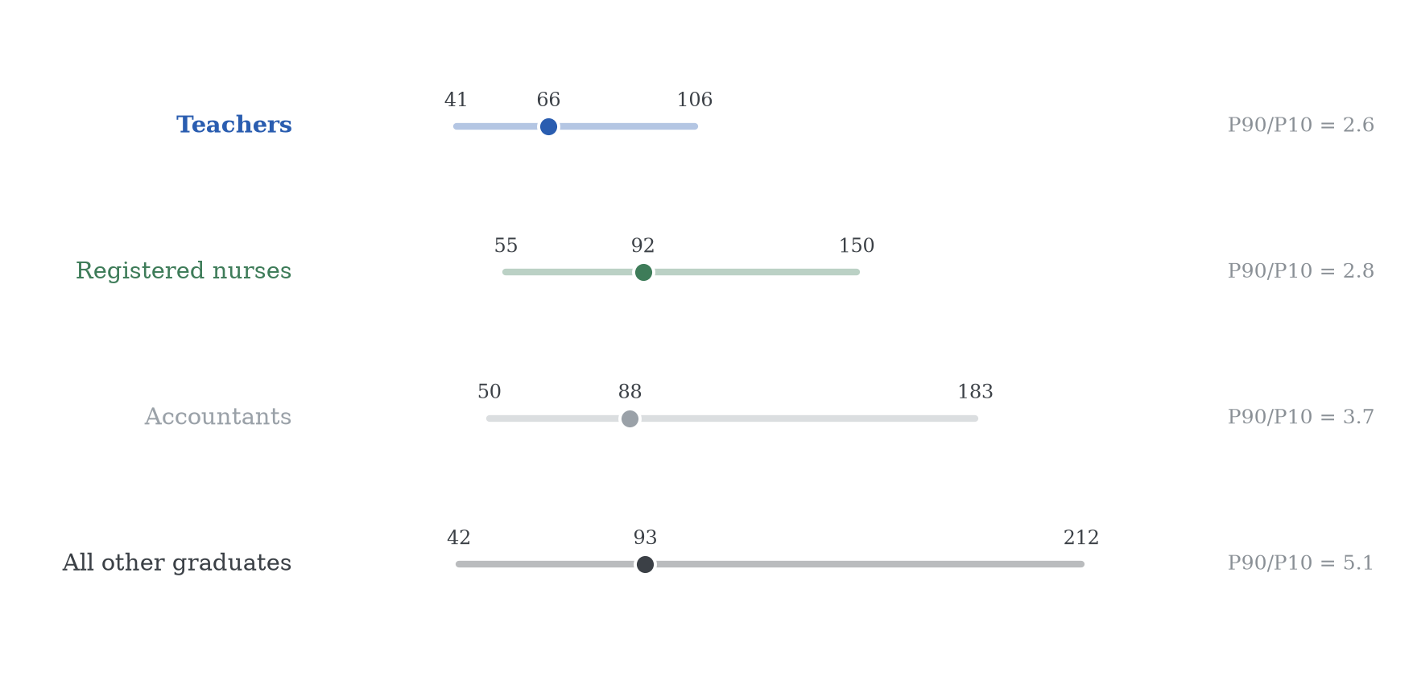
Figure 18. Pay Compression: Teachers and Comparable Professions
Notes: 10th percentile, median and 90th percentile of annual wage and salary earnings, full-time full-year workers with positive earnings, pooled over 2015–2024, in $1,000 of 2024 (CPI-U), ASEC weights. Registered nurses matched across the 2010 and 2018 occupation classifications. Source: author’s calculations from March CPS supplements.

Slide 32
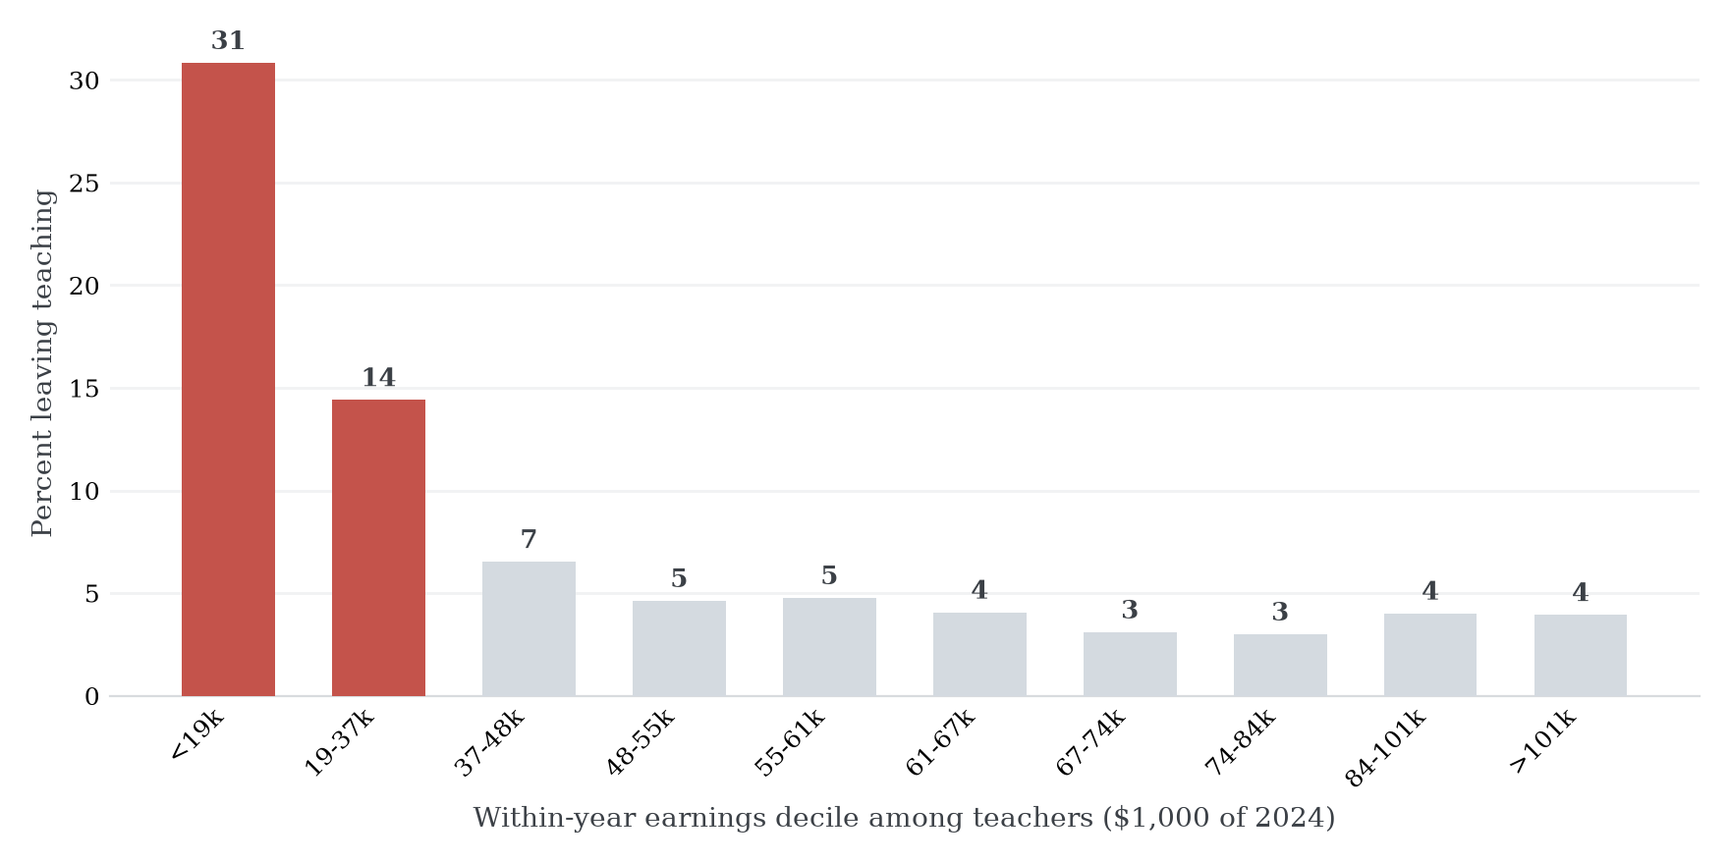
Figure 19. Who Leaves: the Leaving Rate by Position in the Teacher Pay Distribution
Notes: Annual leaving rate by within-year decile of annual wage and salary earnings among college-graduate teachers with positive earnings, pooled over teaching years 2015–2024, ASEC weights. The lowest deciles are dominated by part-year and part-time teaching jobs, so the gradient reflects job attachment as well as pay. Source: author’s calculations from March CPS supplements.

Slide 33
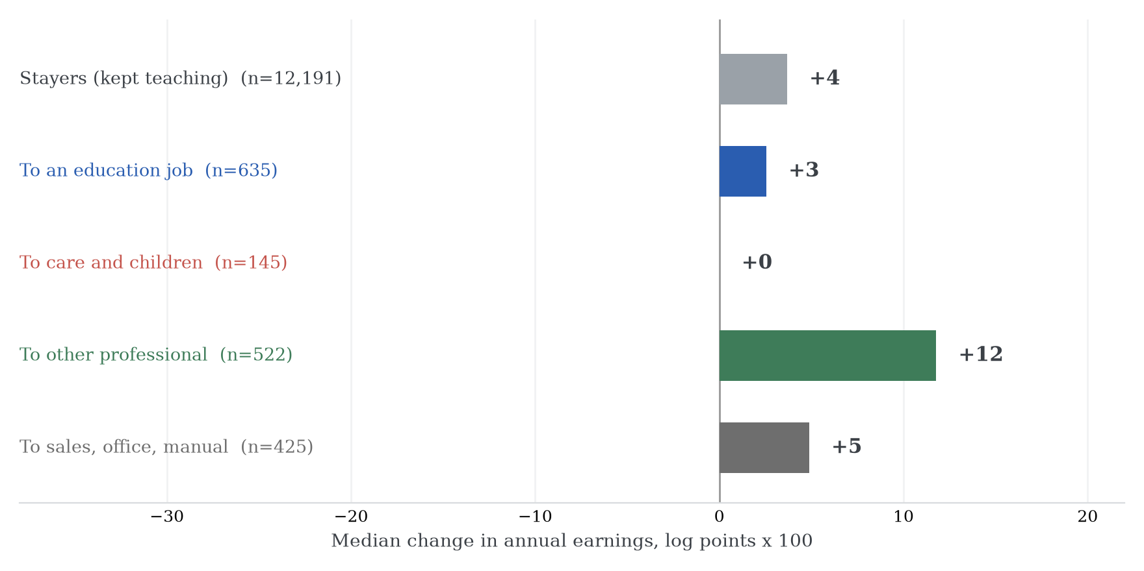
Figure 20. The Earnings Change of Leaving, by Destination
Notes: Median change in log annual earnings (×100) between the teaching year and the next, for teachers linked across consecutive March supplements (2011–2025) with consistent sex and age; positive earnings required in both years, so exits to nonemployment are excluded. Destination groups as in Figure 9. Source: author’s calculations from March CPS supplements.

Slide 34
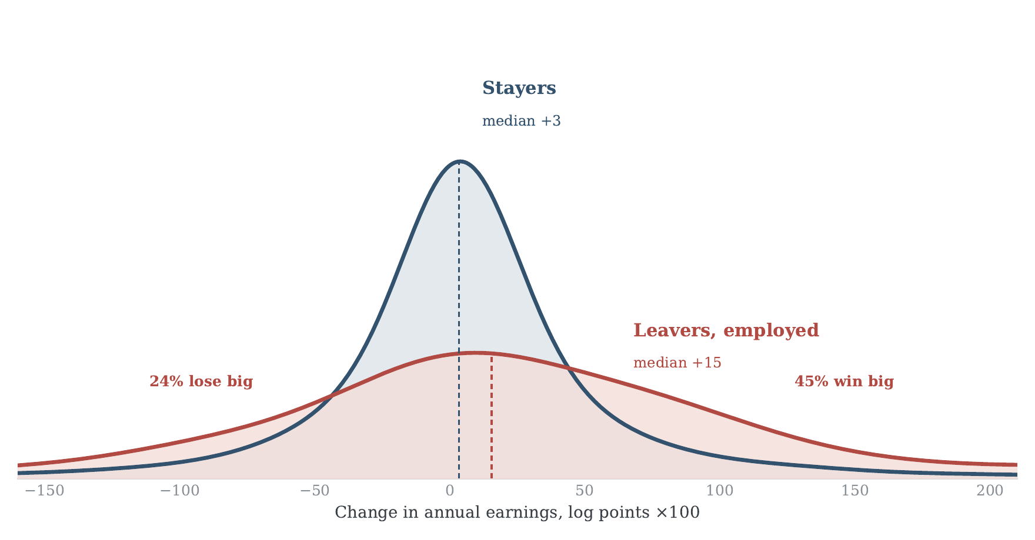
Figure 21. The Distribution of Earnings Changes: Stayers and Leavers
Notes: Kernel densities of the person-level change in annual wage and salary earnings (log points ×100) between the teaching year and the next, for teachers linked across consecutive supplements (rotation-group links, survey years 2011–2025; identity validated on sex and age). Navy: stayers (12,195 links; median +3). Red: leavers employed the following year (225 links; median +15). “Lose big”/“win big” denote changes beyond ±30 log points. The sample conditions on positive earnings in both years; 47 percent of all leavers report zero earnings the following year. Bandwidth 0.25. Source: author’s calculations from March CPS supplements.

Slide 35
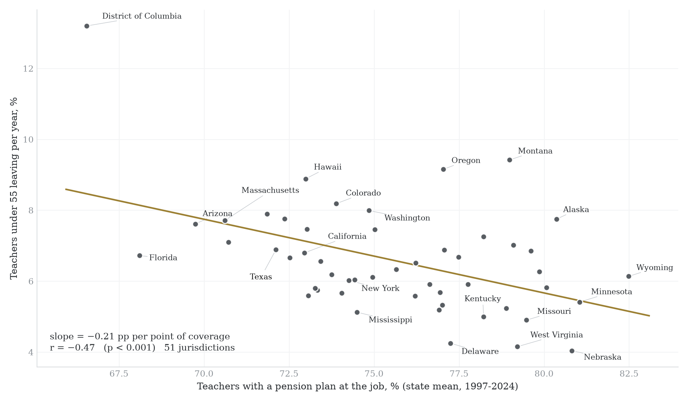
Figure 22. Pension Coverage and Leaving Teaching Across States
Notes: Each point is a state (plus DC), 1997–2024 means: horizontal axis, share of college-graduate teachers whose teaching-year job included a pension plan; vertical axis, annual leaving rate of teachers under 55, which strips most retirements. OLS fit: −0.21 pp per point of coverage, r = −0.47 (p < 0.001). A cross-sectional correlation, not a causal estimate; coverage also proxies for public-sector share and contract quality. Source: author’s calculations from March CPS supplements.

Slide 36
