Slide 1
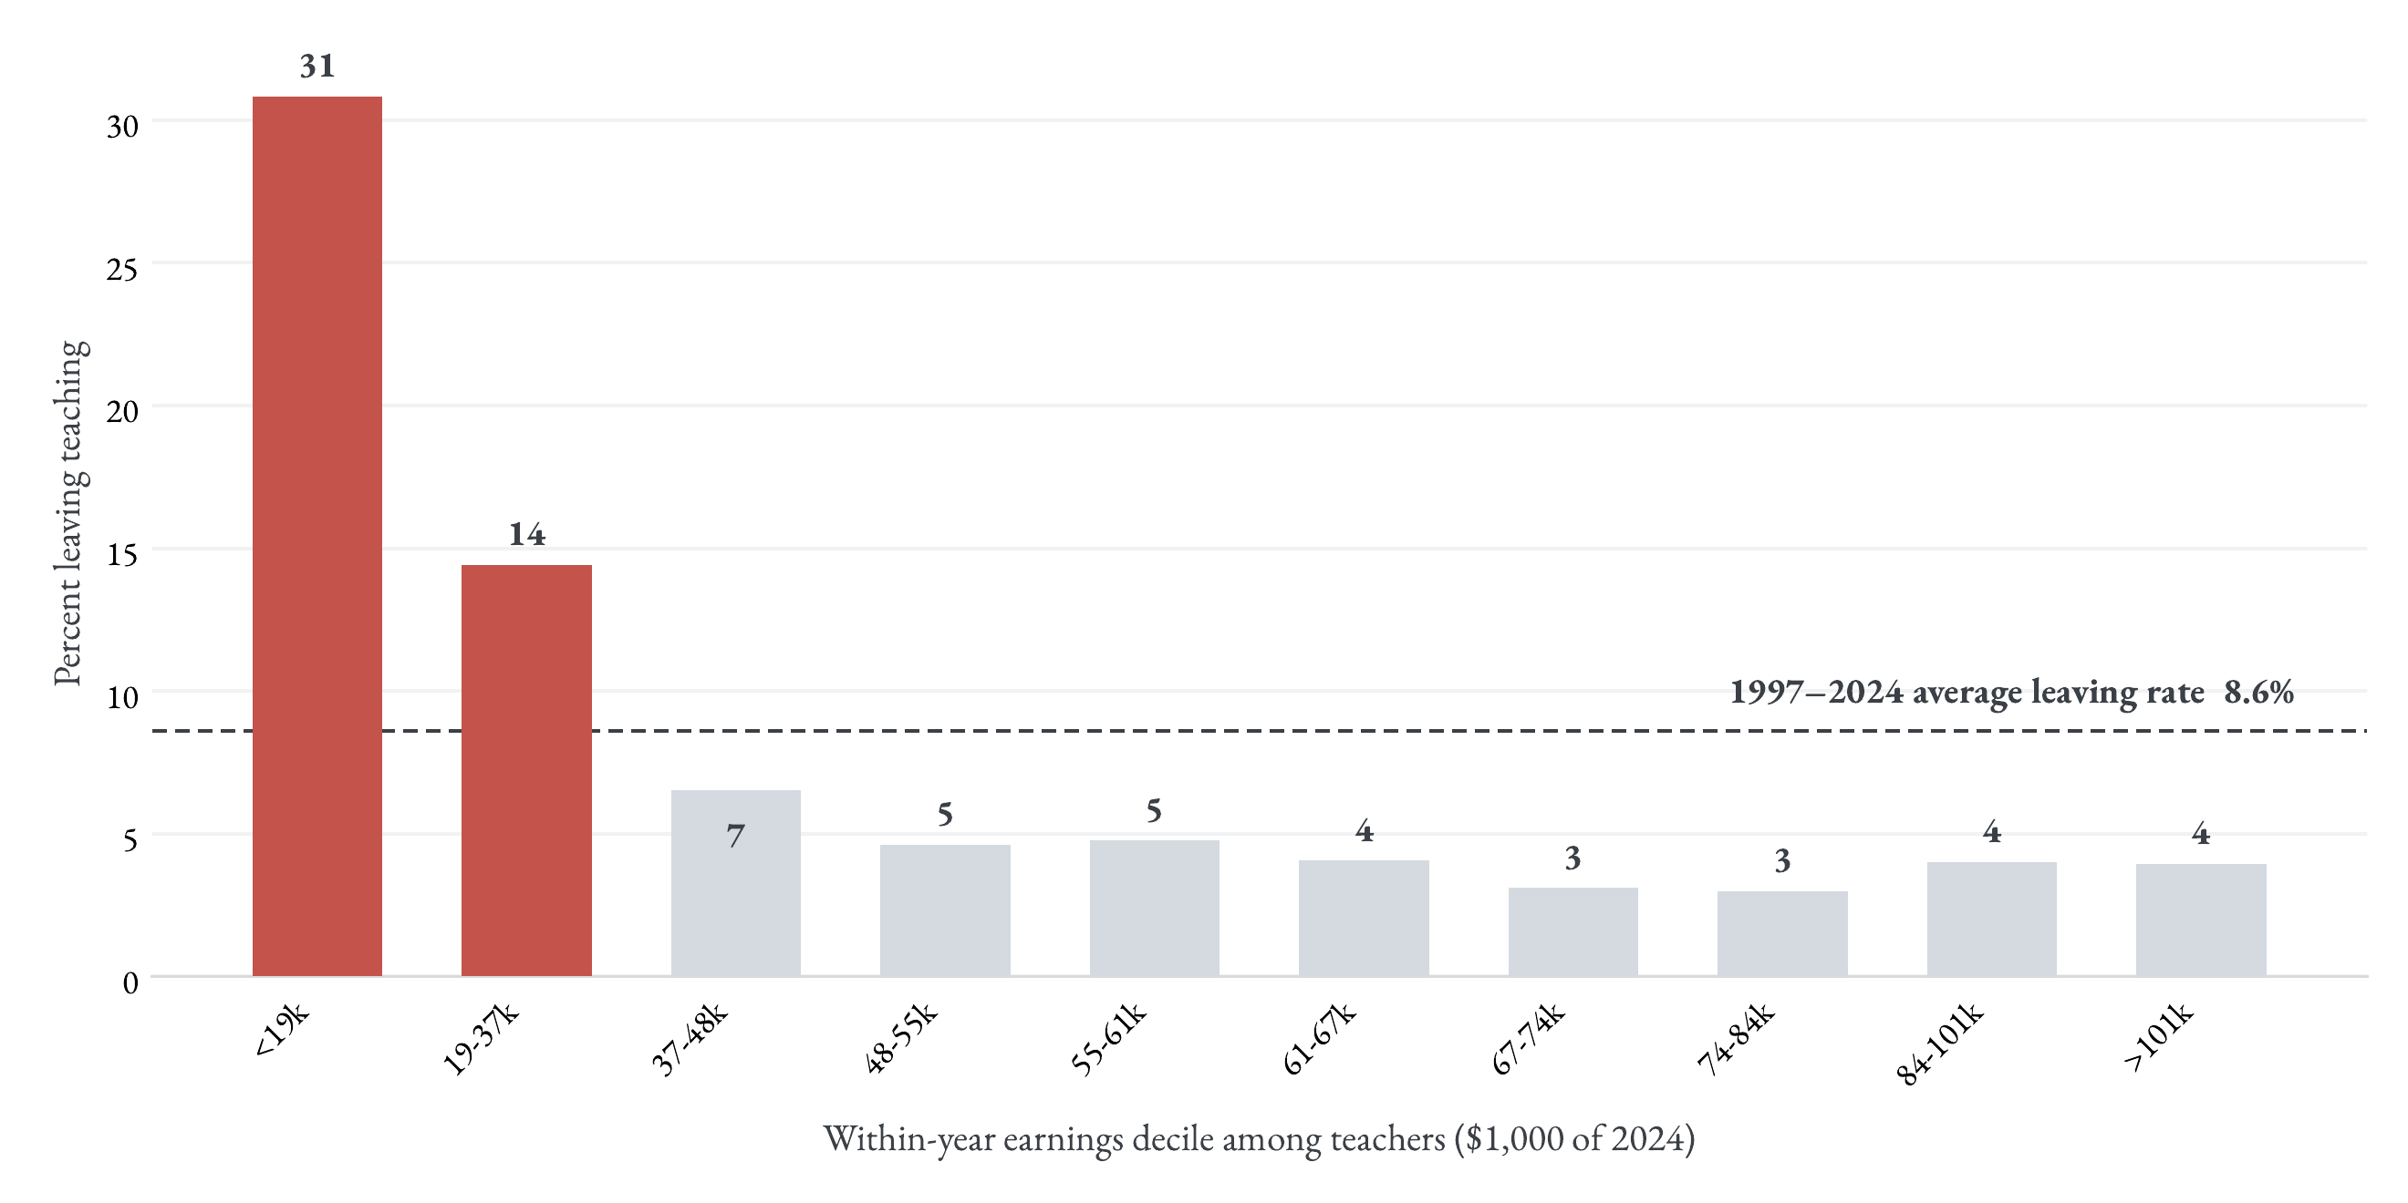
Leaving, by position in the teacher pay distribution
Key message. Leavers are concentrated in the bottom two deciles.
1

