Slide 1
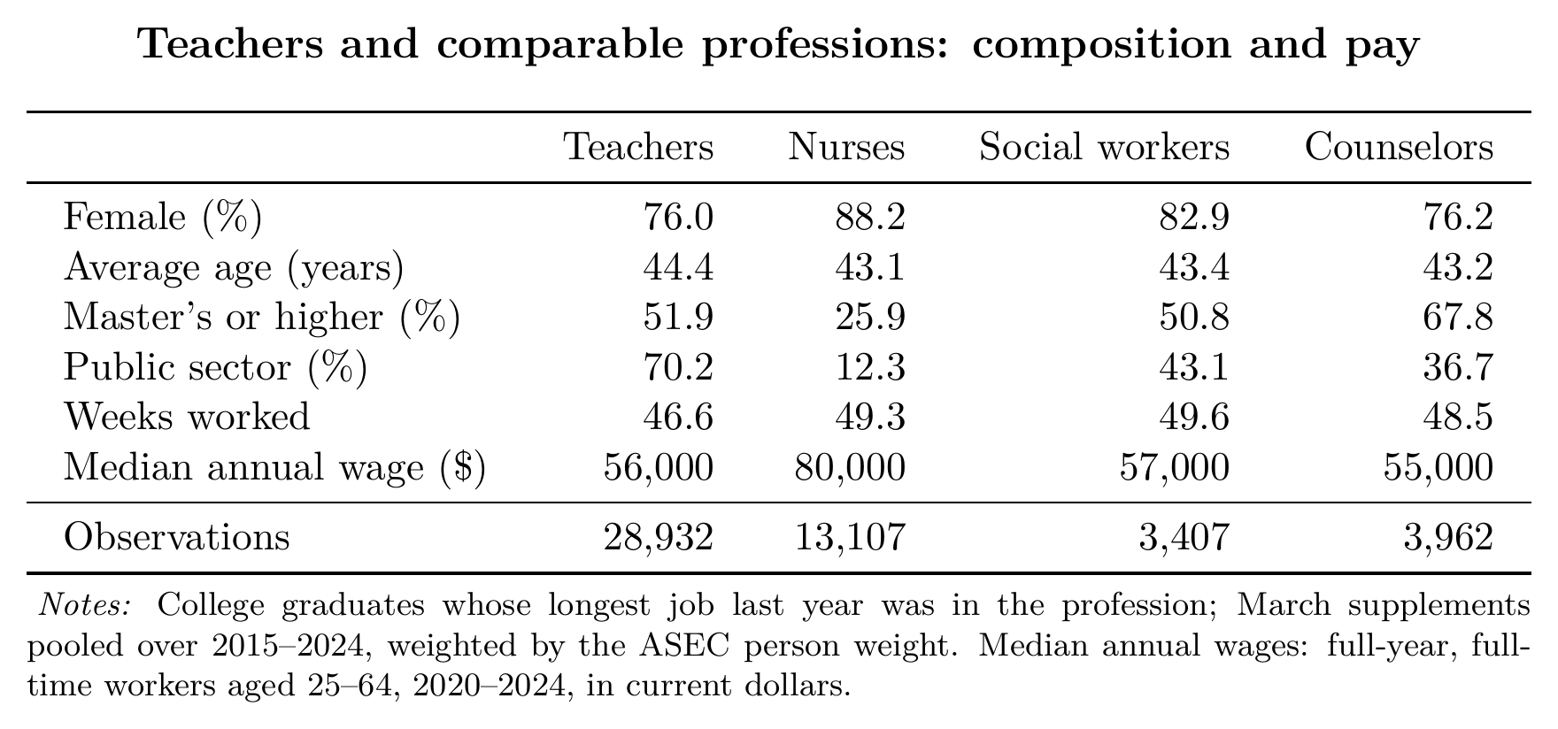
Comparable professions
Key message. Teaching is similar to nursing, social work and counseling in age and gender, and to social work in education and wages; the main difference is nurses' pay.
☞ Back

