Slide 1
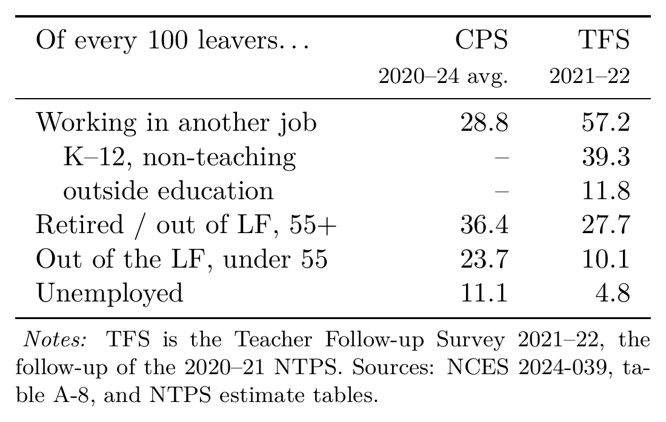
Our destinations vs the NCES follow-up survey
Why the columns differ
1. Who counts as a teacher. TFS follows regular classroom teachers of public schools, sampled in schools; we cover public and private, and anyone whose longest job was teaching.
2. What counts as working. 39 of the TFS's 57 employed leavers hold non-teaching K–12 jobs — they left the classroom, not the school system. Our 28.8 means leaving the occupation.
3. Who is reachable. A school-based sample under-represents weakly attached teachers, exactly those who exit to non-participation; a household survey catches them.
4. The window. Our column averages 2020–2024; the TFS is the single year 2021–22.
☞ back

Slide 2
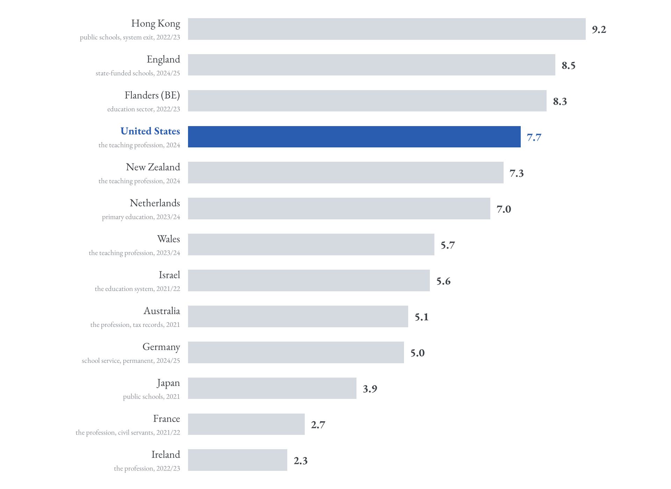
Teacher attrition across countries
☞ international
(copy this button to the main deck)
Annual share of teachers leaving, latest comparable national figure (2021 or later), retirements included. Sources: OECD Education at a Glance 2025 (Table D8.4) and national statistical agencies; the United States is our CPS estimate — Education at a Glance reports no current US figure.
☞ back

