Slide 1








The ELPI: Chile’s national child cohort
Encuesta Longitudinal de Primera Infancia — a birth-cohort panel following the same children from infancy to adolescence: caregiver interviews plus standardized child assessments administered in the home. Public microdata and codebooks (Ministry of Social Development).
15,175
4 waves
0–4 → 14–18
folio
children enrolled in 2010; representative of the 2006–09 birth cohorts
2010 · 2012 · 2017 · 2024, plus refresh samples in 2012 and 2017
ages covered — the same children from cradle to adolescence
child-level ID links every wave; comuna strata & longitudinal weights
WHAT IT MEASURES — EVERY DOMAIN OF THE CHILD’S LIFE
Cognitive skills
Non-cognitive skills
Mental health & risk (14–18)
Health & growth
TVIP/Peabody vocabulary in all 4 waves · EEDP & TADI infant development · Battelle screening · Woodcock-Muñoz · digit span & Hearts-and-Flowers (executive function)
CBCL socio-emotional problem-behavior scales in every wave (internalizing & externalizing syndromes) · ASQ:SE screening (2010–17)
PHQ-2 depression & GAD-2 anxiety screens · 10-item ACEs battery · smoking, alcohol & drug use · self-reported GPA (2024)
Birth weight & gestational age · measured height/weight with WHO z-scores (2010–17) · maternal smoking in pregnancy · breastfeeding
Education & childcare
Family structure
Parenting & home environment
Caregiver & household
Childcare & preschool histories from birth · enrollment, grade & school type in every wave · maternal schooling
Full household roster each wave · marriage, divorce & separation — incl. child’s age when a parent left the home · father presence
HOME inventory (observed 2012 / reported 2017) · discipline & parenting practices · parental involvement & self-efficacy
Maternal depression (EPDS, CES-D) & parental stress (PSI) · work histories by child’s age · income · Chile Crece Contigo · 27-F earthquake module (2012)
Source: ELPI public microdata & codebooks, waves 2010–2024 — observatorio.ministeriodesarrollosocial.gob.cl (instrument coverage by wave in parentheses).
Notes:
ELPI overview: survey design facts on top; eight variable domains with instruments and wave coverage. All coverage claims verified against the microdata and codebooks in the TALIS repo.

Slide 2
What we ask the child — verbatim
Standardized tests administered by a trained evaluator — and, from 2024, a sensitive module the adolescent answers alone. Quotes are verbatim from the official microdata (variable labels), sic.
THE EVALUATOR, WITH THE CHILD
TVIP · all four waves
“Juego del Corazón / de la Flor” · 2017
Backward digit span · 2012–17
The child hears a word and points to 1 of 4 pictures — receptive vocabulary (Peabody, Hispanic norms).
Hearts & Flowers: computerized inhibition task — % correct and reaction times (executive function).
The child repeats digit strings in reverse order — working memory.
THE ADOLESCENT ANSWERS ALONE — SELF-COMPLETED MODULE, 2024 (AGES 14–18)
“¿Te has sentido bajoneado(a), deprimido(a), irritable o desesperanzado(a)?”
“¿Te has sentido muy nervioso(a), angustiado(a) o con los nervios de punta?”
d4_1 · PHQ-2, depression screen
d4_3 · GAD-2, anxiety screen
“Ha presenciado peleas o amenazas entre los integrantes del hogar”
“Vivió o vive con personas que tenían un problema de consumo excesivo de alcohol, drogas o medicinas”
aces_2 · adverse childhood experiences (ACEs)
aces_10 · adverse childhood experiences (ACEs)
“¿Has fumado cigarrillos de tabaco alguna vez en los últimos 12 meses?”
“¿Cuántos días consumiste alcohol la semana pasada?”
g11 · tobacco use
g12_frec · alcohol use
“¿En los últimos 12 meses has recibido llamadas al celular insultantes o amenazantes?”
“¿Qué promedio de notas tuviste el año pasado?”
g2_3 · cyberbullying / victimization
e3_asiste · self-reported GPA (Chilean 1–7 scale)
AND ALREADY AT AGES 8–12 — THE CHILD SELF-REPORTS (2017)
“¿Piensas que en tu colegio hay estudiantes que fuman cigarrillos…?”
“En la última semana, ¿tú y alguien de tu familia leyeron juntos libros…?”
d13 · child questionnaire, risk environment at school
b17 · child questionnaire, family reading
Verbatim variable labels from the ELPI public microdata; 2010–12 files store labels truncated at 80 characters (ellipses). Bracketed terms replace questionnaire placeholders.
Notes:
Verbatim questions, child side: evaluator-administered tests (TVIP, Hearts & Flowers, digit span), the 2024 self-completed adolescent module (PHQ-2 d4_1, GAD-2 d4_3, ACEs aces_2/aces_10, tobacco g11, alcohol g12_frec, cyberbullying g2_3, GPA e3_asiste), and 2017 child self-reports (d13, b17).

Slide 3

What we ask the caregiver — verbatim
The main caregiver (usually the mother) is interviewed at home in every wave — retrospective pregnancy modules, screened mental-health scales, observed parenting, income, programs, and a dedicated 27-F module in 2012.
Family structure & separation
Parenting — reported and observed
“¿Qué edad tenía [el/la adolescente] cuando la madre dejó de vivir con él(ella)?”
“Le dio una palmada o cachetada en alguna parte del cuerpo”
pc4_6 · 2024 · discipline in the last month (also 2012 f20c–g)
m1 · 2024 (also 2017; asked for mother and father) · separation timing
“¿Cree usted que para criar o educar correctamente a un adolescente, se le debe castigar físicamente?”
Pregnancy & birth (retrospective)
pc5 · 2024 · attitudes toward corporal punishment
“Durante el embarazo del(de la) niño(a) seleccionado(a), ¿fumó cigarrillos?”
“La Madre o tutora lee historias al(a la) niño(a), al menos tres veces a la…”
b8 · 2012 (also 2010 g7a) · smoking in pregnancy
h11 · 2010 · HOME inventory — marked by the evaluator observing the home
“¿El embarazo del(de la) niño(a) seleccionado(a) fue planificado?”
The 27-F earthquake module (2012)
b36 · 2012 · planned pregnancy
Caregiver mental health (screened scales)
“Producto del terremoto/tsunami, ¿la vivienda que habitaba el(la) niño(a)…?”
h3 · housing damage
“Me sentí deprimido/a — Sentí que todo lo que hacía me costaba un gran esfuerzo”
“Recuerdos traumáticos del terremoto — stress/angustia/ansiedad — miedo/pánico”
cesd_p1d / cesd_p1e · CES-D-10 depression, 2017 & 2024
h4_2–h4_5 · post-quake symptom checklist
“Ser cuidador/a me pone tenso/a y ansioso/a”
“¿Usted consultó a un psicólogo o psiquiatra a causa de estos síntomas?”
pscs_p16 · parental self-efficacy scale (PSCS), 2017 & 2024
h5 · mental-health care take-up after 27-F
“EPDS postpartum depression score — incl. a ‘Pensamientos Suicidas’ flag”
Programs & the home
epds_pb / epds_ps · 2012 · plus Parental Stress Index (PSI) 2012–2024
Household economy
“¿Conoce o ha escuchado hablar del programa Chile Crece Contigo?”
f27 · 2012 · program awareness & receipt (f29: materials received)
“En [mes pasado], ¿cuál fue el ingreso de [nombre] proveniente de su o sus trabajos, ocupación o actividad?”
“¿Más o menos cuántos libros infantiles o juveniles tiene en su casa?”
home1 · 2024 · HOME, books at home
y1 · 2024 · income module y1–y5, per household member
Verbatim variable labels from the ELPI public microdata; 2010–12 files store labels truncated at 80 characters (ellipses). Bracketed terms replace questionnaire placeholders (%nombre%, %mes pasado%).
Notes:
Verbatim questions, caregiver side: separation timing (m1/p1), pregnancy retrospectives (b8, b36), mental-health scales (CES-D, PSCS, EPDS incl. suicidal-thoughts flag, PSI), discipline reported (pc4, pc5) and HOME observed (h11), the 2012 earthquake module (h3, h4, h5), income (y1) and Chile Crece Contigo (f27/f29).

Slide 4
Four waves, one generation: sampling & attrition
The original 2010 cohort is re-interviewed in every wave; refresh samples added in 2012 and 2017 were not re-fielded in 2024.
17,307 interviewed
34.1%
16,033 interviewed
15,175
+3,135
+4,935
cumulative attrition of the original cohort over 14 years — 65.9% of the 2010 infants are still in the panel as adolescents
12,898
+2,142
10,003
10,230
10,003
85.0%
79.3%
97.8%
adolescents aged 14–18 in 2024 — every one of them enrolled as an infant in 2010
retained
retained
retained
Clean 14-year panel: wave 4 re-fielded only the original cohort. Balanced panel present in all four waves: 7,012 children.
2010
2012
2017–18
2024
Wave 1 · ages 0–4
Wave 2 · ages 2–6
Wave 3 · ages 8–12
Wave 4 · ages 14–18
Infancy
Early childhood
Middle childhood
Adolescence
Original 2010 cohort — followed in every wave
Refresh samples — 2012: +3,135 born 2010–11; 2017: +2,142 of them re-interviewed and +4,935 born 2015–17; none re-fielded in 2024
Counts: children interviewed per wave, by sample of origin (own tabulations from ELPI microdata via the child ID; wave-3 evaluation sample: 15,827). Attrition figure consistent with the ELPI cohort profile.
Notes:
Bars to scale. Blue = original 2010 cohort (15,175 -> 12,898 -> 10,230 -> 10,003; 85.0% / 79.3% / 97.8% between-wave retention; 34.1% cumulative attrition). Gray = refresh samples (2012: +3,135; 2017: +2,142 re-interviewed + 4,935 new), not followed in 2024.

Slide 5
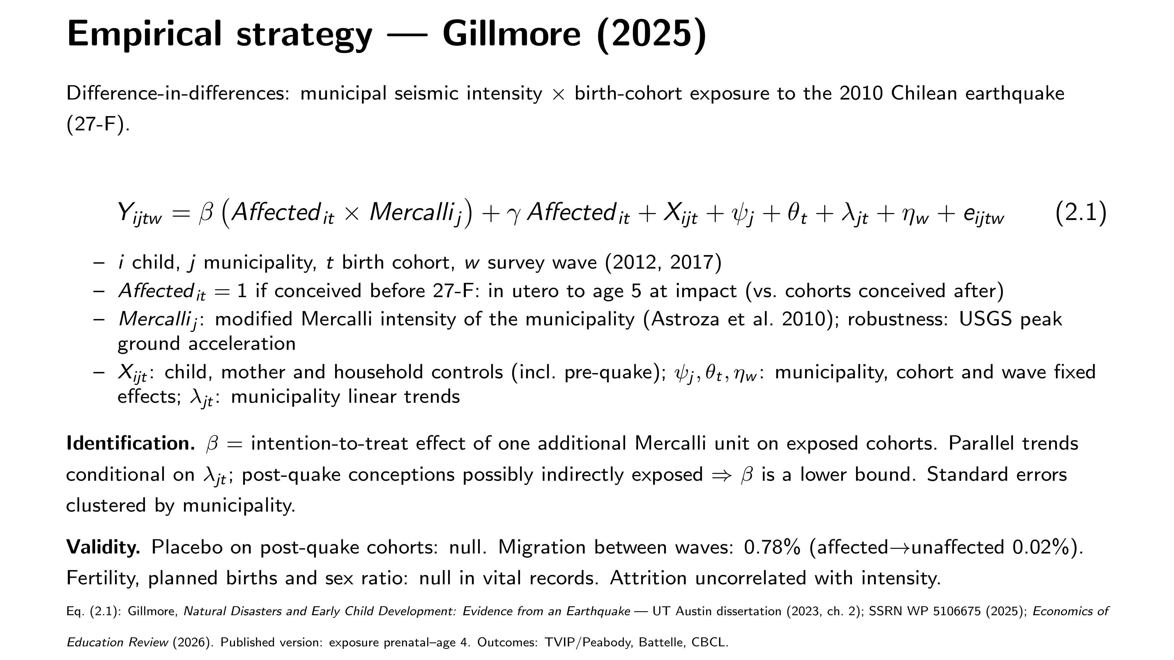
Notes:
Specification slide typeset in LaTeX (Beamer, Computer Modern) and embedded as a full-bleed image; source gillmore_spec.tex in the repo. Eq. (2.1) verbatim from the dissertation chapter; identification incl. lower-bound argument; validity checks.

