Slide 1

Notes:
Welcome. Title slide uses the conference card. Hook: 'This talk is about refusing a tradeoff.'

Slide 2
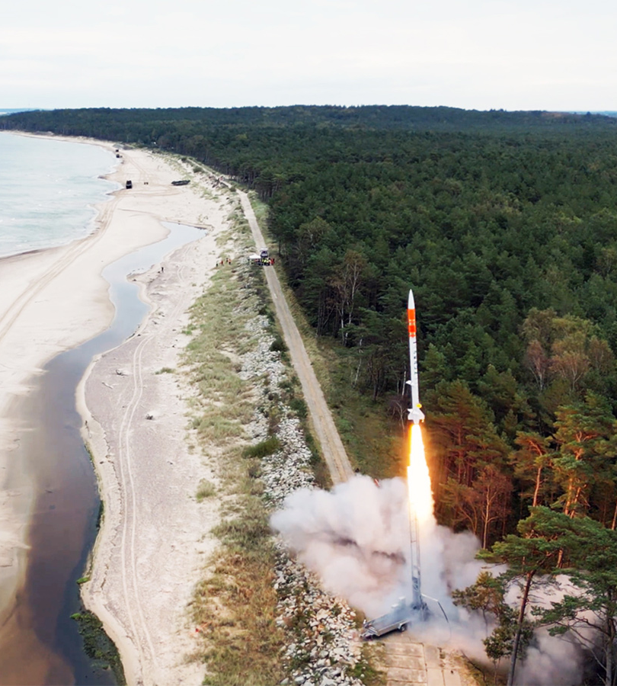
BEFORE WE START
About me
• Jędrzej Michalczyk — R&D Engineer
• SpaceForest (Gdynia, Poland)
– PERUN — single-stage suborbital launch vehicle
– guidance, navigation & control software in modern C++
• The code in this talk is roughly : github.com/jedrzejmichalczyk/accu-on-sea-2026-modular-physics
Separation of Concerns at Zero Cost — ACCU on Sea 2026
2
Notes:
1 min. Who I am, what SpaceForest does. Mention: everything shown today is in the public sopot repo.

Slide 3
SPACEFOREST, A FEW YEARS AGO
The original problem
• Simulate a rocket: 6-DOF dynamics + aerodynamics + propulsion + atmosphere + control
• The same physics must run in three places:
– engineering analysis (parameter studies, Monte Carlo)
– hardware-in-the-loop test benches — real time
– onboard — guidance runs against the same models, in real time
• Correctness and performance are crucial
• And: aero engineers, control engineers and software engineers all touch the same code
Separation of Concerns at Zero Cost — ACCU on Sea 2026
3
Notes:
2-3 min. The setting: flight simulation for guidance. Stress that several disciplines co-own the code — that is WHY separation of concerns is not cosmetic here.

Slide 4
THE GENERAL FLOW
From symbolic math to embedded C
1. High-level framework
2. Rewrite or generate
3. Embedded C
MATLAB · Mathematica · Symbolica
Express the equations once and validate the physics at a high level.
Hand-rewrite or auto-generate
Translate the validated model into portable C from the symbolic source.
Compile & deploy
Runs on the target — fast, deterministic and real-time.
Sometimes it is an overkill.
Separation of Concerns at Zero Cost — ACCU on Sea 2026
4
Notes:
2 min. The Mathematica → hand C → codegen journey from the handwritten plan. Each stage solved the previous stage's problem and created a new one. Punchline at the bottom.

Slide 5
01
The Principle
Separation of concerns in numerical code
≈ 5 min
Separation of Concerns at Zero Cost — ACCU on Sea 2026
5
Notes:
Section 1 of the submitted outline. ~5 min.

Slide 6
THE MODELING PROBLEM
Where do the software modules go?
k₁
m₁
k₂
m₂
k₃
?
?
?
?
It is not obvious where to draw the software module boundaries.
Separation of Concerns at Zero Cost — ACCU on Sea 2026
6
Notes:
The abstract's opening lines, verbatim — the audience saw them in the programme. Then: why each property matters in practice.

Slide 7
THE PRINCIPLE
Choose the states — everything else is a state function
SOPOT — “Obviously Physics, Obviously Templates” — tries to capture this idea
Separation of Concerns at Zero Cost — ACCU on Sea 2026
7
Notes:
The talk's credo: a simple solution to a simple problem; a library does not need to be hard to be useful. 'Obviously no deficiencies' is also why the framework is named the way it is, and why we verify with conservation laws and disassembly. Alternate quotes if preferred: Scott Meyers, Effective C++ Item 18 — 'Make interfaces easy to use correctly and hard to use incorrectly'; Stroustrup — 'Make simple things simple!' (CppCon 2014 keynote).

Slide 8
THE STATUS QUO
What numerical code usually looks like
// derivs.cpp — all of physics in one function
void derivs(double t, const double* y, double* dydt) {
// y[0..2] pos, y[3..5] vel, y[6..9] quat, y[10..12] omega, y[13] mass
double rho = 1.225 * exp(-y[2] / 8500.0); // atmosphere
double v2 = y[3]*y[3] + y[4]*y[4] + y[5]*y[5];
double Fd = 0.5 * rho * v2 * CD * AREA; // aero drag
double Ft = thrust_table_lookup(t); // propulsion
dydt[3] = (Ft*ax(y) - Fd*vx_hat(y)) / y[13]; // dynamics
/* ... 400 more lines, every subsystem interleaved ... */
}
Separation of Concerns at Zero Cost — ACCU on Sea 2026
8
Notes:
This is a caricature, but a recognisable one. Ask the room who has seen y[13] be the mass. Note it IS fast — that's why it survives.

Slide 9
02
The Tradeoff That Isn't
Modularity vs performance — or so we're told
≈ 7 min
Separation of Concerns at Zero Cost — ACCU on Sea 2026
9
Notes:
Section 2. ~7 min.

Slide 10
THE TEXTBOOK FIX
Attempt: classic OO interfaces
struct Component {
virtual void computeDerivatives(double t,
const double* state,
double* dydt) = 0;
virtual double getOutput(const std::string& name) = 0; // !!
virtual ~Component() = default;
};
std::vector<std::unique_ptr<Component>> components;
for (auto& c : components) // innermost loop of RK4,
c->computeDerivatives(t, y, dydt); // 4x per step, 1000s of steps
Separation of Concerns at Zero Cost — ACCU on Sea 2026
10
Notes:
The standard OO decomposition. Modularity: yes. But the optimizer hits a wall at every virtual call, and the interfaces are untyped (double*, strings).

Slide 11
PICK ONE?
The apparent tradeoff
Monolith
Virtual components
fast ✓
unmaintainable ✗
modular ✓
indirection in the hot loop ✗
Can be done
Separation of Concerns at Zero Cost — ACCU on Sea 2026
11
Notes:
Frame the talk's claim. The rest of the hour is the proof: components with single responsibility that compile to the monolith's machine code.

Slide 12
03
The Coupled Oscillator
Two masses, one spring, four components
≈ 8 min
Separation of Concerns at Zero Cost — ACCU on Sea 2026
12
Notes:
Section 3. ~8 min. Running example for the rest of the talk.

Slide 13
THE RUNNING EXAMPLE
Spring k, L0
Mass 1
Mass 2
EnergyMonitor
KE₁ + KE₂ + PE = const?
Separation of Concerns at Zero Cost — ACCU on Sea 2026
13
Notes:
Introduce the example. The conservation law is the point: we can VERIFY the composed system, not just eyeball it.

Slide 14
SEPARATION, CONCRETELY
Who owns what — who asks what
Component
Owns (state)
Provides
Queries
Mass1 / Mass2
[position, velocity]
Position, Velocity, Mass
Force (whoever provides it)
Spring
— nothing
Force, Extension, PE
Position of both masses
EnergyMonitor
— nothing
TotalEnergy, Momentum
everything above
• Composition of the whole system
• Wiring
•
Separation of Concerns at Zero Cost — ACCU on Sea 2026
14
Notes:
The core table of the talk. Spend time here. 'Provides' and 'Queries' are the typed interface.

Slide 15
04
Code Walkthrough
The four components, for real
≈ 12 min
Separation of Concerns at Zero Cost — ACCU on Sea 2026
15
Notes:
Section 4. ~12 min. All code from the public repo, lightly trimmed.

Slide 16
WALKTHROUGH 1/5
Tags: typed names for physical quantities
struct mass1 {
struct Position {}; // empty types — pure compile-time keys
struct Velocity {};
struct Force {};
struct Mass {};
};
struct mass2 { /* same shape, different types */ };
namespace spring {
struct Extension {};
struct PotentialEnergy {};
};
Separation of Concerns at Zero Cost — ACCU on Sea 2026
16
Notes:
physics/coupled_oscillator/tags.hpp. The whole trick starts here: names become types, so the compiler can route and check them.

Slide 17
WALKTHROUGH 2/5
PointMass: owns its state, asks for force
template<typename TagSet, Scalar T = double>
class PointMass final : public Component<2, T> { // 2 states: [x, v]
double m_mass;
public:
template<typename Registry>
LocalDerivative derivatives(T t, std::span<const T> state, const Registry& registry) const {
T velocity = this->localState(state, 1); // dx/dt = v
T force = query<typename TagSet::Force>(registry, state);
return {velocity, force / T(m_mass)}; // dv/dt = F/m
}
template<typename Registry> // Velocity: same, localState(s, 1)
T compute(typename TagSet::Position, std::span<const T> s,
const Registry&) const { return this->localState(s, 0); }
};
Separation of Concerns at Zero Cost — ACCU on Sea 2026
17
Notes:
point_mass.hpp. Highlighted: the registry query — the only coupling to the outside world, and it's by tag, not by type of the provider.

Slide 18
WALKTHROUGH 3/5
Spring: no state, just physics
template<typename TagSet1, typename TagSet2, Scalar T = double>
class Spring final : public Component<0, T> { // 0 states!
double m_stiffness, m_rest_length;
public:
template<typename Registry>
T compute(typename TagSet1::Force, std::span<const T> state, const Registry& reg) const {
T x1 = query<typename TagSet1::Position>(reg, state);
T x2 = query<typename TagSet2::Position>(reg, state);
T extension = x1 - x2 - T(m_rest_length);
return -T(m_stiffness) * extension; // Hooke's law
}
template<typename Registry>
T compute(typename TagSet2::Force, std::span<const T> state, const Registry& reg) const {
return -query<typename TagSet1::Force>(reg, state); // Newton's 3rd
}
};
Separation of Concerns at Zero Cost — ACCU on Sea 2026
18
Notes:
spring.hpp (trimmed: damping & repulsion elided). Point at the two registry calls: that IS the whole dependency.

Slide 19
WALKTHROUGH 4/5
EnergyMonitor: system totals from component data
template<Scalar T = double>
class EnergyMonitor final : public Component<0, T> {
public:
template<typename Registry>
T compute(system::TotalEnergy,
std::span<const T> state, const Registry& registry) const {
T m1 = query<mass1::Mass>(registry, state);
T v1 = query<mass1::Velocity>(registry, state);
T m2 = query<mass2::Mass>(registry, state);
T v2 = query<mass2::Velocity>(registry, state);
T pe = query<spring::PotentialEnergy>(registry, state);
return T(0.5)*m1*v1*v1 + T(0.5)*m2*v2*v2 + pe;
}
};
Separation of Concerns at Zero Cost — ACCU on Sea 2026
19
Notes:
energy_monitor.hpp. 'Doesn't know there's a spring' — the abstract promised exactly this slide.

Slide 20
WALKTHROUGH 5/5
Wiring it together
auto sys = makeODESystem<double>(
Mass1<double>(1.0, /*x0*/ 0.0, /*v0*/ 0.0),
Mass2<double>(1.0, /*x0*/ 2.5, /*v0*/ 0.0),
Spring12<double>(/*k*/ 4.0, /*L0*/ 1.0),
EnergyMonitor<double>()
);
// the wiring is CHECKED at compile time:
static_assert(decltype(sys)::hasFunction<system::TotalEnergy>());
RK4Solver solver;
auto sol = solver.solve(derivs(sys), sys.getStateDimension(),
0.0, 20.0, /*dt*/ 0.001, sys.getInitialState());
double E = sys.query<system::TotalEnergy>(sol.states.back());
Separation of Concerns at Zero Cost — ACCU on Sea 2026
20
Notes:
coupled_system.hpp / examples. If a required provider is missing the static_assert (or the concept) fails AT THE CALL SITE.

Slide 21
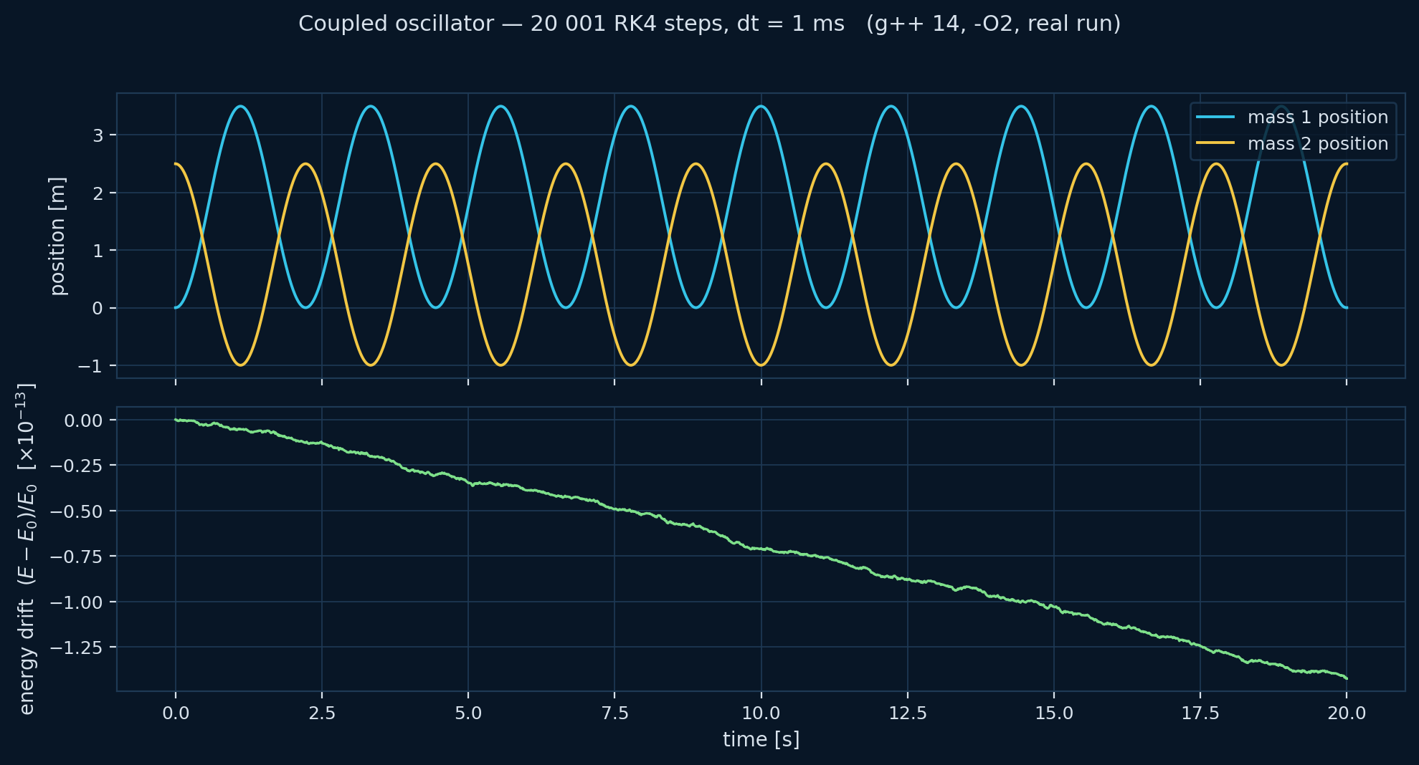
PROOF, NOT PROMISE
Does it work?
20 001
RK4 steps (dt = 1 ms)
16.7 ms
wall clock, g++ 14 -O2
1.4 × 10⁻¹³
max relative energy drift over 20 s
Separation of Concerns at Zero Cost — ACCU on Sea 2026
21
Notes:
Real run: assets/oscillator_demo.cpp against the repo headers. Energy conserved to machine precision — the conservation law validates the COMPOSITION, not just the parts.

Slide 22
05
How It Works
Tags, registry, concepts — no magic
≈ 10 min
Separation of Concerns at Zero Cost — ACCU on Sea 2026
22
Notes:
Section 5. ~10 min.

Slide 23
HOW IT WORKS 1/5
Idea 1 — dispatch on type, not through a hierarchy
// instead of: // we write:
double getOutput( T compute(mass1::Position,
const std::string& name); std::span<const T> state) const;
// one virtual + string compare // one overload per quantity,
// per query, at runtime // chosen by the COMPILER
• Overload resolution replaces virtual dispatch
• The tag argument is empty — it exists only to select the overload
• Unknown tag → compile error, with the tag's name in the message
• This is ordinary C++ — tag dispatch is as old as the STL (std::advance)
Separation of Concerns at Zero Cost — ACCU on Sea 2026
23
Notes:
Demystify: tag dispatch is the iterator-category trick the audience already knows, applied to physics quantities.

Slide 24
HOW IT WORKS 2/5
Idea 2 — the registry: 'who provides what'
template<typename T, ComponentConcept... Components>
class Registry {
std::tuple<const Components&...> m_components;
template<StateTagConcept Tag>
static constexpr bool hasFunction() {
return (ProvidesStateFunction<Components, Tag, T, Registry> || ...);
} // fold over all components
template<StateTagConcept Tag>
auto computeFunction(std::span<const T> state) const {
static_assert(hasFunction<Tag>(),
"No component provides this state function");
const auto& provider = findProvider<Tag>(); // index found constexpr
return provider.compute(Tag{}, state, *this);
}
};
Separation of Concerns at Zero Cost — ACCU on Sea 2026
24
Notes:
core/typed_component.hpp (simplified). The registry is the only 'framework' there is. Emphasize: provider chosen at compile time → calls inline through.

Slide 25
HOW IT WORKS 3/5
compute vs query: provide vs ask
// a component PROVIDES a quantity (one overload per tag):
T compute(mass1::Force, std::span<const T> s, const Registry&) const;
// anyone ASKS for one, by tag — component or driver:
T f = query<mass1::Force>(registry, state);
// query is just the registry call with friendlier syntax:
template<StateTagConcept Tag, typename Registry, typename T>
auto query(const Registry& reg, std::span<const T> s) {
return reg.computeFunction<Tag>(s); // find provider -> provider.compute(...)
}
Separation of Concerns at Zero Cost — ACCU on Sea 2026
25

Slide 26
HOW IT WORKS 4/5
Idea 3 — concepts make the contracts checkable
// what a component IS:
template<typename C>
concept ComponentConcept = requires(const C& c) {
{ C::state_size } -> std::convertible_to<size_t>;
{ c.getInitialLocalState() } -> std::same_as<typename C::LocalState>;
};
// what it PROVIDES (a quantity, selected by tag):
template<typename C, typename Tag, typename T, typename Registry>
concept ProvidesStateFunction =
ComponentConcept<C> && StateTagConcept<Tag> &&
requires(const C& c, std::span<const T> s, const Registry& reg)
{ c.compute(Tag{}, s, reg); };
Separation of Concerns at Zero Cost — ACCU on Sea 2026
26
Notes:
Answer to 'why C++20 made this practical' from the abstract. Without concepts the diagnostics made this pattern team-hostile.

Slide 27
HOW IT WORKS 5/5
Idea 4 — everything is a value
• The system is std::tuple<Mass1, Mass2, Spring, EnergyMonitor>
– no heap, no pointers, no type erasure, no std::function
• The optimizer sees the whole object graph as one struct
– every compute() call is a direct (and inlinable) call
• State lives in one contiguous vector; components know their offsets
• The price: component set is fixed at compile time
– for flight software that's a feature — the vehicle doesn't grow a fin mid-flight
Separation of Concerns at Zero Cost — ACCU on Sea 2026
27
Notes:
The honest tradeoff slide: static composition. Sell the price as a feature in this domain (certifiable, no allocation, deterministic), admit it's a real constraint elsewhere.

Slide 28
06
What the Compiler Sees
Trust, but disassemble
≈ 6 min
Separation of Concerns at Zero Cost — ACCU on Sea 2026
28
Notes:
Section 6. ~6 min.

Slide 29
G++ 14 -O2, REAL OUTPUT
The abstraction compiles away
energy_sopot(span<const double>): ; 4 components, registry dispatch
mov r10, [sys+272]
movsd xmm1, [.LC0] ; 0.5
mov rax, [rcx]
movsd xmm0, [r10+8] ; m1 <- runtime parameters,
movsd xmm3, [rax+rcx*8] ; v1 loaded once
mulsd xmm0, xmm1
mulsd xmm0, xmm3 ; 0.5*m1*v1
mulsd xmm0, xmm3 ; ... * v1
subsd xmm2, [r8+16] ; x1-x2-L0
mulsd xmm1, xmm2 ; PE terms
addsd xmm0, xmm3
addsd xmm0, xmm1 ; KE1+KE2+PE
ret
0 calls · 0 jumps · 0 vtables — straight-line FP, the same shape as the hand-written formula.
Separation of Concerns at Zero Cost — ACCU on Sea 2026
29
Notes:
Real asm from assets/asm_compare.cpp (trimmed for the slide; full listing in repo). Offer godbolt link for the skeptics. Be honest about the constant-propagation difference.

Slide 30
G++ 14 -O2, REAL OUTPUT
…and the derivative? Same story.
mass1_derivative(...): ; returns { dx/dt , dv/dt }
mov r9, [sys+112] ; spring component
mov r10, [sys+128] ; mass1 component
movsd xmm2, [r9+8] ; stiffness k, negated -> -k
xorpd xmm2, [.LC0]
movsd xmm0, [r8+rcx*8] ; x1
subsd xmm0, [r8+rdx*8] ; - x2
subsd xmm0, [r9+16] ; - L0 -> extension
movsd xmm1, [r8+rcx*8] ; v1 (= dx/dt)
mulsd xmm0, xmm2 ; -k * extension (spring force)
comisd xmm3, 0 ; if (damping > 0) - c == 0, so
jbe .Lskip ; the branch is skipped
divsd xmm0, [r10+8] ; force / m1 (= dv/dt)
unpcklpd xmm1, xmm0 ; pack { v1, a1 }
movups [rax], xmm1
ret
the whole query chain — spring force, then ÷ mass — is ~15 instructions, no calls.
Separation of Concerns at Zero Cost — ACCU on Sea 2026
30

Slide 31
MEASURED, NOT ESTIMATED
Numbers
~1 ns per state-function query — fully inlined
16.7 ms 20 001 RK4 steps of the 4-component oscillator (laptop, -O2)
1000× faster than an equivalent OO C# version
Separation of Concerns at Zero Cost — ACCU on Sea 2026
31
Notes:
Keep this slide quick. The asm slide is the argument; these are corroborating measurements from the repo.

Slide 32
FROM THE HANDWRITTEN PLAN
Why C++20 — and not C++26?
• Everything here needs only C++20:
– concepts (the diagnostics!), fold expressions, std::span, CTAD
• C++26 reflection (P2996) would remove the remaining boilerplate:
– tag declarations and compute() registration could be generated
– we have working experiments in the repo: reflect/
• But flight software ships on the toolchain you have, not the one you want
– embedded / cross targets lag years behind; certification lags more
Separation of Concerns at Zero Cost — ACCU on Sea 2026
32
Notes:
Plan item 'dlaczego 20 a nie 26'. Show genuine enthusiasm for P2996 (reflect/ dir has the experiments) but ground it in deployment reality.

Slide 33
07
Where It Scales
From two masses to a flying vehicle
≈ 7 min
Separation of Concerns at Zero Cost — ACCU on Sea 2026
33
Notes:
Section 7. ~7 min.

Slide 34
PRODUCTION, NOT PROMO
Same pattern, real vehicle: 6-DOF rocket
StandardAtmosphere
TranslationDynamics
AxisymmetricAero
ForceAggregator
RotationDynamics
InterpolatedEngine
RocketBody (mass, I)
Gravity
• 11 components, 14 states — position, velocity, quaternion, angular rate, mass
• Thrust vector control & attitude determination: same tags-and-registry architecture
• These patterns run in production flight software — correctness and performance both non-negotiable
Separation of Concerns at Zero Cost — ACCU on Sea 2026
34
Notes:
rocket/ in the repo mirrors what flies. Each box is a header a different engineer can own. Don't over-claim: say which parts are the open-source mirror of the production patterns.

Slide 35
WE PLANTED T EVERYWHERE — PAYOFF
Bonus: the scalar is a template parameter
// simulate:
auto sim = makeODESystem<double>(comps...);
// differentiate — SAME components, different scalar:
using D = Dual<double, 14>; // forward-mode autodiff
auto grad = makeODESystem<D>(comps...);
auto J = computeJacobian(grad, t, state); // exact, to machine precision
// linearize -> LQR gain straight from the nonlinear model
auto K = lqr(J.A, J.B, Q, R);
• Jacobians without hand-derived math or finite differences
• The controller you'll see in a minute was designed exactly this way
Separation of Concerns at Zero Cost — ACCU on Sea 2026
35
Notes:
Dual<T,N> from core/dual.hpp. One sentence of mechanism (dual numbers), then the payoff: exact linearization for control design. Sets up the finale.

Slide 36
OPEN IDEAS
Can we go further?
• Frames as types — body vs ENU vs ECEF: mixing them up should be a compile error too
• Physical laws as concepts — 'conserves energy', 'action-reaction pair' as checkable contracts
• Units in the type system — dimensional analysis at compile time
The goal, all the way down: a consistent level of abstraction
Separation of Concerns at Zero Cost — ACCU on Sea 2026
36
Notes:
The circled phrase from the handwritten plan — 'consistent level of abstraction' — is the thesis. Land it here.

Slide 37
A SHORT HISTORY LESSON
We've been here before
XISP1=250.; XISP2=250.; XMF1=.85; XMF2=.85;
WPAY=100.; DELV=20000.;
DELV1=.3333*DELV; DELV2=.6667*DELV;
AMAX1=10.; AMAX2=10.; GAMDEG=85.;
TOP2=WPAY*(exp(DELV2/(XISP2*32.2))-1.);
BOT2=1/XMF2-((1.-XMF2)/XMF2)*exp(DELV2/(XISP2*32.2));
WP2=TOP2/BOT2; WS2=WP2*(1-XMF2)/XMF2; WTOT2=WP2+WS2+WPAY;
TRST2=AMAX2*(WPAY+WS2); TB2=XISP2*WP2/TRST2;
% ... then TOP1,BOT1,WP1,WS1,WTOT,TRST1,TB1 -- same again for stage 1
Zarchan, Tactical & Strategic Missile Guidance, 6th ed. (MATLAB) — gravity-turn booster sim
• Six decades of rocket code — the math was always modular; the code never was
• Not because the engineers were careless — because the languages made them choose
Separation of Concerns at Zero Cost — ACCU on Sea 2026
37
Notes:
TODO(Jędrzej): drop in the book scan and cite it properly. Beat: we finally have a language where the modular math can stay modular in code.

Slide 38
A SHORT HISTORY LESSON
One loop, every variable global
while ~(ALT<0 & T>10)
if T<TB1
WGT=-WP1*T/TB1+WTOT; TRST=TRST1;
elseif T<(TB1+TB2)
WGT=-WP2*T/TB2+WTOT2+WP2*TB1/TB2; TRST=TRST2;
else
WGT=WPAY; TRST=0.;
end
AT=32.2*TRST/WGT; VEL=sqrt(X1^2+Y1^2);
TEMBOT=(X^2+Y^2)^1.5;
X1D=-GM*X/TEMBOT+AT*X1/VEL;
Y1D=-GM*Y/TEMBOT+AT*Y1/VEL;
... % + Euler step, range/altitude bookkeeping
end
Zarchan, Tactical & Strategic Missile Guidance, 6th ed. (MATLAB) — gravity-turn booster sim
One scope. Every name global. Physics, staging, and the integrator all tangled together.
Separation of Concerns at Zero Cost — ACCU on Sea 2026
38

Slide 39
A SHORT HISTORY LESSON
Same script — even the plotting and file I/O
if S>=9.99999
R=sqrt(X^2+Y^2); RF=sqrt(XFIRST^2+YFIRST^2);
BETA=acos((X*XFIRST+Y*YFIRST)/(R*RF));
DISTNM=A*BETA/6076.; ALTNM=(sqrt(X^2+Y^2)-A)/6076.;
count=count+1;
ArrayT(count)=T; ArrayDISTNM(count)=DISTNM; ArrayALTNM(count)=ALTNM;
end
end
figure
plot(ArrayDISTNM,ArrayALTNM),grid
xlabel('Downrange (Nmi)'); ylabel('Altitude (Nmi)');
save datfil output /ascii
disp 'simulation finished'
Zarchan, Tactical & Strategic Missile Guidance, 6th ed. (MATLAB) — gravity-turn booster sim
No boundary between simulation, analysis, and I/O — every concern in one scope.
Separation of Concerns at Zero Cost — ACCU on Sea 2026
39

Slide 40

Notes:
SWITCH TO BROWSER. Fallback if Wi-Fi dies: screen recording (TODO: record one). Show: stabilization, then poke it. Mention cart-pole → 6-chain generalization was a small diff because components compose.

Slide 41
IF YOU REMEMBER FOUR THINGS
Takeaways
• Separation of concerns is achievable at zero cost in C++20 — measured, not asserted
• The recipe is small: typed tags + overloaded compute() + a constexpr registry + concepts
– no inheritance, no virtuals, no strings, no codegen
• Prefer abstractions you can verify — conservation laws and disassembly are unit tests for architecture
• Quality vs performance was the false tradeoff — modern C++ finally lets us refuse it
Separation of Concerns at Zero Cost — ACCU on Sea 2026
41
Notes:
Slow down. One breath per bullet.

Slide 42
Thank you! Questions?
• Code & slides: github.com/jedrzejmichalczyk/accu-on-sea-2026-modular-physics
• Email: jedrzej.michalczyk@gmail.com
Separation of Concerns at Zero Cost — ACCU on Sea 2026
42
Notes:
Q&A budget: 5 min. Likely questions: compile times (fold expressions cut 40-60% per repo notes), dynamic composition (honest answer: not this pattern's job), comparison with Modelica/acausal (experiments in physics/acausal/).

