Slide 1

innovative solutions for your next revolution
Phil Brady, Co-Founder & CEO
Rajiv Suresh, Co-Founder & COO
Lea Zhang, Executive Vice-President

Slide 2
Our Story
Copernican Solutions, LLC was founded in September 2013, after enriching and valuable summer experiences by two Stanford students. In a few short months, they were receiving casework from early-stage startups across the globe. After undergoing a shift in their ideology and mission in 2014, Copernican Solutions began to expand, hiring team members and successfully bringing in new clientele. Today, the team as a whole has professional backgrounds in finance, venture capital, strategy consulting, startup business development, and academic research. Through a variety of different projects, the team at Copernican Solutions remains committed to helping early-stage startups grow and achieve their full potential.
By the numbers
7 Team Members – 2 Co-Founders, 1 EVP, 4 Business Analysts
5 Current Clients – includes hardware and software startups
4 Geographic Areas Served – Bay Area, Dallas Area, Finland, & New York

Slide 3
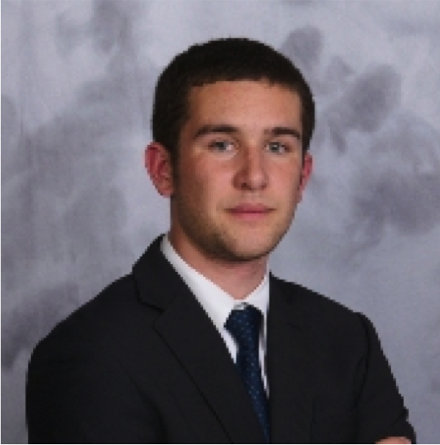


Our Core Team
Phil Brady
Founder & CEO
Stanford University
B.S. Candidate in Management Science and Engineering
Venture Capital, Private Equity, and Startup Accelerators
Rajiv Suresh
Co-Founder & COO
Stanford University
B.A. Candidate in Economics and Music Performance
Consulting, Hardware Startups, and Academic Research

Slide 4
Our Mission
To provide
INNOVATIVE STRATEGIES
that promote improvement and growth of
STARTUP COMPANIES

Slide 5
What WE can do for YOU

Slide 6
Our Process
EVALUATION
Our process consists of 4 KEY COMPONENTS:
EVALUATE the Company
ASSESSMENT
ASSESS the Trajectory
CREATION
CREATE Innovative Strategies
RECOMMENDATION & IMPLEMENTATION
RECOMMEND/IMPLEMENT Methods

Slide 7
Why US

Slide 8
Together we have…
1
2
3
4
5
Assisted with investment/ crowdfunding for startups
Seen the
entire life cycle of a startup
Developed solutions
for complex business problems
s here under the number
Access to resources
at a premier university
An extensive network in Silicon Valley, Texas, and Scandinavia

Slide 9
Let’s move forward TOGETHER and get you to YOUR NEXT REVOLUTION

