Slide 1
Intelleship Aggregation and Shipping Streamlining Application
Team: Joe Durham, Nermeen Saleh, Alex Yeoh, Isaak Nijakowski

Slide 2
Project Challenge:
Packing, shipping, and receiving 2 pharmaceutical products, one of which has temperature constraints.
Tracking temperature during transport.
Confirming to DSCSA guidelines regarding interoperable electronic constraints.
Project Description:
A user interface application that distributors can use to aggregate, ship, and receive products in different temperature.
The application will allow the user to:
Choose if they will use a temperature sensor RFID tags or Temperature probe/ data logger.
Choose the appropriate event based on their way of temperature tracking.

Slide 3
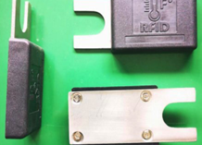
Temperature Tracking:
Temperature Logger with Standard EPC label on the pallet
small companies
Higher cost up front
Sustainable, reusable
Historical Temperature records
Label With Temperature sensing RFID tag
large companies
Discounts on the price might be applied
High-cost
Pointing time Temperature record
Temperature Sensor RFID Tag

Slide 4
EPCIS Events:
Event 1 Aggregation
(Pack cases onto pallet)
Action: ADD
Event 2 Object
(ship pallet)
Event 3 Object
(Receive pallet)
Action: Observe
Parent: SSCC of the pallet
Children: GTINs of Miracle drug and Example drug
Action: Observe
What: SSCC of pallet
What: SSCC of pallet

Slide 5
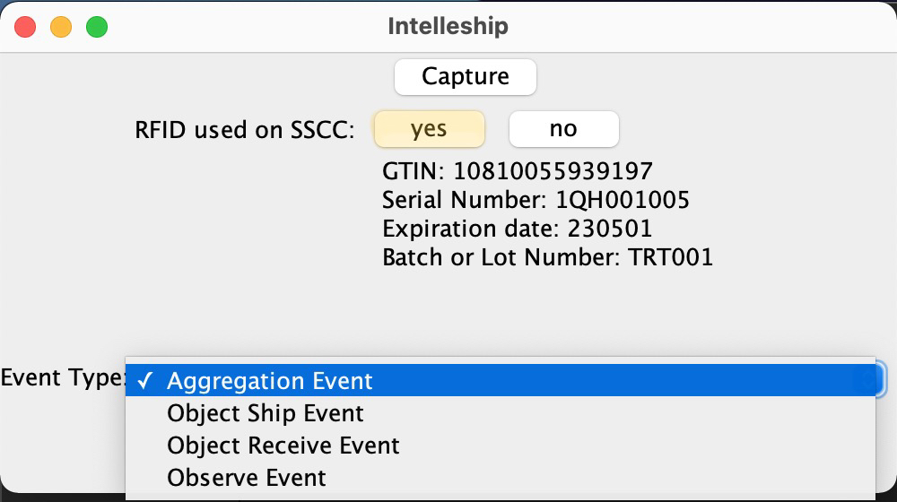
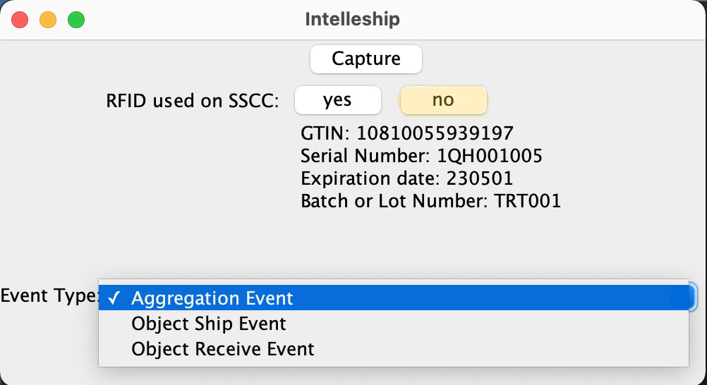
Intelleship Interface
Using Temperature Sensor RFID
Using Temperature probe

Slide 6
Benefits:
Flexibility:
Can be used by different size companies.
Gives the option to choose between different temperature tracking systems.
Cost:
Sustainability of the temperature probe.
Satisfying DSCSA requirements
regarding electronic product tracing and transaction information such as history.

Slide 7
Standards and Technologies used:
GS1 Standards
BarTender: was used to create 3 labels.
Printronix: was used to print the labels with RFIDs
Tag Data Standard 2.0 (TDS): was used to generate the RFID Hexadecimal code.
EPCIS Workbench and Freepcis: were used to create the EPCI events.
VS code IDE (Java): was used to code the GUI

Slide 8
Enhancing Ideas:
Recreate as a Web application that shows product information such as temperature at any given time.
Graph that shows the product was within the appropriate range of temperature allowed.

Slide 9
Citation:
Thank you!
RFID Temperature Monitoring - Temperature Sensor Tags | RFID, Inc. (rfidinc.com)
Drug Supply Chain Security Act (DSCSA) | FDA

