Slide 1
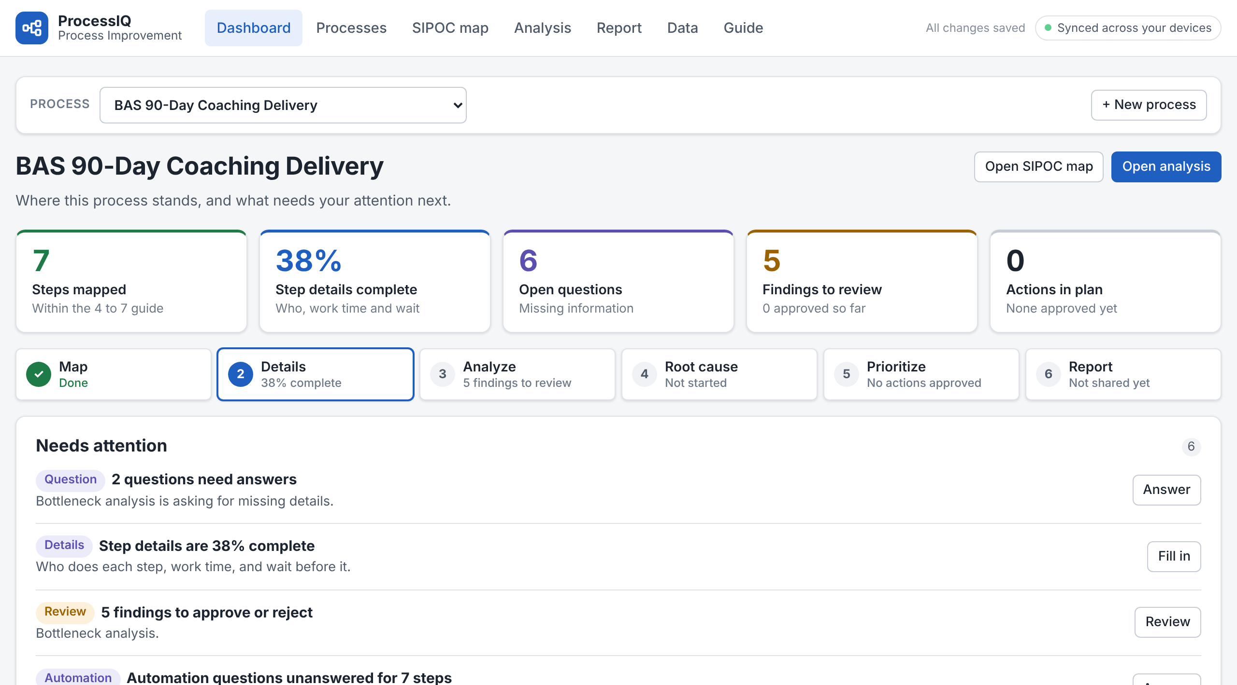
ProcessIQ: from process map to action plan
A private web app that maps a process, finds delays and waste, and turns what you approve into a plan.
1
Map
2
Details
3
Analyze
Suppliers, inputs, steps, outputs and customers on one page
Who does each step, work time, and how long work waits
Delays, handoffs, waste, and where automation fits
4
Root cause
5
Prioritize
6
Report
A guided 5 Whys, each answer backed by evidence
Impact versus effort, then owners and target dates
Share the summary and send actions to the tracker
Live example: Sunshine BAS 90-Day Coaching Delivery
Every finding carries a label, and nothing is approved for you
Then track the follow-through
FACT
HYPOTHESIS
QUESTION
Approved actions export straight into the AI Adoption Follow-Through Tracker, which checks each week that the new behaviors stick.
Calculated from what you entered
A possible issue to check first
Missing information: it asks, never guesses
Private to your Claude account · Syncs your computer and iPhone · Optional Claude suggestions, always labeled and never approved automatically
Notes:
ProcessIQ is a web app I built to take a business process from a rough map to an action plan people actually follow.
It follows six steps. Map the process as a SIPOC: suppliers, inputs, the main steps, outputs and customers. Add details for each step: who does it, how long the hands-on work takes, and how long work waits before it. The app then analyzes the process for delays, handoffs, duplication and waste, and shows where automation, AI or existing software could help. A guided 5 Whys gets to root causes, with each answer backed by evidence. Improvements are rated for impact and effort, placed on a matrix, and turned into an ordered plan with owners and dates. Finally, a one-page report summarizes it all.
What makes it trustworthy: every finding is labeled as a fact, calculated from entered data; a hypothesis, a possible issue to check; or a question, where information is missing. It asks instead of guessing, and nothing moves forward until I approve it.
The screenshot is a live example: Sunshine Enterprises' BAS 90-Day Coaching Delivery process.
Approved actions export directly into my AI Adoption Follow-Through Tracker, which checks each week whether the new behaviors are sticking. Data stays private to my Claude account and syncs between my computer and iPhone. Claude can suggest ideas, but they are always labeled and never approved automatically.

