Slide 1
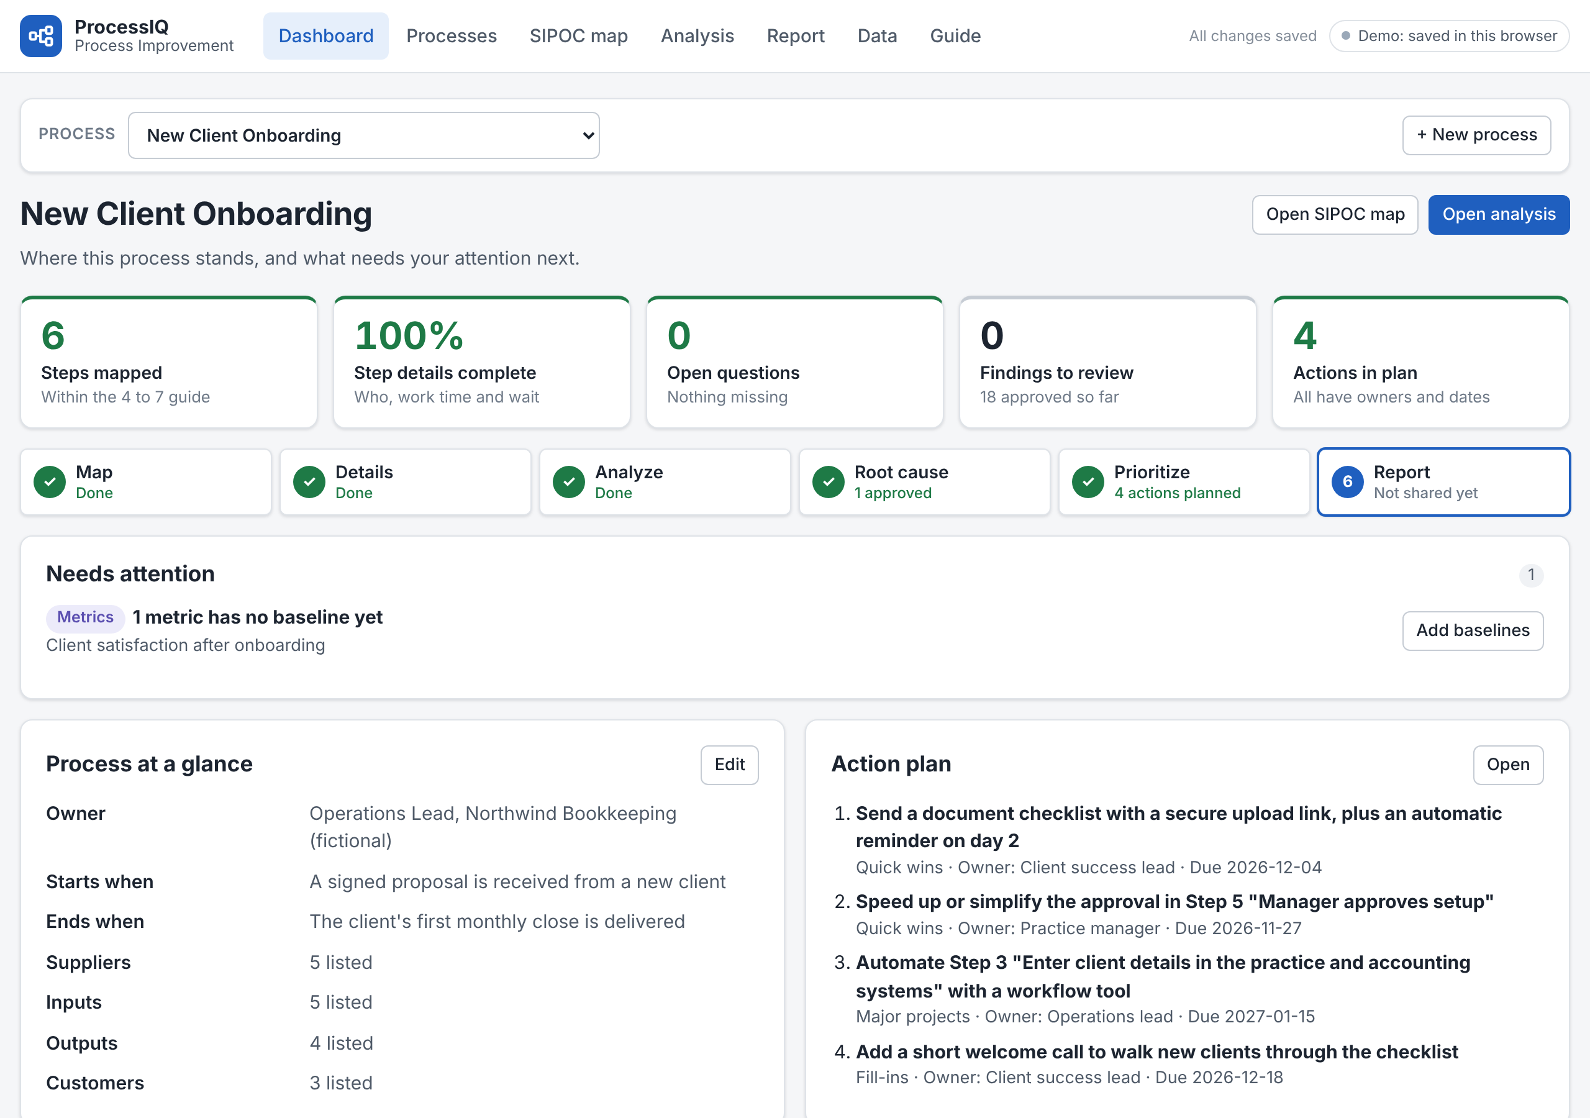
ProcessIQ
PROCESS IMPROVEMENT AND AUTOMATION
From process map to an action plan that sticks
A web app that maps a process, finds delays and waste, identifies what to automate, and tracks that improvements last.
Jason Mosley · Fictional sample data shown
Notes:
ProcessIQ is a web app I built to take a business process from a rough map to an action plan that people actually follow. Everything you'll see uses a fictional sample: new client onboarding at a bookkeeping firm called Northwind.

Slide 2
Why process improvement often stalls
Four gaps that ProcessIQ is built to close.
1
The map stays on the wall
2
Opinions replace evidence
Workshops produce a diagram, not decisions about what to change.
Nobody measures where the time actually goes, so the loudest view wins.
3
Automation comes too soon
4
Changes fade
Tools get bought before the process is understood, and automate the waste.
Nobody checks whether the new way of working sticks after launch.
ProcessIQ · Examples use fictional sample data (Northwind Bookkeeping)
2 / 13
Notes:
Most improvement efforts don't fail for lack of ideas. They stall in four predictable places: the map never turns into decisions, opinions stand in for evidence, automation gets bought before anyone understands the process, and the new way of working quietly fades. ProcessIQ is built to close each of these gaps.

Slide 3
One path from map to lasting change
The app shows where you are on the path, and what needs attention next.
1
2
3
4
5
6
7
Map
Details
Analyze
Root cause
Prioritize
Report
Track
Suppliers, inputs, steps, outputs, customers
Who does each step, work time, and waiting
Delays, handoffs, waste, automation fit
A guided 5 Whys backed by evidence
Impact versus effort, owners, dates
A one-page summary to share
Weekly check that the change sticks
Step 7 runs in my AI Adoption Follow-Through Tracker: approved actions export from ProcessIQ and are checked every week until the new behavior is routine.
ProcessIQ · Examples use fictional sample data (Northwind Bookkeeping)
3 / 13
Notes:
ProcessIQ follows one path. Map the process, add the details of each step, analyze it for delays and waste, find the root cause, prioritize the fixes, report them, and then track whether they stick. The app shows where you are on this path and what needs attention next.

Slide 4
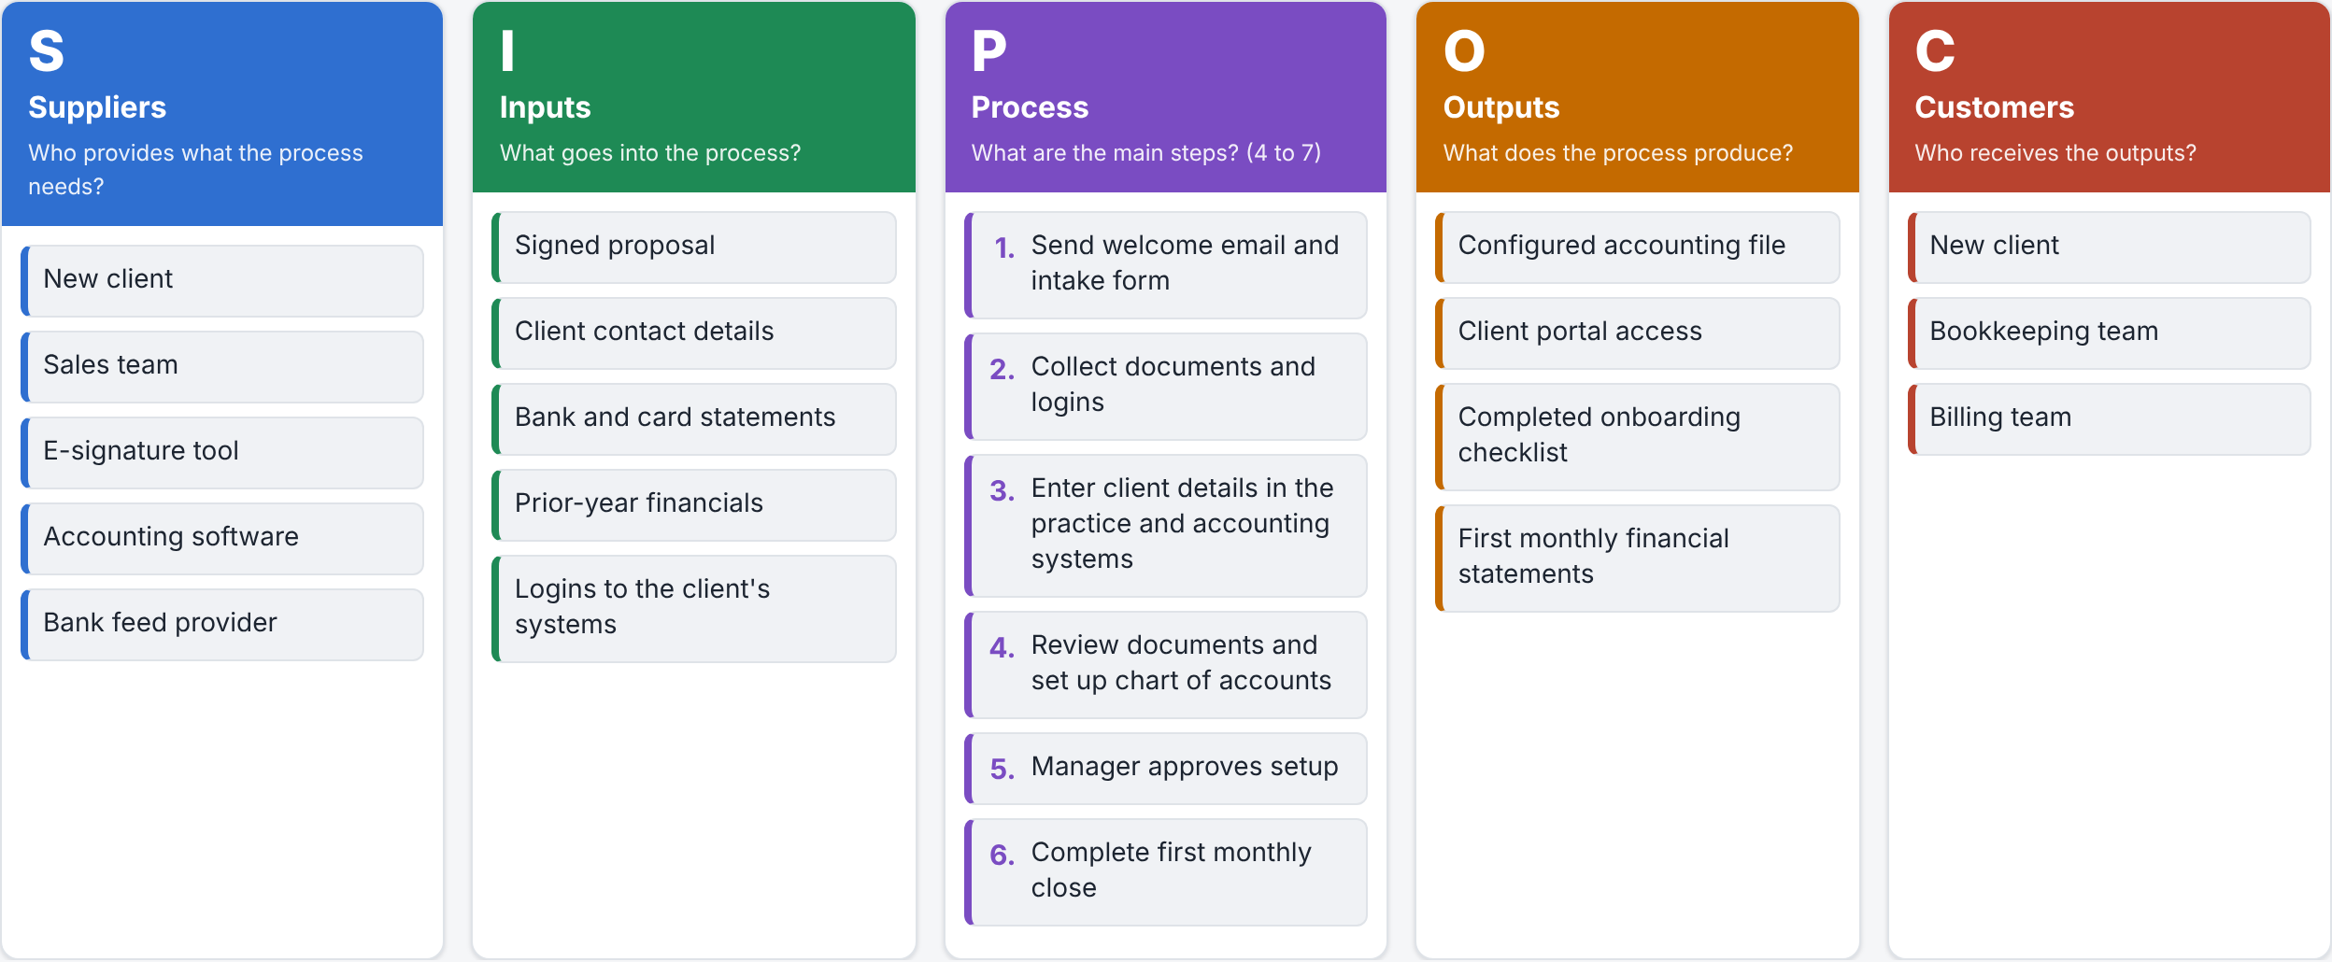
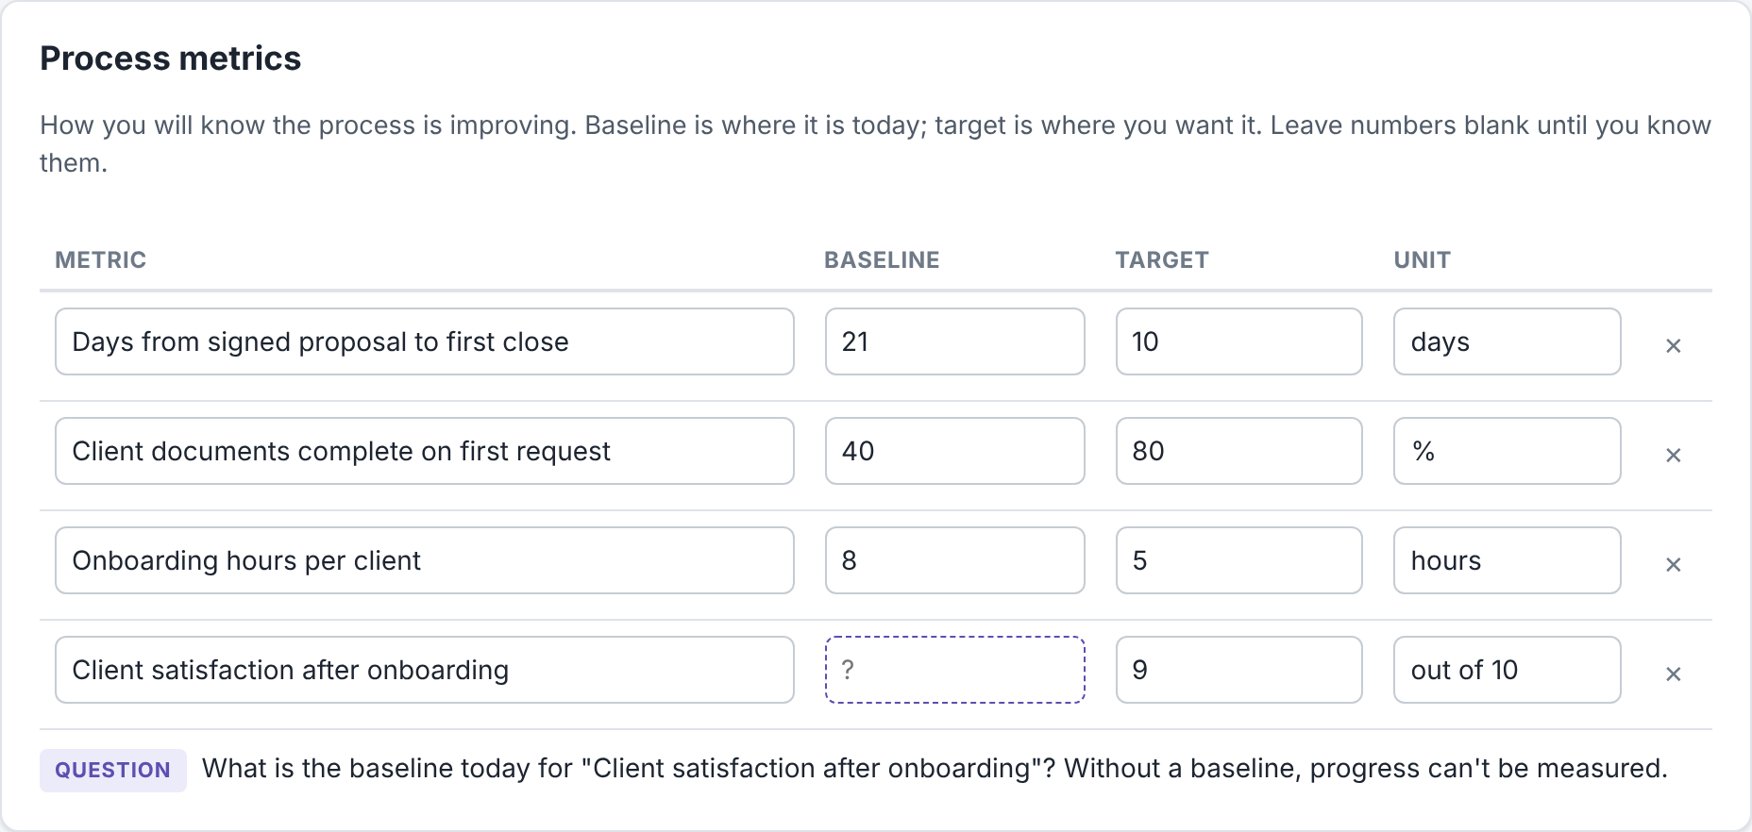
Map the process on one page
A SIPOC map shows who supplies what, the main steps, and who receives the results.
Clear scope
Where the process starts and where it ends
Metrics that define success
Each with a baseline today and a target
Unknowns become questions
Blank values are asked about, never guessed
ProcessIQ · Examples use fictional sample data (Northwind Bookkeeping)
4 / 13
Notes:
Step one is a SIPOC map: suppliers, inputs, the main process steps, outputs and customers, plus where the process starts and ends. Underneath sit the metrics that define success, each with a baseline and a target. Notice the last metric has no baseline yet. ProcessIQ doesn't guess it; it asks.

Slide 5
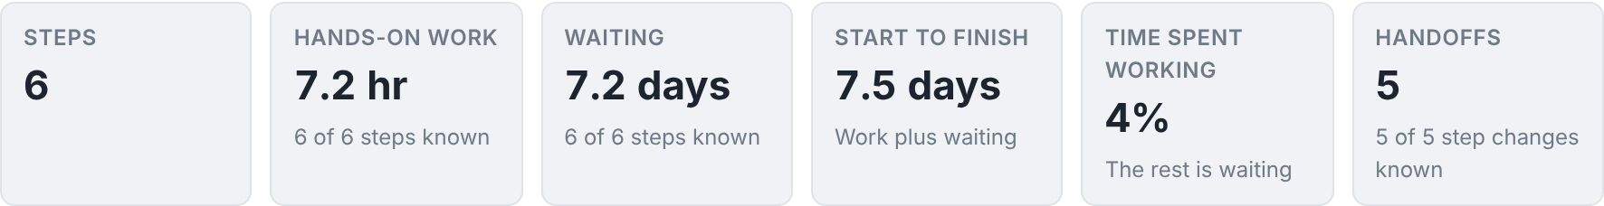
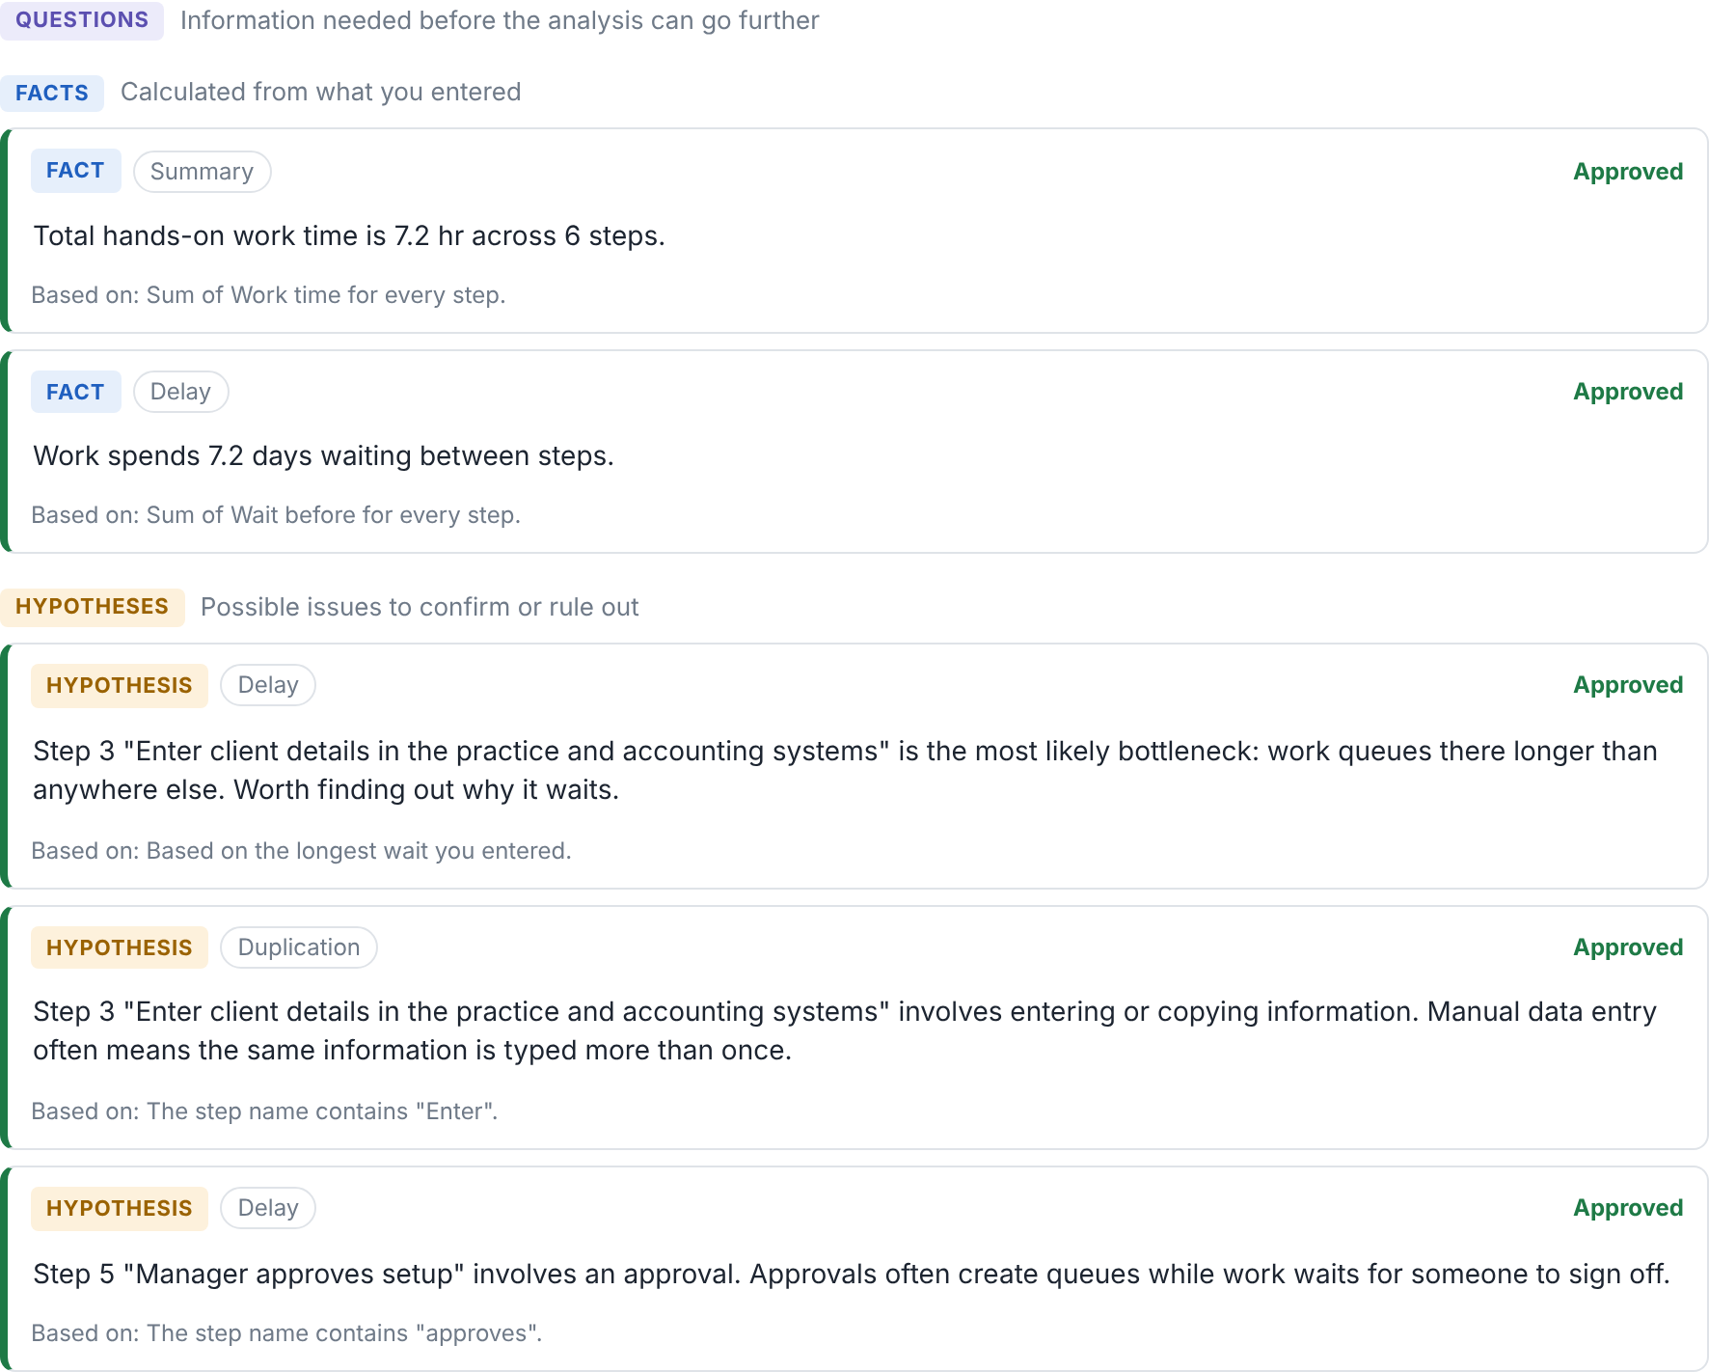
Every finding is labeled, so you know what to trust
ProcessIQ calculates where time goes and flags likely bottlenecks, handoffs, duplication and waste.
FACT
Calculated from what you entered
HYPOTHESIS
A possible issue to check first
QUESTION
Missing information: it asks
Nothing moves forward until a person approves it.
ProcessIQ · Examples use fictional sample data (Northwind Bookkeeping)
5 / 13
Notes:
Once each step has its details, ProcessIQ calculates where the time goes. In the sample, the process takes seven and a half days but only four percent of that is hands-on work. Every finding carries a label: a fact is calculated from the data, a hypothesis is a possible issue to check, and a question means information is missing. Nothing moves forward until a person approves it.

Slide 6
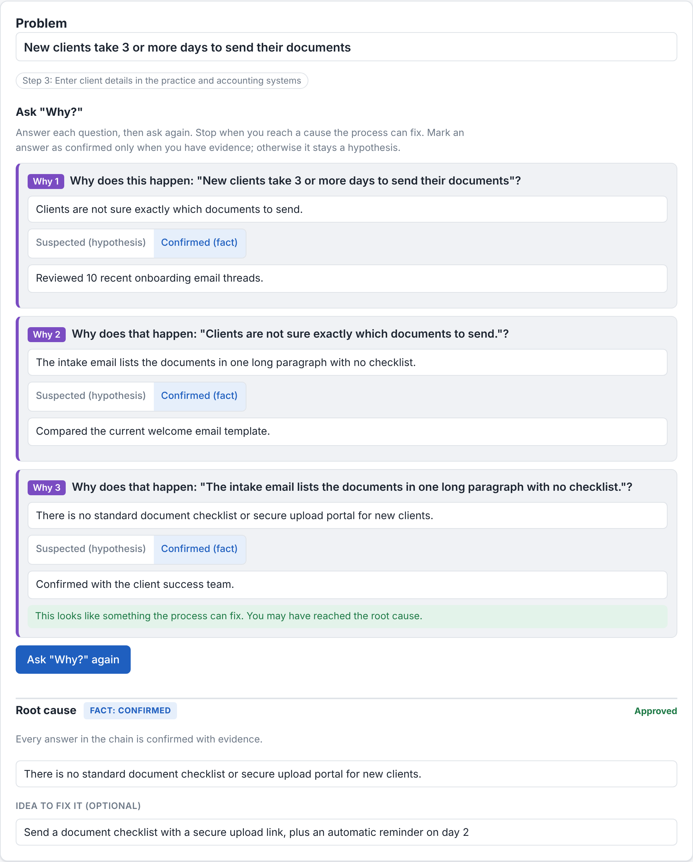
Get to the root cause with evidence
Each answer is marked suspected or confirmed, with how you know it.
Problem
Clients took 3+ days to send their documents
Root cause, confirmed
No standard document checklist or upload portal
Fix
A checklist with a secure upload link and a day-2 reminder
Coaching built in
Warns on blame and vague answers
ProcessIQ · Examples use fictional sample data (Northwind Bookkeeping)
6 / 13
Notes:
For the biggest problem, a guided 5 Whys digs underneath the symptom. Each answer is marked suspected or confirmed, with how you know. The app warns when an answer blames a person or is too vague. Here, clients took three or more days to send documents; the confirmed root cause was that there was no standard checklist or upload portal. The fix idea flows straight into the action plan.

Slide 7
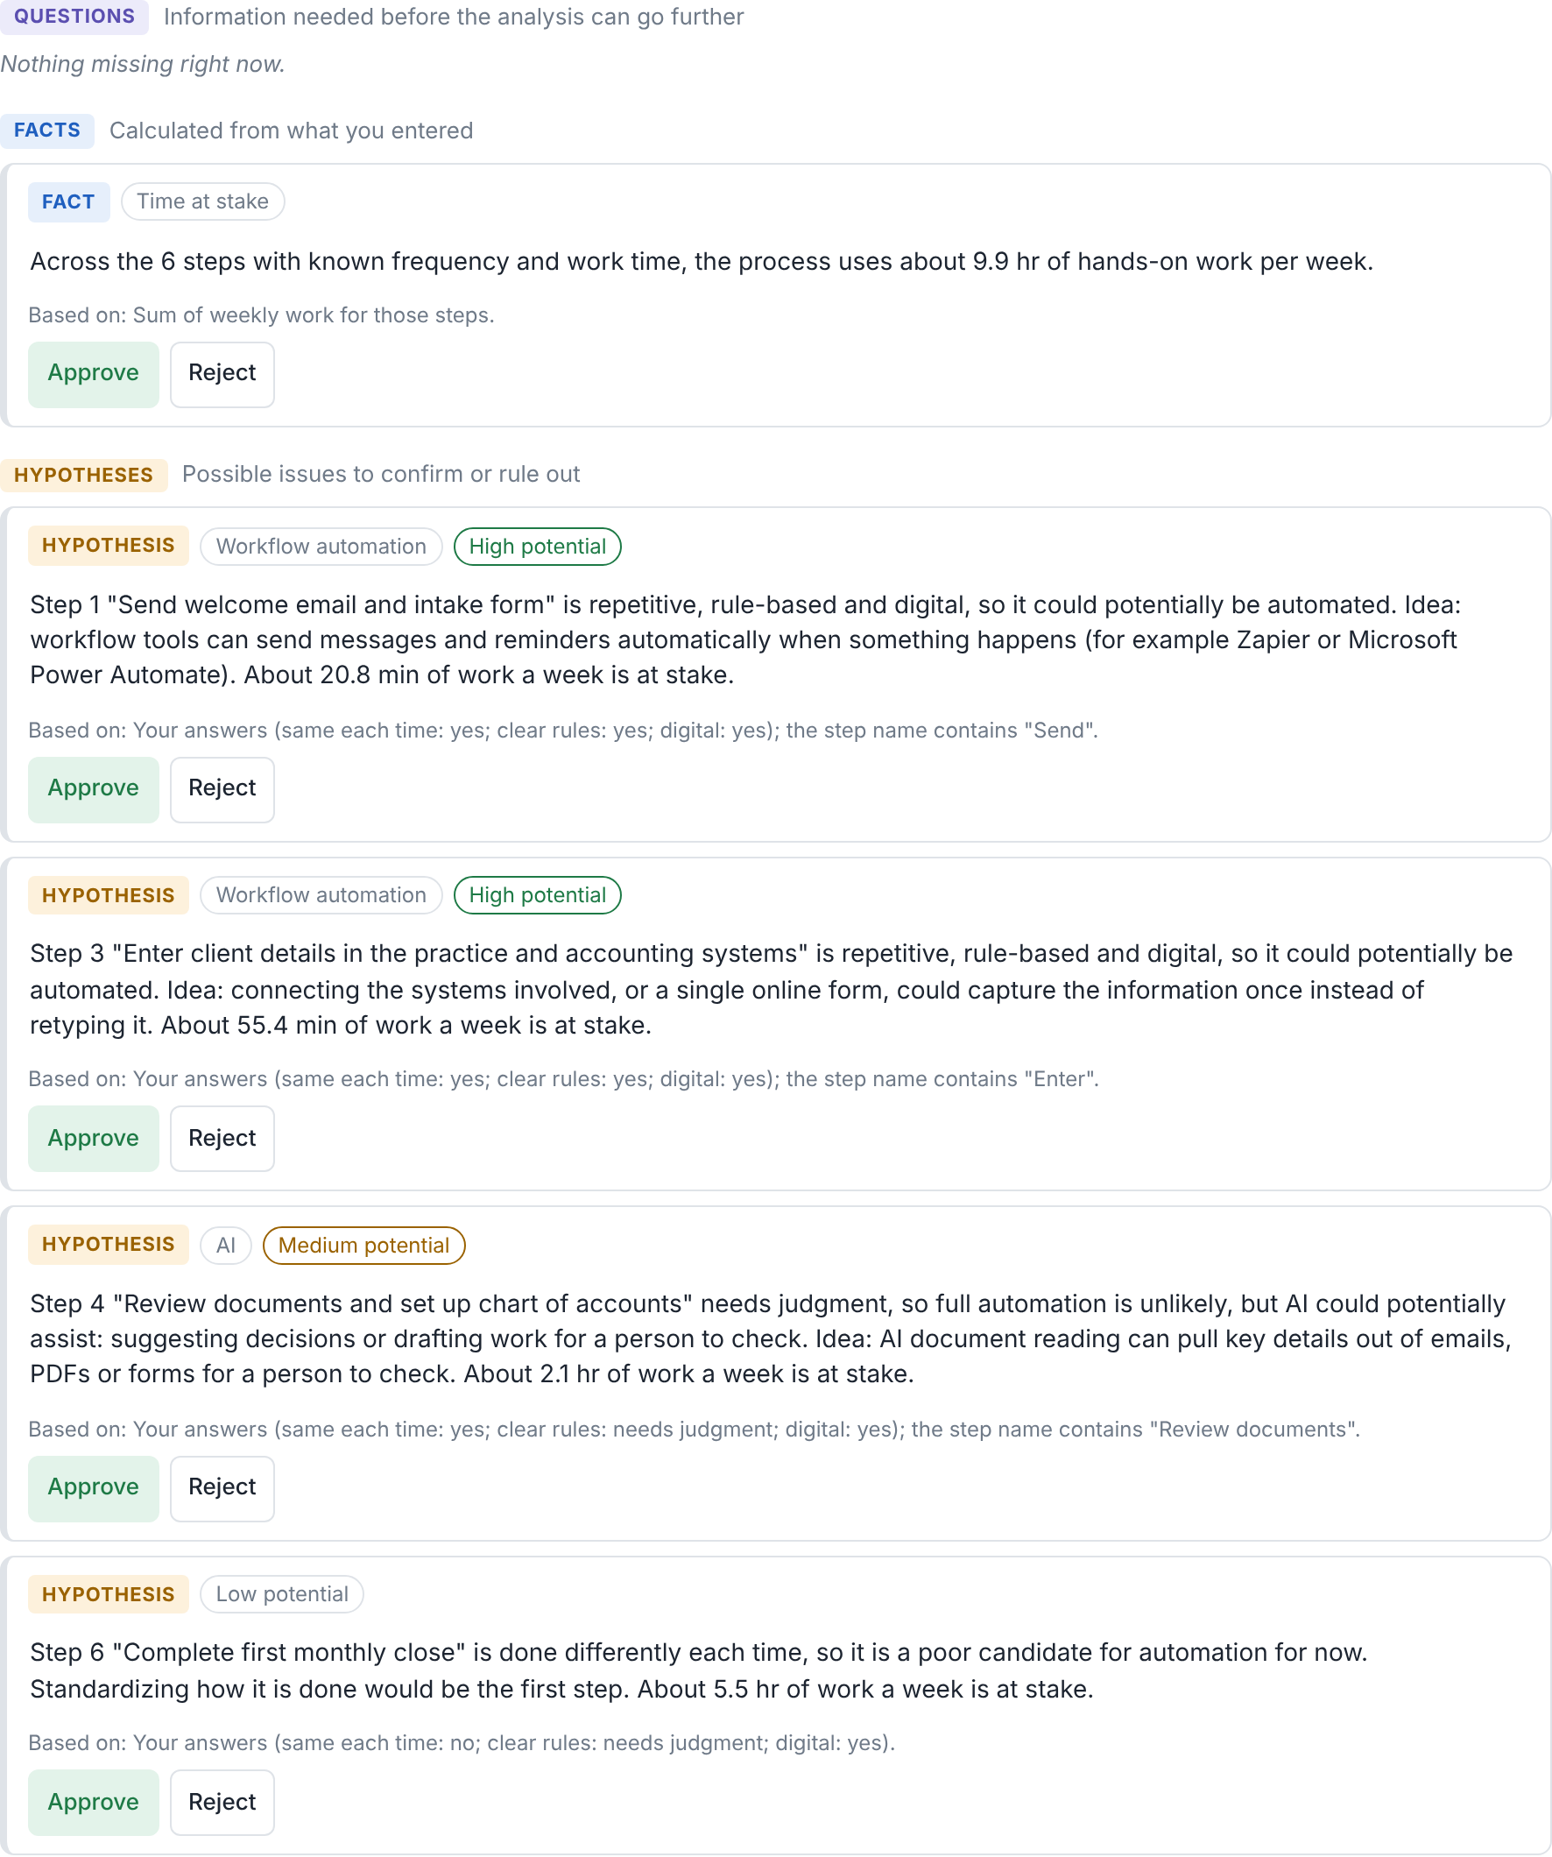
Find what to automate, and what not to
Four plain questions per step, then a potential level and the right kind of fix.
Hours at stake
9.9 hours of hands-on work a week, step by step
3 high-potential steps
Workflow automation or existing software
AI where judgment is needed
Assists a person rather than replacing them
1 poor fit, said plainly
Before any money is spent
ProcessIQ · Examples use fictional sample data (Northwind Bookkeeping)
7 / 13
Notes:
The automation finder asks four plain questions about each step: is it done the same way each time, does it follow clear rules or need judgment, is the information digital, and how often does it happen. From that it measures the hours at stake and recommends a fit: workflow automation, AI assistance, existing software, digitize first, or not worth it yet. That last answer matters: it stops money being spent on the wrong thing.

Slide 8
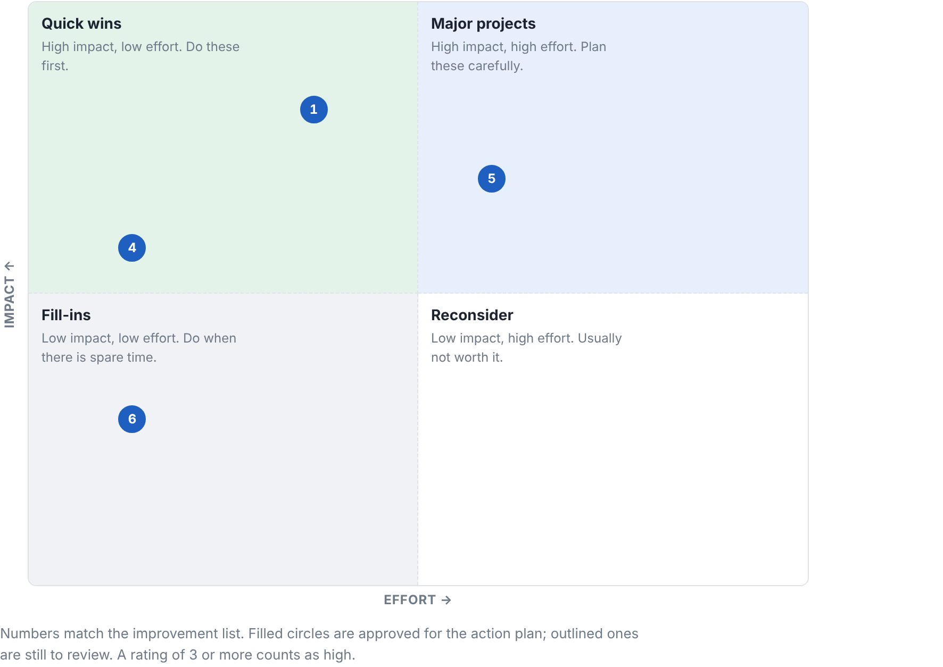
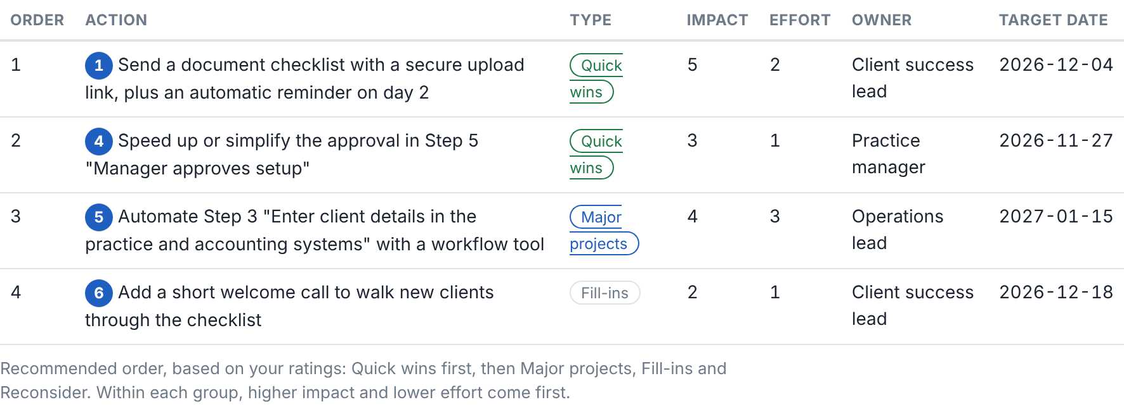
Decide what to fix first
Improvements are rated for impact and effort, then ordered into a plan.
Quick wins first
High impact, low effort
Owners and target dates
On every approved action
Measures that matter
Baseline to target, from the process metrics
A one-page report
Ready to share with the team
ProcessIQ · Examples use fictional sample data (Northwind Bookkeeping)
8 / 13
Notes:
Approved findings, root causes and automation ideas become improvements. Each is rated for impact and effort, placed on the matrix, and ordered: quick wins first, then major projects. Every action gets an owner, a target date, and a measure linked to the process metrics.

Slide 9
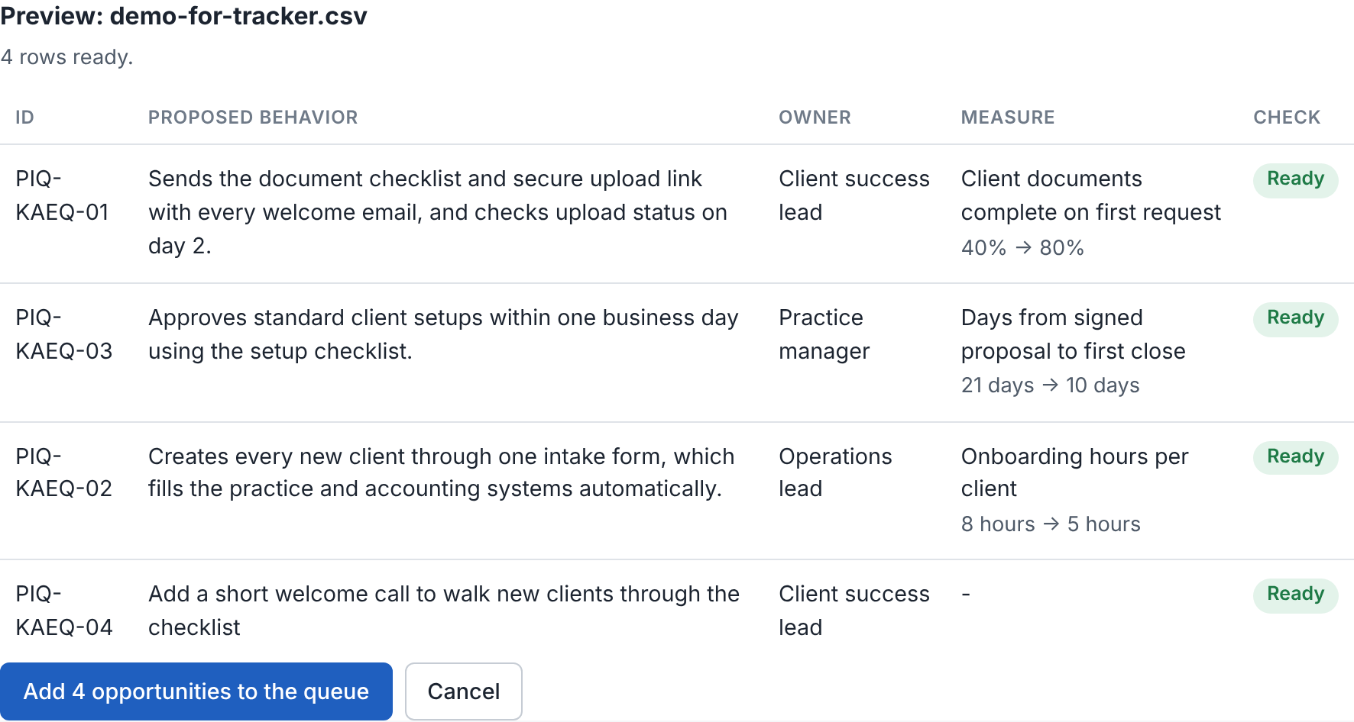
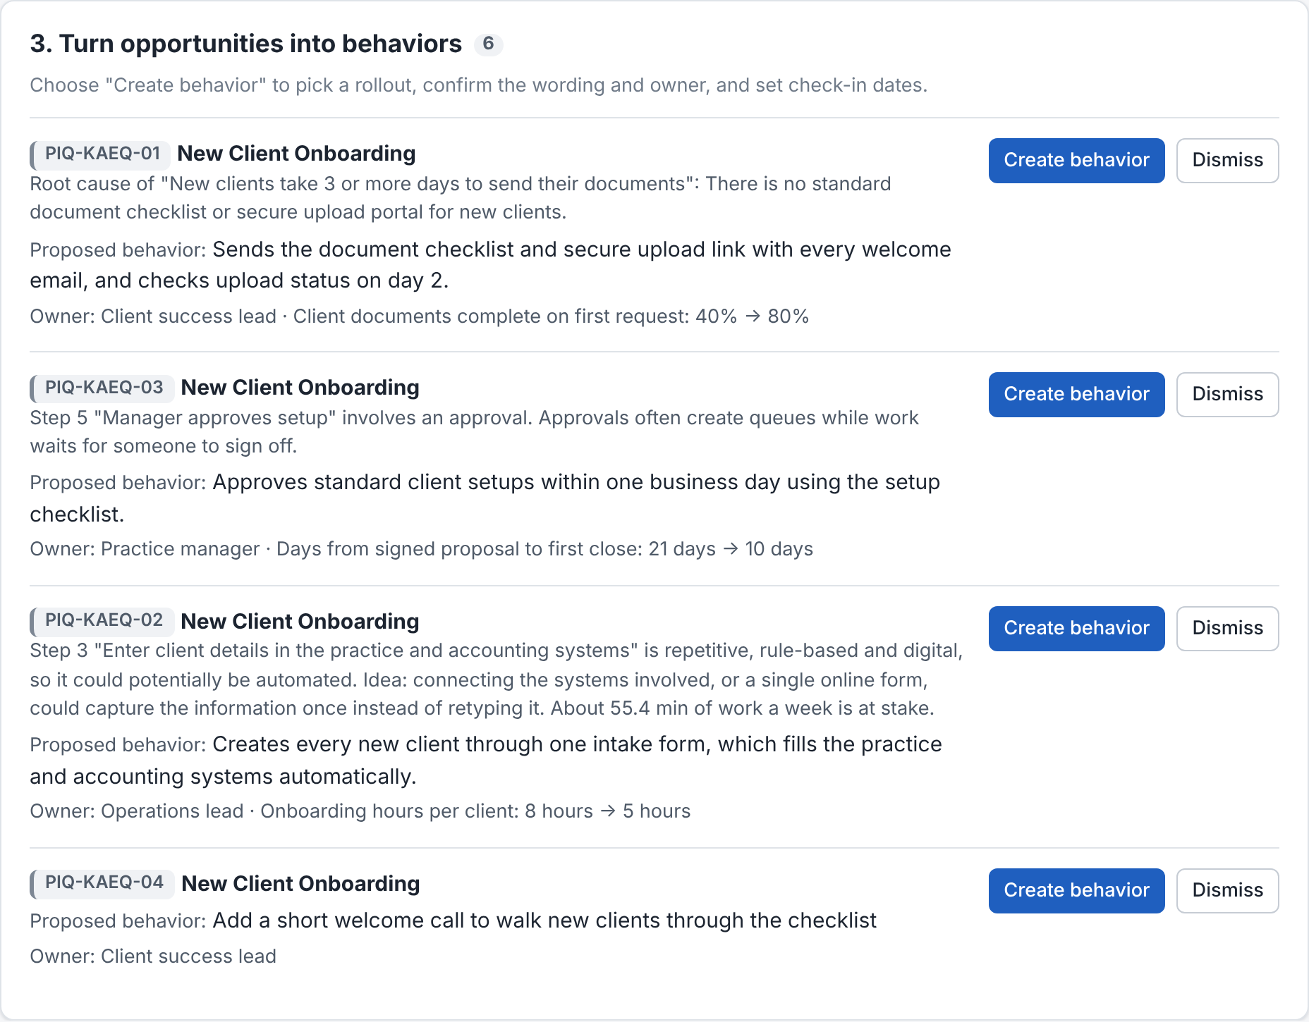
Make sure the change sticks
Approved actions flow into the AI Adoption Follow-Through Tracker.
One click to export
In the tracker's own import format
Permanent IDs
Importing again never duplicates
Measures carry over
For example 40% to 80% complete on first request
Weekly check-ins
Until the new behavior is routine
ProcessIQ · Examples use fictional sample data (Northwind Bookkeeping)
9 / 13
Notes:
The approved plan exports straight into my AI Adoption Follow-Through Tracker. Each action keeps a permanent ID, so importing again never creates duplicates. Behaviors, owners and baseline-to-target measures carry over, and the tracker checks every week whether the new way of working is actually happening.

Slide 10
What the sample analysis surfaced
Fictional sample: new client onboarding at Northwind Bookkeeping.
96%
9.9 hr
1
4
of onboarding time was waiting, not work
of hands-on work a week, measured step by step
root cause, confirmed with evidence
actions with owners, dates and measures
The takeaway: speeding up the work would barely help. Cutting the waiting, starting with a document checklist and upload link, is where the time is.
ProcessIQ · Examples use fictional sample data (Northwind Bookkeeping)
10 / 13
Notes:
Here is what the analysis found in the fictional sample. Nearly all of the onboarding time was waiting rather than work. The scan measured almost ten hours of hands-on work a week. One root cause was confirmed with evidence, and four actions were planned, each with an owner, a date and a measure.

Slide 11
Built to be trusted
?
Asks, never guesses
✓
Nothing approved for you
Missing information becomes a question, not an assumption.
Every finding, root cause and action needs a person's decision.
•
Private by design
AI
AI that's labeled
Your processes stay in your own account and sync across your devices.
Optional Claude suggestions are marked and stay hypotheses until approved.
ProcessIQ · Examples use fictional sample data (Northwind Bookkeeping)
11 / 13
Notes:
A few design choices make the results trustworthy. It asks instead of guessing. Nothing is approved for you. Your data stays private and syncs between your own devices. And AI suggestions are optional, always labeled, and never approved automatically.

Slide 12
How a project could run
1
2
3
4
Discover
Analyze
Plan
Sustain
Map the process with the people who do the work, and set the metrics that matter.
Measure where time goes, confirm root causes, and assess what to automate.
Agree on prioritized actions with owners, dates and measures.
Track adoption weekly until the new way of working holds.
Every stage runs in ProcessIQ, so the map, the evidence, the decisions and the follow-through stay in one place.
ProcessIQ · Examples use fictional sample data (Northwind Bookkeeping)
12 / 13
Notes:
Working together usually follows four stages. Discover: map the process with the people who do the work. Analyze: measure where the time goes, find root causes, and assess automation fit. Plan: agree on prioritized actions with owners and measures. Sustain: track adoption weekly until the change holds.

Slide 13
Let's find what's slowing your process down
Process mapping, root cause analysis, automation assessment, and adoption tracking, in one connected method.
Jason Mosley
Interactive demo available on request
Notes:
If any of this sounds like your process, let's talk. I can walk you through the interactive demo, or we can start by mapping one of your own processes together.

