Slide 1
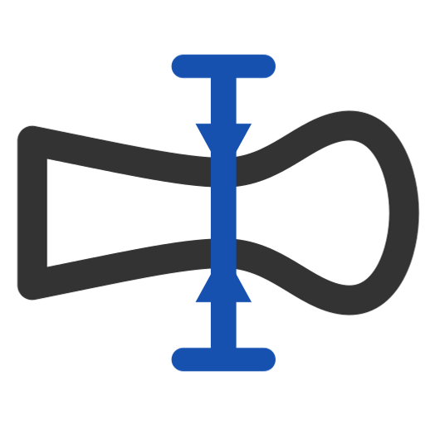
Analyze footprint
Measure any sidecut: dimensions, waist, taper, tip and tail length, average and natural radius, widest and inflection points -- and publish them as variables.
footprint · Onshape custom feature
Draft 2026-09-26

Slide 2

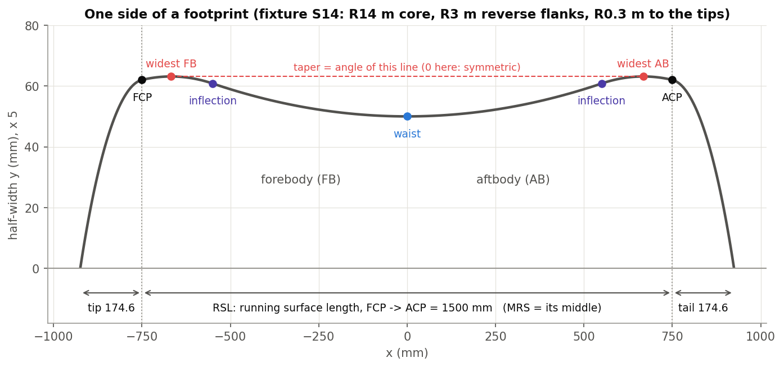
What it does
Comparing sidecuts needs the same numbers, measured the same way: tip-waist-tail, taper, radius. Analyze footprint reads them off any outline -- designed, scaled or imported -- and publishes them for later features.
Use it when
Check a sidecut against its targets
Compare skis in a family
Drive later features from measured values
The points it finds: contacts, widest, inflections, waist.
Analyze footprint · footprint
Draft 2026-09-26

Slide 3
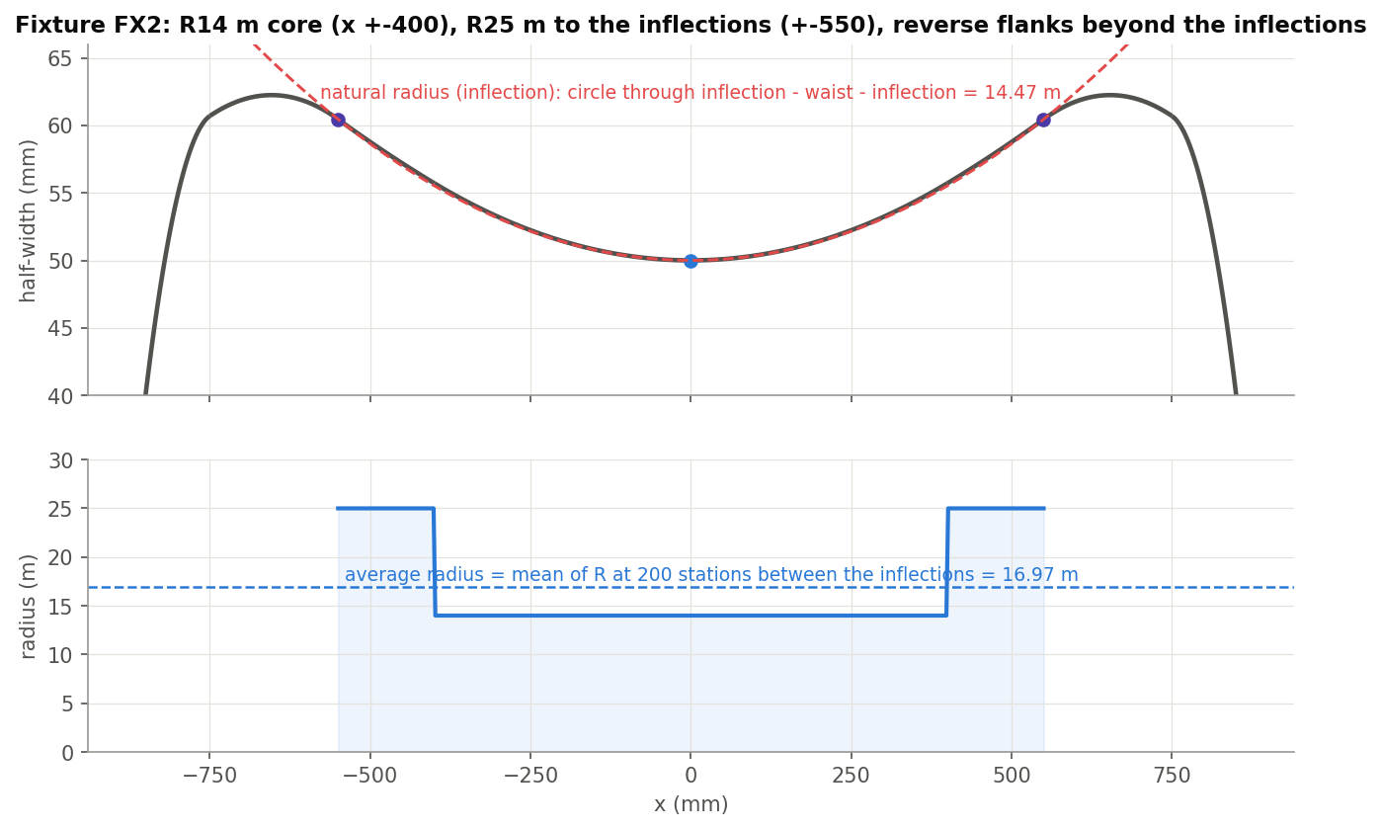
Average vs natural radius
Average
Mean of R at 200 X stations between the inflections -- independent of how the edges are split.
Natural
One circle through inflection - waist - inflection (or widest - waist - widest).
They differ
FX2: 16.97 m average vs 14.47 m natural. Both are right; they answer different questions.
Analyze footprint · footprint
Draft 2026-09-26

Slide 4
The dialog
IMAGE MISSING: docs/decks/analyze_footprint/shots/dialog.png
# | Parameter | What it means
1 | Footprint edges | The sidecut (+Y side).
2 | RSL line | A straight edge FCP to ACP.
3 | FCP | Plane, vertex or mate connector; the nearest point on the RSL line is used.
4 | ACP | As FCP.
5 | Sketch key points | Draw the waist, widest and inflection lines.
6 | Footprint Data | Read-only: tip-waist-tail, waist width and X, taper, tip and tail length.
7 | Radius calculations | Average, natural (widest), natural (inflection).
8 | Widest & Inflection points | Distances from each contact; inflection to widest.
9 | Recalculate | Button: refresh the panel.
Analyze footprint · footprint
Draft 2026-09-26

Slide 5
Examples (Footprint tests)
AF1: S14
Inflections +-550, average 14.00 m, natural (inflection) 14.00 m, natural (widest) 17.00 m, taper 0.
AF2 / AF3: FX2 in 7 or 13 edges
Same result either way: average 16.97 m, natural 14.47 m.
Analyze footprint · footprint
Draft 2026-09-26

Slide 6
Outputs and messages
Published for Extract variables
Messages
Key | What it holds
tipWidth, waistWidth, tailWidth | Full widths at the widest points and the waist.
waistX, tipLength, tailLength | World X of the waist; contact to tip / tail end.
taperAngle | Widest to widest; positive when the tip is wider.
sidecutRadius | The average radius.
output | The key-point sketch (when on).
 | Message / what to do
Info | Tip-waist-tail ... mm | average radius ... | natural radius (inflection) ... Every regeneration, always current.
Analyze footprint · footprint
Draft 2026-09-26

Slide 7
Tips and limits
!
Panel goes stale
The dialog panel updates only when the feature is edited or Recalculate is pressed; the info line and variables are always current.
✓
Any orientation along X
Tip at +X and off-centre skis measure correctly (AF4, AF5); raw sketch arcs too (AF7).
Analyze footprint · footprint
Draft 2026-09-26

Slide 8
Where it lives
Document | footprint (52724f3a857fa52d3ecceb77)
Tab | analyzeFootprint (+ fpt_analyze, predicates)
Tests | Footprint tests studio (build_ / check_footprint_tests.py): AF1-AF7
Explainer | docs/explainers/footprint/footprint_explained.md, section 1.3, 2.2
Related | Integrate footprint, Analyze footprint, Scale Footprint, Arc fit, Generate Footprint Points
Analyze footprint · footprint
Draft 2026-09-26

