Slide 1

Arc fit
Turn freeform coplanar edges into a chain of lines and circular arcs within a position tolerance -- for CAM and for radius callouts.
footprint · Onshape custom feature
Draft 2026-09-26

Slide 2

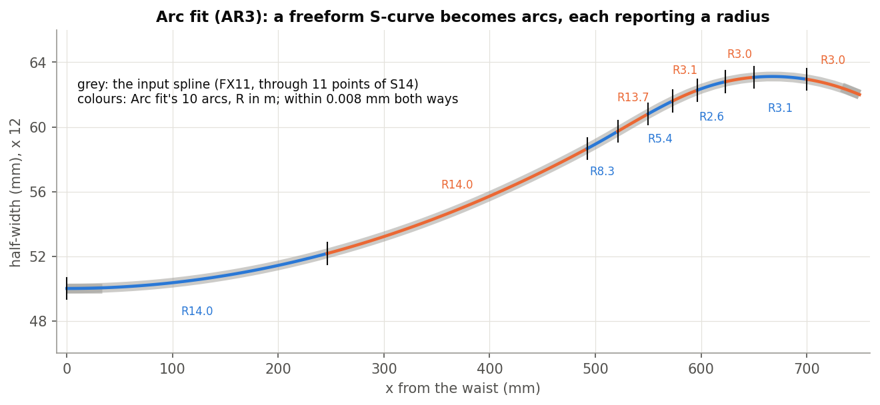
What it does
Machines and drawings want lines and arcs; design curves are splines. Arc fit replaces each edge with the fewest lines and arcs that stay within tolerance, keeping edges that already are arcs or lines.
Use it when
A spline sidecut needs radius callouts
CAM needs line/arc geometry
Check how 'arc-like' a curve is
AR3: a spline S-curve -> 10 arcs within 0.008 mm.
Arc fit · footprint
Draft 2026-09-26

Slide 3
How it fits
Keep what is exact
An edge that already is a circle or line passes through whole.
Biarcs
Each segment: a line, a biarc (two tangent arcs matching the end tangents) or a 3-point arc.
Split, then merge
Split at the worst point until in tolerance; merge neighbours while it stays in tolerance.
Arc fit · footprint
Draft 2026-09-26

Slide 4
The dialog
IMAGE MISSING: docs/decks/arc_fit/shots/dialog.png
# | Parameter | What it means
1 | Edges to fit | Coplanar edges, selected in chain order.
2 | Position tolerance | Largest deviation (0.01 mm); also the join tolerance.
3 | Plane tolerance | Allowed out-of-plane error (0.01 mm).
4 | Minimum segment length | 1 mm.
5 | Tangency tol | No effect today.
6 | Validation samples per arc | Where the deviation is checked (16).
7 | Max subdivision depth | 8.
8 | Output type | Curves / Sketch / Curves and sketch.
9 | Debug | Console diagnostics.
Arc fit · footprint
Draft 2026-09-26

Slide 5
Example: AR3
A spline S-curve (R14 core into an R3 reverse flank), tolerance 0.01 mm
10 arcs, within 0.008 mm both ways, one wire. Also tested: AR1 five exact arcs pass through unchanged; AR2 a spline on an R14 arc -> one arc R14000; AR4 2 mm knot spans with a 10 mm minimum -> no gaps.
Arc fit · footprint
Draft 2026-09-26

Slide 6
Outputs and messages
Published for Extract variables
Messages
Key | What it holds
output | The arc-fit wire (empty when Output type is Sketch).
 | Message / what to do
Error | edges not coplanar (deviation stated) Raise Plane tolerance or fix the input.
Arc fit · footprint
Draft 2026-09-26

Slide 7
Tips and limits
!
Order matters
Select the edges in chain order; they are not re-ordered.
!
Across edges
Arcs are tangent within an input edge, not across input edges.
!
Tight tolerances
Very small tolerances drive every segment to maximum depth: slow.
Arc fit · footprint
Draft 2026-09-26

Slide 8
Where it lives
Document | footprint (52724f3a857fa52d3ecceb77)
Tab | arcFit
Tests | Footprint tests studio (build_ / check_footprint_tests.py): AR1-AR4
Explainer | docs/explainers/footprint/footprint_explained.md, section 2.4
Related | Integrate footprint, Analyze footprint, Scale Footprint, Arc fit, Generate Footprint Points
Arc fit · footprint
Draft 2026-09-26

