Slide 1

Deform
Bend a whole body, or selected faces, onto the profile with the same map -- a flat-modelled insert, core feature or tip protector.
curveMapping_public · Onshape custom feature
Draft 2026-09-26

Slide 2

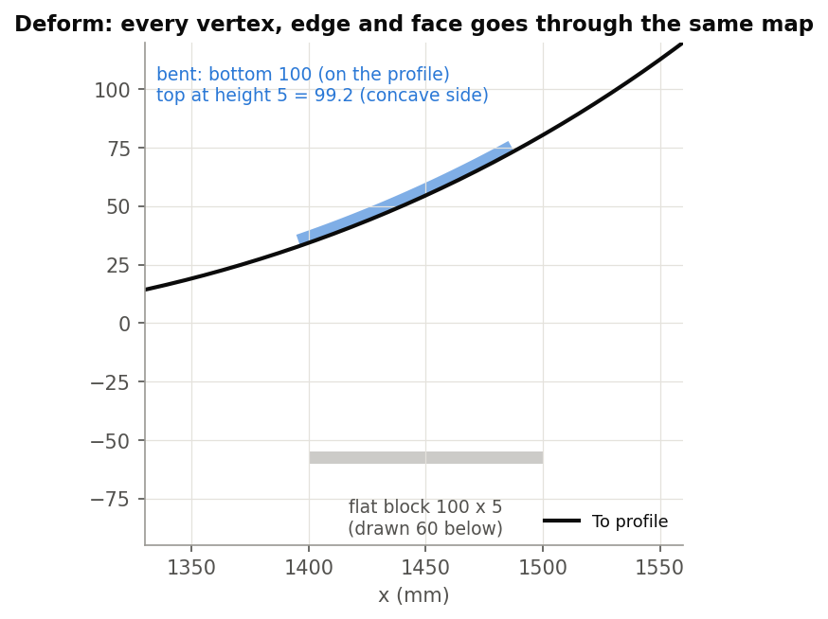
What it does
Parts modelled flat must sit on the curved ski. Native Bend only flexes around an axis. Deform maps every vertex, edge and face through the bending map, so the part follows the profile exactly as a layer would.
Use it when
An insert or protector modelled flat
Features that must follow rocker / camber
Faces rather than a whole body
A 100 x 5 block bent onto the tip: bottom 100, top 99.2 (concave side).
Deform · curveMapping_public
Draft 2026-09-26

Slide 3
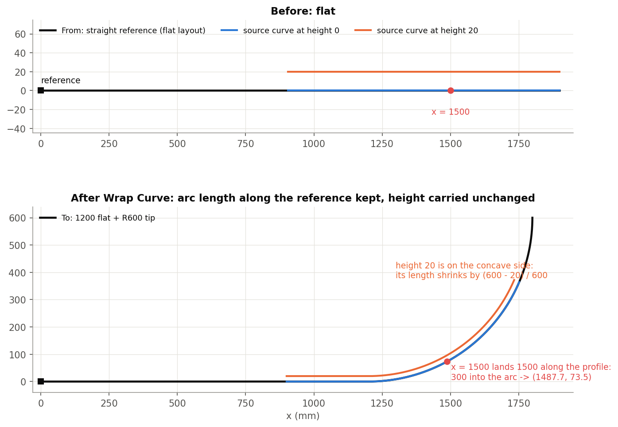
The bending map
Arc length kept
A point s along the From reference lands s along the To reference (a shift, no scaling).
Height and width kept
The point's offsets in the frame carry over: ribs stay perpendicular.
Layers bend
At height h around radius R they stretch or shrink by (R - h) / R, as a real layer does.
Deform · curveMapping_public
Draft 2026-09-26

Slide 4
The dialog
IMAGE MISSING: docs/decks/deform/shots/dialog.png
# | Parameter | What it means
1 | Mode | Bodies (one solid or sheet) / Faces.
2 | From data | From edge(s) (G1 chain) and From reference (vertex, mate connector, plane).
3 | To data | To edge(s), Flip (reverse To), To reference, Flip normal.
4 | Frame orientation | Frenet (default) / Binormal (face, mate connector or world axis).
5 | Setup | Sampling, degree, max control points, tolerance; Use face guide points; Keep wires.
6 | Debug | Create wires / faces / bodies stages; show frames.
Deform · curveMapping_public
Draft 2026-09-26

Slide 5
Outputs and messages
Outputs
Messages
Key | What it holds
(body) | A new body (the source stays); solids closed into solids.
 | Message / what to do
Console | per-face WARNING / ERROR, OPEN END reports Check for a missing face or a sheet instead of a solid.
Deform · curveMapping_public
Draft 2026-09-26

Slide 6
Tips and limits
!
Every face is a fill
Planes and cylinders are not kept as such; inner loops may fail.
✓
Guide points
Turn on Use face guide points when fills do not follow the face.
!
Heavy
The slowest of the family: many edges, many projections.
Deform · curveMapping_public
Draft 2026-09-26

Slide 7
Where it lives
Document | curveMapping_public (d12583277c42b00c63a9b7b7)
Tab | deform (+ engine curveMappingCore)
Tests | none
Explainer | docs/explainers/curve_mapping/curve_mapping_explained.md, section 2.3
Related | Wrap Curve, Wrap and Loft, Deform, Measure curve distance, Offset edges
Deform · curveMapping_public
Draft 2026-09-26

