Slide 1

Generate Footprint Points
Export the sidecut as tip, RSL and tail point tables at equal arc-length spacing, each relative to its own origin -- for CNC, specs and spreadsheets.
footprint · Onshape custom feature
Draft 2026-09-26

Slide 2

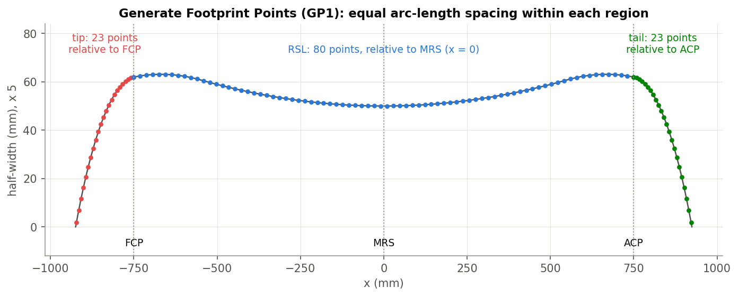
What it does
Shops and spec sheets want numbers, not curves. Generate Footprint Points splits the +Y outline at the contacts and samples each region evenly, in a table you can copy out.
Use it when
Send a sidecut to CNC or a supplier
Fill a spec sheet
Compare outlines point by point
GP1: 23 tip, 80 RSL and 23 tail points on S14.
Generate Footprint Points · footprint
Draft 2026-09-26

Slide 3
The dialog
IMAGE MISSING: docs/decks/generate_footprint_points/shots/dialog.png
# | Parameter | What it means
1 | Geometry Selection Type | FACE (the footprint face) / EDGES (edges or wires).
2 | Footprint Edges | (EDGES) the outline.
3 | RSL Line | FCP to ACP.
4 | Tip toward +X | Off: the tip is the lower-X end; on: the higher-X end.
5 | Include Points | Not used.
6 | Table Formatting | Units, decimal places ('sig figs'), units in cells, point counts 23 / 80 / 23, flips.
7 | Additional options | Keep the region curves / FCP-ACP planes; make sketches of the points.
Generate Footprint Points · footprint
Draft 2026-09-26

Slide 4
Example: GP1
S14, RSL -750 ... 750
Tip: 23 points x -924.567 ... -750 relative to the FCP; RSL: 80 points relative to the MRS; tail: 23 points relative to the ACP. All on the curve, spacing equal to 0.2 %.
Generate Footprint Points · footprint
Draft 2026-09-26

Slide 5
Outputs and messages
Published for Extract variables
Messages
Key | What it holds
tipCurve, rslCurve, tailCurve | The region curves (empty unless Retain curves is on).
Footprint Points table | Reads tipEdgePoints / rslEdgePoints / tailEdgePoints / tableFormat stored on the origin (keep these stable).
 | Message / what to do
(none)
Generate Footprint Points · footprint
Draft 2026-09-26

Slide 6
Tips and limits
✓
Tip at +X
Turn on Tip toward +X; tip and tail swap with their origins (GP2).
!
Last one wins
The stored point lists are shared: the last Generate Footprint Points in the tree feeds the table.
Generate Footprint Points · footprint
Draft 2026-09-26

Slide 7
Where it lives
Document | footprint (52724f3a857fa52d3ecceb77)
Tab | getFootprintPoints
Tests | Footprint tests studio (build_ / check_footprint_tests.py): GP1-GP3
Explainer | docs/explainers/footprint/footprint_explained.md, section 2.5
Related | Integrate footprint, Analyze footprint, Scale Footprint, Arc fit, Generate Footprint Points
Generate Footprint Points · footprint
Draft 2026-09-26

