Slide 1
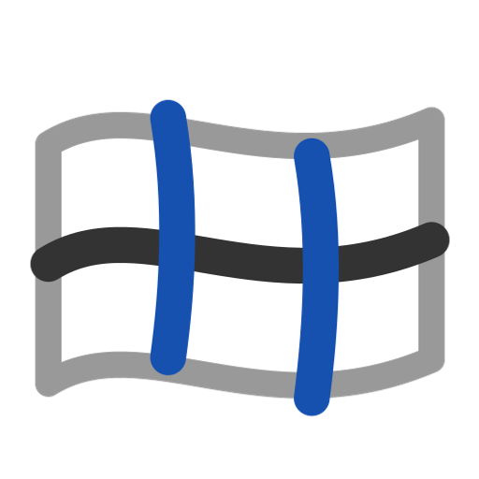
Gordon Surface
One B-spline face through a whole network of crossing curves -- every U curve and every V curve, interior ones included.
gordonSurface · Onshape custom feature
Draft 2026-09-26

Slide 2

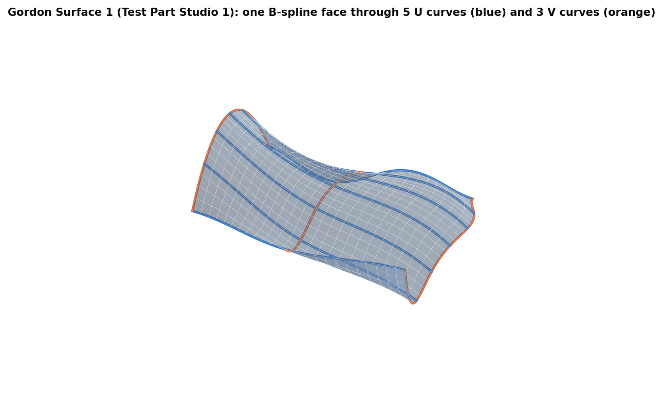
What it does
A loft passes through one family of sections; a boundary surface only through its edges. Gordon Surface passes through a full U x V network, so interior curves shape the face exactly where you drew them.
Use it when
The shape is defined by curves in both directions
Interior curves must lie on the surface
One smooth face instead of patches
Gordon Surface 1: one face through 5 U and 3 V curves.
Gordon Surface · gordonSurface
Draft 2026-09-26

Slide 3
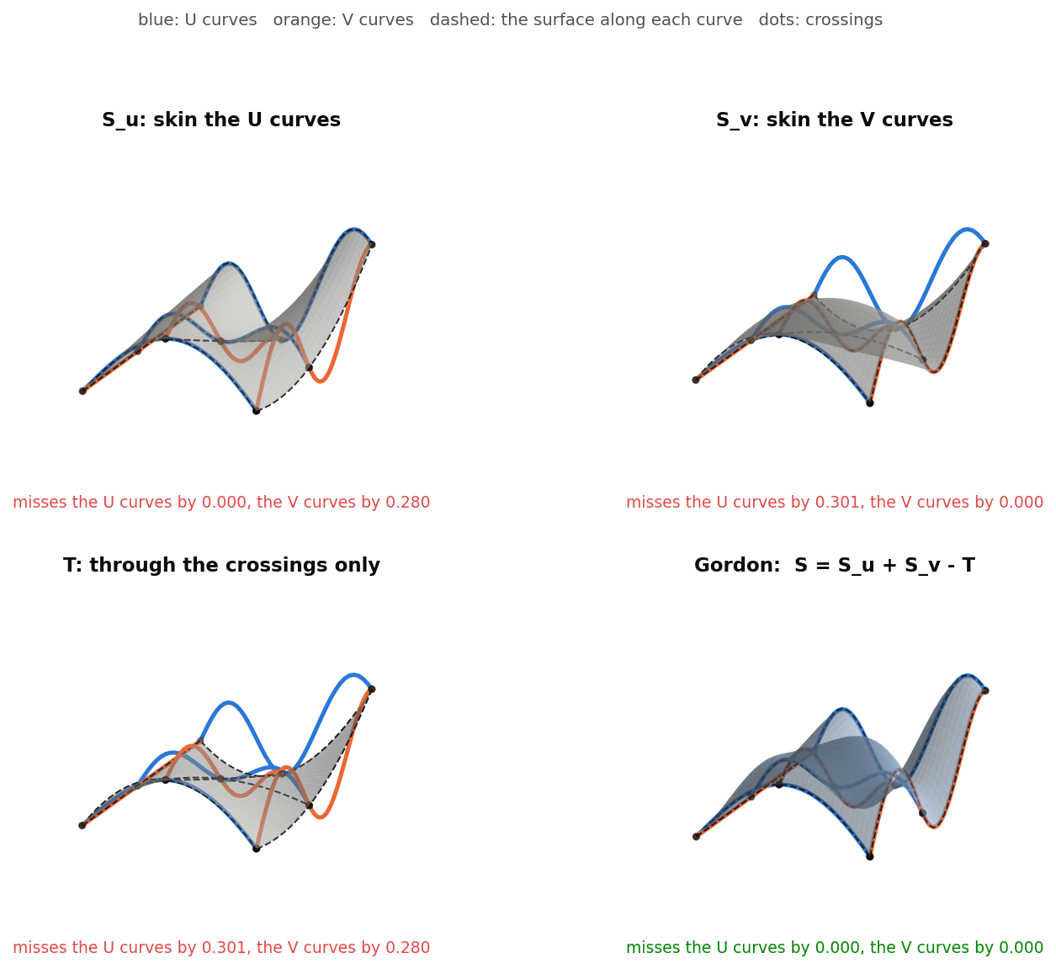
S = S_u + S_v - T
Two skins
S_u through the U curves (misses V); S_v through the V curves (misses U).
Minus the grid
T passes through the crossings only; along each curve it cancels the other skin.
Exact on both
The sum reproduces every curve; done control point by control point once compatible.
Gordon Surface · gordonSurface
Draft 2026-09-26

Slide 4
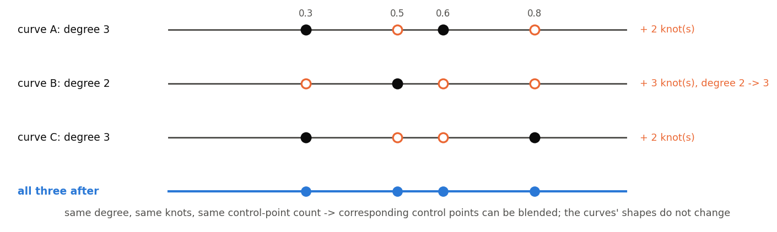
Compatible curves
Same degree
Every curve raised to the highest degree -- exactly.
Same knots
The union of all interior knots inserted into every curve -- exactly.
Then blend
Corresponding control points can be combined; the shapes do not change.
Gordon Surface · gordonSurface
Draft 2026-09-26

Slide 5
The dialog
IMAGE MISSING: docs/decks/gordon_surface/shots/dialog.png
# | Parameter | What it means
1 | U-Curves | Up to 10 edges, in section order (the pick order is used).
2 | V-Curves | The crossing family, in order.
3 | Debug and details | Create S_u / S_v / tensor sheets, show curves (on), print, degree in u and v (3).
Gordon Surface · gordonSurface
Draft 2026-09-26

Slide 6
Outputs and messages
Outputs
Messages
Key | What it holds
Gordon surf | One sheet body.
 | Message / what to do
Error | Need at least 2 curves Per family.
Error | (dimension mismatch) The network is inconsistent.
Gordon Surface · gordonSurface
Draft 2026-09-26

Slide 7
Tips and limits
✓
Seed with Interior curves
Four boundaries -> interior curves that are guaranteed to cross.
!
Curves must cross
Every U must cross every V, in order; a near miss is used silently (midpoint of the closest points).
!
Averaged crossings
Uneven crossing parameters make the fit approximate; arcs' weights are ignored.
Gordon Surface · gordonSurface
Draft 2026-09-26

Slide 8
Where it lives
Document | gordonSurface (d0950ed72a894fbe35c27d43)
Tab | gordonSurface (+ gordonCurveCompat)
Tests | none yet
Examples | Test Part Studio 1: Gordon Surface 1, 2
Explainer | docs/explainers/gordon_surface/gordon_surface_explained.md, section 1.1, 1.2, 2.1
Related | Gordon Surface, Interior curves, Scaled Curve, Modify curve end, Pull surface, Simplify surface
Gordon Surface · gordonSurface
Draft 2026-09-26

