Slide 1

Integrate footprint
Design a sidecut from its radius: draw the radius along the ski as sketch lines, get the outline -- exact arcs where the radius is constant, placed so the waist lands where you ask.
footprint · Onshape custom feature
Draft 2026-09-26

Slide 2

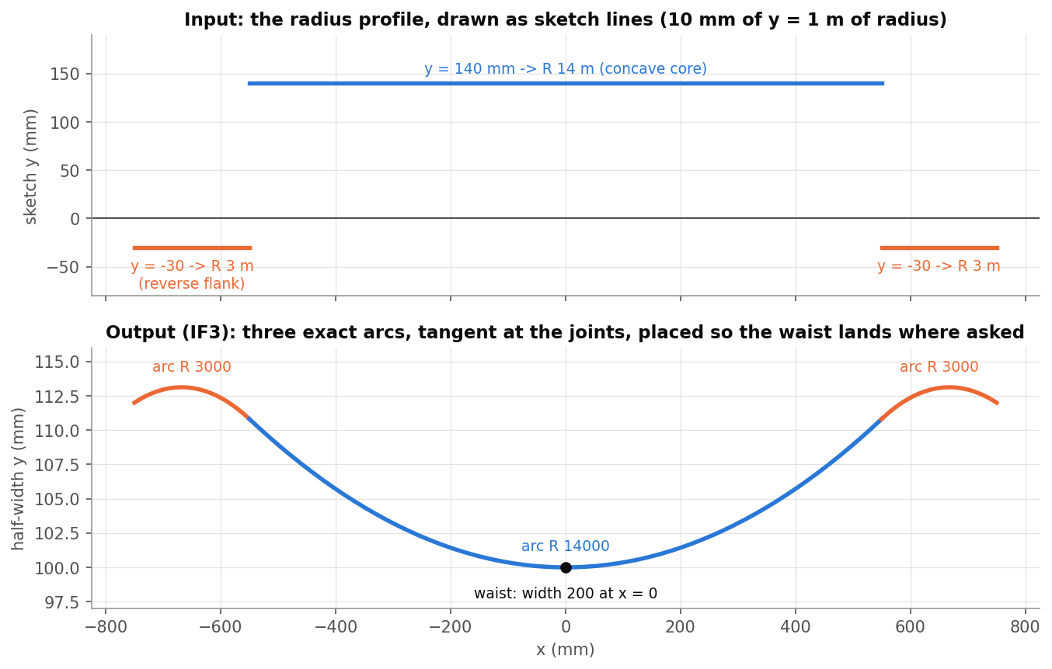
What it does
A sidecut is designed by its radii, but drawn as an outline. Integrate footprint turns a radius profile into the outline: curvature integrated twice, with the waist location (or taper) and width you set. Constant-radius stretches come out as true arcs that report their radius.
Use it when
Start a sidecut from radius targets
Try a reverse-radius flank or a transition
Need arcs that show 'R 14000' when clicked
IF3: profile lines at R14 m and R3 m (reverse) -> three exact, tangent arcs.
Integrate footprint · footprint
Draft 2026-09-26

Slide 3
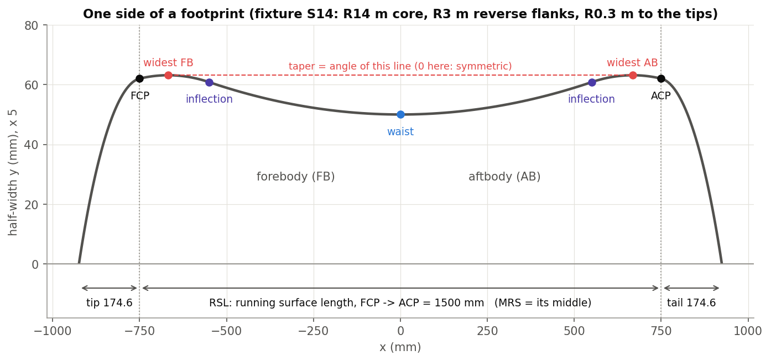
The words
Contacts and RSL
FCP / ACP where the ski meets the snow; RSL between them, MRS its middle.
Waist, widest, inflection
Narrowest point; widest point of each half; where the curvature changes sign.
Taper
Angle of the line joining the widest points; positive when the tip is wider.
Integrate footprint · footprint
Draft 2026-09-26

Slide 4
Exact where it matters
Constant radius -> arc
Closed form sin(phi) = sin(phi0) + (x - x0) / R: an exact circle, emitted as a sketch arc.
Changing radius -> spline
A sloped profile line is integrated numerically and joins the arcs tangentially.
Placed by a solver
Tangent angle solved so the waist lands at the waist location (or the taper matches), then shifted to the waist width.
Integrate footprint · footprint
Draft 2026-09-26

Slide 5
The dialog (1/2)
IMAGE MISSING: docs/decks/integrate_footprint/shots/dialog.png
# | Parameter | What it means
1 | Spline method | APPROX / FIT: how transition splines are made.
2 | Build Mode | One curve per same-sign region, or per profile edge.
3 | Unify curves | One curve for all (ignored when there are arcs).
4 | Strict | Force arcs / lines -- rational curves that do NOT report a radius.
5 | Waist/Taper Angle Calculations | WAIST: place the narrowest point; TAPER: set the overall taper angle.
6 | Waist location | World X of the waist (65 mm).
7 | Waist width | Full width at the waist (95 mm).
Integrate footprint · footprint
Draft 2026-09-26

Slide 6
The dialog (2/2)
IMAGE MISSING: docs/decks/integrate_footprint/shots/dialog.png
# | Parameter | What it means
8 | Radius Profile(s) | The profile sketch lines: 10 mm of y = 1 m of radius; below y = 0 = reverse.
9 | Contact points | FCP sets which end is the forebody (taper sign). ACP is not used yet.
10 | Integration definition | Y-axis scaling: 10 / 20 / 50 / 100 mm per metre.
11 | Spline approximation parameters | Degree, maximum control points, tolerance.
12 | Debug & details | Samples per profile edge; group output into one wire.
13 | Recalculate? | No effect.
Integrate footprint · footprint
Draft 2026-09-26

Slide 7
Example: IF3
Profile: R14 m core line (y = 140), R3 m reverse flanks (y = -30); waist width 200 at x = 0
Three exact arcs R3000 / R14000 / R3000, tangent at the joints; widest points exactly at x = +-667.857. Also tested: IF1 one line -> one arc R14000; IF2 25 / 14 / 25 m -> three arcs; IF5 placed by taper 0.25 deg; IF6 sloped transitions -> exact core + 2 tangent splines.
Integrate footprint · footprint
Draft 2026-09-26

Slide 8
Outputs and messages
Outputs
Messages
Key | What it holds
(wire) | One +Y side wire: sketch arcs for constant radius, splines for transitions.
 | Message / what to do
(none) | No messages; a solver that does not converge stops on its last try silently.
Integrate footprint · footprint
Draft 2026-09-26

Slide 9
Tips and limits
✓
Horizontal lines for arcs
Only a constant-radius (horizontal) profile line gives an exact arc.
!
Profile edges
An edge may not cross y = 0: split concave and reverse regions.
!
Strict
Its arcs are rational splines and report no radius; leave it off for radius callouts.
Integrate footprint · footprint
Draft 2026-09-26

Slide 10
Where it lives
Document | footprint (52724f3a857fa52d3ecceb77)
Tab | integrateFootprint (+ fpt_geometry, arcFit)
Tests | Footprint tests studio (build_ / check_footprint_tests.py): IF1-IF8
Explainer | docs/explainers/footprint/footprint_explained.md, section 1.2, 2.1
Related | Integrate footprint, Analyze footprint, Scale Footprint, Arc fit, Generate Footprint Points
Integrate footprint · footprint
Draft 2026-09-26

