Slide 1

Interior curves
From four boundary chains, make interior U and V curves that are guaranteed to cross -- a ready network for Gordon Surface.
gordonSurface · Onshape custom feature
Draft 2026-09-26

Slide 2

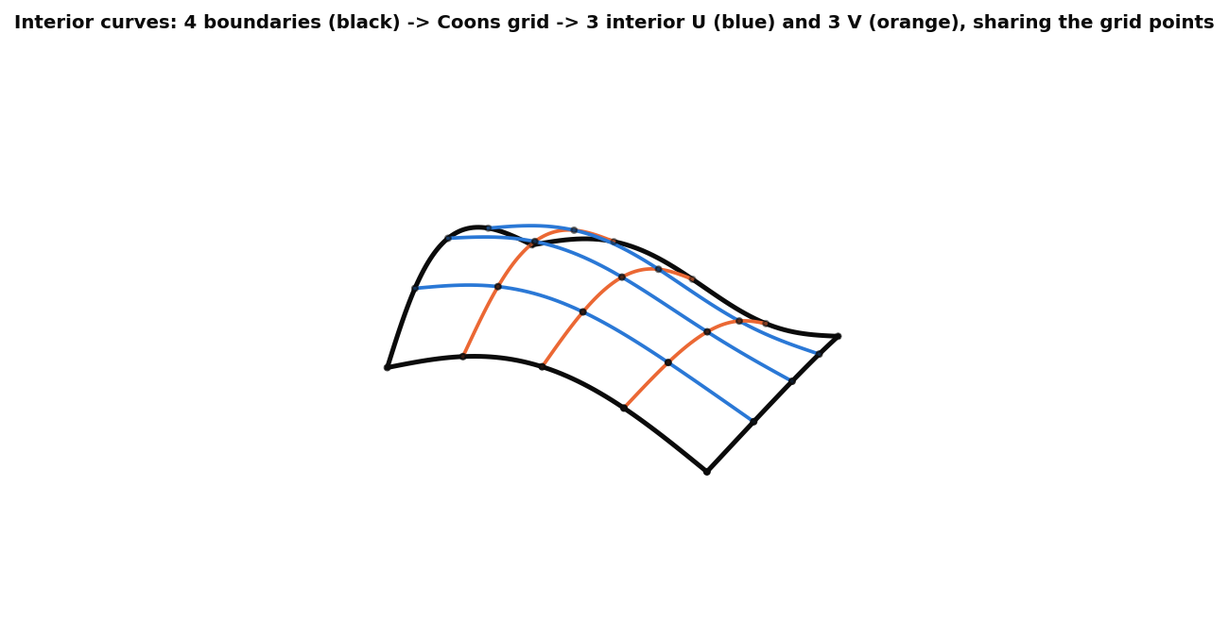
What it does
A Gordon network needs curves that actually cross. Interior curves fills a four-sided boundary with the rows and columns of a Coons patch, which share their grid points by construction.
Use it when
Start a Gordon network from its boundary
Need crossing interior curves to edit later
4 boundaries -> Coons grid -> 3 + 3 interior curves.
Interior curves · gordonSurface
Draft 2026-09-26

Slide 3
The dialog
IMAGE MISSING: docs/decks/interior_curves/shots/dialog.png
# | Parameter | What it means
1 | U0 | Boundary chain (edges joined).
2 | U1 | Opposite boundary.
3 | V0 | Crossing boundary.
4 | V1 | Opposite crossing boundary.
5 | Interior U cure count | Interior U curves (3; 1-15).
6 | Interior V cure count | Interior V curves (3).
7 | Debug & Details | Print curve data (its output tolerance / degree are not used).
Interior curves · gordonSurface
Draft 2026-09-26

Slide 4
Outputs and messages
Outputs
Messages
Key | What it holds
interiorU_i, interiorV_i | The interior wires.
 | Message / what to do
Error | Boundary curves don't form a closed loop at v0
Interior curves · gordonSurface
Draft 2026-09-26

Slide 5
Tips and limits
!
Coarse
Each curve is fitted through count + 2 points (3 x 3 -> 5 points each).
!
Uniform in parameter
Not in length; prototype, untested.
Interior curves · gordonSurface
Draft 2026-09-26

Slide 6
Where it lives
Document | gordonSurface (d0950ed72a894fbe35c27d43)
Tab | interiorCurves (symbol myFeature)
Tests | none yet
Examples | Test Part Studio 1: Interior curves 1
Explainer | docs/explainers/gordon_surface/gordon_surface_explained.md, section 2.2
Related | Gordon Surface, Interior curves, Scaled Curve, Modify curve end, Pull surface, Simplify surface
Interior curves · gordonSurface
Draft 2026-09-26

