Slide 1

Iterative Solve
Find the value of one variable that makes a result -- a variable, a mass or a volume -- hit a target, by re-running a list of features; keep only the answer.
solvers · Onshape custom feature
Draft 2026-09-26

Slide 2

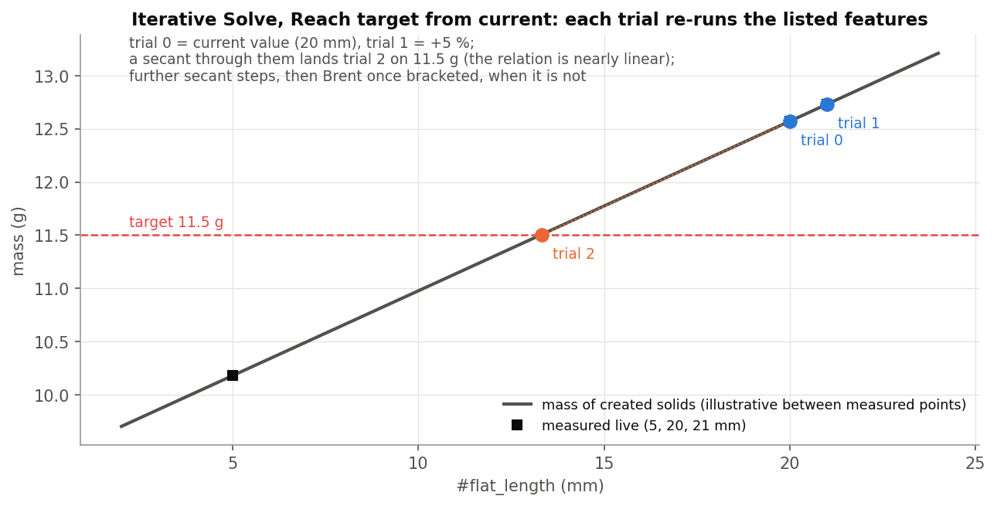
What it does
Setting one number so a result comes out right usually means a Pattern 'Reapply features' trick: slow (about 6 % closer per pass) and it keeps every pass. Iterative Solve treats the listed features as a function of the variable, solves for the target and keeps only the accepted trial.
Use it when
A dimension must give a target mass or volume
A variable must make another variable hit a value
Find the first value that meets a condition
Stray_Weight: #flat_length for a target mass -- trial 2 lands on it.
Iterative Solve · solvers
Draft 2026-09-26

Slide 3
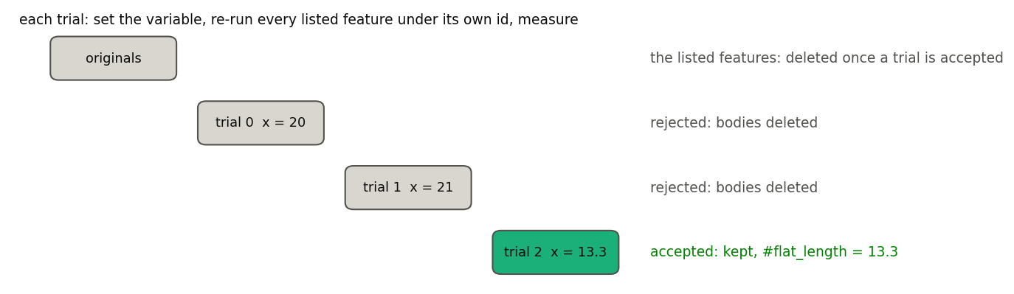
Trials
One trial
Set the variable, re-run every listed feature under its own id, measure.
Keep the answer
Rejected trials are deleted; the accepted one is kept, the originals deleted, the variable set.
No answer
An error rolls the whole feature back; the originals stay.
Iterative Solve · solvers
Draft 2026-09-26

Slide 4
Methods
From the current value
Current, then +5 %; secant steps; Brent once the target is bracketed.
Both bounds
A trial at each bound (they must bracket), then Brent.
First match
Even steps from lower to upper; stop at the first value meeting <, <=, > or >=.
Iterative Solve · solvers
Draft 2026-09-26

Slide 5
The dialog (1/2)
IMAGE MISSING: docs/decks/iterative_solve/shots/dialog.png
# | Parameter | What it means
1 | Features to iterate | The features to re-run (tree order).
2 | Iteration variable | The name, without #; must exist upstream.
3 | Variable type | Length / Angle / Number.
4 | Lower bound | Search range. Lower = upper by default: an error until you set them.
5 | Upper bound | Upper end of the search range.
6 | Method | Reach target / First value meeting condition.
Iterative Solve · solvers
Draft 2026-09-26

Slide 6
The dialog (2/2)
IMAGE MISSING: docs/decks/iterative_solve/shots/dialog.png
# | Parameter | What it means
7 | Start from | Current value (+ First step %, 5) / Both bounds.
8 | Result | Variable / Mass of created solids (+ density) / Volume of created solids; Store result as.
9 | Target from variables | On: target and tolerance variables, re-read each trial. Off: typed target and tolerance.
10 | Max trials | 30.
11 | Debug | Watch variables, feature trace, keep failed trial, run once at a value.
Iterative Solve · solvers
Draft 2026-09-26

Slide 7
Outputs and messages
Published for Extract variables
Messages
Key | What it holds
#<iteration variable> | The solution.
<Store result as> | Optional: the mass (g) or volume (mm^3) at the solution.
(bodies) | The accepted trial's bodies.
 | Message / what to do
Info | #x = ... after N trials; result ... Normal.
Error | The target lies beyond the lower / upper bound Widen the bounds or change the target.
Error | The bounds do not bracket the target / No value met the condition
Error | The result does not depend on the iteration variable Do the listed features read it?
Iterative Solve · solvers
Draft 2026-09-26

Slide 8
Tips and limits
✓
Set the tolerances
Length tolerance defaults to 25 mm and angle tolerance to 0 (exact).
!
Downstream references
They bind to <solver>trialN<feature> and break if a later edit accepts a different trial.
✓
Probe first
Debug > Run once at a value builds one trial without searching.
!
Cost
Every trial re-runs the whole list.
Iterative Solve · solvers
Draft 2026-09-26

Slide 9
Where it lives
Document | solvers (3cf445f157b6a28aa1d35fcf; named 'Stray_Weight_Concept_1' in Onshape)
Tabs | iterative_solve, solver_core
Tests | verified live 2026-09-22 (Stray_Weight, Design_Master derive); no test studio
Explainer | docs/explainers/solvers/solvers_explained.md
Related | Part Volume
Iterative Solve · solvers
Draft 2026-09-26

