Slide 1
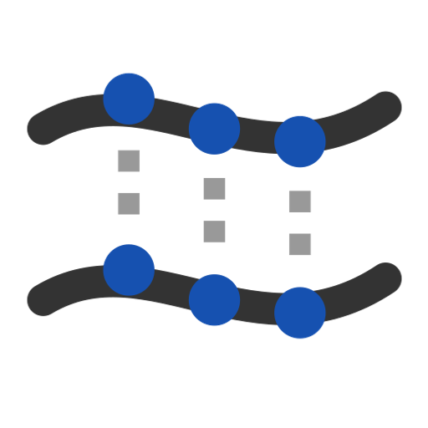
makeCurvesCompitable
Developer utility: make selected curves share degree and knots, and print a before / after report.
gordonSurface · Onshape custom feature
Draft 2026-09-26

Slide 2

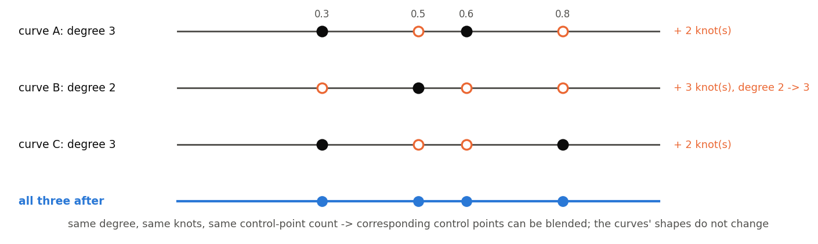
What it does
Every surface-from-curves tool here first makes curves compatible. This feature exposes that step for checking: what degrees, knots and control-point counts the curves have before and after.
Use it when
Diagnose a skinning or Gordon problem
Inspect curve structure
Degree elevation and knot union, exact.
makeCurvesCompitable · gordonSurface
Draft 2026-09-26

Slide 3
The dialog
Parameter | What it means
Edges to make compatible | The curves (in selection order).
Print Report? | Degrees, control-point counts, knots, rational flags, match checks -- before and after.
Create wire? | Output the compatible curves as wires compatibleBSpline_i (shapes unchanged).
makeCurvesCompitable · gordonSurface
Draft 2026-09-26

Slide 4
Tips and limits
!
Name and description
The feature name is misspelled and its description is empty.
!
Rational input
Edges are read without forcing non-rational.
makeCurvesCompitable · gordonSurface
Draft 2026-09-26

Slide 5
Where it lives
Document | gordonSurface (d0950ed72a894fbe35c27d43)
Tab | gordonCurveCompat
Tests | none
Examples | none
Explainer | docs/explainers/gordon_surface/gordon_surface_explained.md, section 1.1, 2.7
Related | Gordon Surface, Interior curves, Scaled Curve, Modify curve end, Pull surface, Simplify surface
makeCurvesCompitable · gordonSurface
Draft 2026-09-26

