Slide 1
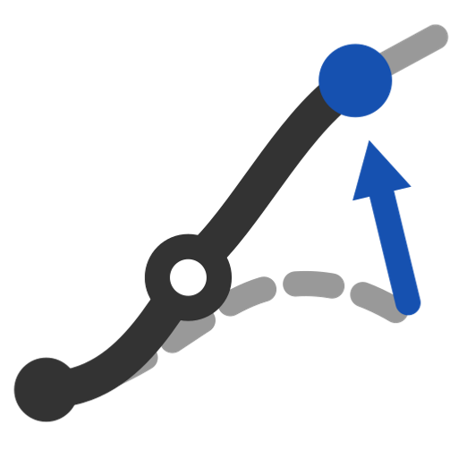
Modify curve end
Move one end of a curve, chain or wire to a new point and blend the change back -- hold part of the curve exactly, keep G1/G2 there, and match the end to a reference.
gordonSurface · Onshape custom feature
Draft 2026-09-26

Slide 2
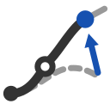
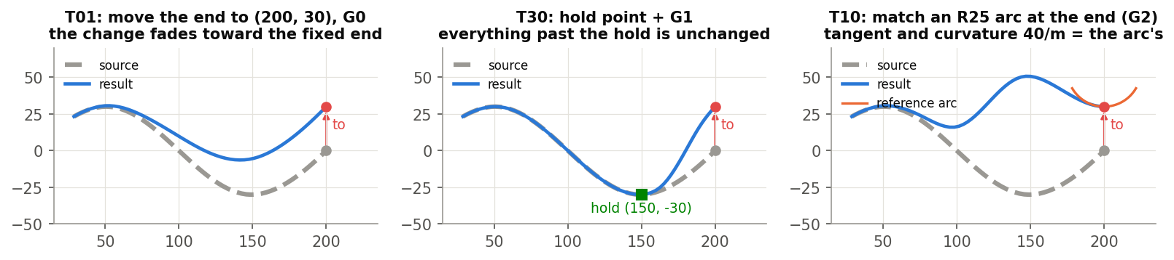
What it does
Moving an end of a network curve usually means redrawing it. Modify curve end edits the curve's own control points: the end goes where you ask, the change fades back, and whatever you hold stays exactly as it was.
Use it when
Stretch a curve to a new corner of the network
Keep most of a curve untouched
Land an end tangent (or curvature-continuous) to an edge, face or mate connector
T01 move, T30 hold, T10 match an arc (G2).
Modify curve end · gordonSurface
Draft 2026-09-26

Slide 3
How it works
Control points, not a refit
Free control points move by a share of the offset that fades by arc length; the last moves fully.
Exact hold
Knots at the hold make the held part depend only on locked control points; G1 / G2 lock one / two more.
Closed-form end
Tangent (and curvature) of an edge, face or mate connector set directly on the last control points.
Modify curve end · gordonSurface
Draft 2026-09-26

Slide 4
The dialog
IMAGE MISSING: docs/decks/modify_curve_end/shots/dialog.png
# | Parameter | What it means
1 | Edges or wire to modify | An edge, a chain in any order, or a wire; open, unbranched.
2 | Modified end | The end to move (empty = the chain's end).
3 | To point | Where it goes (empty = stays / snaps onto the reference).
4 | Hold part of the curve | Hold by Point or Distance (arc length from the modified end).
5 | Parameters | Transition type; continuity at the fixed end / hold (G0 / G1 / G2); end reference.
6 | Project onto surface? | + face: only the part after the hold is projected (G1 kept at the hold).
7 | Debug, Details | Degree, tolerance, max control points of a merged chain, sampling multiple, print.
Modify curve end · gordonSurface
Draft 2026-09-26

Slide 5
End reference (in Parameters)
Parameter | What it means
Endpoint continuity ref. | An edge, a face or a mate connector.
Opposite direction | Reverse the end tangent.
Match | G0 / G1 / G2 at the moved end.
End curvature | (G2) Match the reference / Zero / Radius.
End radius | 100 mm; bends toward the connector's X, else the edge's normal, else the curve's own.
Offset frame | No effect any more (kept for saved features).
Modify curve end · gordonSurface
Draft 2026-09-26

Slide 6
Example: hold point (T30)
End (200, 0) -> (200, 30); hold at (150, -30), G1
Everything from the fixed end to the hold is unchanged (under 1 micron); the tangent at the hold is kept. T10: matching an R25 arc gives end curvature 40/m, as the arc.
Modify curve end · gordonSurface
Draft 2026-09-26

Slide 7
Outputs and messages
Published for Extract variables
Messages
Key | What it holds
output | The modified curve (one wire).
movedVertex | The end at the To point.
holdVertex | The hold point, or the fixed end when there is no hold.
 | Message / what to do
Info | Notes: no Modified end picked, hold has no effect, G0 hold leaves a corner, reference far away, handle shortened, projection keeps G1 only One line.
Error | branched / several chains / closed chain Select one open chain.
Error | hold point missing or at the modified end; hold distance longer than the curve
Modify curve end · gordonSurface
Draft 2026-09-26

Slide 8
Tips and limits
✓
Hold instead of G2 everywhere
A hold keeps the part you care about exactly; blend only the rest.
✓
Mate connector reference
Z = the end tangent, X = the bend side; set a radius for exact end curvature (T13).
!
Projection
Keeps the end tangent only if it lies in the face; end curvature cannot be kept.
Modify curve end · gordonSurface
Draft 2026-09-26

Slide 9
Where it lives
Document | gordonSurface (d0950ed72a894fbe35c27d43)
Tab | modifyCurveEnd
Tests | Gordon tools tests: T01-T40 (all pass)
Examples | Test Part Studio 1: Modify curve end 1
Explainer | docs/explainers/gordon_surface/gordon_surface_explained.md, section 2.4
Related | Gordon Surface, Interior curves, Scaled Curve, Modify curve end, Pull surface, Simplify surface
Modify curve end · gordonSurface
Draft 2026-09-26

