Slide 1

Move Along Edge
Move or copy bodies, mate connectors, sketch edges or points along an edge, chain or wire -- by a distance along it, or to the point nearest a target.
smallTools · Onshape custom feature
Draft 2026-09-26

Slide 2

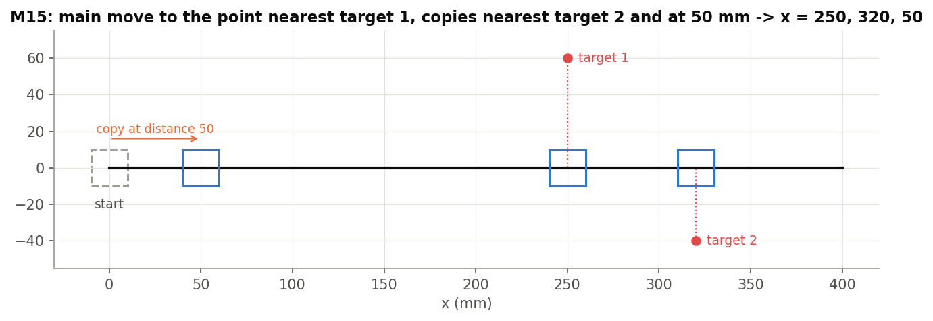
What it does
Native Transform cannot follow a curve by arc length, and Curve pattern spaces instances evenly. Move Along Edge moves (or copies) things a set distance along a path, or to where the path is nearest a target, turning them with the path if asked.
Use it when
Place a part at a station along a curve
Copy a detail to several named stations
Put a point where a curve meets another
M15: moved nearest target 1; copies nearest target 2 and at 50 mm.
Move Along Edge · smallTools
Draft 2026-09-26

Slide 3
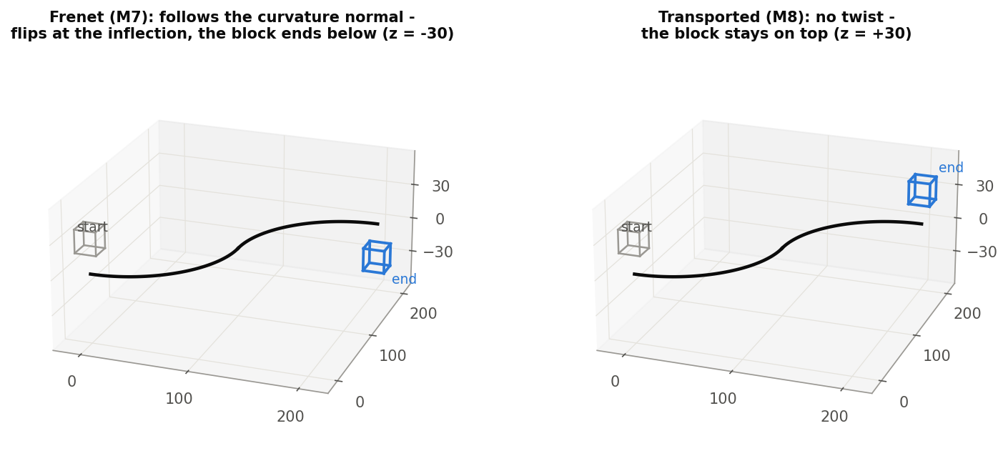
Orientation
Tangent only
Default: the entity turns with the path's tangent.
Transported
No twist: a rotation-minimising frame (M8 stays on top).
Frenet
Follows the curvature normal: flips at inflections (M7 ends below), arbitrary on lines.
Move Along Edge · smallTools
Draft 2026-09-26

Slide 4
The dialog (1/2)
IMAGE MISSING: docs/decks/move_along_edge/shots/dialog.png
# | Parameter | What it means
1 | Entities to move | Bodies, mate connectors, sketch edges, sketch vertices.
2 | Edges or wire to move along | The path; positive = the first edge's own direction.
3 | Provide Reference Point | + vertex: use it instead of the centroid / connector origin.
4 | Move to | Distance (signed, 25 mm; Flip direction or the arrow) / Nearest point to a target.
5 | Apply | Move and rotate / Translate only / Rotate only.
Move Along Edge · smallTools
Draft 2026-09-26

Slide 5
The dialog (2/2)
IMAGE MISSING: docs/decks/move_along_edge/shots/dialog.png
# | Parameter | What it means
6 | Orientation | Tangent only / Transported (no twist) / Curve normal (Frenet).
7 | Copy Bodies? | Copy instead of move.
8 | Naming | New name / Prefix / Suffix + Name text.
9 | Mate connectors as points | Output points instead of moving connectors.
10 | Additional copies | More copies from the same start, each by distance or target, each named.
Move Along Edge · smallTools
Draft 2026-09-26

Slide 6
Example: nearest point and copies (M15)
Main move nearest (250, 60); copies nearest (320, -40) and at 50 mm
The cube lands at x = 250, copies at 320 and 50. Also tested: a closed loop wraps (M6), moving back past the start extends the path (M9), rotate only turns in place (M18).
Move Along Edge · smallTools
Draft 2026-09-26

Slide 7
Outputs and messages
Published for Extract variables
Messages
Key | What it holds
output / inputs | The moved entities (or copies) / the sources.
initial_copy | The first copy (Copy on).
copy_1 ... copy_n | The additional copies.
 | Message / what to do
Info | rotate only on points / mate connectors cannot be named
Warning | source names missing Edit the feature once to refresh the names.
Move Along Edge · smallTools
Draft 2026-09-26

Slide 8
Tips and limits
✓
Moves keep identity
A moved body is the same body: downstream references survive.
!
Nearest ignores Flip
And names refresh only on edit.
!
Frenet on lines
Undefined normal: use Transported.
Move Along Edge · smallTools
Draft 2026-09-26

Slide 9
Where it lives
Document | smallTools (14cdaad24a8beab67af40fe4)
Tab | Move_Along_Edge
Tests | Move along edge tests: M1-M20 + M3b (all pass)
Explainer | docs/explainers/small_tools/small_tools_explained.md, section 1
Related | Trim curve +; Extract variables (copy_n keys)
Move Along Edge · smallTools
Draft 2026-09-26

