Slide 1
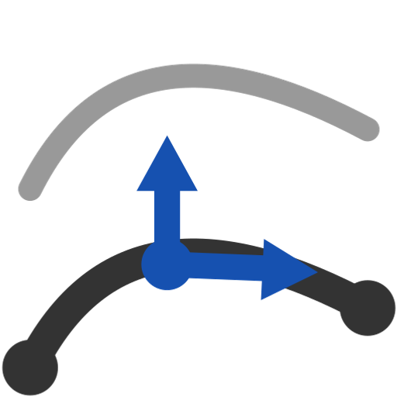
Offset edges
Offset one chain by amounts that vary along its length -- regions with ramps and dwells, blended; in-plane or out-of-plane; sharp corners handled.
example_1 · Onshape custom feature
Draft 2026-09-26

Slide 2

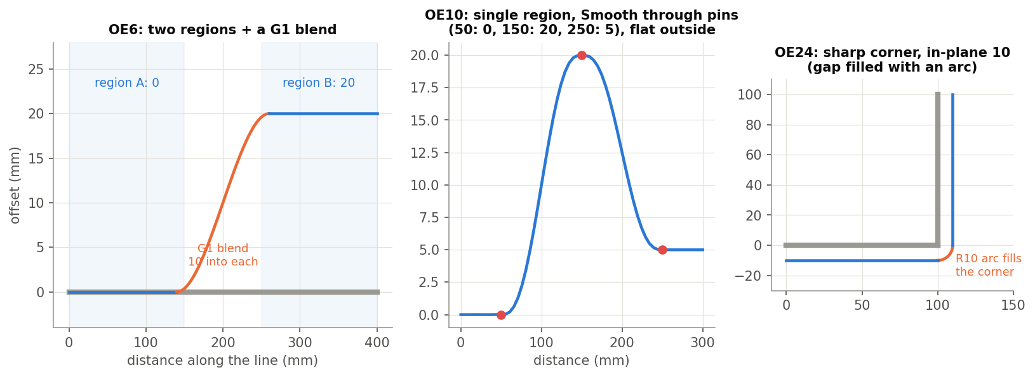
What it does
Native Offset curve is constant and in a sketch plane. Ski edges need offsets that change along the length -- a bevel that grows toward the tip, a step between two zones -- following a 3D chain.
Use it when
Offsets that vary along a sidecut or edge line
Zones with blends between them
Out-of-plane offsets along a 3D chain
OE6 regions + blend, OE10 pins, OE24 corner.
Offset edges · example_1
Draft 2026-09-26

Slide 3
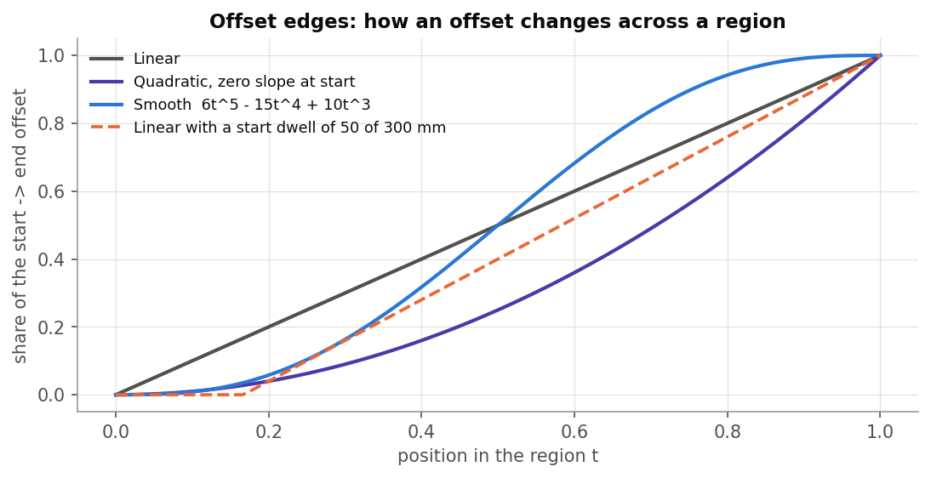
Regions
Per region
Extent (distances from the reference or two points), start / end offset, Linear / Quadratic / Smooth, dwells.
Blends
Neighbouring regions blended over a distance into each, matched to G0 / G1 / G2.
Or pins
Single region: offsets at chosen points, flat beyond the first and last.
Offset edges · example_1
Draft 2026-09-26

Slide 4
Directions (physically)
'Normal offset'
Moves OUT of the chain's plane (a line in XY offsets along Z).
'Binormal offset'
Moves WITHIN the plane, toward / away from the centre of curvature.
Names
The reverse of Frenet naming: describe results physically.
Offset edges · example_1
Draft 2026-09-26

Slide 5
The dialog (1/2)
IMAGE MISSING: docs/decks/offset_edges/shots/dialog.png
# | Parameter | What it means
1 | Reference edges | One chain (G1, or with sharp corners).
2 | Reference point | Where distance 0 is.
3 | Flip direction | Reverse the distance direction (+ Show direction indicator).
4 | Flip normal | Reverse the out-of-plane direction (Flip binormal likewise).
5 | Source arcs | Convert to splines / Keep as arcs (concentric or arc pairs).
6 | Sampling density | Points per region / blend (20).
Offset edges · example_1
Draft 2026-09-26

Slide 6
The dialog (2/2)
IMAGE MISSING: docs/decks/offset_edges/shots/dialog.png
# | Parameter | What it means
7 | Offset layout | Multiple regions / Single region.
8 | Regions | Type, name, extent, offset type, start / end offsets, dwells.
9 | Intersections | Per neighbouring pair: blend, continuities, distances.
10 | Approximation | Degree 3, tolerance 0.01 mm, max control points 100.
11 | Debug | Show frames / regions / blends; print data.
Offset edges · example_1
Draft 2026-09-26

Slide 7
Outputs and messages
Outputs
Messages
Key | What it holds
(wire) | One wire, split at source-edge boundaries and region / blend joints.
 | Message / what to do
Info | N arc pairs, worst deviation ... Keep as arcs with varying offsets.
Warning | no regions / overlapping regions / clamped dwell or blend / region consumed by blends
Offset edges · example_1
Draft 2026-09-26

Slide 8
Tips and limits
✓
Keep as arcs
Constant offsets of arcs stay exact arcs (report a radius).
!
Gaps
Gaps between regions are gaps in the output; blending off gives a step.
!
Slivers
A region boundary within ~1 mm of an edge boundary can leave a sliver edge.
Offset edges · example_1
Draft 2026-09-26

Slide 9
Where it lives
Document | example_1 (7183868d32cdc7a6ad14410d)
Tab | refSurfCreation/offsetEdges (+ engine curveMappingCore)
Tests | Offset edges tests: OE1-OE24 (all pass)
Explainer | docs/explainers/curve_mapping/curve_mapping_explained.md, section 2.5
Related | Wrap Curve, Wrap and Loft, Deform, Measure curve distance, Offset edges
Offset edges · example_1
Draft 2026-09-26

