Slide 1

Part Volume
Write one solid's volume to a variable, as a plain number in mm^3 -- typically the result Iterative Solve drives.
solvers · Onshape custom feature
Draft 2026-09-26

Slide 2

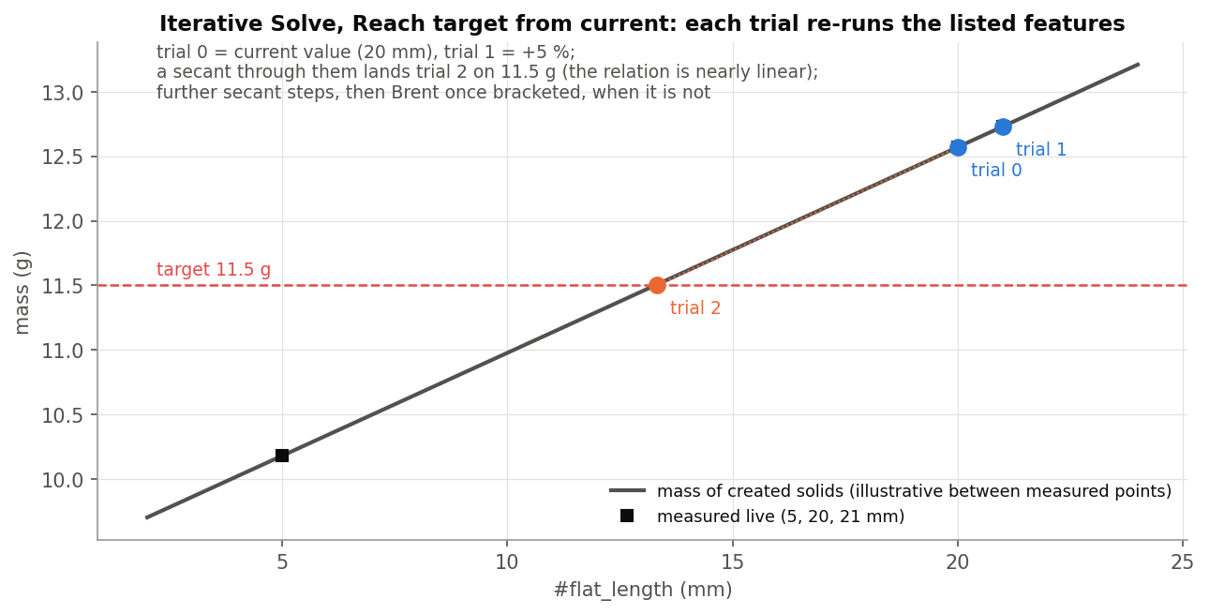
What it does
Iterative Solve and later features read variables. Part Volume turns one part's volume into one: evaluated precisely, stored as a unitless number of mm^3, and printed to the console.
Use it when
Drive Iterative Solve by a part's volume
Show a volume in a variable or table
Its value can be Iterative Solve's result variable.
Part Volume · solvers
Draft 2026-09-26

Slide 3
The dialog
Parameter | What it means
Part | One solid.
Variable Name | The name to set (not checked: an empty name is not caught).
Part Volume · solvers
Draft 2026-09-26

Slide 4
Tips and limits
!
Unitless
The value is a number of mm^3, not a volume with units.
!
One part
Single solid only; no description or messages.
Part Volume · solvers
Draft 2026-09-26

Slide 5
Where it lives
Document | solvers (3cf445f157b6a28aa1d35fcf; named 'Stray_Weight_Concept_1' in Onshape)
Tab | Part_Vol
Tests | none
Explainer | docs/explainers/solvers/solvers_explained.md, section 2.2
Related | Iterative Solve
Part Volume · solvers
Draft 2026-09-26

