Slide 1
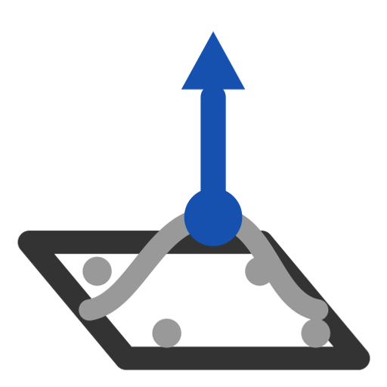
Pull surface
Push and pull a face with a grid of handles; the edges keep G0, G1 or G2 with their neighbours along their whole length.
gordonSurface · Onshape custom feature
Draft 2026-09-26

Slide 2

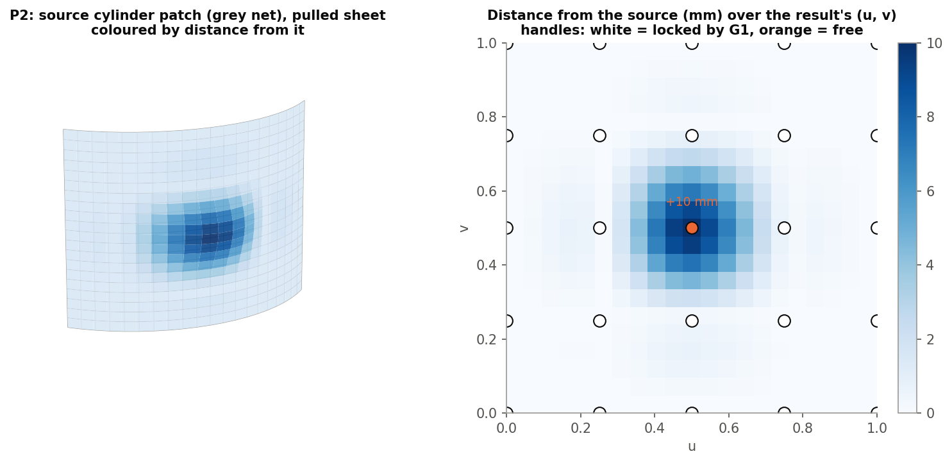
What it does
Onshape has no control-net push/pull. Pull surface puts arrow handles on a face; drag them and a new sheet is built from the face's own control net, with the edge rows locked so it still fits its neighbours.
Use it when
Add a bump or dip to a face
Tweak a surface without rebuilding its curves
Keep continuity with surrounding faces
P2: +10 mm at the centre of a cylinder patch, G1 edges.
Pull surface · gordonSurface
Draft 2026-09-26

Slide 3
Locks and handles
Locked rows
1 / 2 / 3 control-point rows per edge for G0 / G1 / G2: continuity holds along the whole edge.
Handles
Free control points move along the normal; the offsets are solved so the surface passes through each handle.
Enough handles
G1 needs 5+ handles each way before any is free, G2 7+.
Pull surface · gordonSurface
Draft 2026-09-26

Slide 4
The dialog
IMAGE MISSING: docs/decks/pull_surface/shots/dialog.png
# | Parameter | What it means
1 | Face | The face to pull (kept; the result is a new sheet).
2 | U curve count | Handles across u, edges included (2-20, 4).
3 | V curve count | Handles across v.
4 | Continuity | G0 / G1 / G2 along the edges.
5 | Active offsets | U, V, Offset per handle; filled by dragging; 0 removes.
6 | Debug | Iso-curves, keep curves / points, handle grid, offset vectors, print.
7 | Approximation | Degree (minimum, up to 5); how exactly the face is read.
Pull surface · gordonSurface
Draft 2026-09-26

Slide 5
Outputs and messages
Published for Extract variables
Messages
Key | What it holds
output | The pulled sheet (pullSurf).
 | Message / what to do
Info | no handle is free / holes not kept / solve fell back / trimmed edges held approximately One line.
Pull surface · gordonSurface
Draft 2026-09-26

Slide 6
Tips and limits
✓
Counts first
Changing a count or the continuity resets the offsets; set them before dragging.
!
Trims
Holes are dropped; edges trimmed inside the face hold continuity only approximately.
Pull surface · gordonSurface
Draft 2026-09-26

Slide 7
Where it lives
Document | gordonSurface (d0950ed72a894fbe35c27d43)
Tab | pullSurface
Tests | Gordon tools tests: P1-P3
Examples | Test Part Studio 1: Pull surface 1
Explainer | docs/explainers/gordon_surface/gordon_surface_explained.md, section 2.5
Related | Gordon Surface, Interior curves, Scaled Curve, Modify curve end, Pull surface, Simplify surface
Pull surface · gordonSurface
Draft 2026-09-26

