Slide 1

Recognize arcs
Find spline edges that a single circular arc represents within a tolerance -- report them, and optionally rebuild the wire with true arcs so Onshape shows their radius.
Curve_tools · Onshape custom feature
Draft 2026-09-26

Slide 2

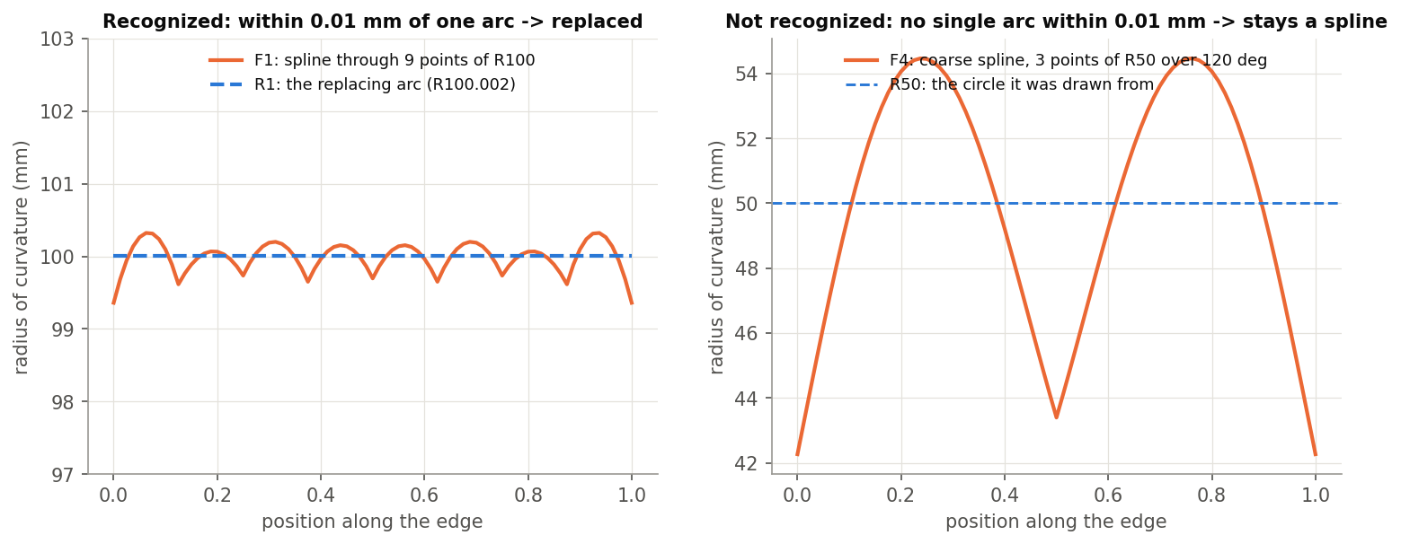
What it does
Imported and fitted curves carry arcs as splines: clicking them shows no radius, and drawings and CAM cannot use them as arcs. Recognize arcs asks of each spline 'is this really one arc?' and, where it is, puts a true sketch arc in its place.
Use it when
A spline that should report a radius
Check which edges of a wire are really arcs
Before drawings or CAM that need arcs
R1: a spline through 9 points of R100 is replaced; R5's coarse spline is not.
Recognize arcs · Curve_tools
Draft 2026-09-26

Slide 3
The test
One arc, never a biarc
The circle through both ends and the best interior sample must be within tolerance at all 64 samples.
Ends agree
Both end directions within Max end tangent change of the circle's -- the kink a replacement can add.
Connected
The arc passes exactly through the edge's ends; lines and arcs pass through unchanged.
Recognize arcs · Curve_tools
Draft 2026-09-26

Slide 4
The dialog
IMAGE MISSING: docs/decks/recognize_arcs/shots/dialog.png
# | Parameter | What it means
1 | Edges or wires | The edges or wire bodies to examine (only splines are candidates).
2 | Tolerance | Largest distance between the spline and its arc (0.01 mm).
3 | Max end tangent change | Largest end-direction change allowed (0.05 deg).
4 | Replace with arcs | On: build a copy with true arcs. Off: report and highlight only.
5 | Name | Names the output wires.
6 | Delete input | Delete input wire bodies once the copy is built.
7 | Highlight matches | Show matching splines in green.
Recognize arcs · Curve_tools
Draft 2026-09-26

Slide 5
Example: a line-arc-line chain (R2)
Line, spline on R200 (30 deg), line -> line, arc R200, line
One wire of 3 edges, joints within the 0.05 deg allowance. Also tested: R1 -> arc R100.002; R3 (S-curve) and R5 (coarse) stay splines; R4 report only -> no body.
Recognize arcs · Curve_tools
Draft 2026-09-26

Slide 6
Outputs and messages
Published for Extract variables
Messages
Key | What it holds
output | The rebuilt wire(s) (when Replace with arcs is on).
recognizedCount / candidateCount | Splines replaced / splines examined.
arcEdges | The new arc edges.
 | Message / what to do
Info | N of M spline edges are arcs ... (deviation and tangent change per candidate) Near misses are visible.
Error | Select edges or wire bodies.
Recognize arcs · Curve_tools
Draft 2026-09-26

Slide 7
Tips and limits
✓
Report first
Turn Replace off to see which edges qualify and by how much.
!
Kinks
A replacement can add up to Max end tangent change at a joint -- keep it small.
Recognize arcs · Curve_tools
Draft 2026-09-26

Slide 8
Where it lives
Document | Curve_tools (2143812a99089658c704f0bc)
Tab | recognize_arcs (uses curve_core)
Tests | Arc tangency tests: R1-R5 (9/9 incl. P12/P13, M1/M2)
Examples | Arc tangency tests studio
Explainer | docs/explainers/curve_tools/curve_tools_explained.md, section 2.7
Related | Clean wire, Map curve, Merge curve, Evaluate profiles, Fillet wire; Extract variables
Recognize arcs · Curve_tools
Draft 2026-09-26

