Slide 1
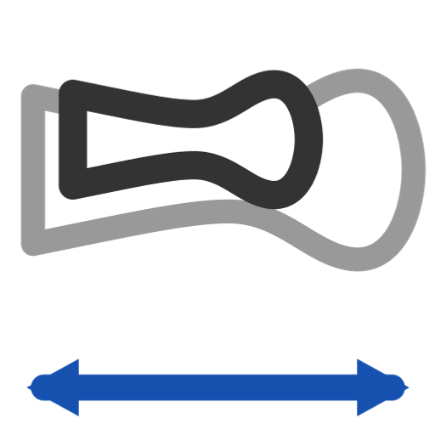
Scale Footprint
Derive a footprint for a new running-surface length from a reference: accordion in X, or keep the taper -- arcs stay tangent arcs that report their radius.
footprint · Onshape custom feature
Draft 2026-09-26

Slide 2

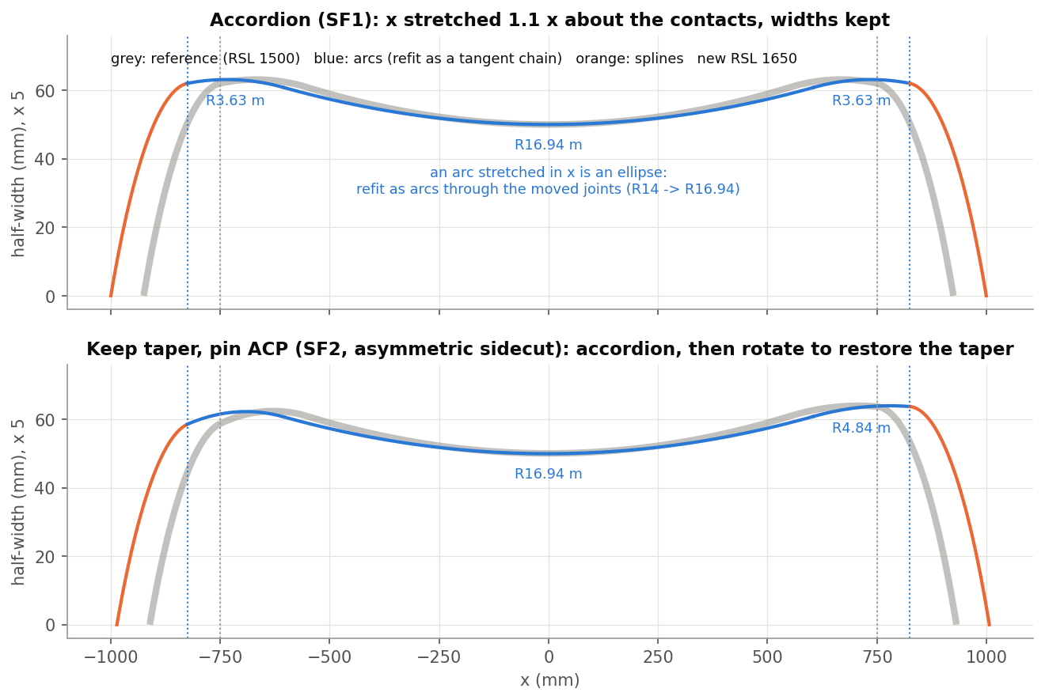
What it does
A ski family shares one sidecut at several lengths. Scale Footprint moves the tip and tail to the new contacts and stretches the sidecut between them -- keeping arcs as arcs and, if asked, the reference taper.
Use it when
Grow or shrink a ski family by length
Keep a taper angle across lengths
Keep radius callouts on the scaled outline
SF1 (accordion) and SF2 (keep taper, pin ACP): reference grey, arcs blue, splines orange.
Scale Footprint · footprint
Draft 2026-09-26

Slide 3
Arcs stay arcs
Stretch = ellipse
A circle stretched in X is no longer a circle.
Refit as a chain
Arcs through the moved joints, each starting tangent to the last -- tangent by construction (R14 -> R16.94 m at x 1.1).
Splines exact
A spline sidecut is stretched by its control points; knots kept (within 0.001 mm).
Scale Footprint · footprint
Draft 2026-09-26

Slide 4
The dialog (1/2)
IMAGE MISSING: docs/decks/scale_footprint/shots/dialog.png
# | Parameter | What it means
1 | Reference footprint edges | The whole reference, +Y and -Y.
2 | Reference RSL line | FCP = its lower-X end.
3 | New RSL line | The new contacts.
4 | Symmetry mode | Symmetric (mirror +Y) / Asymmetric (each side on its own).
5 | Scale mode | Accordion (X only) / Keep taper angle.
6 | Pin location | Keep taper: hold the ACP width or the MRS width.
7 | Spline options | Degree, Strict arcs, tolerance, maximum control points.
Scale Footprint · footprint
Draft 2026-09-26

Slide 5
The dialog (2/2)
IMAGE MISSING: docs/decks/scale_footprint/shots/dialog.png
# | Parameter | What it means
8 | Specify target width | Target waist width (full).
9 | -Y Scale mode | Asymmetric: the -Y side's own settings.
10 | Enforce tangency at tip (FCP) | Move one tip control point so the tip joins tangentially.
11 | Enforce tangency at tail (ACP) | Same at the tail.
12 | Keep reference curves | Keep the input.
13 | Debug | Colour curves by type; skip wire merge; print the arc chain.
Scale Footprint · footprint
Draft 2026-09-26

Slide 6
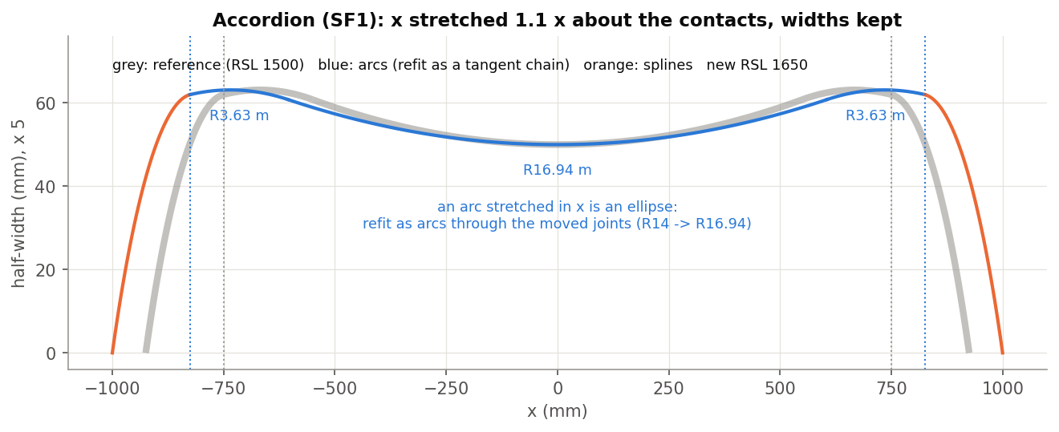
Example: accordion (SF1)
S14 to RSL 1650 (x 1.1)
Contacts at +-825, y 61.999; tip end -924.567 -> -999.567; waist (0, 50) kept; arcs refit R14 -> R16.94 m, R3 -> R3.63 m; -Y is the mirror.
Scale Footprint · footprint
Draft 2026-09-26

Slide 7
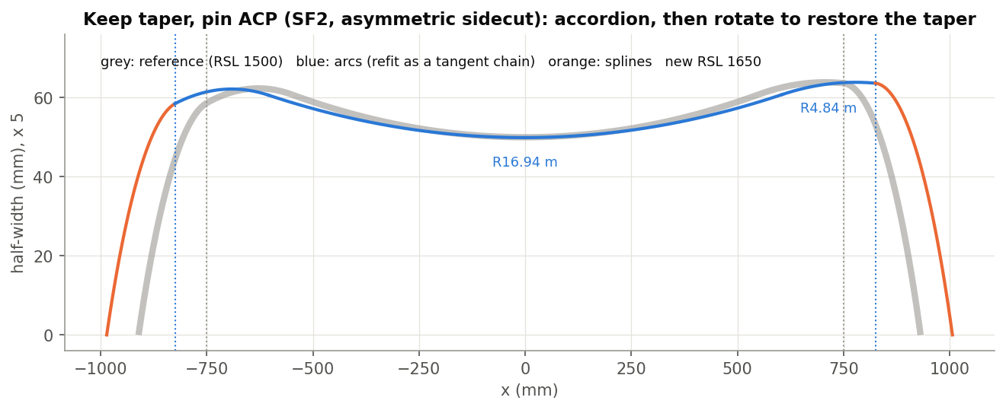
Example: keep taper, pin ACP (SF2)
Asymmetric sidecut (R2 / R4 m flanks) to RSL 1650
Taper -0.0662 deg kept (accordion alone would give -0.0602); ACP width 63.666 kept. Also tested: SF5, a spline sidecut stretched exactly (knots kept, within 0.001 mm).
Scale Footprint · footprint
Draft 2026-09-26

Slide 8
Outputs and messages
Published for Extract variables
Messages
Key | What it holds
positiveSide / negativeSide | The scaled +Y and -Y wires (open; never closed into a loop).
lengthScale | New RSL / reference RSL.
 | Message / what to do
Error | Asymmetric with no -Y data Select both sides of the reference.
Scale Footprint · footprint
Draft 2026-09-26

Slide 9
Tips and limits
✓
Pin choice
Pin ACP keeps the tail width; pin MRS keeps the mid-stance width.
!
World axes
Works in world XY with the FCP at the lower-X end of each RSL line.
!
No Scale radius
The retarget-radius mode was removed 2026-09-25 (it missed its target).
Scale Footprint · footprint
Draft 2026-09-26

Slide 10
Where it lives
Document | footprint (52724f3a857fa52d3ecceb77)
Tab | scaleFootprint (+ fpt_analyze, arcFit)
Tests | Footprint tests studio (build_ / check_footprint_tests.py): SF1, SF2, SF5
Explainer | docs/explainers/footprint/footprint_explained.md, section 2.3
Related | Integrate footprint, Analyze footprint, Scale Footprint, Arc fit, Generate Footprint Points
Scale Footprint · footprint
Draft 2026-09-26

