Slide 1

Scaled Curve
A curve between two rails whose position across them changes along its length -- 30 % at the start, 70 % at the end, along a chosen transition.
gordonSurface · Onshape custom feature
Draft 2026-09-26

Slide 2

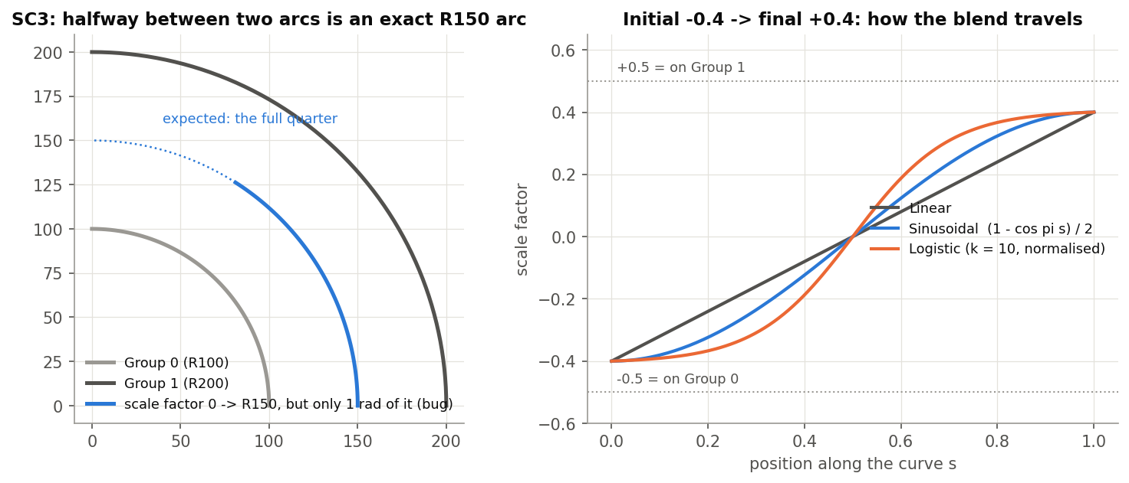
What it does
A mid-curve between two rails at a varying percentage is tedious by hand. Scaled Curve blends the rails point by point with a factor that travels from the initial to the final value.
Use it when
A character line drifting between two edges
A midline between two rails
Seed curves for a network
SC3 and the three transition shapes.
Scaled Curve · gordonSurface
Draft 2026-09-26

Slide 3
The dialog
IMAGE MISSING: docs/decks/scaled_curve/shots/dialog.png
# | Parameter | What it means
1 | Group 0 | First rail (edges joined); Flip? reverses it.
2 | Group 1 | Second rail.
3 | Initial curve scalefactor | -0.5 = on Group 0, 0 = halfway, +0.5 = on Group 1.
4 | Final curve scalefactor | The value at the end.
5 | Transition Type | Linear / Sinusoidal / Logistic.
6 | Curve name | Names the wire.
7 | Project onto surface? | + face: drop the result onto it.
8 | Debug & Details | Show ends / curves; output samples, tolerance, degree; input sampling.
Scaled Curve · gordonSurface
Draft 2026-09-26

Slide 4
Example: SC3
Arcs R100 and R200, scale factor 0
An exact R150 arc (within 0.00062 mm) -- but only its first radian: the known arc bug. SC0: lines y = 0 and y = 100 -> y = 50; SC2: output degree 5.
Scaled Curve · gordonSurface
Draft 2026-09-26

Slide 5
Outputs and messages
Outputs
Messages
Key | What it holds
(wire) | The scaled curve, named by Curve name.
 | Message / what to do
(none)
Scaled Curve · gordonSurface
Draft 2026-09-26

Slide 6
Tips and limits
!
Arcs: first radian only
On arc rails the result stops after 1 rad of each arc (bug; SC3 checks only the radius).
!
Matched by parameter
Not by length: uneven rails skew the blend. Orientation is manual (Flip).
!
Projection
Can move the ends.
Scaled Curve · gordonSurface
Draft 2026-09-26

Slide 7
Where it lives
Document | gordonSurface (d0950ed72a894fbe35c27d43)
Tab | scaledCurve
Tests | Gordon tools tests: SC0-SC3
Examples | Test Part Studio 1: Scaled Curve 1
Explainer | docs/explainers/gordon_surface/gordon_surface_explained.md, section 2.3
Related | Gordon Surface, Interior curves, Scaled Curve, Modify curve end, Pull surface, Simplify surface
Scaled Curve · gordonSurface
Draft 2026-09-26

