Slide 1

Trim curve (reference copy)
A verbatim copy of Onshape's own Trim curve (Move curve boundary), kept to compare with Trim curve +. Use the native feature.
smallTools · Onshape custom feature
Draft 2026-09-26

Slide 2

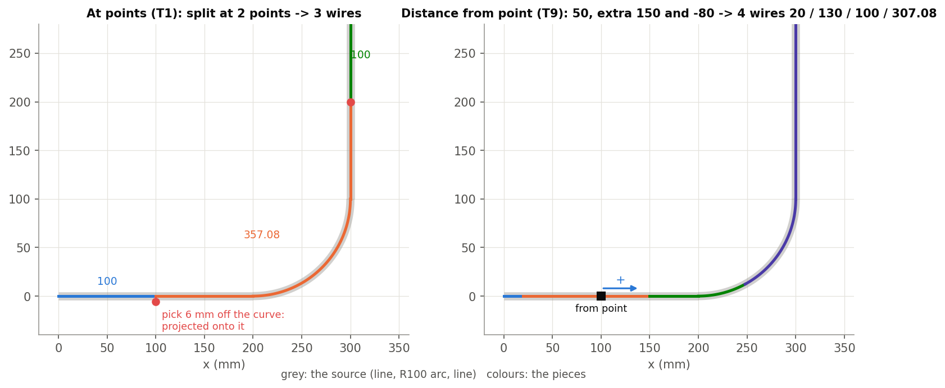
What it is
OS_Trim.fs is PTC's MIT-licensed source of native Trim curve with only the version bumped. It exists so Trim curve + can be compared with it; nothing imports it.
Use it when
Never in models: use the native Trim curve
Reading how the native feature works
What Trim curve + adds: cuts at exact positions.
Trim curve (reference copy) · smallTools
Draft 2026-09-26

Slide 3
The dialog
Parameter | What it means
Move curve boundary type | Trim / Extend.
Curves to adjust | Non-sketch wires.
End condition | (Extend) Blind + distance, or Up to entity; then extension shape.
Up to entity | (Trim) where to trim.
Help point | Picks the end / side.
Opposite direction | Flip.
Trim curve (reference copy) · smallTools
Draft 2026-09-26

Slide 4
Where it lives
Document | smallTools (14cdaad24a8beab67af40fe4)
Tab | OS_Trim
Tests | none
Explainer | docs/explainers/small_tools/small_tools_explained.md, section 3
Related | Trim curve +
Trim curve (reference copy) · smallTools
Draft 2026-09-26

