Slide 1

Trim curve +
Trim or split wires at exact arc-length positions: at points, signed distances from a point, even divisions, or inflections.
smallTools · Onshape custom feature
Draft 2026-09-26

Slide 2

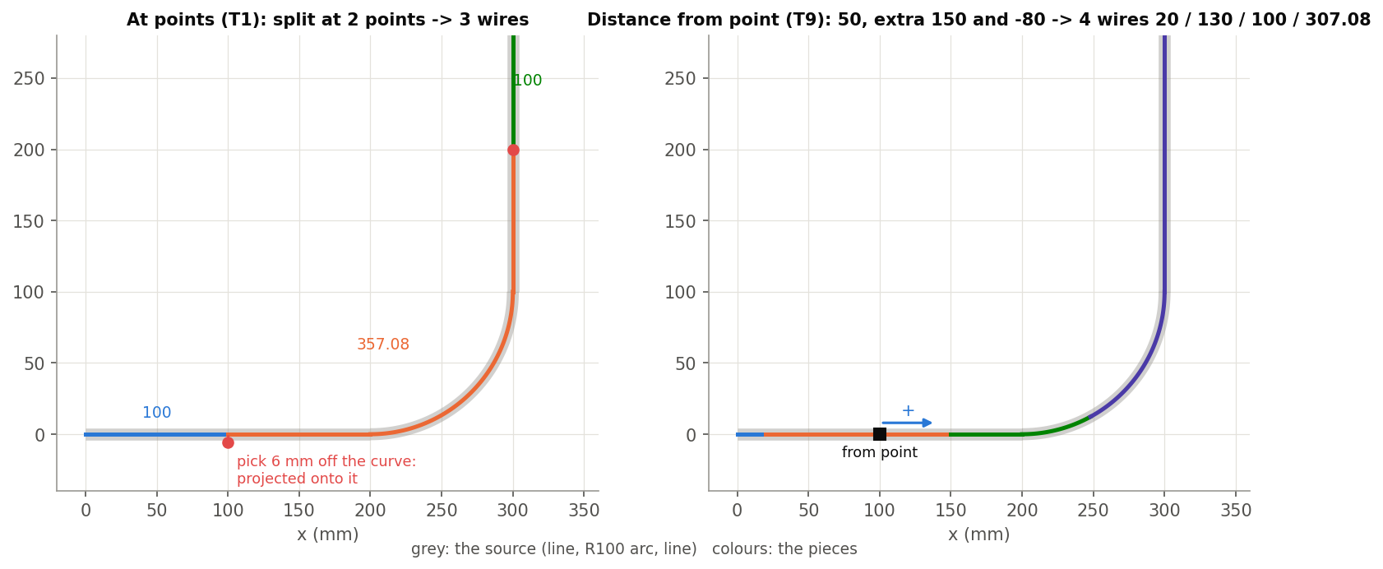
What it does
Native Trim curve trims up to one entity. Trim curve + reads each wire -- multi-edge too -- as one path and cuts it where you say, exactly, splitting into pieces or trimming away one side.
Use it when
Split a profile at stations
Cut a set distance from a point
Divide evenly, or split at inflections
T1 at points, T9 by distances.
Trim curve + · smallTools
Draft 2026-09-26

Slide 3
The dialog
IMAGE MISSING: docs/decks/trim_curve_plus/shots/dialog.png
# | Parameter | What it means
1 | Operation | Split (default) / Trim.
2 | Curves to adjust | Wire bodies (not sketch).
3 | Cut location | At points / Up to entity / Distance from point / Even division / At inflections.
4 | Cut points | (At points) off-curve picks are projected (dashed preview).
5 | Return single wire | (Split) one wire split in place; off = separate wires, source deleted.
6 | Keep opposite side | (Trim) keep the other piece (default: end side).
7 | Debug | Print inflection solve / cuts.
Trim curve + · smallTools
Draft 2026-09-26

Slide 4
Cut locations
Parameter | What it means
At points | Cut points (vertices or mate connectors).
Up to entity | Where the curve meets it (nearest point per edge).
Distance from point | From point + signed Distance (Opposite direction); Split: Additional distances, Also split at reference point.
Even division | Between two points (segments; also cuts at both) / Every distance from point (spacing, count).
At inflections | Click the red dots, or the one nearest each end (one planar, single-edge curve).
Trim curve + · smallTools
Draft 2026-09-26

Slide 5
Examples: T1 and T9
T1: at 2 points (one 6 mm off) -> 100 / 357.08 / 100. T9: 50, extra 150 and -80 -> 20 / 130 / 100 / 307.08
Also tested: split in place (T2, 5 edges), trim (T3), a mate connector point (T7), and 600 mm past the end -> error (T8).
Trim curve + · smallTools
Draft 2026-09-26

Slide 6
Outputs and messages
Published for Extract variables
Messages
Key | What it holds
output / inputs | The result / the source.
cut_1 ... cut_n, cutVertices | The vertices at the cuts (2 per cut when split into separate wires).
piece_1 ... piece_m | The pieces (bodies, or edges when split in place).
cutCount | Variable: the number of cuts.
 | Message / what to do
Error | runs past the end of the curve Distance mode.
Error | no valid cut / not planar / no inflections
Trim curve + · smallTools
Draft 2026-09-26

Slide 7
Tips and limits
!
Separate pieces
The source wire is deleted: downstream references to it break. Use Return single wire to keep it.
!
Trim
Uses only the first cut.
!
Directions
Distance: positive = path direction. Spacing: away from the midpoint by default.
Trim curve + · smallTools
Draft 2026-09-26

Slide 8
Where it lives
Document | smallTools (14cdaad24a8beab67af40fe4)
Tabs | betterCurveTrim, curveTrimCore
Tests | Trim curve + tests: T1-T9 (all pass)
Explainer | docs/explainers/small_tools/small_tools_explained.md, section 2
Related | Move Along Edge; native Trim curve
Trim curve + · smallTools
Draft 2026-09-26

