Slide 1

Wrap and Loft
Wrap curves onto the profile, offset them along its normal, and loft a strip -- sidewall and core-edge reference surfaces that follow rocker and camber.
curveMapping_public · Onshape custom feature
Draft 2026-09-26

Slide 2

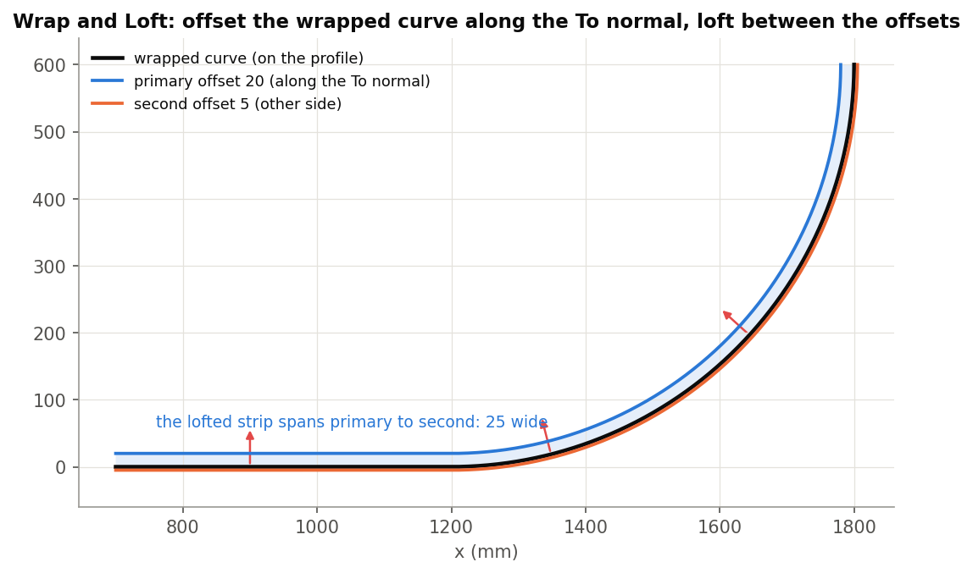
What it does
A reference surface that follows the profile through the thickness needs the wrapped curve and a matching offset curve, lofted -- with no gaps where source curves meet. Wrap and Loft does all of it in one feature.
Use it when
Sidewall or core-edge reference surfaces
A strip of set height along the profile
Planar sources (the From path is made for you)
Primary 20 + second 5: a 25 wide strip along the To normal.
Wrap and Loft · curveMapping_public
Draft 2026-09-26

Slide 3
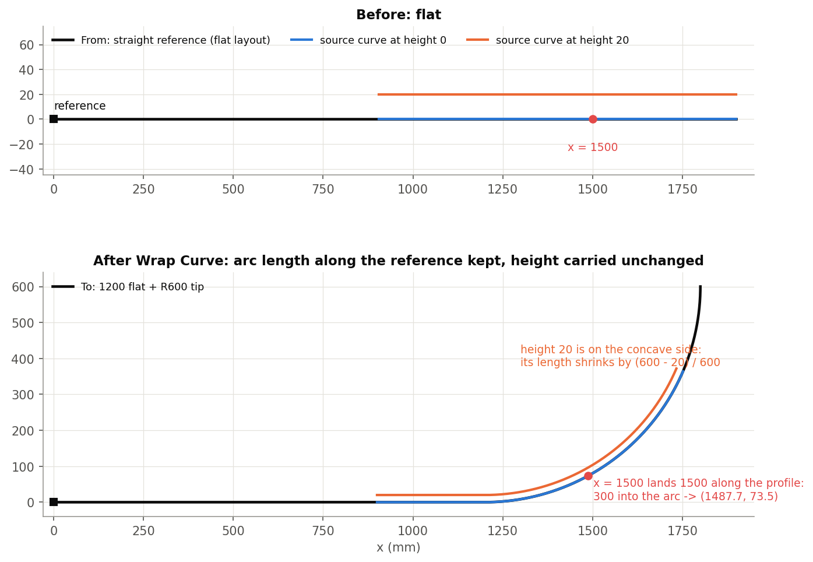
The bending map
Arc length kept
A point s along the From reference lands s along the To reference (a shift, no scaling).
Height and width kept
The point's offsets in the frame carry over: ribs stay perpendicular.
Layers bend
At height h around radius R they stretch or shrink by (R - h) / R, as a real layer does.
Wrap and Loft · curveMapping_public
Draft 2026-09-26

Slide 4
The dialog
IMAGE MISSING: docs/decks/wrap_and_loft/shots/dialog.png
# | Parameter | What it means
1 | Wrap edges | The source curves.
2 | From data | From edge(s) (G1 chain) and From reference (vertex, mate connector, plane).
3 | To data | To edge(s), Flip (reverse To), To reference, Flip normal.
4 | Frame orientation | Frenet (default) / Binormal (face, mate connector or world axis).
5 | Offset | Primary offset (20 mm), Flip offset direction, Second direction + Second offset.
6 | Keep output curves | Keep all / Keep wrapped only.
7 | Details | As Wrap Curve, + Fix control-point clustering (on), Break spans, Exact ruled surface.
8 | Debug | Print curves, show frames.
Wrap and Loft · curveMapping_public
Draft 2026-09-26

Slide 5
What makes it robust
Planar shortcut
Planar sources: From edge(s) disappears; the From path is the To chain projected onto the source plane (wraps, not drapes).
Welds
Where curves meet, the later adopts the first's offset direction: no 0.35 mm gaps at seams.
Exact ruled (option)
An exact ruled B-spline instead of a loft where possible; changes face ids.
Wrap and Loft · curveMapping_public
Draft 2026-09-26

Slide 6
Outputs and messages
Outputs
Messages
Key | What it holds
(sheet) | One face per source curve, unioned.
(wires) | Optional: wrapped, primary, second curves.
 | Message / what to do
Info | clustering fix recommended Only when it is off and slivers were found.
Wrap and Loft · curveMapping_public
Draft 2026-09-26

Slide 7
Tips and limits
✓
Negative offset
Use Flip offset direction; primary cannot be negative.
!
Planar check
A single straight source edge cannot define a plane: the flag keeps its previous value.
!
Failures
Loft / union failures are reported on the console only.
Wrap and Loft · curveMapping_public
Draft 2026-09-26

Slide 8
Where it lives
Document | curveMapping_public (d12583277c42b00c63a9b7b7)
Tab | wrapAndLoft (+ engine curveMappingCore)
Tests | none
Explainer | docs/explainers/curve_mapping/curve_mapping_explained.md, section 2.2
Related | Wrap Curve, Wrap and Loft, Deform, Measure curve distance, Offset edges
Wrap and Loft · curveMapping_public
Draft 2026-09-26

