Slide 1
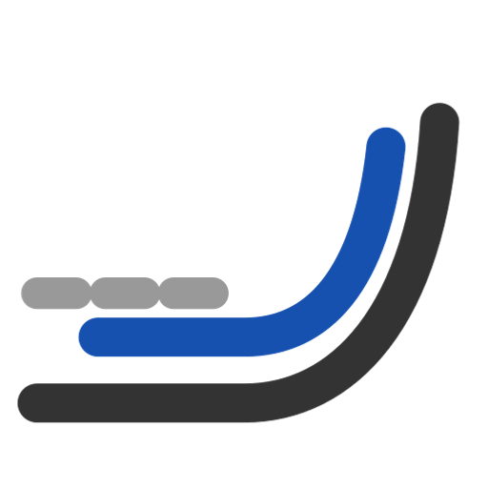
Wrap Curve
Wrap flat curves onto a curved profile by arc length -- length along the profile kept, height and width carried over.
curveMapping_public · Onshape custom feature
Draft 2026-09-26

Slide 2

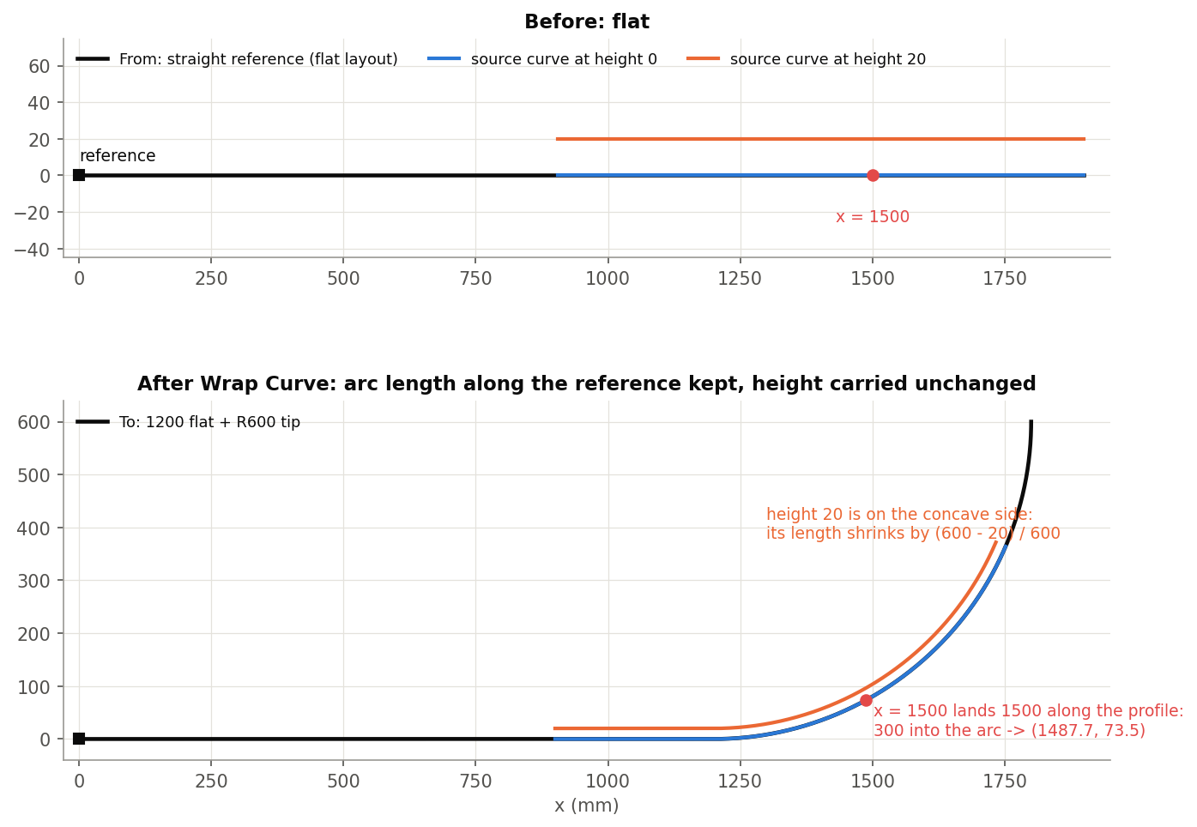
What it does
Planforms, graphics, inlays and insert lines are drawn flat; the ski is built on a rockered, cambered profile. Native Wrap only handles cylinders and cones, and projecting foreshortens. Wrap Curve keeps the arc length along the profile, so a station 1500 mm along the layout lands 1500 mm along the ski.
Use it when
Put flat layout lines on the profile
Keep stations at their true distance along the ski
Carry width and height exactly
Tip example: 1200 flat + R600 tip; x = 1500 lands 300 into the arc.
Wrap Curve · curveMapping_public
Draft 2026-09-26

Slide 3
The bending map
Arc length kept
A point s along the From reference lands s along the To reference (a shift, no scaling).
Height and width kept
The point's offsets in the frame carry over: ribs stay perpendicular.
Layers bend
At height h around radius R they stretch or shrink by (R - h) / R, as a real layer does.
Wrap Curve · curveMapping_public
Draft 2026-09-26

Slide 4
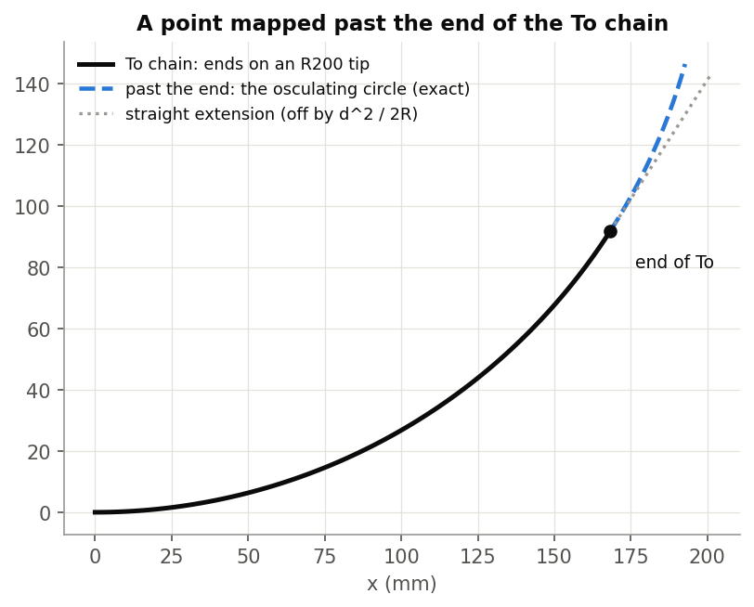
Frames and ends
Frenet (default)
One normal carried along with minimal rotation: no flip at inflections.
Binormal
Normal from a plane you give (face or mate connector); every edge must lie in it.
Past the ends
The osculating circle continues the chain -- exact on arcs.
Wrap Curve · curveMapping_public
Draft 2026-09-26

Slide 5
The dialog
IMAGE MISSING: docs/decks/wrap_curve/shots/dialog.png
# | Parameter | What it means
1 | From data | From edge(s) (G1 chain) and From reference (vertex, mate connector, plane).
2 | To data | To edge(s), Flip (reverse To), To reference, Flip normal.
3 | Source curves | The curves to wrap.
4 | Frame orientation | Frenet (default) / Binormal (face, mate connector or world axis).
5 | Details | Sampling (control-point or length based), degree 3, max control points 15, tolerance 0.01 mm; Break spans at curvature jumps and corners.
6 | Debug | Print curves, show frames and sample points.
Wrap Curve · curveMapping_public
Draft 2026-09-26

Slide 6
Outputs and messages
Outputs
Messages
Key | What it holds
(wire) | One wire: spline spans, plus exact copies on straight stretches.
 | Message / what to do
Console | span fitted at a lower degree The source's degree was too high for a short To edge.
Console | cannot be fitted; the output will have a gap Rebuild the source at degree 3 or sample by length.
Wrap Curve · curveMapping_public
Draft 2026-09-26

Slide 7
Tips and limits
✓
Flip normal
If 'up' comes out on the wrong side -- older models may need it after the 2026-09-23 frame change.
!
Only To flips
From's direction comes from its chain; an off-centre From reference pushes points past an end.
!
Break spans
Changes topology (more edges) -- downstream references may move.
Wrap Curve · curveMapping_public
Draft 2026-09-26

Slide 8
Where it lives
Document | curveMapping_public (d12583277c42b00c63a9b7b7)
Tab | wrapCurve (+ engine curveMappingCore, pinned)
Tests | none
Explainer | docs/explainers/curve_mapping/curve_mapping_explained.md, section 1, 2.1
Related | Wrap Curve, Wrap and Loft, Deform, Measure curve distance, Offset edges
Wrap Curve · curveMapping_public
Draft 2026-09-26

