Slide 1

Case template
Name the inputs a chain of features is built on -- selections and values -- for case 1, and list the further cases a Case pattern will re-run the chain for.
Case_Pattern · Onshape custom feature
Draft 2026-09-25

Slide 2

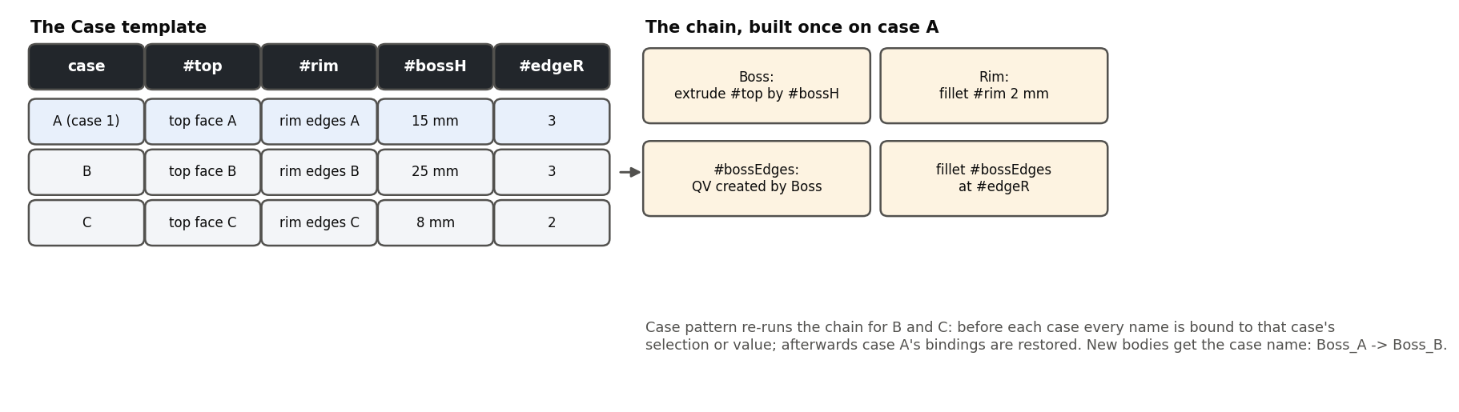
What it does
To build the same detail on several places (a boss on each of three blocks, each its own height), build it once against names -- #top, #rim, #bossH -- and let a Case pattern re-run it. The Case template defines those names for case 1 and holds the other cases' selections and values.
Use it when
The same feature chain applies to several places
Each place has its own selections and values
A transform pattern cannot do it (the places differ)
The template's case table and the chain built on case A.
Case template · Case_Pattern
Draft 2026-09-25

Slide 3
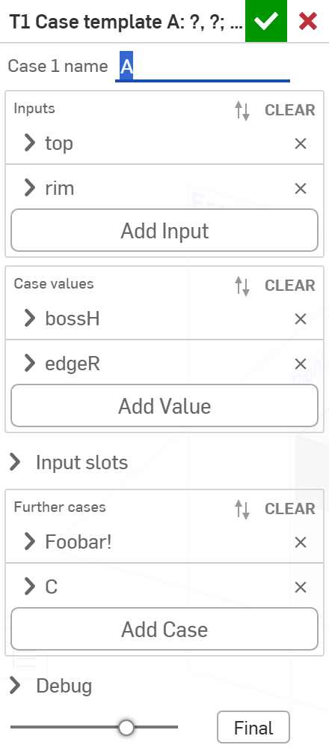
The dialog
# | Parameter | What it means
1 | Case 1 name | The template's own case (default A); its suffix is swapped for each case's name.
2 | Inputs | Up to 8: a query-variable name and case 1's selection.
3 | Case values | Up to 4: a name, a type (Length / Angle / Area / Volume / Number / Text), case 1's value.
4 | Input slots | Read-only: the inputs as the case rows show them.
5 | Further cases | One row per case: its name, a selection per input, a value per value.
6 | Debug | Print bindings.
1
2
3
4
5
6
Case template · Case_Pattern
Draft 2026-09-25

Slide 4
Outputs and messages
Published for Extract variables
Messages
Key | What it holds
the input names | Query variables bound to case 1's selections.
the value names | #variables with case 1's values.
(hidden) case signature | What the Case pattern reads: every case's selections and values.
 | Message / what to do
Error | Case 1 selection for #x selects nothing
Error | Name #x is used twice / Case name "B" is used twice
Error | Add at least one input. At most 8 inputs and 4 values.
Case template · Case_Pattern
Draft 2026-09-25

Slide 5
Tips and limits
✓
Build the chain on the names
Every listed feature should use #top, #bossH ... -- never a clicked case-1 entity.
!
Rows follow the template
After adding an input or changing a type, edit the template once so every row gets the slot.
Case template · Case_Pattern
Draft 2026-09-25

Slide 6
Where it lives
Document | Case_Pattern (2099413dd91f34578b385892)
Tab | case_pattern (both features)
Tests | Case pattern tests studio: T1-T5
Explainer | docs/explainers/case_pattern/case_pattern_explained.md
Related | Case pattern
Case template · Case_Pattern
Draft 2026-09-25

