Slide 1
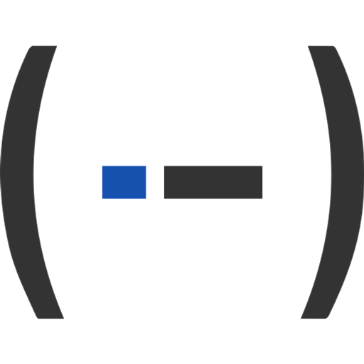
Case pattern
Build a chain of features once, against named inputs, then run it again per case -- each case with its own selections and values. Three features: Define case, Case, Close case.
Case_Pattern · Onshape custom feature
Draft 2026-09-29 (v3)

Slide 2
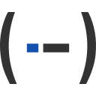
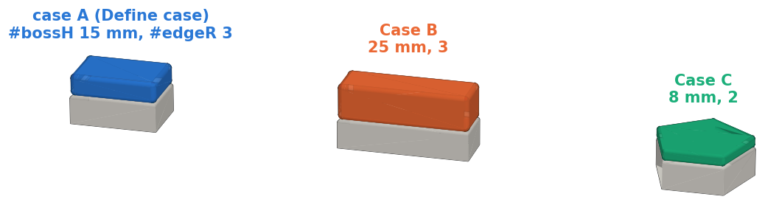
What it does
'Apply to each' for the feature tree. Build a detail once for case A against names (#top, #bossH); each further case gives its own geometry and values, and the chain is run again for it. Nothing is moved by a transform, so the places may differ in shape.
Use it when
The same feature chain applies to several places
Each place has its own selections and dimensions
The chain edits existing geometry (fillet, move face) as well as making new
Test T1: one chain (boss, rim fillet, boss-edge fillet) built for case A and run again for B and C.
Case pattern · Case_Pattern
Draft 2026-09-29 (v3)

Slide 3
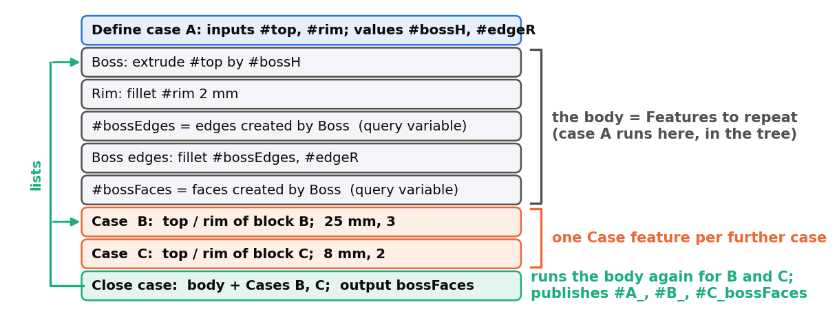
Three features, like a function
Define case = the signature
Names the inputs and values, with case 1's selections. The features after it (the body) use those names.
Case = one call's arguments
One feature per further case: a selection per input, a value per value. Runs nothing itself.
Close case = runs the calls
Lists the body and the Cases, runs the body once per Case, publishes each case's outputs.
Case pattern · Case_Pattern
Draft 2026-09-29 (v3)

Slide 4
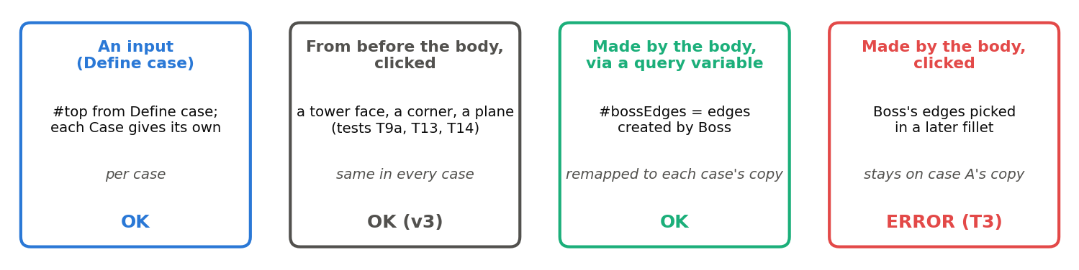
What the body may point at
The one rule
Geometry the body itself made is referenced through a query variable ('created by' a body feature). A click stays on case A's copy.
New in v3
Geometry from before the body may be clicked directly (a side reference, an 'up to' face): every case uses the same one.
Values
Numbers and lengths are not geometry: plain variables from anywhere earlier work. Put one in Define case only if it changes per case.
Case pattern · Case_Pattern
Draft 2026-09-29 (v3)

Slide 5

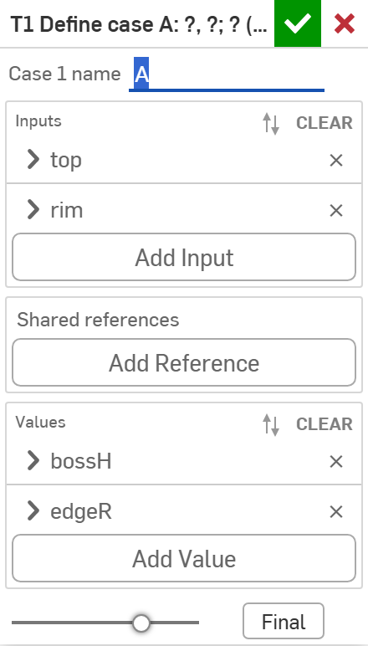
Define case
# | Parameter | What it means
1 | Case 1 name | The case the tree itself builds (letters, digits, _; starts with a letter).
2 | Inputs | Up to 8 query variables that change per case: a name and case 1's selection.
3 | Shared references | Optional: one selection for every case. Clicking the geometry in the body does the same; this is one place to change it.
4 | Values | Up to 6 variables that change per case: name, type (Length, Angle, Area, Volume, Number, Integer, Text, Boolean), case 1's value.
1
2
3
4
Also sets #caseName and #caseIndex (1 for case 1); every case updates them.
Case pattern · Case_Pattern
Draft 2026-09-29 (v3)

Slide 6
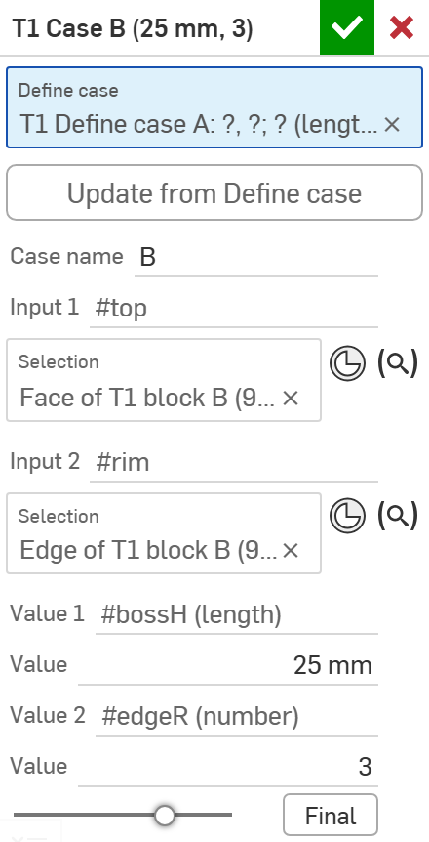
Case
# | Parameter | What it means
1 | Define case | The Define case this case belongs to. Picking it lays out the slots.
2 | Update from Define case | Lays the slots out again after inputs or values changed in the Define case; selections and values are kept by name.
3 | Case name | Unique among the Define case's cases; also the output prefix (#B_...).
4 | Input slots | A selection for each input (labelled #top, #rim ...).
5 | Value slots | A value for each value. New slots start with case 1's value (a copy, not a link).
1
2
3
4
5
Place each Case after the body and before the Close case that runs it. A missing selection or value is an error on the Case.
Case pattern · Case_Pattern
Draft 2026-09-29 (v3)

Slide 7

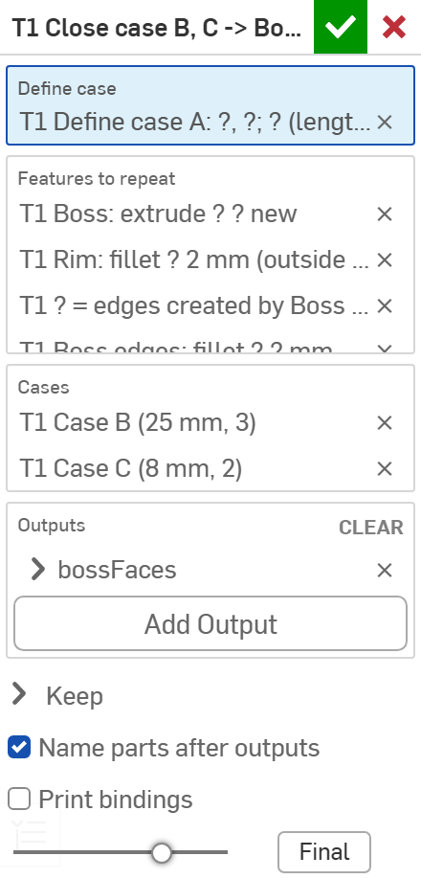
Close case
# | Parameter | What it means
1 | Define case | The Define case this body belongs to.
2 | Features to repeat | The body's features, in tree order.
3 | Cases | The Case features to run. May be empty: then it only publishes case 1's outputs.
4 | Outputs | Per output: a Name and the query variable the body sets (its name as plain text, no #). Evaluate on use / Track downstream changes as in Extract variables.
5 | Keep | Which new bodies each case keeps: parts, surfaces, curves and points, mate connectors, planes on; sketches off.
6 | Name parts after outputs | On: a part an output points to is named like the output's variable (B_rib).
7 | Print bindings | Print each case's selections and values to the notices.
1
2
3
4
5
6
7
Case pattern · Case_Pattern
Draft 2026-09-29 (v3)

Slide 8
Example: bosses on three blocks (T1)
Define case A: #top, #rim; #bossH, #edgeR. Body: Boss (extrude #top by #bossH), Rim fillet on #rim, #bossEdges = edges created by Boss, fillet #bossEdges at #edgeR, #bossFaces = faces created by Boss.
Case B (25 mm, 3) and Case C (8 mm, 2); one Close case with output bossFaces. Result: three bosses at their own heights, every rim and boss edge filleted; parts A_bossFaces, B_bossFaces, C_bossFaces and the query variables #A_bossFaces, #B_bossFaces, #C_bossFaces.
Case pattern · Case_Pattern
Draft 2026-09-29 (v3)

Slide 9
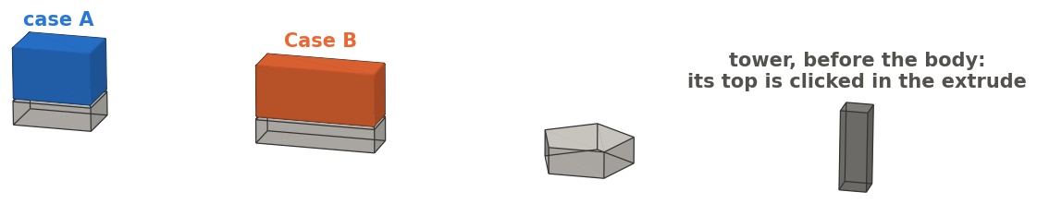
Example: a reference clicked from before the body (T14)
The boss is extruded 'up to' the top of an outside tower, clicked directly in the extrude; the body also fillets the case's block rim and the boss edges.
Case B's boss stops at the same tower top as case A's (z 20..60); B's rim and boss edges are filleted. All three kinds of reference in one case: clicked outside geometry, an edit of geometry from before the body, a query variable made in the body. In v2 the clicked face was lost.
Case pattern · Case_Pattern
Draft 2026-09-29 (v3)

Slide 10
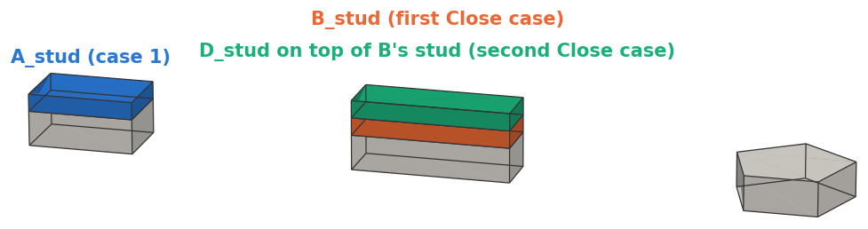
Example: closing again (T7)
A first Close case runs Case B (a stud on block B). Case D selects the top of B's stud; a second Close case, on the same Define case with the body picked again, runs it.
D's stud sits on B's (z 30..40); #A_stud, #B_stud and #D_stud each hold one body. Use this when a case must select geometry an earlier case made.
Case pattern · Case_Pattern
Draft 2026-09-29 (v3)

Slide 11
Outputs and messages
Variables
Messages
Key | What it holds
#<case>_<output> | One query variable per output per case, case 1 included (#A_bossFaces, #B_bossFaces ...). Fixed when the case closes unless Evaluate on use.
inputs, values | Define case binds them to case 1; after the Close case later features see case 1 again.
#caseName, #caseIndex | The running case's name and number (case 1 = 1); back to case 1 after the Close case.
other body variables | Keep the LAST case's value after the Close case.
 | Message / what to do
Warning | Not built: B: repeated feature 3 failed (...) The other cases are still built; Onshape's own reason is quoted.
Error | No case was built. Every listed case failed.
Error | #h has no value: click Update from Define case. On a Case: the Define case changed (T11 shows the error).
Info | #B_x is not case B's geometry: make #x a query variable 'created by' a repeated feature The output was not remade per case.
Info | Sketches are re-solved per case ... Constraints to the origin / default planes keep case 1's position.
Case pattern · Case_Pattern
Draft 2026-09-29 (v3)

Slide 12
Tips and limits
✓
Few, short local names
Query variables made in the body are locals: name them by role (_body, _edges, _out) and reuse them in every template. A name can never be deleted from the list.
!
Order and undo
Cases run in order and see earlier results; a failed case cannot undo its edits to existing geometry (only its new bodies are removed).
✓
Outputs only for what is used later
Each output makes one name per case. Type output names as plain text: a leading # turns the field into a reference.
!
Tested edits
Fillet, Move face, Move face+ on geometry from before the body; chamfer, shell, draft, booleans into existing parts are untested. No sheet metal or derived features.
✓
Switch features per case
A Boolean value suppresses a feature by expression (#pin), re-checked per case (T6). Numeric fields take expressions: #flag ? 3 mm : 0 mm.
!
Cost and dialog
Every rebuild runs the body once per case. In a NEW Case the grey slot names stay blank until Update from Define case is pressed once.
Case pattern · Case_Pattern
Draft 2026-09-29 (v3)

Slide 13
Where it lives
Document | Case_Pattern (2099413dd91f34578b385892)
Tab | case_pattern (Define case, Case, Close case)
Tests | Case pattern tests studio: T1-T14 (T3, T11 must error), 53/53 checks pass 2026-09-29 -- devtools/onshape/build_case_pattern_tests.py, check_case_pattern_tests.py
Explainer | docs/explainers/case_pattern/case_pattern_explained.md
Design | case_pattern/DESIGN.md sections 11-12; corrections log 41, 50, 60
From v2 | Case pattern features are gone: each case row becomes a Case feature listed in the Close case; outputs are typed as query-variable names.
Case pattern · Case_Pattern
Draft 2026-09-29 (v3)

