Slide 1

Create offset profile
Type an offset profile as regions or points -- width and height against station -- and get exact wires for Driven edge offset and Driven offset surface.
driven_offset (BeamBuilder Testbed) · Onshape custom feature
Draft 2026-09-29

Slide 2

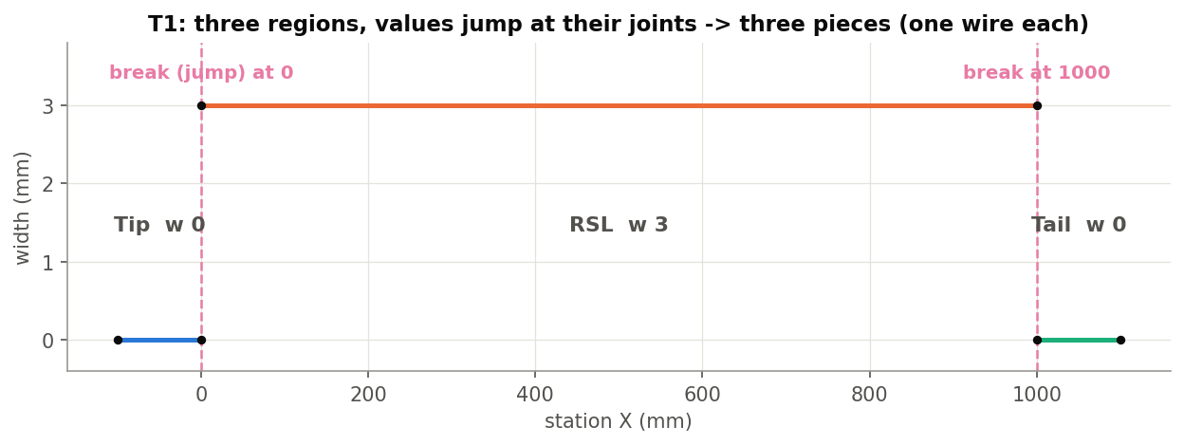
What it does
Driven edge offset (DEO) and Driven offset surface (DOS) read an offset profile: wires in profile coordinates, X = station, Y = width offset, Z = height offset. Create offset profile builds those wires from a table, exactly (polynomial Beziers, no sampling), instead of a hand-drawn sketch.
Use it when
The offset is defined by regions: tip, running length, tail ...
Width or height ramps, holds or steps along X
Stations come from the part: a vertex or mate connector
Test T1: Tip w 0, RSL w 3, Tail w 0. The values jump at 0 and 1000, so the profile breaks there: three wires.
Create offset profile · driven_offset (BeamBuilder Testbed)
Draft 2026-09-29

Slide 3
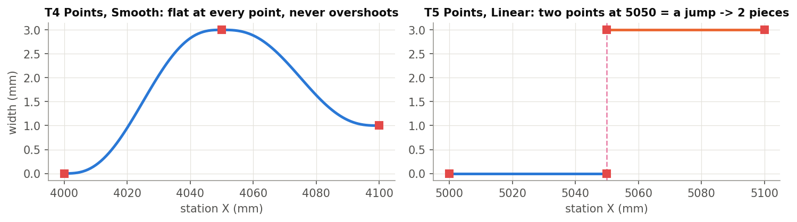
Pieces and breaks
A piece = one wire
A continuous stretch of the profile, e.g. T4 left: three Smooth points, one piece. Touching regions with equal values join too.
A break
Where the offset jumps (touching regions or two points at one station, different values -- T5 right) or is undefined (a gap in X), the profile ends and a new piece starts.
Ends
The profile starts at the first item and stops at the last; nothing is extrapolated.
Create offset profile · driven_offset (BeamBuilder Testbed)
Draft 2026-09-29

Slide 4
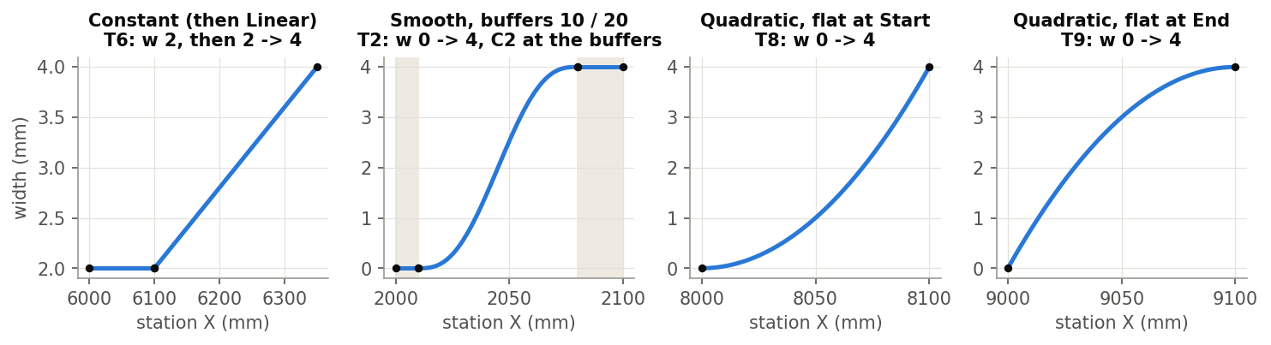
Region shapes
Constant / Linear
One width and height; or a straight change from start to end values (corners at the ends).
Smooth
Smootherstep: flat, zero curvature at both ends of the change, never overshoots. Buffers hold the end values first (shaded).
Quadratic
A parabola flat at one end ('Flat at' Start or End), a kink at the other. Width and height use the same shape.
Create offset profile · driven_offset (BeamBuilder Testbed)
Draft 2026-09-29

Slide 5
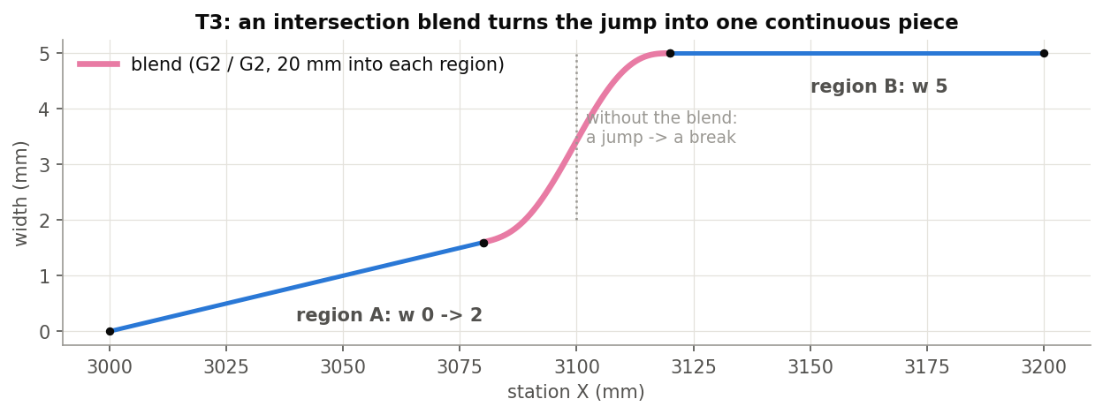
Blending two regions
Intersections
One entry per pair of consecutive regions, kept by region names. Blend off: join as they are if the values match, else break.
Blend on
A Hermite bridge from a distance into the first region to a distance into the second, G0 / G1 / G2 at each side.
Drag arrows
Each blend distance also has a drag arrow on the profile while the dialog is open.
Create offset profile · driven_offset (BeamBuilder Testbed)
Draft 2026-09-29

Slide 6
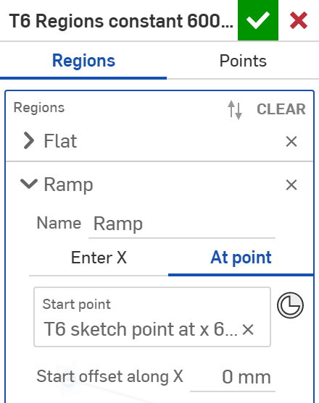
The dialog: Regions (1/2)
# | Parameter | What it means
1 | Mode | Regions or Points.
2 | Region name | Empty = Region n. Intersections are kept by these names, so they must differ.
3 | Start station | Enter X (type the station) or At point.
4 | Start point | At point: a vertex or mate connector (one can be created in the field).
5 | Start offset along X | Station = the point's world X plus this signed distance.
1
2
3
4
5
Create offset profile · driven_offset (BeamBuilder Testbed)
Draft 2026-09-29

Slide 7
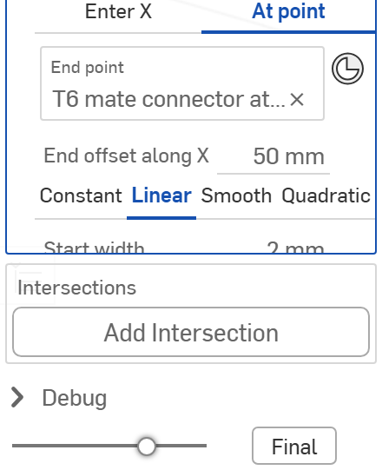
The dialog: Regions (2/2)
6
# | Parameter | What it means
6 | End station | The same for the end. A region may be entered toward -X (start > end).
7 | Shape | Constant, Linear, Smooth or Quadratic.
8 | Start / end width, height | The values at each end (Constant: one Width, one Height).
9 | Intersections | Between consecutive regions, rebuilt automatically (next slides).
7
8
9
Create offset profile · driven_offset (BeamBuilder Testbed)
Draft 2026-09-29

Slide 8
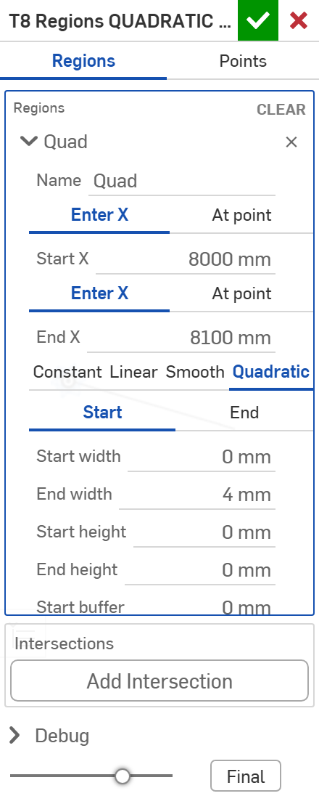
The dialog: Quadratic and buffers
# | Parameter | What it means
1 | Shape | Quadratic (test T8).
2 | Flat at | Start or End: the end of the change with zero slope; the other end meets its neighbour at a kink.
3 | Start / end width, height | End values; width and height follow the same shape.
4 | Start / end buffer | Hold the start (end) value this far in from that end; the change runs between the buffers. Not for Constant.
1
2
3
4
Entered toward -X, each end keeps its own values and buffer, and a quadratic's flat end stays at the end it was given (T11).
Create offset profile · driven_offset (BeamBuilder Testbed)
Draft 2026-09-29

Slide 9
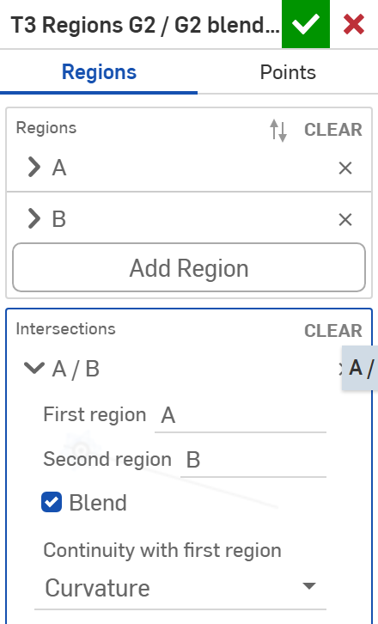
The dialog: an intersection blend (1/2)
# | Parameter | What it means
1 | Intersections | One per consecutive pair (here A / B), labelled by the region names.
2 | Blend | Off: touching regions with equal values join, anything else breaks. On: a blend.
3 | Continuity with first region | G0, G1 (tangent) or G2 (curvature) where the blend leaves region A.
1
2
3
Create offset profile · driven_offset (BeamBuilder Testbed)
Draft 2026-09-29

Slide 10
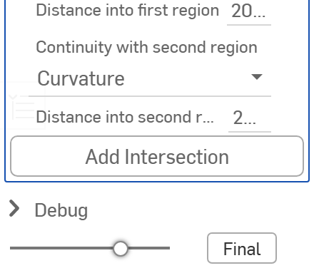
The dialog: an intersection blend (2/2)
4
# | Parameter | What it means
4 | Distance into first region | How far back from A's end the blend starts.
5 | Continuity with second region | The same where it joins region B.
6 | Distance into second region | How far past B's start it ends. Both 0 only works across a gap in X.
5
6
Create offset profile · driven_offset (BeamBuilder Testbed)
Draft 2026-09-29

Slide 11
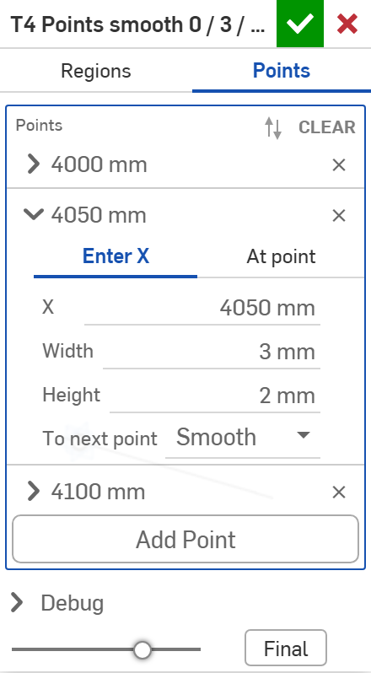
The dialog: Points
# | Parameter | What it means
1 | Mode | Points: the profile through a list of stations.
2 | Station | Enter X or At point (vertex / mate connector plus a signed offset along +X).
3 | X | The station, typed.
4 | Width | Width offset at this station.
5 | Height | Height offset at this station.
6 | To next point | Smooth (flat at both points, no overshoot), Linear, or Hold (keep this value to the next point, then break). Ignored on the last point.
1
2
3
4
5
6
Two points at one station with different values are a jump: the profile breaks there (T5).
Create offset profile · driven_offset (BeamBuilder Testbed)
Draft 2026-09-29

Slide 12
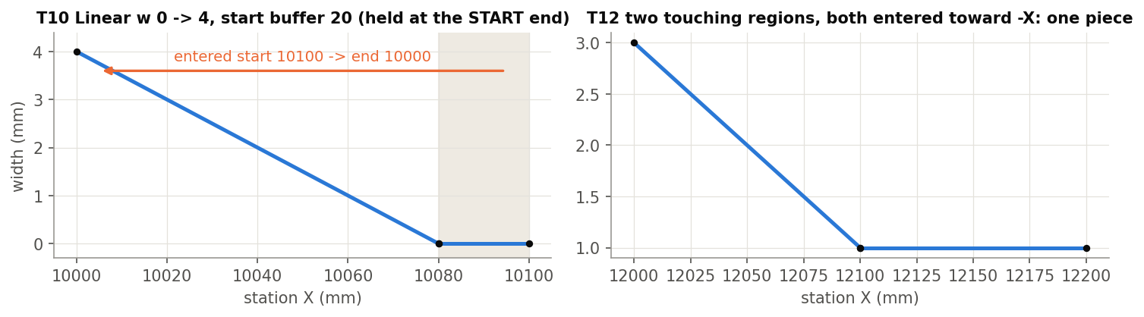
Example: regions entered toward -X (T10, T12)
For a part whose tip is at +X, enter regions from the tip: start 10100, end 10000. The same region stated low to high.
T10: Linear w 0 -> 4 with a start buffer of 20: width 0 held from 10100 to 10080, 4 at 10000. T12: two touching regions both entered toward -X join into one piece (w 1 at 12150, 2 at 12050).
Create offset profile · driven_offset (BeamBuilder Testbed)
Draft 2026-09-29

Slide 13
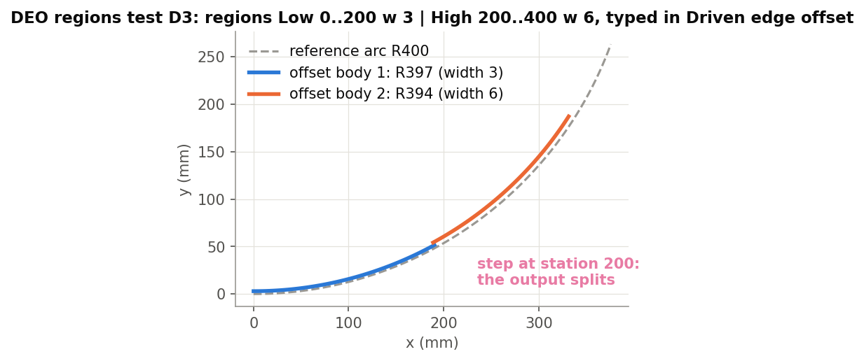
Driven edge offset takes regions directly
Profile source: Regions
Driven edge offset has the same Regions table (same parameters, from offset_profile_core); no wire is made. Tests D1-D5: identical to the wire, within 1e-3 mm.
Stations
A region's X means what a wire's X means under DEO's Measure along. 'At point' stations land exactly on the part only when measuring along World X.
Not built yet
Per-break None / Line join in DEO / DOS. Today every break splits the output (D3: two offset bodies at the step).
Create offset profile · driven_offset (BeamBuilder Testbed)
Draft 2026-09-29

Slide 14
Outputs and messages
Published for Extract variables
Messages
Key | What it holds
output | All piece wires (T1: 3).
piece1 .. pieceN | Each piece, in station order.
startVertex / endVertex | Where the profile starts (lowest station) / ends (highest).
breakVertices | The piece ends on both sides of every break (T1: 4).
pieceCount, breakCount | Numbers (T1: 3 and 2).
breakStations | Station of each break: a jump, or the middle of a gap (T1: 0, 1000 mm).
startStation, endStation | First and last station (T1: -100, 1100 mm).
 | Message / what to do
Error | Add at least one region. / Add at least two points at different stations.
Error | Regions 'A' and 'B' overlap. Regions may touch, not overlap.
Error | Region 'x': the buffers are as long as the region or longer.
Error | Two regions are named 'x' ... Intersections are kept by name.
Error | The blend between 'A' and 'B' has no length but the offset jumps ... Give a distance, or leave a gap in X.
Error | Start point: pick a point (vertex or mate connector) for the station. At point with nothing picked.
Create offset profile · driven_offset (BeamBuilder Testbed)
Draft 2026-09-29

Slide 15
Tips and limits
✓
Name regions by role
Tip, RSL, Tail ... Intersection settings follow the names when regions are reordered.
!
Breaks split the output
DEO / DOS have no per-break None / Line choice yet: a step in the profile is a step (a gap) in the offset.
✓
Smooth for joins that must not kink
A buffer into a Smooth ramp is curvature-continuous (C2); a Linear corner is only G0.
!
One shape per region
Width and height share the region's shape.
✓
Print segments
Debug group: every piece and sub-segment with its stations, degree and end values.
!
Stations are world X
Picked points give their world X; on a part measured along its reference, place stations accordingly.
Create offset profile · driven_offset (BeamBuilder Testbed)
Draft 2026-09-29

Slide 16
Where it lives
Document | driven_offset / BeamBuilder Testbed (f61d2c000ab2d1240776342e)
Tabs | create_offset_profile (the feature), offset_profile_core (regions / points -> exact pieces; shared with Driven edge offset)
Tests | Offset profile tests studio: T1-T12 (+ 3 error cases) -- devtools/onshape/build_offset_profile_tests.py, check_offset_profile.py; DEO regions tests: D1-D5 (5/5 pass 2026-09-29)
Design | driven_offset/research_create_offset_profile.md; driven_offset/DOCUMENT_MAP.md
Related | Driven edge offset, Driven offset surface (consumers); Evaluate offset (a profile measured from existing edges)
Create offset profile · driven_offset (BeamBuilder Testbed)
Draft 2026-09-29

