Slide 1
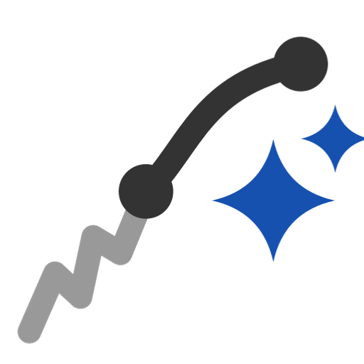
Clean wire
Rebuild a messy model-made wire with fewer edges and control points: tangent stretches become one spline each, real corners stay corners, lines and arcs pass through exactly.
Curve_tools · Onshape custom feature
Draft 2026-09-25

Slide 2

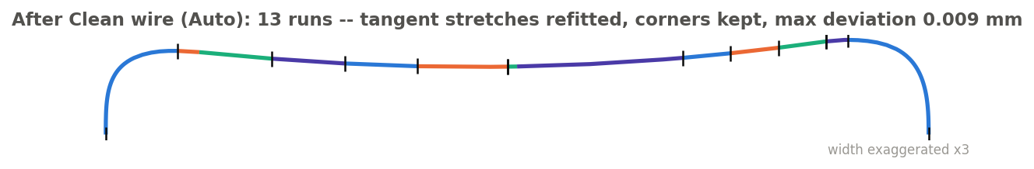
What it does
Model-made wires come out correct but messy: slivers a tenth of a millimetre long, 0.4 deg kinks, heavy rational splines -- and lofts and fills through them wiggle or fail. Native Approximate samples 200 fixed points and ignores corners. Clean wire rebuilds the wire run by run.
Use it when
A wire feeds a loft, fill or driven offset
It has slivers or near-tangent kinks
You want a lighter curve that stays within 0.01 mm
SW_SHELF after Clean wire (Auto): 13 runs, max deviation 0.009 mm.
Clean wire · Curve_tools
Draft 2026-09-25

Slide 3
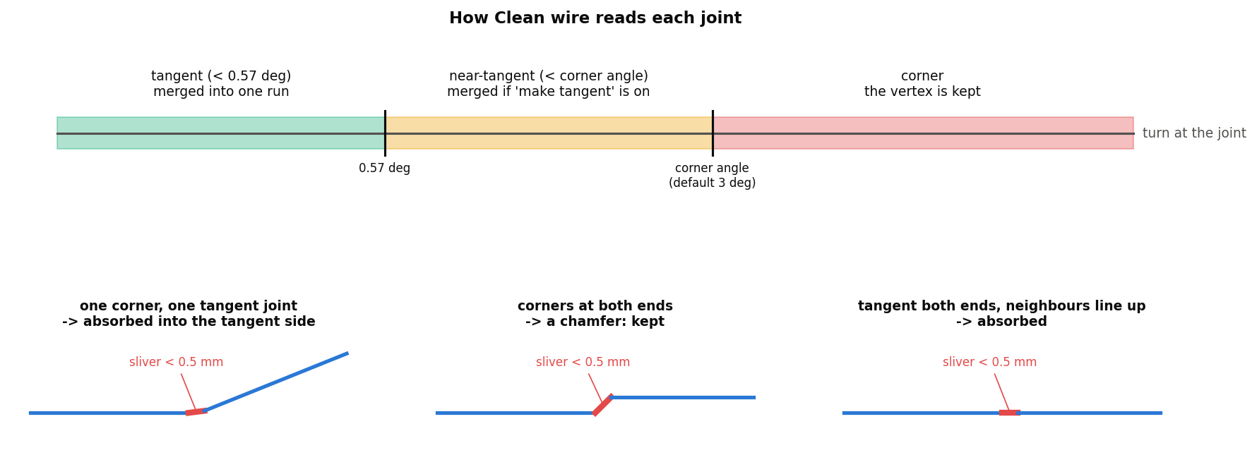
How each joint is read
Tangent, near, corner
Under 0.57 deg: merged. Under the corner angle (3 deg): merged if 'make tangent' is on. Larger: a corner, kept.
Slivers (< 0.5 mm)
Judged by their own two joints: absorbed next to a tangent joint, kept as a chamfer between two corners.
Lines and arcs
A real line or arc passes through unchanged; arcs stay sketch arcs, so Onshape shows their radius.
Clean wire · Curve_tools
Draft 2026-09-25

Slide 4
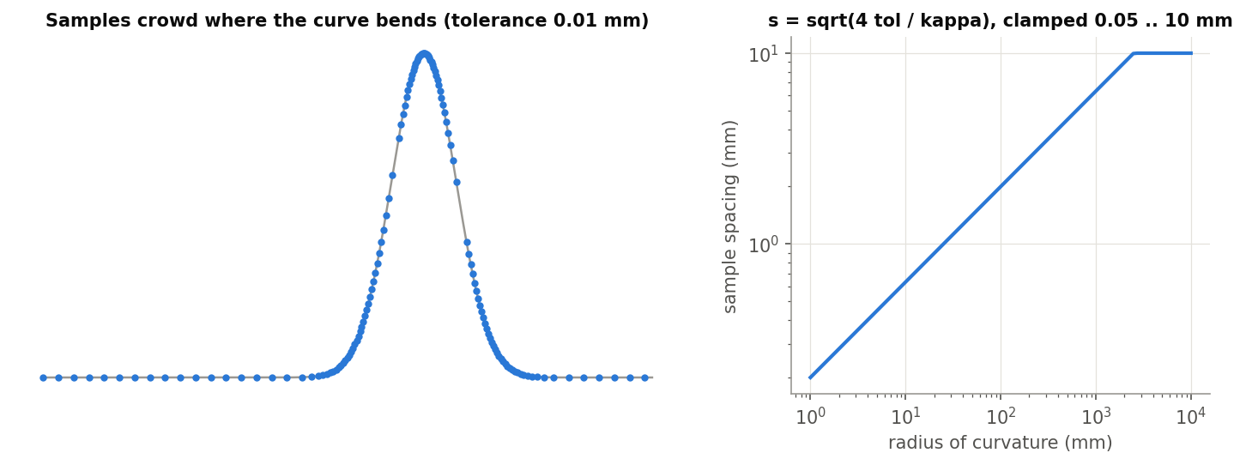
Samples where the curve bends
Spacing from the tolerance
s = sqrt(4 tol / kappa): the chord between samples misses the curve by half the tolerance.
No edge skipped
3 to 200 samples per edge, 0.05 to 10 mm apart -- a sliver still gets its samples.
Exact end tangents
Each fit starts and ends on the true tangent, so runs join smoothly.
Clean wire · Curve_tools
Draft 2026-09-25

Slide 5
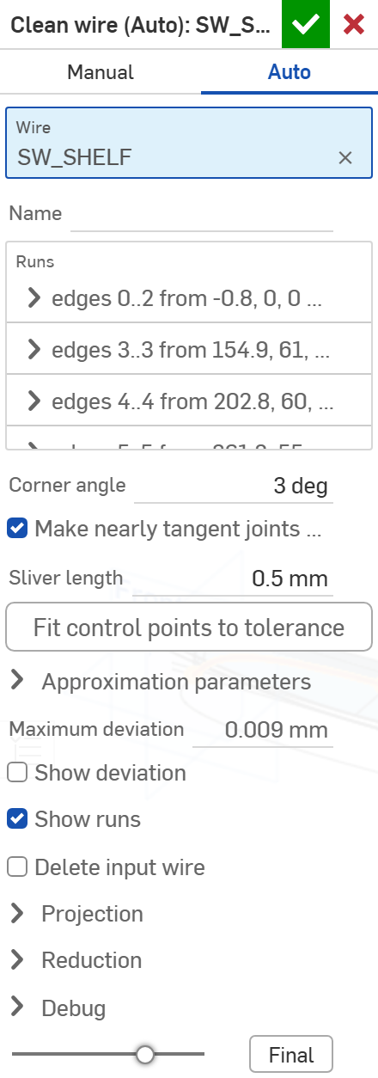
The dialog (Auto) (1/2)
# | Parameter | What it means
1 | Mode | AUTO: runs made from the joints. MANUAL: you group edges yourself (Auto-populate fills the groups).
2 | Wire | A wire body or the edges of one open chain.
3 | Name | Names the result.
4 | Runs | Read-only: each run's edges, exact copy or fit, control points, deviation.
5 | Corner angle | Joints turning more than this are corners (3 deg keeps the ski's ramp creases).
6 | Make nearly tangent joints tangent | Merge joints between 0.57 deg and the corner angle.
7 | Sliver length | Edges shorter than this are judged as slivers (0.5 mm).
8 | Fit control points to tolerance | Button: fit every run with no cap; set the maximum to what the largest run needed.
1
2
3
4
5
6
7
8
9
10
11
12
13
14
15
16
Clean wire · Curve_tools
Draft 2026-09-25

Slide 6
The dialog (Auto) (2/2)
# | Parameter | What it means
9 | Approximation parameters | Degree 3, tolerance 0.01 mm, maximum 30 control points.
10 | Maximum deviation | Read-only: the result's largest distance from the source.
11 | Show deviation | Draw that deviation as a comb.
12 | Show runs | Colour the runs in the view.
13 | Delete input wire | Remove the source wire (whole wire bodies only).
14 | Projection | Also clean the plan view: the 3D wire is dropped onto a wall over the cleaned plan.
15 | Reduction | Read-only: control points and edges before / after.
16 | Debug | Joints, runs, corners, control polygons.
1
2
3
4
5
6
7
8
9
10
11
12
13
14
15
16
Clean wire · Curve_tools
Draft 2026-09-25

Slide 7
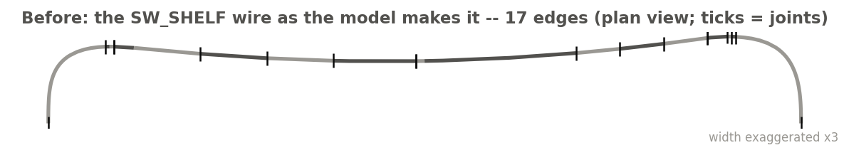
Example: before
The SW_SHELF wire as the model makes it: 17 edges (plan view, ticks at the joints)
Several short pieces and near-tangent joints -- each a place a loft or offset can wiggle.
Clean wire · Curve_tools
Draft 2026-09-25

Slide 8
Example: after
Clean wire (Auto), default settings: 13 runs, max deviation 0.009 mm
Tangent stretches refitted as one spline each, the real corners kept, lines and arcs copied exactly.
Clean wire · Curve_tools
Draft 2026-09-25

Slide 9
Outputs and messages
Published for Extract variables
Messages
Key | What it holds
startVertex / endVertex | The ends of the result (start = the tail end: arc length grows with world X).
startEdge / endEdge | The edge at each end.
breakVertices | The vertices between runs (the corners kept).
 | Message / what to do
Warning | Short of tolerance: ... A run misses the source by more than the tolerance: raise its control points, or split it.
Info | N edge(s) -> M; K corner(s) inside a group were fitted through Manual mode.
Warning | ...came out as N bodies instead of one A joint did not close; the gaps are listed.
Error | Closed loops are not supported / not one chain Pick one open chain.
Clean wire · Curve_tools
Draft 2026-09-25

Slide 10
Tips and limits
✓
Start with Auto
Check the Runs list; switch to Manual (Auto-populate) only to override a run.
!
Open chains only
Closed loops are refused.
✓
Reference the body or its keys
Never the result's edge ids: they change whenever a run changes.
!
Manual groups go stale
They point at the source's edges; after an upstream renumbering, Auto-populate again.
Clean wire · Curve_tools
Draft 2026-09-25

Slide 11
Where it lives
Document | Curve_tools (2143812a99089658c704f0bc)
Tab | clean_wire (uses curve_core)
Tests | Tests studio (curve_tools_tests: ends, runs in order)
Examples | Test_1 studio
Explainer | docs/explainers/curve_tools/curve_tools_explained.md, section 2.1
Related | Clean wire, Map curve, Merge curve, Evaluate profiles, Fillet wire; Extract variables
Clean wire · Curve_tools
Draft 2026-09-25

