Slide 1
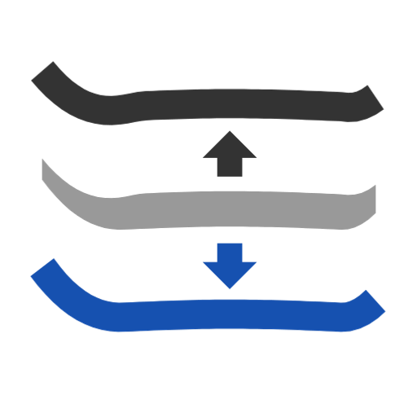
Evaluate profiles
Project a chain onto a plane and cut it where it folds back -- or outline a part and split its outline into top, bottom and middle profiles.
Curve_tools · Onshape custom feature
Draft 2026-09-25

Slide 2

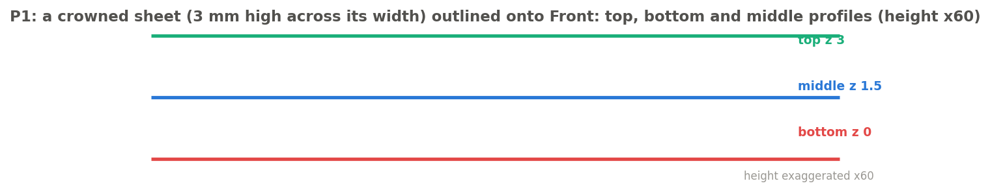
What it does
Side profiles of a core, a topsheet or a sidewall are needed as clean curves: for fills, for drawings, for measuring. Native Project and Outline give an undivided loop, with slivers, that can fold back at the tip. Evaluate profiles gives the profiles you actually want, named.
Use it when
You need a part's top / bottom / middle side profile
A projected chain folds back at a tip
An outline has micro-edges that break a fill
P1: a crowned sheet outlined: top, middle and bottom profiles.
Evaluate profiles · Curve_tools
Draft 2026-09-25

Slide 3
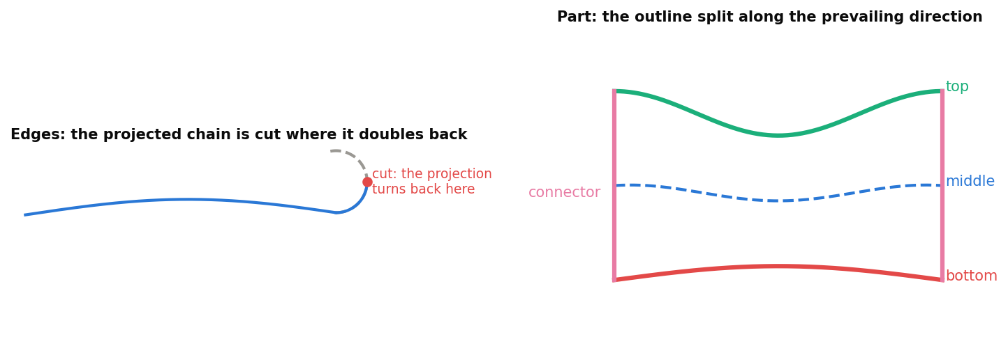
Two jobs
Edges
Project, then cut where the chain stops advancing along the prevailing direction (400-sample scan, then bisection).
Part
The two longest runs along the direction are top and bottom (top = higher); the middle is their average at matching stations.
Micro-edges merged
Outline edges under 0.01 mm are merged away -- a 1.7 um edge once broke a fill.
Evaluate profiles · Curve_tools
Draft 2026-09-25

Slide 4
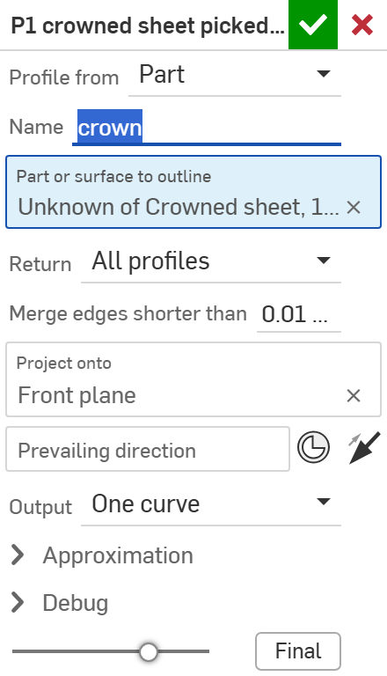
The dialog: Part (1/2)
# | Parameter | What it means
1 | Profile from | EDGES: project a chain. PART: outline a solid or surface.
2 | Name | Part outputs are named <name> top, <name> bottom, ...
3 | Part or surface to outline | A solid or surface body, or a face of one.
4 | Return | Top / Bottom / Middle / Periphery / All profiles / Full (profiles + connectors).
5 | Merge edges shorter than | 0.01 mm; 0 = off.
1
2
3
4
5
6
7
8
9
10
Evaluate profiles · Curve_tools
Draft 2026-09-25

Slide 5
The dialog: Part (2/2)
# | Parameter | What it means
6 | Project onto | A planar face.
7 | Prevailing direction | The direction profiles run along (+ flip). Default: the longest in-plane extent.
8 | Output | One curve / One per input curve (exact) / Efficient (merges where exact).
9 | Approximation | 60 samples, degree 3, 0.01 mm, 24 control points.
10 | Debug | Scan, curve detail, colour the profiles.
1
2
3
4
5
6
7
8
9
10
Evaluate profiles · Curve_tools
Draft 2026-09-25

Slide 6
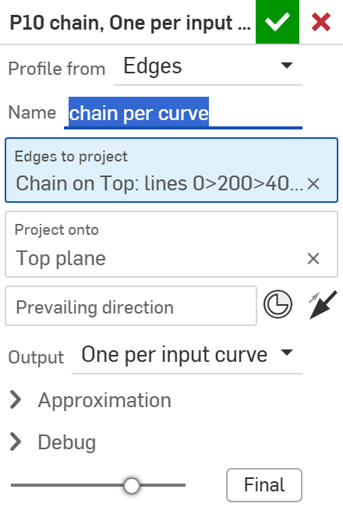
The dialog: Edges
# | Parameter | What it means
1 | Profile from | EDGES.
2 | Edges to project | The chain.
3 | Project onto | A planar face.
4 | Prevailing direction | Default: the chain's chord.
5 | Output | One curve / One per input curve / Efficient -- see the examples.
1
2
3
4
5
Evaluate profiles · Curve_tools
Draft 2026-09-25

Slide 7
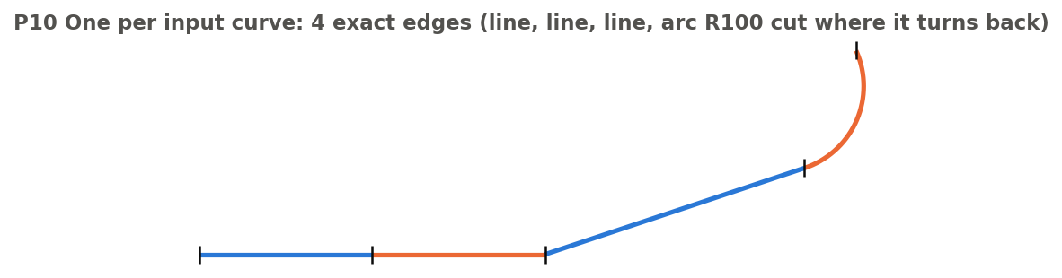
Example: One per input curve
P10: lines 0-200-400 (collinear), a line to (700, 700), an R100 hook -- projected onto Top
4 exact edges: the projected edges themselves, the arc cut exactly where it turns back (at (759.55, 835.96)).
Evaluate profiles · Curve_tools
Draft 2026-09-25

Slide 8
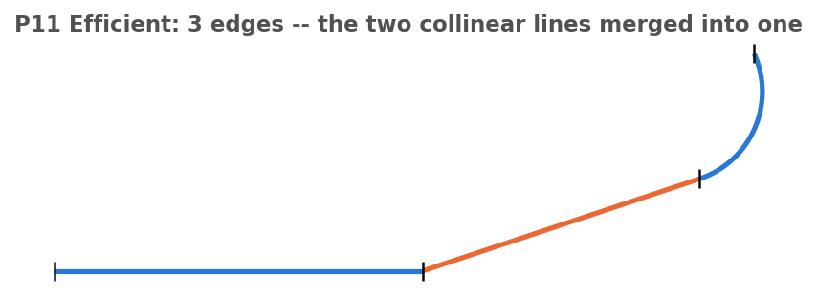
Example: Efficient
P11: the same chain, Efficient
3 edges: the two collinear lines merged into one 400 mm line; the slanted line and the R100 arc kept exact. One curve (P9) gives a single fitted spline instead.
Evaluate profiles · Curve_tools
Draft 2026-09-25

Slide 9
Outputs and messages
Published for Extract variables
Messages
Key | What it holds
top / bottom / middle | The named profile wires (empty when not requested).
periphery | The undivided outline (Return = Periphery).
connectors | The pieces joining top and bottom (Return = Full).
length | Length of the retained projection (the periphery for a part).
trimmedStart / trimmedEnd | Whether the projection was cut at each end.
 | Message / what to do
Error | Nothing projected / not a single connected chain
Error | ...seen edge-on: project its edges instead A surface lying in the projection direction has no outline.
Error | does not separate into a top and a bottom profile Check the prevailing direction.
Info | Merged N outline edge(s) shorter than ... Micro-edges removed; locations listed.
Evaluate profiles · Curve_tools
Draft 2026-09-25

Slide 10
Tips and limits
✓
Prefer exact output
One per input curve or Efficient keep lines and arcs exact; One curve is a fit.
!
Longest loop only
An outline with several loops keeps only the longest.
Evaluate profiles · Curve_tools
Draft 2026-09-25

Slide 11
Where it lives
Document | Curve_tools (2143812a99089658c704f0bc)
Tab | evaluate_profiles (uses curve_core)
Tests | Evaluate profiles tests studio: P1-P11 (P3 must error)
Examples | Evaluate profiles tests studio
Explainer | docs/explainers/curve_tools/curve_tools_explained.md, section 2.4
Related | Clean wire, Map curve, Merge curve, Evaluate profiles, Fillet wire; Extract variables
Evaluate profiles · Curve_tools
Draft 2026-09-25

