Slide 1

Fillet wire
Round the corners of a wire or edge chain: an exact tangent arc Onshape recognises as an arc, or a smooth curvature blend -- picked corner by corner.
Curve_tools · Onshape custom feature
Draft 2026-09-25

Slide 2

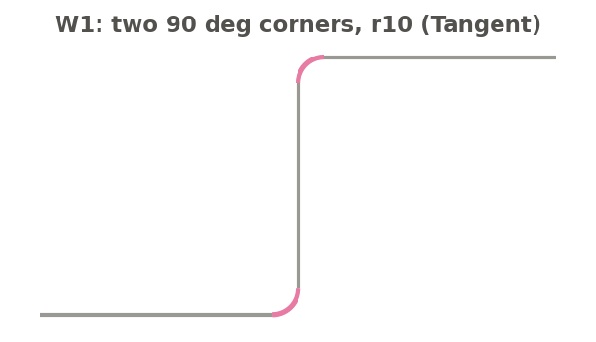
What it does
Onshape can fillet corners in a sketch, but not the corners of a wire. Fillet wire rounds chosen corners of any wire or edge chain -- in 2D or 3D -- and edits a wire body in place, so the untouched parts keep their identity.
Use it when
A wire (not a sketch) needs rounded corners
The fillets must be true arcs with a radius
A 3D corner needs a smooth (G2) blend
W1: two 90 deg corners filleted r10 (magenta).
Fillet wire · Curve_tools
Draft 2026-09-25

Slide 3
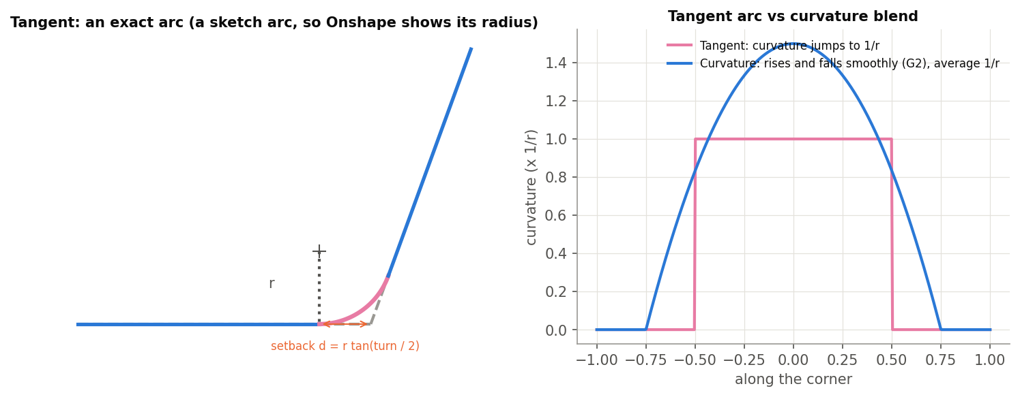
Tangent arc or curvature blend
Tangent
An exact arc, set back d = r tan(turn / 2), emitted as a sketch arc. Needs the corner to be planar.
Curvature
A G2 blend matching both edges' curvature, sized so its average curvature is 1/r. Works in 3D.
In place
A wire is split at the tangent points and only the corner pieces are replaced.
Fillet wire · Curve_tools
Draft 2026-09-25

Slide 4
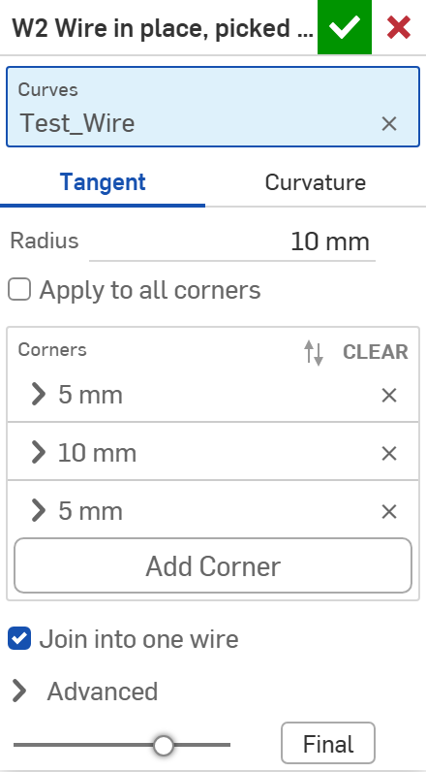
The dialog
# | Parameter | What it means
1 | Curves | Edges or wire bodies.
2 | Continuity | TANGENT: exact arcs. CURVATURE: G2 blends.
3 | Radius | The fillet radius.
4 | Apply to all corners | Off: only the corners you pick.
5 | Corners | Filled by clicking corner points in the view; each can have its own radius.
6 | Join into one wire | Wire input: rejoin the pieces into one body.
7 | Advanced | Corner angle (0.5 deg), Print corners.
1
2
3
4
5
6
7
Fillet wire · Curve_tools
Draft 2026-09-25

Slide 5
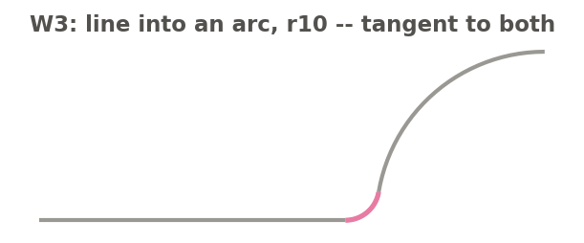
Examples
W3: a line running into an arc, r10 -- the fillet is an exact circle tangent to both
W1: two 90 deg corners, r10 -> one wire 291.416 mm long (300 - 4r + pi r). W4: a 3D corner with Tangent is skipped (not planar); W5: the same corner with Curvature -> a G2 blend, average curvature 0.1 /mm.
Fillet wire · Curve_tools
Draft 2026-09-25

Slide 6
Outputs and messages
Published for Extract variables
Messages
Key | What it holds
filletEdges | The fillet edges.
cornerCount / filletCount / skippedCount | Corners found / filleted / not filleted.
 | Message / what to do
Warning | N corner(s) not filleted: ... With the reason: radius too large, no circle touches both edges, not in one plane (use Curvature), edges too short, or fillets overlapping.
Info | N corner(s) found. Click them... Nothing picked yet.
Fillet wire · Curve_tools
Draft 2026-09-25

Slide 7
Tips and limits
✓
Radius shown in Onshape
Tangent fillets are sketch arcs, so clicking one shows its radius.
!
Curvature fillets are splines
They have no single radius.
!
No end keys yet
Fillet wire does not publish start / end keys.
Fillet wire · Curve_tools
Draft 2026-09-25

Slide 8
Where it lives
Document | Curve_tools (2143812a99089658c704f0bc)
Tab | fillet_wire (uses curve_core)
Tests | Fillet wire tests studio: W1-W6 (devtools/onshape/check_fillet_wire.py)
Examples | Fillet wire tests studio
Explainer | docs/explainers/curve_tools/curve_tools_explained.md, section 2.5
Related | Clean wire, Map curve, Merge curve, Evaluate profiles, Fillet wire; Extract variables
Fillet wire · Curve_tools
Draft 2026-09-25

