Slide 1

Map curve
Carry a span from one chain onto another by arc length from a reference point: s mm along the first from its zero lands s mm along the second from its zero.
Curve_tools · Onshape custom feature
Draft 2026-09-25

Slide 2

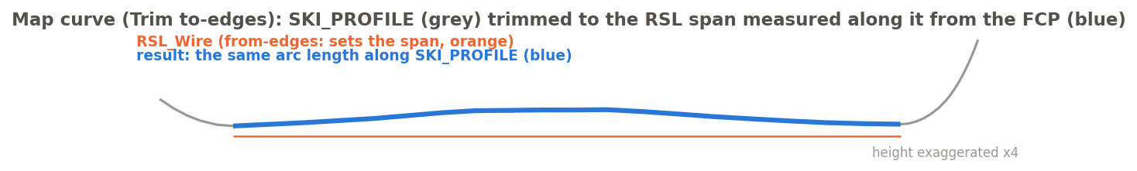
What it does
The same stations are needed on different curves of a ski -- the RSL, the side profile, the core bottom -- measured along each curve from the same place (the FCP). Trim and split work by position, not by distance along the curve. Map curve measures along both chains from a zero point.
Use it when
A span defined on one curve is needed on another
Distances must follow the curve, not X
Arcs must stay arcs (Trim mode never refits)
SKI_PROFILE trimmed to the RSL span, measured along it from the FCP.
Map curve · Curve_tools
Draft 2026-09-25

Slide 3
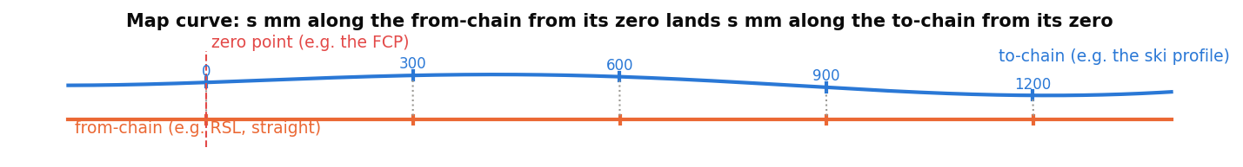
Arc length from a zero point
Same distance along each
The from-chain's span [start, end], measured from its zero, is laid onto the to-chain from its zero.
World X or closest
World X: the zero lands where each chain crosses the point's X. Closest point: the nearest point on each chain.
Direction check
If the chains run opposite ways at the zero, the feature stops and asks for Flip to-chain.
Map curve · Curve_tools
Draft 2026-09-25

Slide 4
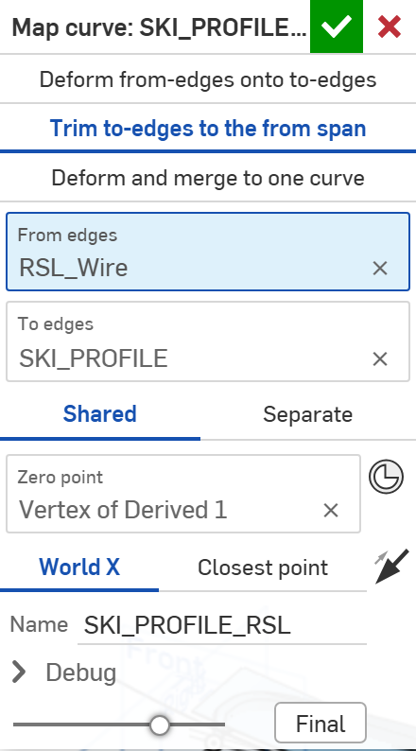
The dialog
# | Parameter | What it means
1 | Mode | Deform from-edges onto to-edges / TRIM to-edges to the from span / Deform and merge to one curve.
2 | From edges | The chain that sets the span.
3 | To edges | The chain the span lands on (never modified).
4 | Reference point | SHARED: one zero point for both. SEPARATE: a zero for each chain.
5 | Zero point | A mate connector or vertex (e.g. the FCP).
6 | Projection | WORLD X (default) or CLOSEST POINT: how the zero lands on each chain.
7 | Flip to-chain | The arrow: when the two chains run opposite ways at the zero.
8 | Name | Names the result.
9 | Debug | Chain ends (green start, red end) and a summary.
1
2
3
4
5
6
7
8
9
Map curve · Curve_tools
Draft 2026-09-25

Slide 5
Example: trim to the RSL span
SKI_PROFILE (grey) trimmed to the span of RSL_Wire (orange), zero at the FCP vertex -- result in blue
Trim mode copies the to-edges and cuts them exactly at the two arc lengths; nothing is refitted, so the profile's arcs stay arcs.
Map curve · Curve_tools
Draft 2026-09-25

Slide 6
Outputs and messages
Published for Extract variables
Messages
Key | What it holds
startVertex / endVertex | The ends of the result (start = the tail end: arc length grows with world X).
startEdge / endEdge | The edge at each end.
spanStart / spanEnd | The from-chain's span, measured from its zero.
toStart / toEnd | Where that span lands on the to-chain.
stationCount | Samples used (Deform modes).
 | Message / what to do
Error | chains point in opposite directions ... Tick Flip to-chain
Error | from-edges run X mm past the start / end of the to-edges The to-chain is too short for the span.
Info | do not span the zero point's X; closest point used World X fell back to Closest point.
Info | Merged result is a spline; arc radius not preserved Deform and merge mode.
Map curve · Curve_tools
Draft 2026-09-25

Slide 7
Tips and limits
✓
Use Trim for exact results
It cuts the original edges; lines and arcs keep their type.
!
Deform modes are phase 1
They give the to-chain over the from span, resampled and refitted; carrying geometry that lies off the from-chain is not built yet.
Map curve · Curve_tools
Draft 2026-09-25

Slide 8
Where it lives
Document | Curve_tools (2143812a99089658c704f0bc)
Tab | map_curve (uses curve_core)
Tests | Tests studio (curve_tools_tests: trim to-edges, ends)
Examples | Test_1 studio
Explainer | docs/explainers/curve_tools/curve_tools_explained.md, section 2.2
Related | Clean wire, Map curve, Merge curve, Evaluate profiles, Fillet wire; Extract variables
Map curve · Curve_tools
Draft 2026-09-25

