Slide 1

Merge curve
Absorb one edge into its neighbour as a single fitted spline -- Edit curve / Composite + Approximate in one step -- and keep the right body.
Curve_tools · Onshape custom feature
Draft 2026-09-25

Slide 2

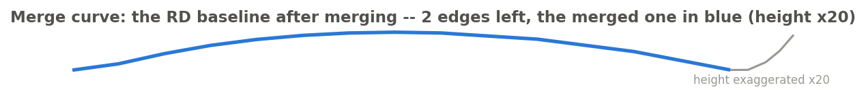
What it does
A short edge next to a long one (a tip section, a sliver left by a split) wants to be part of it. Onshape has no join; every route is fit-then-replace, and doing it by hand loses the wire's identity. Merge curve fits the two edges as one spline and puts it back where it belongs.
Use it when
Two edges of a wire should be one smooth curve
The wire's name and identity must survive
The ends must still meet their neighbours exactly
The RD baseline after merging its tip section: 2 edges left.
Merge curve · Curve_tools
Draft 2026-09-25

Slide 3
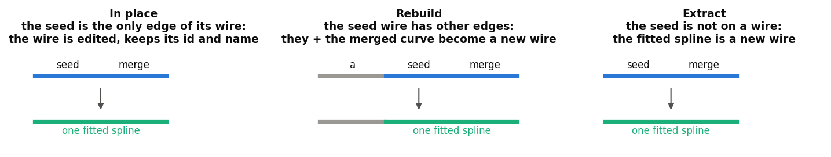
Which body survives
In place
The seed is its wire's only edge: the wire is edited and keeps its id and name.
Rebuild
The wire has other edges: they and the merged curve become a new wire (info notice).
Extract
The seed is not on a wire: the fitted spline is the output.
Merge curve · Curve_tools
Draft 2026-09-25

Slide 4
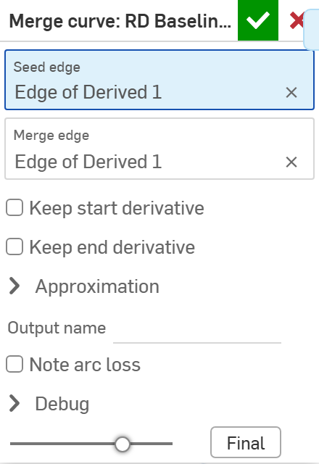
The dialog
# | Parameter | What it means
1 | Seed edge | The edge that is edited.
2 | Merge edge | The edge absorbed; it must meet the seed end to end.
3 | Keep start derivative | Keep the seed's own start tangent (on).
4 | Keep end derivative | Keep the merge edge's own end tangent (on).
5 | Approximation | Degree, tolerance, maximum 100 control points.
6 | Output name | Pre-filled with the seed wire's name.
7 | Note arc loss | Say so when a line or arc becomes a spline.
8 | Debug | Print diagnostics.
1
2
3
4
5
6
7
8
Merge curve · Curve_tools
Draft 2026-09-25

Slide 5
Example: the RD baseline tip
The baseline's tip section merged into its main edge (the merged edge in blue)
The seed wire had other edges, so it was rebuilt: the untouched edge and the merged curve form the new wire, the ends snapped to their neighbours so it still chains.
Merge curve · Curve_tools
Draft 2026-09-25

Slide 6
Outputs and messages
Published for Extract variables
Messages
Key | What it holds
startVertex / endVertex | The ends of the result (start = the tail end: arc length grows with world X).
startEdge / endEdge | The edge at each end.
mergedEdge | The merged curve's edge.
degree / controlPointCount | Of the fitted spline.
 | Message / what to do
Info | Rebuilt the seed wire ... original body was replaced The Rebuild case.
Info | arc radius not preserved A line or arc became a spline.
Error | not G0 connected The two edges do not meet end to end.
Merge curve · Curve_tools
Draft 2026-09-25

Slide 7
Tips and limits
!
Always a spline
A merged line or arc loses its type.
✓
Many edges?
To clean a whole wire use Clean wire instead.
Merge curve · Curve_tools
Draft 2026-09-25

Slide 8
Where it lives
Document | Curve_tools (2143812a99089658c704f0bc)
Tab | merge_curve (uses curve_core)
Tests | Tests studio (curve_tools_tests: merge, ends)
Examples | Test_1 studio
Explainer | docs/explainers/curve_tools/curve_tools_explained.md, section 2.3
Related | Clean wire, Map curve, Merge curve, Evaluate profiles, Fillet wire; Extract variables
Merge curve · Curve_tools
Draft 2026-09-25

