Slide 1

Mutual Trim+
Onshape's mutual trim, with the side to keep on each surface named by a reference instead of by a flip -- so the trim keeps the right corner whatever the surfaces' orientations.
Reference_Side_Features · Onshape custom feature
Draft 2026-09-25

Slide 2

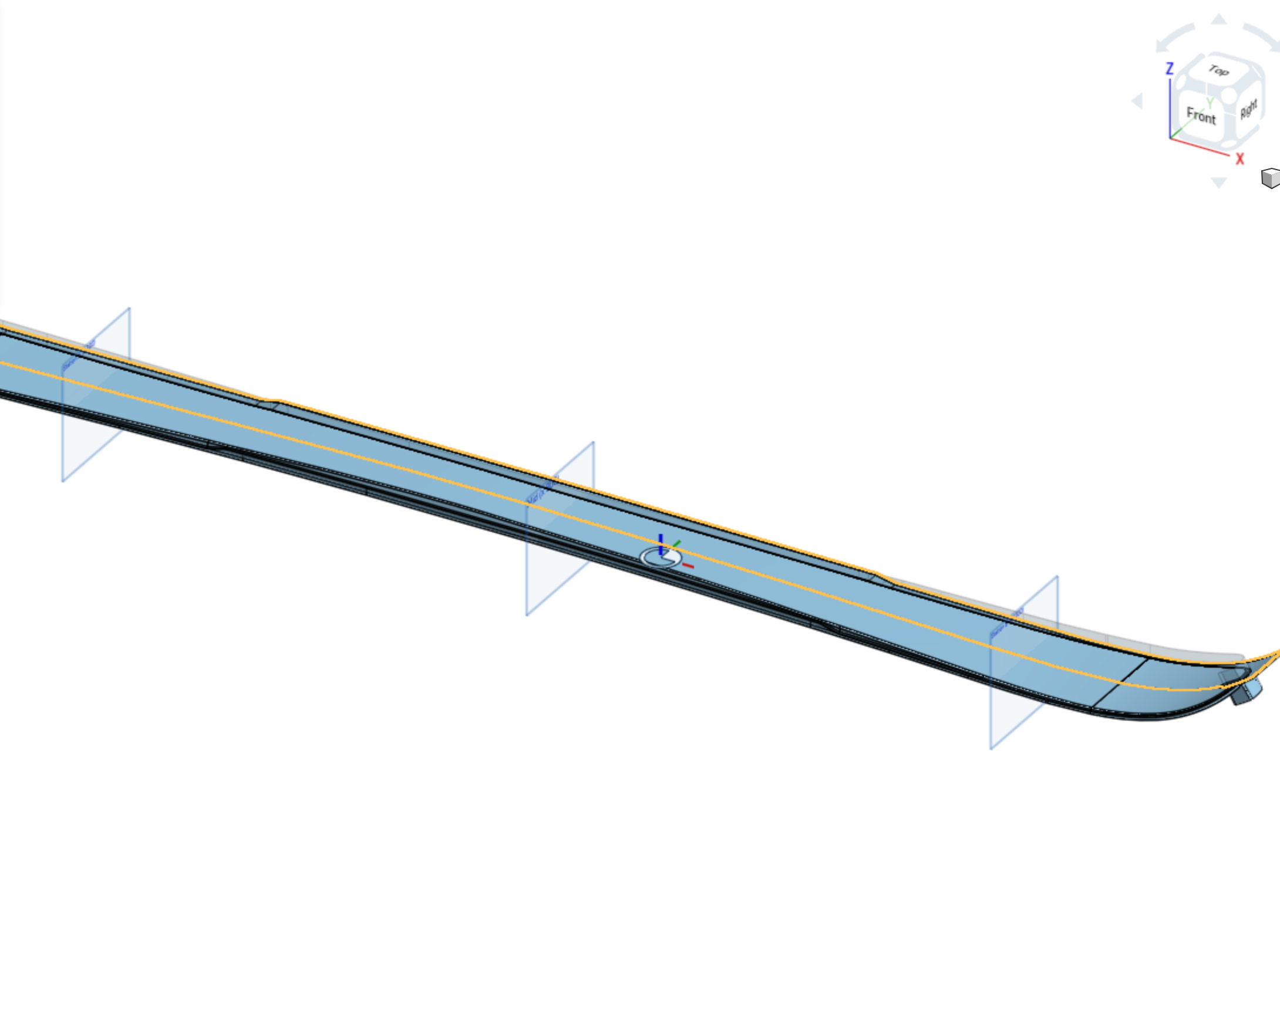
What it does
Two surfaces trim each other along their intersection and each keeps one side. The built-in picks that side with a 'keep opposite side' box per surface, tied to each surface's normal -- which flips when a loft, offset or mirror upstream changes. Mutual Trim+ keeps, on each surface, the side a reference is on.
Use it when
Two surfaces meet at a corner you want to keep (a top and a wall)
Either surface's orientation may change upstream
A fillet or thicken will follow the trim edge
Mutual Trim+ open on the ski: unfilleted top x SW rout wall.
Mutual Trim+ · Reference_Side_Features
Draft 2026-09-25

Slide 3
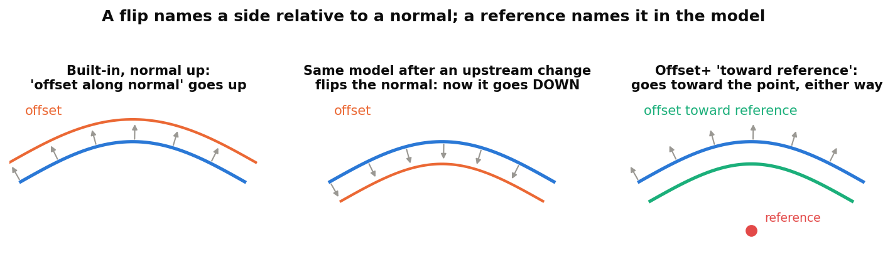
Why a reference instead of a flip
A flip is about a normal
'Front', 'opposite direction', 'Thickness 1' all mean: relative to the normal -- and normals change freely upstream.
A reference is about the model
Pick geometry on the side you mean. The choice survives any change of orientation.
Drop-in
With no reference, the feature behaves exactly like the built-in.
Mutual Trim+ · Reference_Side_Features
Draft 2026-09-25

Slide 4
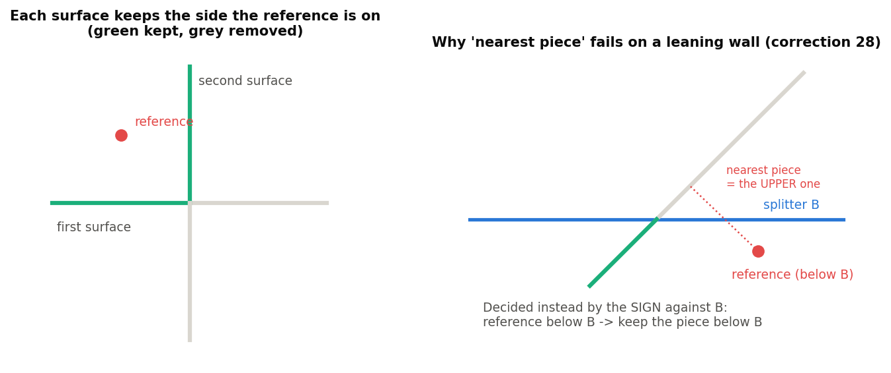
How each side is decided
Against the OTHER surface
Each surface is cut in two by the other one. The side kept is the one on the reference's side of that other surface (signed distance).
Not by nearness
On a leaning wall the nearest piece can be the wrong one (right). Distance is only a fallback when the pieces do not straddle the other surface.
Per surface
Each surface has its own 'keep side nearest reference' arrow: on = the reference's side, off = the other side.
Mutual Trim+ · Reference_Side_Features
Draft 2026-09-25

Slide 5
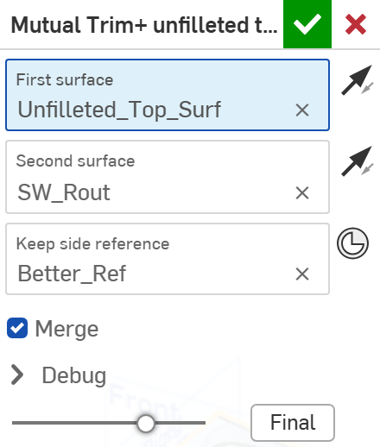
The dialog
# | Parameter | What it means
1 | First surface | One surface body.
2 | Keep side nearest reference (first) | The arrow by the first surface. On: keep its side nearer the reference (the inside). Off: the farther side.
3 | Second surface | The other surface body.
4 | Keep side nearest reference (second) | The same for the second surface.
5 | Keep side reference | Geometry on the keep side of BOTH surfaces -- best a mate connector or vertex in the corner you keep. Empty = the built-in.
6 | Merge | Union the two trimmed surfaces into one body (default on).
7 | Debug | Print side distances: which side each surface kept, and whether by side (normal case) or by distance (fallback).
1
2
3
4
5
6
7
Mutual Trim+ · Reference_Side_Features
Draft 2026-09-25

Slide 6
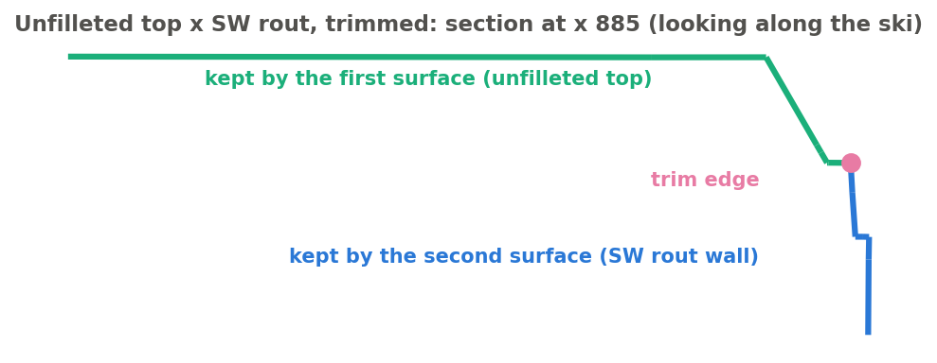
Example: top x sidewall rout
Unfilleted_Top_Surf trimmed with SW_Rout, reference Better_Ref, merged (topsheet_surf studio)
Each surface keeps the part on the reference's side of the other: the top keeps its inside (green), the rout wall keeps the part below the top (blue). The published trimEdges (magenta) is the intersection along which the two were trimmed -- the edge a fillet wants.
Mutual Trim+ · Reference_Side_Features
Draft 2026-09-25

Slide 7
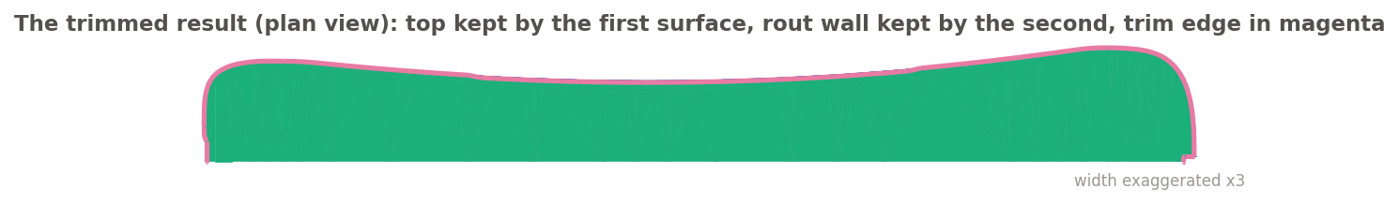
Example: the whole trim edge
The same result from above: keptFaces1 (green) and the trim edge all round the ski (magenta)
keptFaces1 / keptFaces2 tell the two surfaces apart even after Merge makes them one body, so a later feature can offset or thicken just the top, or just the wall.
Mutual Trim+ · Reference_Side_Features
Draft 2026-09-25

Slide 8
Outputs and messages
Published for Extract variables
Messages
Key | What it holds
output | The trimmed surfaces (one body when merged).
trimEdges | The intersection edges the trim left -- where to fillet. Tracked through the merge.
keptFaces1 | The faces the first surface kept (still told apart after the merge).
keptFaces2 | The faces the second surface kept.
trimEdgeCount | How many trim edges.
 | Message / what to do
Info | boolean union no-op The surfaces do not intersect; nothing was trimmed.
Error | The keep side reference cannot be placed on either side of the first/second surface The pieces do not straddle the other surface and the reference is equally far from both. Pick a closer reference inside the corner to keep.
Mutual Trim+ · Reference_Side_Features
Draft 2026-09-25

Slide 9
Tips and limits
✓
Put the reference in the corner you keep
A mate connector just inside the kept corner (e.g. at MRS) -- not a far plane: a far plane's closest point can land at the tip, where the surfaces have turned.
!
Outputs keep their input's orientation
The reference picks the side, not the normal. Built-ins downstream that follow the normal (Thicken, Offset surface, Move face) need Orient to reference first -- or use the reference-side feature instead.
✓
Fillet along trimEdges
Publish trimEdges with Extract variables; it survives upstream edits that renumber edges.
!
One orientation after Merge
Merged, the two halves are one body with one orientation.
Mutual Trim+ · Reference_Side_Features
Draft 2026-09-25

Slide 10
Where it lives
Document | Reference_Side_Features (22764764a00a7f607dbc1c4d)
Tab | mutual_trim_plus (uses reference_side_utils)
Tests | Reference side tests studio: M1-M2 - devtools/onshape/check_reference_side_tests.py (34/34)
Examples | topsheet_surf studio (the user's derive of Design_Master topsheet and sidewall bodies)
Explainer | docs/explainers/reference_side/reference_side_explained.md, section 2.1
Related | Split+, Mutual Trim+, Offset+, Thicken+, Orient to reference (same reference rule); Extract variables
Mutual Trim+ · Reference_Side_Features
Draft 2026-09-25

